Slide 1
ECGR4161/5196 – Lecture 11 – July 19, 2012
Today:
Discussion - Exam
Presentations – Future of Robots (recorded in two sessions, with a break in the middle).
Quiz 9

Slide 2
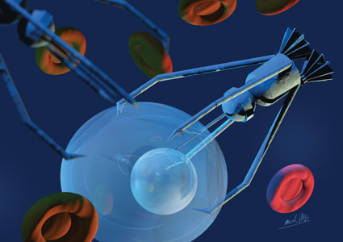
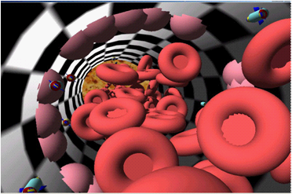
Future of Medical NanoRobotics
Possible Uses:
  Drug Delivery [1]
  Neural Scans
  Diagnosis
  Therapeutic: anti-cancer, anti-viral,
  and anti-tumor [3]
  Dentistry
Implementation:
  Swarms
  Injected into System
Current Limitations:
  Communication
  Safe Test Environment
Rendering of Nanobots [1]
[1] http://www.nanotech-now.com/Art_Gallery/erik-viktor.htm
[2] http://omicsgroup.org/journals/ARA/ARA-1-101.pdf
[3]http://www.futuremedicine.com/doi/full/10.2217/nnm.12.54
Simulation of Nanobots in Blood Vessel [2]

Slide 3
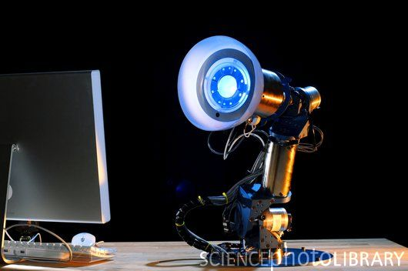
AUR Robotic Desk Lamp
Designed to demonstrate human-robot interaction and nonverbal behavior
Aimed to evoke a personal relationship with human
Originally thought up as a research project to study fluency
Tries to simulate the relationship between two humans who are familiar with one another performing a task together
The robot learns through repetitive practice and learns to “anticipate”
Video: http://www.youtube.com/watch?v=KvyLWvs4DPI&feature=player_embedded
http://robotic.media.mit.edu/projects/robots/aur/overview/overview.html
http://www.sciencephoto.com/image/344517/530wm/T2500545-AUR_robot_desk_lamp,_MIT,_USA-SPL.jpg

Slide 4
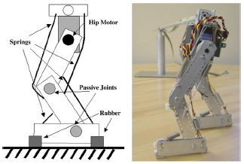

Robotics and Autonomous Systems
  While a rigid body stucture is assumed, elastic materials are also essential.
  To understand how to make a human like, robotic leg, examine a human walking.
  Comparable models:
    Spring-mass
There's a few major parts to make simple leg
motions; four 'muscles,' a motor, passive joints,
and rubber.
Using this knowledge, a test robotic system can be created to analyze.
Comparing observations of a human leg vs robotic test leg, one can see similarities.
While this method ignores certain aspects of walking, it shows dynamic behavior well.
Pictures from Robotics and Autonomous Systems PDF
4

Slide 5
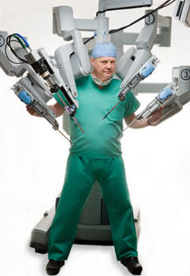
Advances in Telesurgery
What is Telesurgery?
-A technique which allows surgeons to robotically operate on a patient while being at a considerable distance from the operating table.
-First successful Telesurgery was a laparoscopic surgery on a woman in France. The surgeon was in New York City thousands of miles away!
How does it work?
-Multiple robotic arms with very accurate and precise sensors are used to interact with the patient. Many cameras at different angles are used.
-All of the information is sent through the internet to the surgeon who then can monitor and control the robotic arms with great precision.
-Today the two most commonly used robots for Telesurgery are the ZEUS and da Vinci.
What is the future of Telesurgery?
-Less delay when transferring data from the operating table to the surgeon.
(faster internet speeds)
-More degrees of freedom in the robotic arms to allow for more flexibility.
-Better monitoring systems such as 3D vision and more camera angles.
What are future uses for Telesurgery?
-Surgeries for injured solders on the battlefield
-Surgeon specification in rare operations

Slide 6
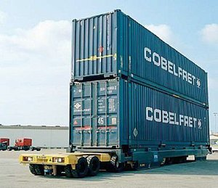
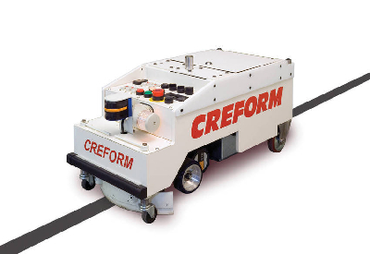
Automated/Self Guided Vehicles (ASG/AGV)
Types of Vehicles - Deck Truck, Fork Lift, Tow Train
Deck Truck - 4 wheels for greater stability and payload
Fork Lift/Tow Train - 3 wheels better turn radius
Applications- Container Yards, Assembly Lines, Factories
Energy - Battery Operated, ASG CPU will notify low battery (or when not in use) and send ASG to charging station
Guidance -
Fixed: Floor wire, Magnetic tape, Reflective tape
Open: Laser, Inertia (greater path flexibility)
Semi-Fixed (Magnetic): Magnets embedded in path
Sensors - Encoder; tracks vehicle position using odometry or dead reckoning
Future Advancements – Complete autonomy, longer battery life/solar powered, carry larger payload, more time efficient, more advanced control algorithms
Figure 1: Deck Truck [1]
Figure 2: Tow Train: [1]
Works Cited:
[1] google images
http://www.journalamme.org/papers_vol31_2/31241.pdf
http://www.werc.org/assets/1/workflow_staging/Publications/430.PDF

Slide 7

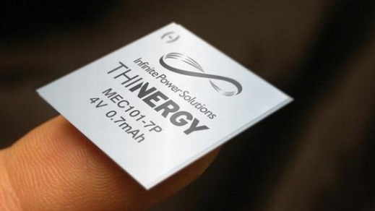
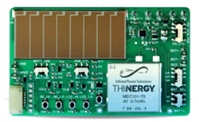
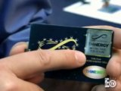
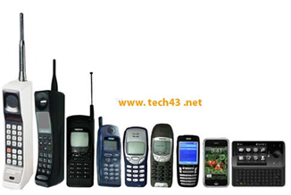
THINERGY MEC™
[3]
M.E.C is an acronym for Micro-Energy Cell
IPS has developed a thin-film solid-state rechargeable battery that is going to revolutionize the embedded device world!
What makes these thin-film batteries unique is the acceptance of charge! They can take any amount of current (pulsed or solid)
[1]
Can be charged with ambient energy sources such as:
Radio Frequency (RF)
Kinetic (Vibration)
Thermal
Magnetic, Solar…. Etc….
[4]
[2]
Q: So what makes THINERGY work so efficiently?
A: The Electrolyte material: Lithium Phosphorus Oxynitride (LiPON)
THINERGY
makes it
THIN!!
***Imagine a world with no chargers required!***
Advancements in battery technology can always be seen by observing the end user product
References:
[1] (2009). Eco Tech: THINERGY flexible batteries for even slimmer electronics(2009).
[Web Photo]. Retrieved from http://www.ecofriend.com/entry/eco-tech-thinergy-flexible-batteries-for-even-slimmer-electronics/
[2] (2012). Alpha Micro – Universal energy-harvesting evaluation kit expands wireless portfolio (Alpha Micro - THINERGY MEC201) (2012).
[Web Photo]. Retrieved from
http://www.electropages.com/2012/02/alpha-micro-universal-energy-harvesting-evaluation-kit-expands-wireless-portfolio/
[3] (2012). IPS (Infinite Power Solutions LOGO)(2012).
[Web Photo]. Retrieved from http://www.infinitepowersolutions.com/
[4] (2011). Action Tracker for April 2011(2011).
[Web Photo]. Retrieved from http://www.engineeringtv.com/latest/2011/4?activity=4&page_key=activity
Presented by: Benjamin B. Rhoades
Date presented: 7-18-2012

Slide 8
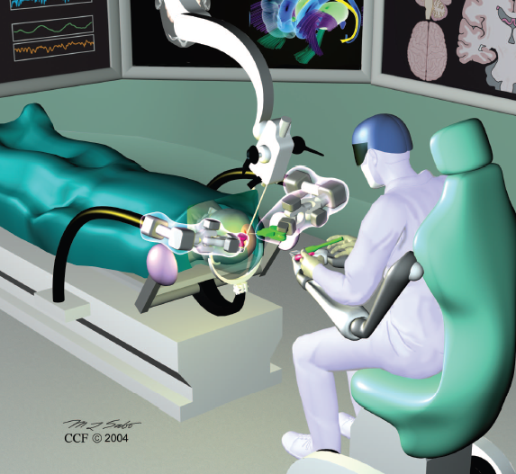
Neurosurgery For The Future
Current Neuro-robots:
Assist the surgeon
Extent or enhance human skills
System Types:
Supervisory controlled
Tele-surgical
Share-control
Future:
Artificial intelligence
  Allowed robots to think (make decisions)
  Program themselves
  More independent and self-reliant
  Challenge:
  Convincing surgeons and patients that Neuro-robots are safe
www.neurosurgery-online.com
In touch with robotics: Neurosurgery for the future.
Volume 56: pages 421-433

Slide 9
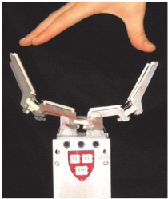
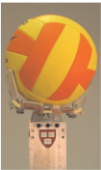
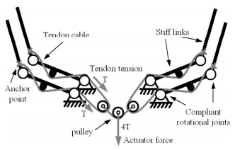
SDM Grasping Hand
Shape Deposition Manufacturing
Each finger is one molded piece and is flexible
Uses 1 actuator
Simple design
Embedded force sensor and tendon cable
Video: http://www.youtube.com/watch?v=_4ChbQNVbD4&feature=relmfu
Source:http://biorobotics.harvard.edu/publications.html#tech_report

Slide 10
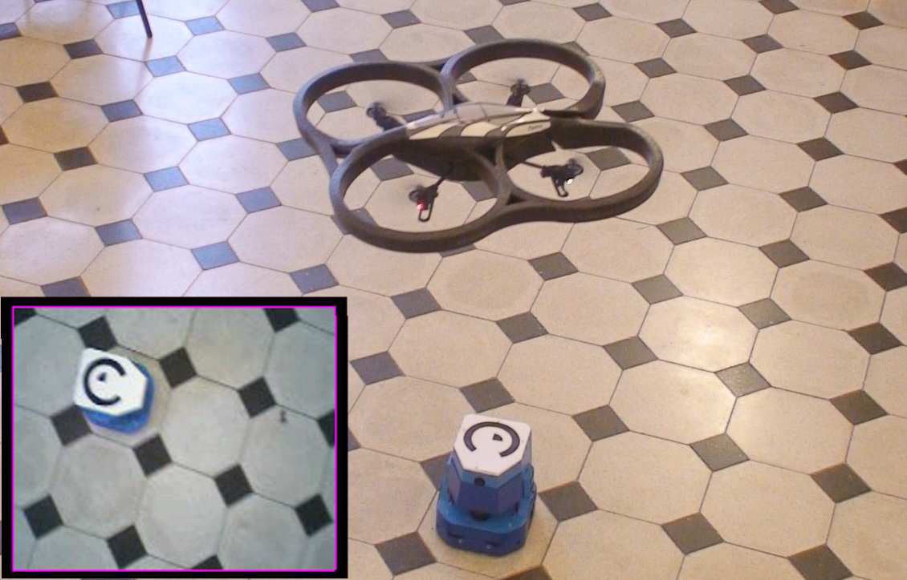
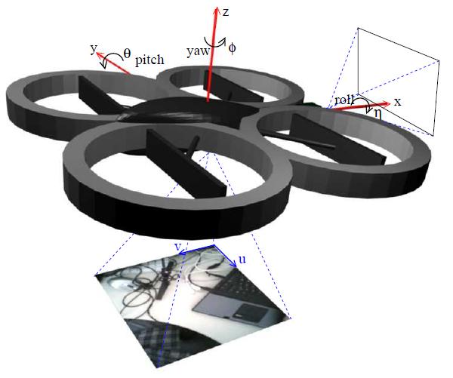
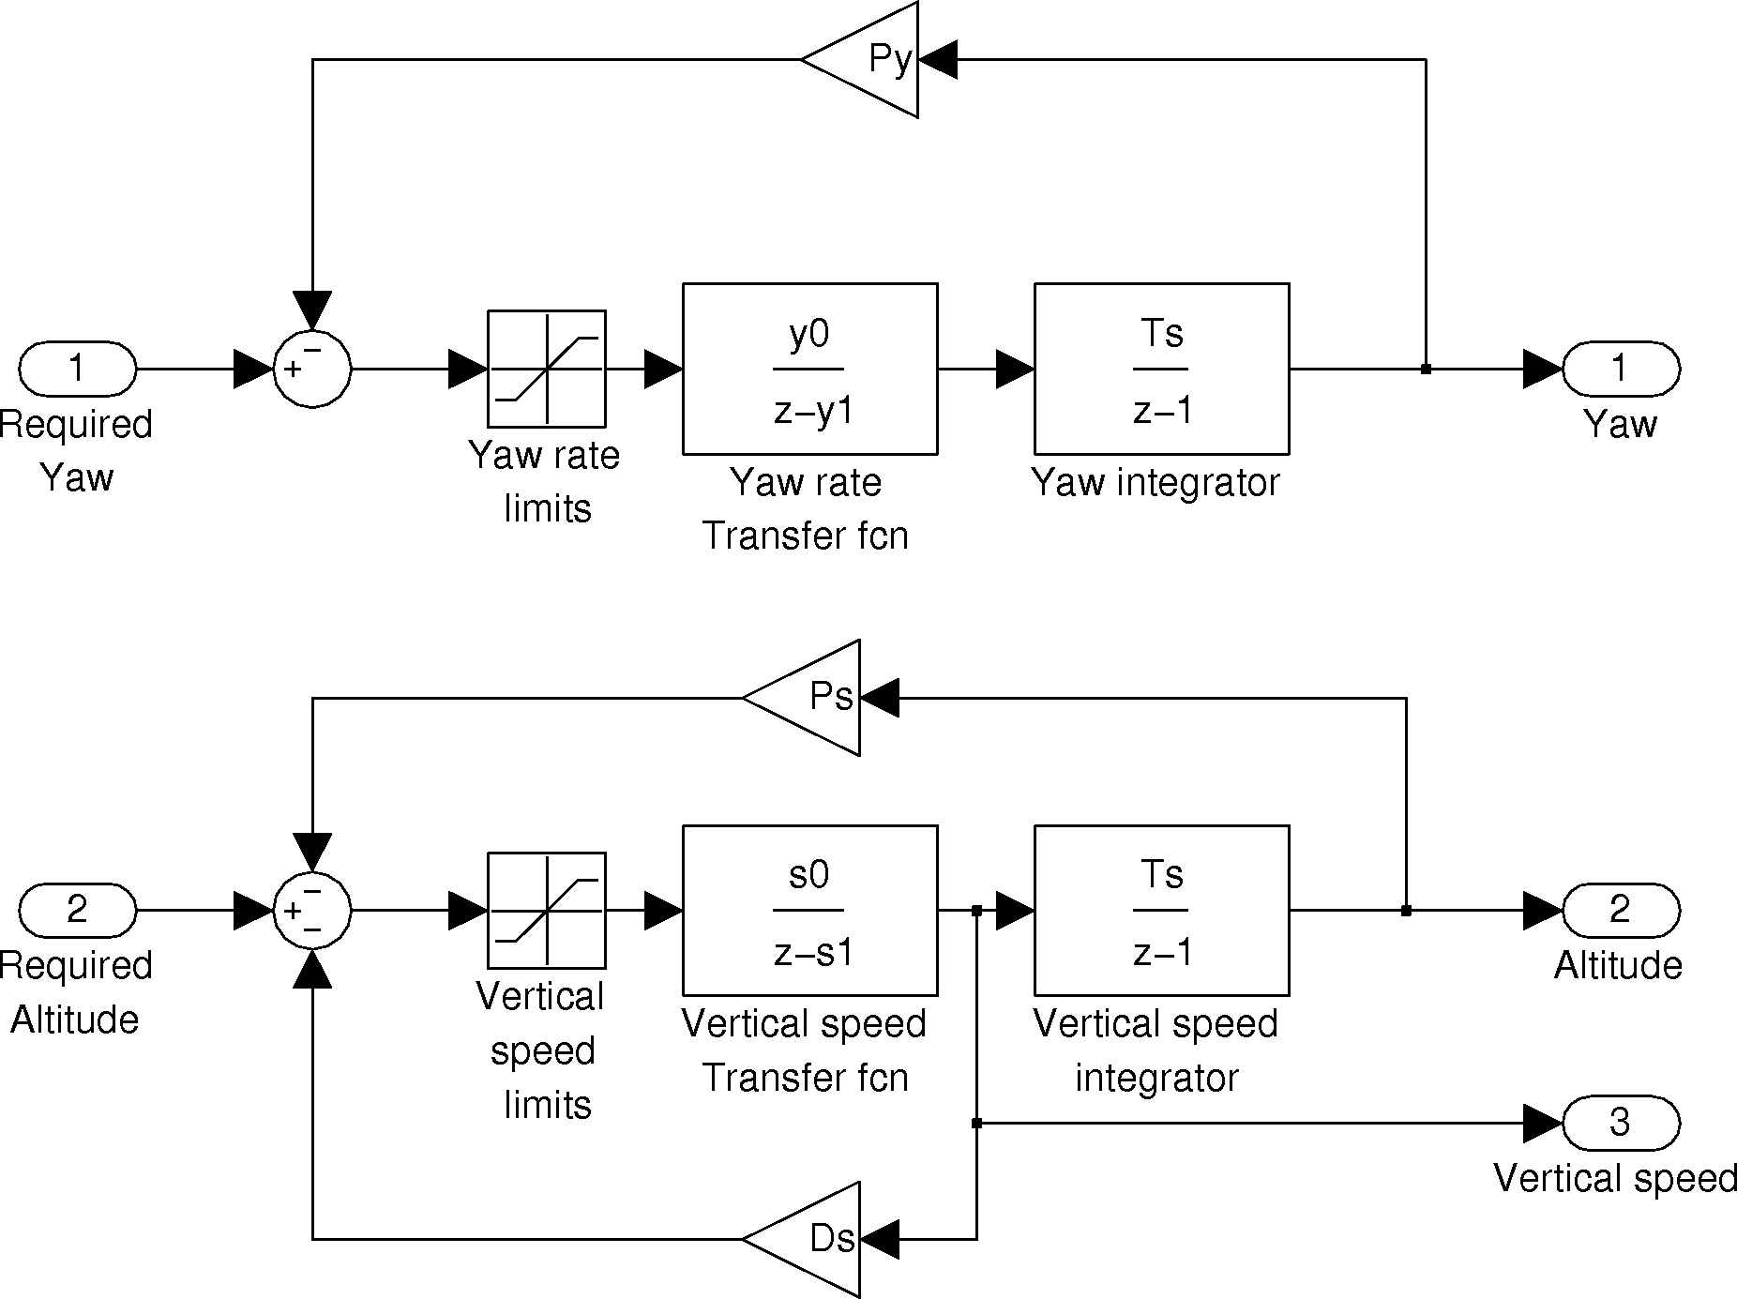
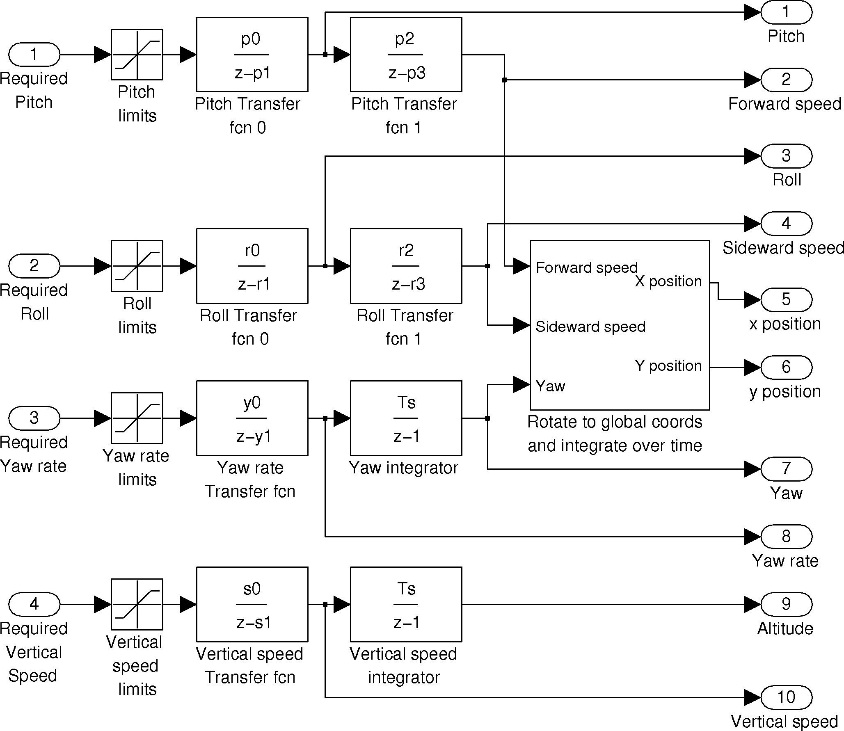
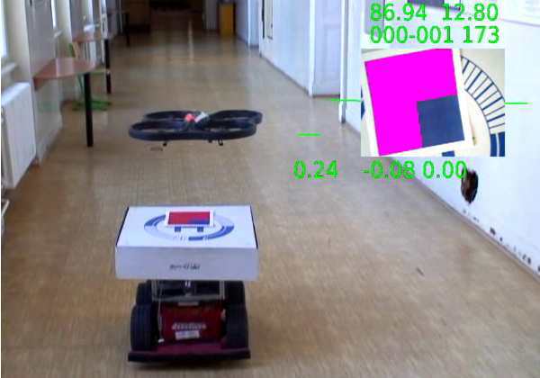
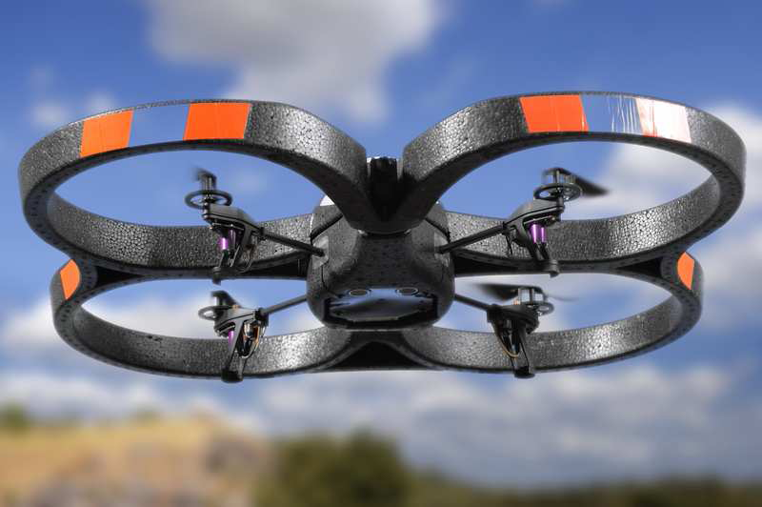
AR-Drone as a Platform for Robotic Research and Education
AR-Drone as a Platform for Robotic Research
and Education
Tom´aˇs Krajn´ık, Vojtˇech Von´asek, Daniel Fiˇser, and Jan Faigl
The Gerstner Laboratory for Intelligent Decision Making and Control
Department of Cybernetics, Faculty of Electrical Engineering
Czech Technical University in Prague
{tkrajnik,vonasek,danfis,xfaigl}@labe.felk.cvut.cz
Purpose
To provide a basis for future educational use and implementation of an AR-Drone and to gain experience with control systems.
Closed Loop Control Diagrams for vertical velocity, position and yaw.
Open Loop Control Diagrams for position, velocity, pitch, roll, and yaw.
Technical Specifications
ARM9 processor @ 468 MHz
128 MB of DDR RAM @ 200 MHz
Included Software Interface
Ad-hoc WiFi
6-degree-of-freedom inertial measurement unit
Sonar-based altimeter
Front (640 x 480 with FOV 75¬ x 60¬) and down facing cameras (176 x 144 with FOV 45¬ x 35¬)
IDG-400 2-axis gyro
3-axis accelerometer
XB-3500CV high precision gyro
Patterson C. Taylor III

Slide 11
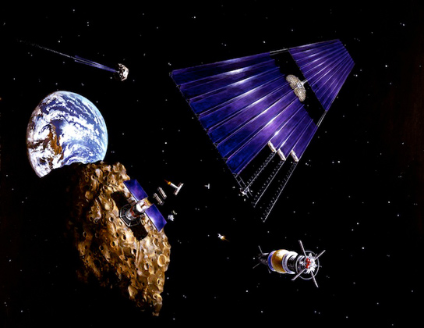
Robotic Mining in Space
    Localization without GPS
      GPS does not work in mines
      No positioning satellites around moon
    Small
      Fit into holes
      Lightweight
    Autonomous
      Communication delay
      No people on the moon
    Transport/Storage
      Earth
      ISS
      Moon
    Profit
      Transport could outweigh value for ore
[1] http://scitechdaily.com/billionaires-and-futurists-plan-space-missions-to-mine-asteroids-for-metals/
Asteroid Mining[1]

Slide 12
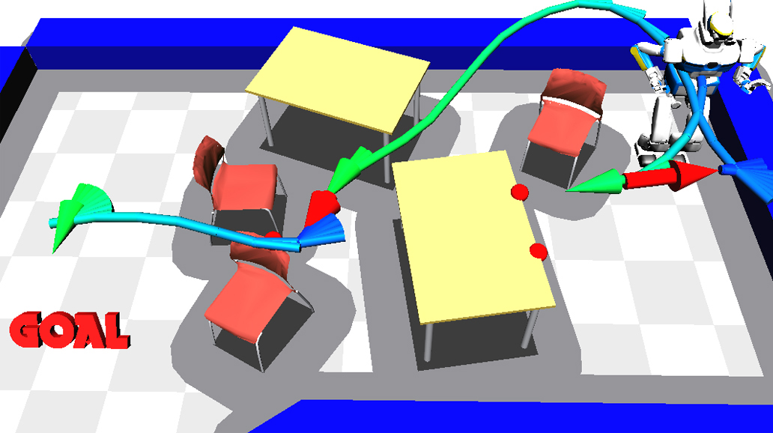
NAMO
Navigation among movable objects
Completing a task with reasoning
Moving objects if needed
External optical tracking
Joint encoders
Four-6 axis force sensors
http://www.kuffner.org/james/papers/NAMO_plan_exec_iros2006.pdf

Slide 13
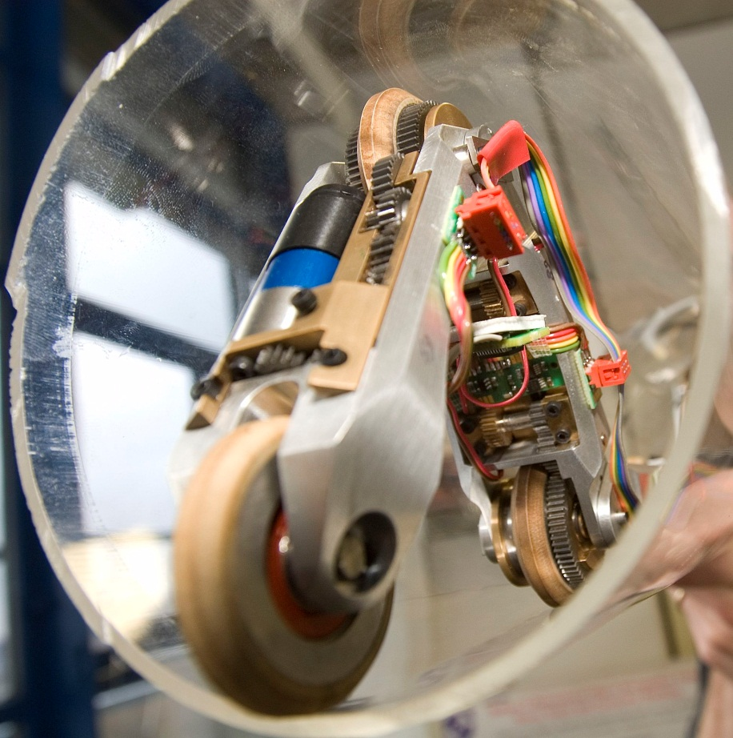
Future Robotics in the Oil and Gas Industry
The Problem: Safety of Humans
Key Issues:
Robots are restricted to static environments and lack of human-robot synergy.
Trust
Accountability
Tool or Workmate
  Interaction Design
  Autonomy
Complexity of Environment and Task
Situational Awareness
Solutions:
Teleinspection
Teleoperation
Complete Autonomy
http://www.ce.utwente.nl/e13/pirate/images/pirate.jpg

Slide 14
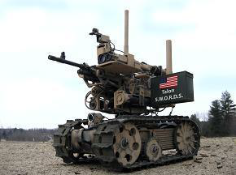
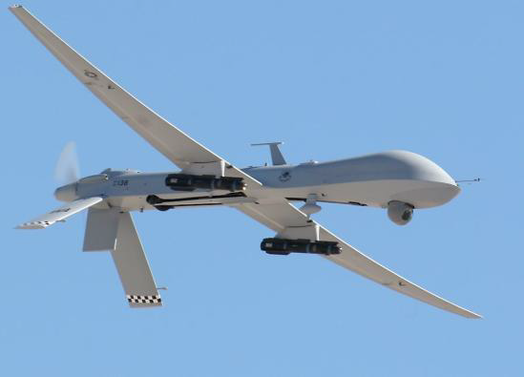
Robotics In Military Application
Reconnaissance
IED Investigation and Elimination
Fighting
Weapons and Gear Transfer
Future Applications
Completely robotic warfare
http://www.dtic.mil/cgi-bin/GetTRDoc?Location=U2&doc=GetTRDoc.pdf&AD=ADA534697
http://www.youtube.com/watch?v=Kgcl-APRPps
http://www.dtic.mil/cgi-bin/GetTRDoc?Location=U2&doc=GetTRDoc.pdf&AD=ADA534697

Slide 15
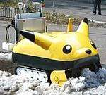
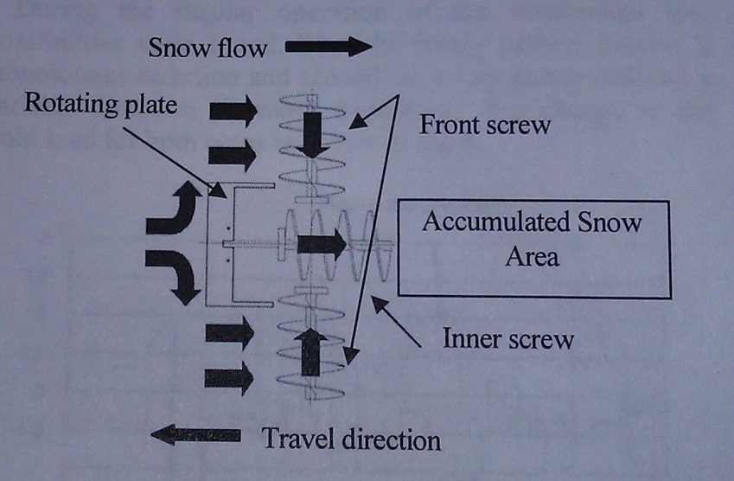
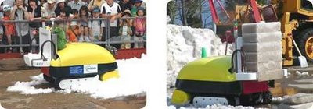
Snow Eater Robot
A snow eater robot was developed in Japan. It is capable of take in the snow from the front tray and compress the snow into an ice brick.
Sensors:
GPS positioning sensor
Twin video cameras for obstacle avoidance
Integral snowblock maker/compressor
IEEE journal “Development of Snow Dragging Mechanism for an Autonomous Snow Eater Robot”
http://inventorspot.com/articles/robot_snowplow_japan_shovels_sno_9534

Slide 16
Personal Service Robots (PSR) J. Scot Collins
Three sectors: industrial service, personal service and professional service.
Defined by Robotics Trends as robots or robotic technology purchased by individual buyers (consumers) which educate, entertain or assist in home.
  Entertainment, education, home security, medical care, housework routine, etc…
PSR, will be realized and fully boomed in the next 10-20 years.
  PSR development is becoming an intensive knowledge domain in academia and research institutes of global enterprise such as Sony, NEC, Philip, etc…
    Tiger Electronics – Furby, first robotic pet released in commercial segment in 1998
    Sony – AIBO, robotic pet in 1999
    Honda – ASIMO, humanoid robot in 2000
Robots will/should understand human instruction/desire through use of sensors technology, motion technology and intelligent technology.
Technologies currently under development include Spatial-temporal cognition, Decision making, Learning, and Interaction and communication.
According to a Japan Robotics Association study, the personal and professional service robots will triple from $17.1 billion in 2010 to $51.7 billion in 2025.
Sub-topics/fields of future PSR Technologies
  system, security, personal assistance, information, interfacing, identification, household, health care, entertainment, education, and communication.
Reference: James K. C. Chen, Algane Jong, Benjamin J. C. Yuan and Julia H. J. Liu. A Study of Personal Service Robot Future Marketing Trend. www.foresightfordeveloment.org and www.otemerindades.com.

Slide 17
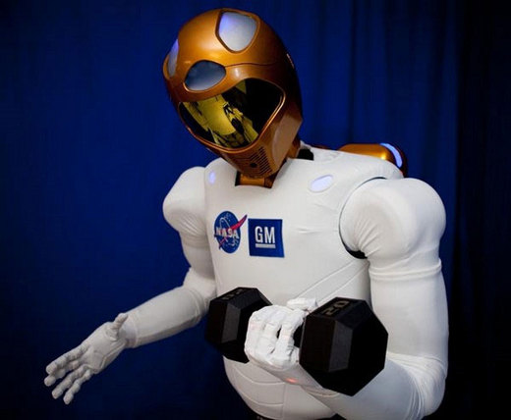
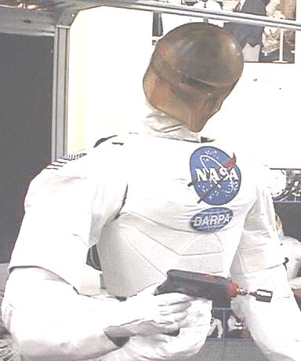
Tactile Gloves for Autonomous Grasping with the NASA Robonaut
The Robonaut‘s hand has 14 DoF, the glove in the hand is rugged and designed to protect the sensors, provide excellent gripping surfaces and take the abuse from wide rage of space and planetary task, also to provide good tactile data.
1
http://images.suite101.com/3400684_com_robonaut22.jpg
Both gloves have incorporated the basic construction of an outer glove with a sensor layer. This allows for assembly of the sensors and wiring independent of most of the sewing and to enhance repair or upgrade of the two layers.
The technology in its hands and fingers is considered state of the art and should be capable of allowing R2 to carry out such tasks as changing air filters or manipulating objects using tools.
http://http://www-robotics.cs.umass.edu/P
apers/icra04_martin.pdf
2
http://www-robotics.cs.umass.edu/Papers/icra04_martin.pdf
Notes:
Both gloves have incorporated the basic construction of an outer glove with a sensor layer. This allows for assembly of the sensors and
wiring independent of most of the sewing and to enhance repair or upgrade of the two layers. The outer glove is a hybrid of an
abrasion resistant grip fabric and a flexible lycra blend. The grip fabric is used mostly on the grasping surfaces of the hand
where a non-slip robust surface is crucial. The lycra fabric provides good flexibility in the joint areas and creates tension
where needed to help position and shape the glove. The sensor layer includes the sensors, force concentrators, wiring, and supporting fabrics. The supporting fabrics include a backing or slip layer next to the finger and adhesive backed fabric to help secure the sensor.
The technology in its hands and fingers is considered state of the art and should be capable of allowing R2 to carry out such tasks as changing air filters or manipulating objects using tools.

Slide 18
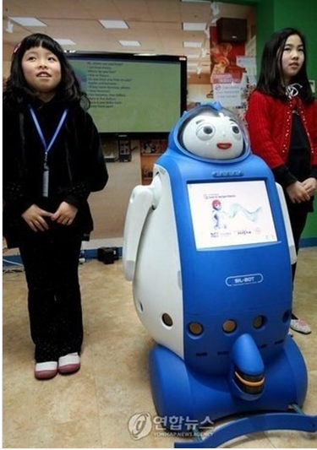
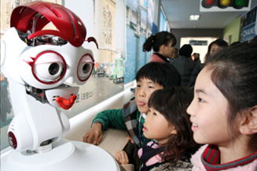
Teacher Robot
Functions:
Being able to play multiple roles
Comprehensive skill-sets for various applications: instructing, problem solving, etc.
Intelligence for logical behavior and emotional interactions
Features:
Autonomous
Simulates the teacher’s behavior, intelligence, emotion and functions
Recognizes the circumstances, interacting freely with students, thereby influencing the students
Independent and spontaneous
Decision making ability and free will
Learns, summarizes and accumulate various teaching experiences
Technology:
Developed from the teaching software and long-distance education classroom with integrated sensors and actuators
Limiting Factors:
Interactive technology
Dynamic decision
Knowledge database
http://www.popsci.com/technology/article/2010-02/south-korea-gives-go-robot-english-teachers-classrooms

Slide 19
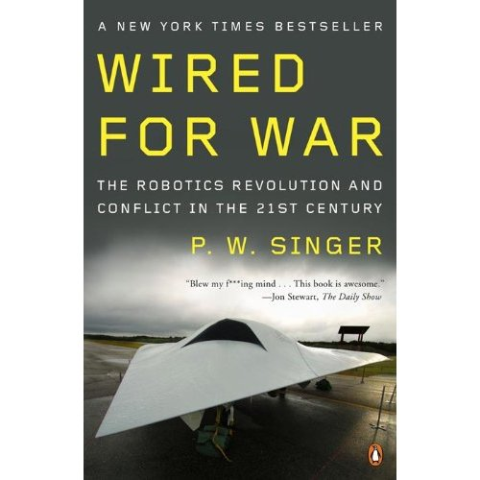

Singularity (“Wired For War” P.W. Singer)
Technological Singularity – The technological singularity is the hypothetical future emergence of greater-than-human super-intelligence through technological means. Since the capabilities of such intelligence would be difficult for an unaided human mind to comprehend, the occurrence of a technological singularity is seen as an intellectual event horizon, beyond which events cannot be predicted or understood.
Singularity – the way they conceptualize it is that every so often you have this meta-change where the rules of the game are rewritten, and there’s new questions that have to be asked about not what’s possible, but what’s proper or not.”
Citation:
“A singularity in the skies”.
Defense Management Journal
Dr. Stephen Prior.
Director of the Autonomous Systems Laboratory
Middlesex University

Slide 20
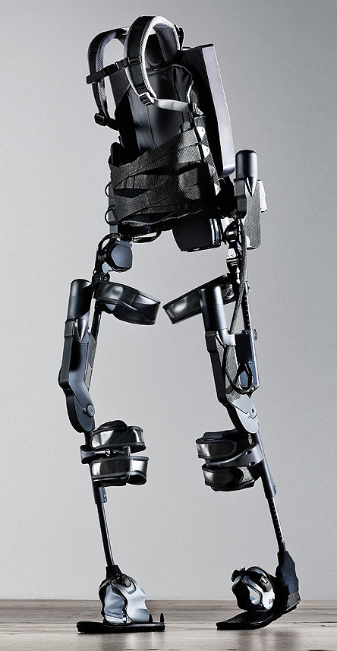
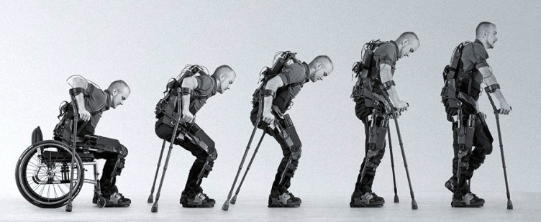
EKSO Bionics Powered Exoskeleton
Suit Specs and Features:
Weighs20 kilograms
Remote controlled
4 Servo motors
Battery pack located on back
Allows heel-to-toe walk gait
Future Plans:
Approval by U.S. food and drug administration
Motion sensors under walk sticks
Make it smaller and more lightweight
Applications for stroke patients
Better master of balance
Use in daily living
Nerves = Sensors
Motors = Muscles
Computer = Brain
References:
http://cdn2.digitaltrends.com/wp-content/uploads/2011/10/ekso.jpg
http://www.kurzweilai.net/images/Ekso-exoskeleton-profile.png
http://www.theengineer.co.uk/sectors/medical-and-healthcare/news/us-researchers-create-suit-that-can-enable-paraplegics-to-walk/1010691.article
(2)
(1)

Slide 21
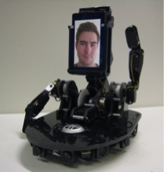
Telepresence
Use of technology to simulate appearance at distant events.
Example: MeBot
  Created by Sigurður Örn Aðalgeirsson at MIT Media Lab.
  Intended to “convey the non-verbal channels of social communication.” ^{[1]}
    Mobile phone for picture and sound
    Head movements
    Hand gestures
Telepresence vs. Video Conferencing
  More engaged in interaction.
  Higher levels of enjoyment.
MeBot Telepresence Robot ^{[1]}
http://robotic.media.mit.edu/projects/robots/mebot/overview/overview.html
Related Paper: http://robotic.media.mit.edu/pdfs/theses/siggi_ms_thesis.pdf

Slide 22
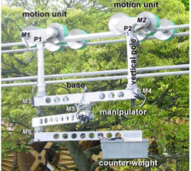
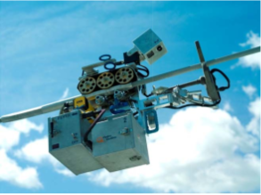
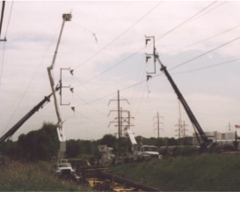
Robotic Applications for Energized Transmission Line
Transmission line maintenance, assessment/monitoring, and repair
Remotely controlled: radio controller (transmitter and receiver)
Visual inspection by Camera
Application of sensors such: Corrosion detection
Source: IEEE Journal: Overview of Robotic Applications for Energized Transmission Line Work –Technologies, Field Projects and Future Developments. David Elizondo, Thomas Gentile, Hans Candia, Greggory Bell.

Slide 23
Tucson Explorer II
Designed for autonomous surface and subsurface exploration of Titan lakes
Physical Features
  1.8 X 1.5 X 0.5 meters
  Payload = 150 pounds
  Two independently controlled
  above water electrically
  driven propellers
Navigation
  Overhead Detection
  Visual Odometry
  Hazard Avoidance
  Fuzzy Logic systems
Youtube Link
Reference:
Robotic lake lander test bed for autonomous surface and subsurface exploration of Titan lakes, Fink, W.; Tuller, M.; Jacobs, A.; Kulkarni, R.; Tarbell, M.A.; Furfaro, R.; Baker, V.R. Aerospace Conference, 2012 IEEE
Digital Object Identifier: 10.1109/AERO.2012.6187056 Publication Year: 2012 , Page(s): 1 - 12
Sensors
  Drop Impact Sensor
  Adapted thermistor or thermocouple
  Ultrasonic
  Onboard cameras
  Onboard Scanning Laser Rangefinder
  Onboard GPS (Earth based applications)
  Future onboard sensors for hyperspectral images, monitoring microbes on liquid surfaces

