Slide 1
ECGR4161/5196 – July 28, 2011
Read Chapter 5
Exam 2 contents:
Labs 0, 1, 2, 3, 4, 6
Homework 1, 2, 3, 4, 5
Book Chapters 1, 2, 3, 4, 5
All class notes

Slide 2
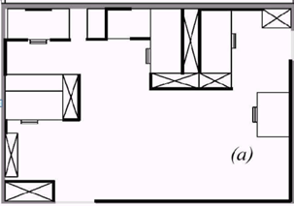
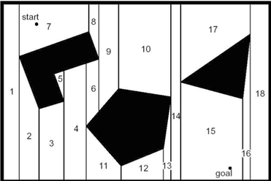
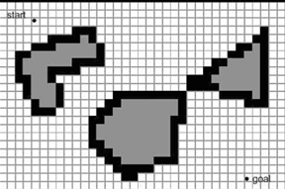
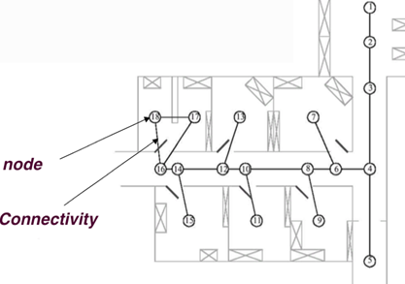
Varieties of Map Representation
Types of representation:
Continuous
- continuous valued coordinate space (closed- world assumption, total area of map proportional to object density)
- high accuracy and fidelity
- computational costly (alleviated with abstraction)
Decomposition
- breaking down continuous representation mapping to
extract the most pertinent information
- loss of fidelity and most likely movement precision
- computational superiority along with better reasoning
and planning
Forms of Decomposition:
1. Opportunistic – nodes of free space
2. Fixed – discrete approximation (Occupancy Grid)
3. Topological – connectivity of nodes through arcs
References:
Siegwart, Roland. Autonomous Mobile Robots. Cambridge, Massachusetts. The MIT Press, 2011, 284-296.

Slide 3
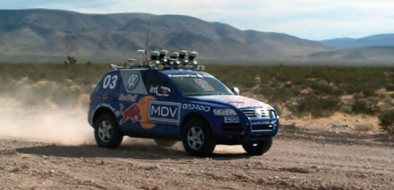
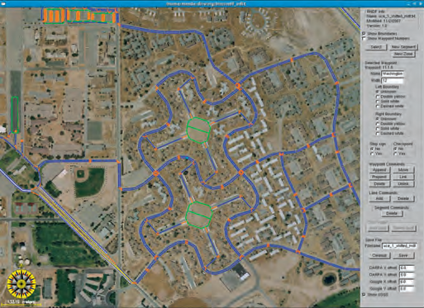
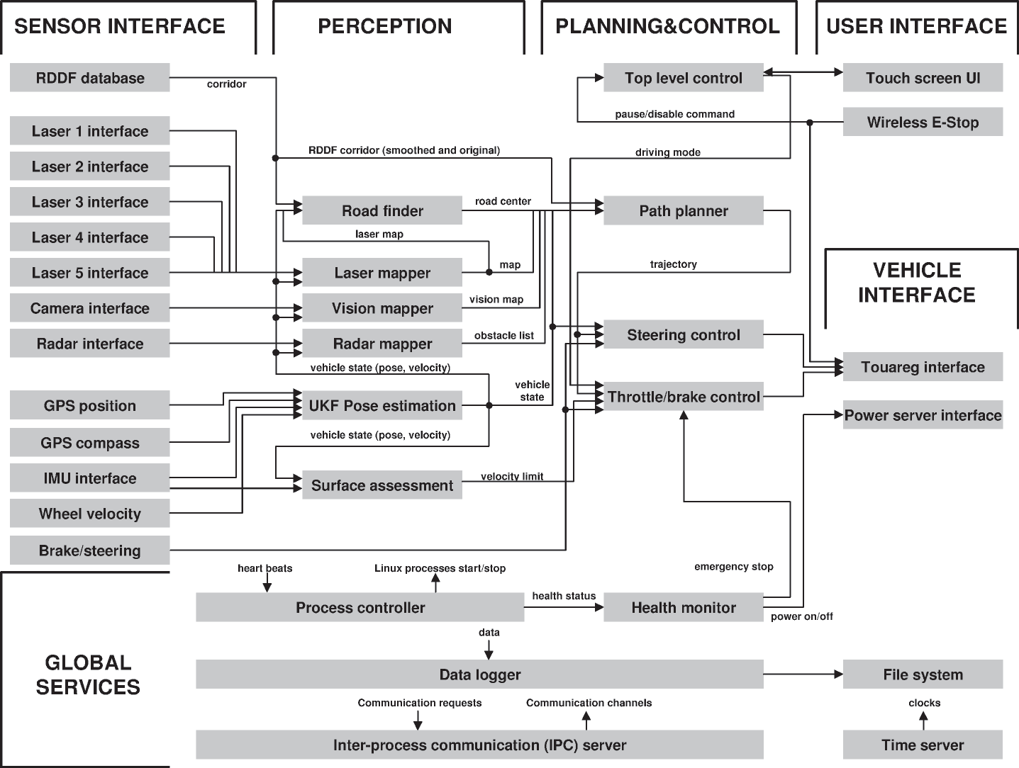
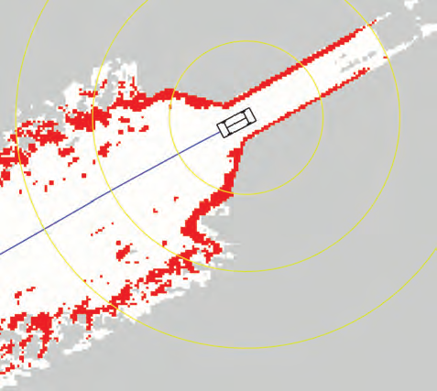
Waypoint Mapping – A Topological System
  Waypoint mapping is a high-level mapping strategy to ensure that a mobile robot arrives at its ultimate goal efficiently.
  Waypoint mapping typically requires some form of Global (or Localized Global) coordinate localization
  May operate independently of obstacle avoidance algorithm, or in coordination with other mapping strategies (A* occupancy for example)
  Analogous to the Topological map representation in section 5.5.2 of Introduction to Autonomous Mobile Robots
  Can be reduced to very simple form
Video:
Bol-Bot Vision-Based Fixed Waypoints
Refs:
Introduction to Autonomous Mobile Robots, Siegwart Roland, Nourbakhsh, Illah Reza
Toward Robotic Cars, Trun, S.
A waypoint-tracking controller for a biomimetic autonomous underwater vehicle Jenhwa Guo

Slide 4
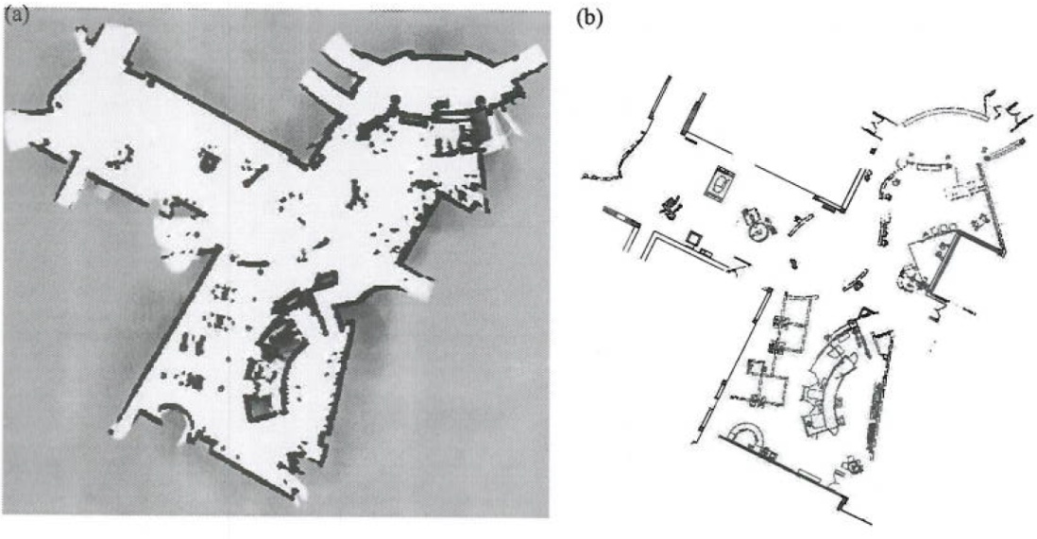

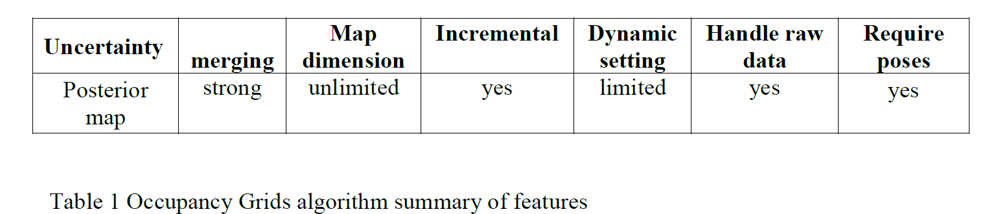
Occupancy grid maps (OGM) a mapping Algorithm
The best application of the OGM require robots with sonar or laser range finder sensors, both sensors are sensitive to absorption and dispersion which is a problem that OGM resolves by generating a probabilistic map.
The posterior of a map is approximated by
Factoring it into this equation
from reference [3]
Due to this factorization a binary Bayes Filter can
Be used to estimate the occupancy
probability for each grid cell [3].
From ref [1 ,fig 9)] and ref [2 fig 5.17]
References: 1. Robotic Mapping by Sebastian Thrun February 2002 Carnegie Mellon
2. Chapters 5 of the introduction to Autonomous Mobile Robots
3. Wikipedia
Notes:
Occupancy grid maps developed by Elfes and Moravec in the mid 80 where it became very popular and was used in many autonomous robots, this methods can be used with the simultaneous localization and mapping (SLAM) technique. There are four major Components of Occupancy grid mapping approach. They are interpretation, Integration, position estimation and exploration.

Slide 5
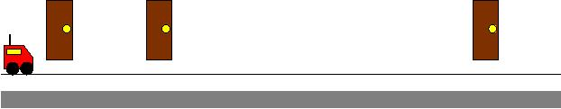
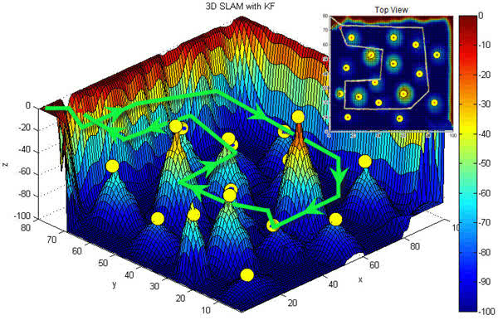
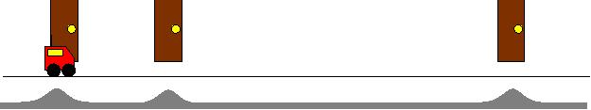
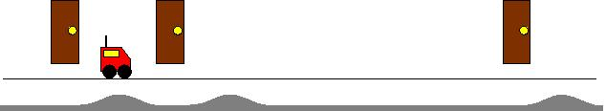
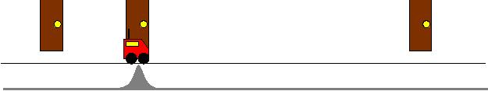
Kalman Filters
Statements:
The robot must explore and determine the structure of the space it is in
  Simultaneous Localization and Mapping (SLAM)
Each belief is uniquely characterized by its mean and covariance matrix
This filter uses unimodal distribution and linear assumptions
Initial state
detects nothing:
Moves and
detects landmark:
Moves and
detects nothing:
Moves and
detects landmark:
Figure 1: Kalman Filter Sensor Processing [2]
Figure 2: Kalman Filter SLAM
Problems:
A linear process model must be generated
Linearization will increase the state error
Sources:
[1] Robot Localization and Kalman Filters (http://www.negenborn.net/kal_loc/thesis.pdf)
[2] Mobile Robot Localization and Mapping Using the Kalman Filter (http://www.cs.cmu.edu/~robosoccer/cmrobobits/lectures/Kalman.ppt)

Slide 6
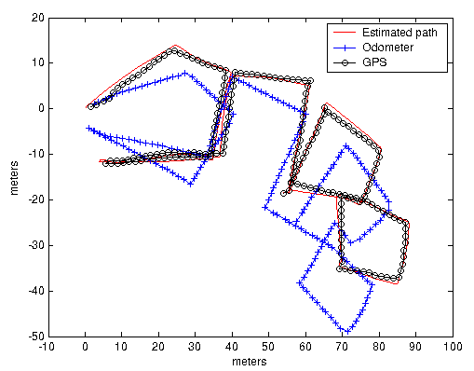
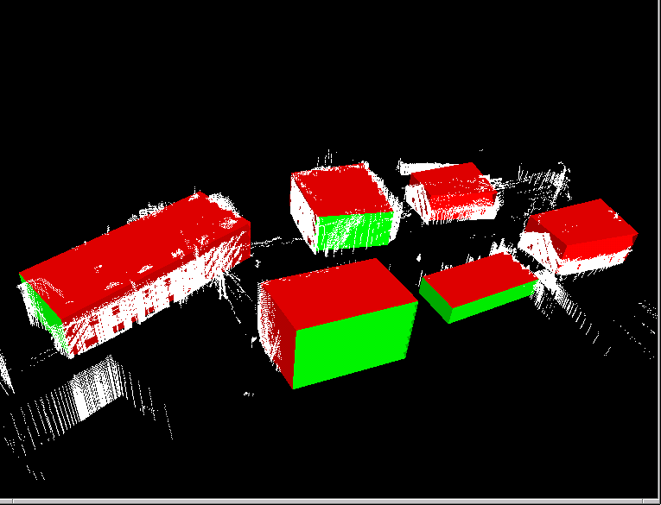
3D Mapping of Outdoor Environments
The algorithm focuses on efficiency and compactness of the representation rather than a high level of detail.
Mapping Algorithm has 3 steps:
Generating a point cloud map based on odometry, inertial measurement unit, GPS, and range information.
Point cloud are very memory inefficient.
Extracting planes from the point cloud map,
Hough transform is used to extract planes from point cloud.
Associating planes and geometrically represent buildings.
Ref - http://ieeexplore.ieee.org/xpl/freeabs_all.jsp?arnumber=1545152

Slide 7
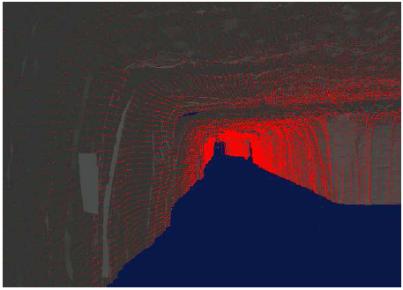
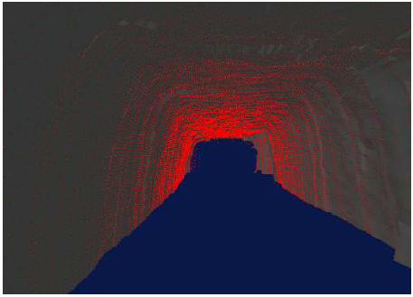
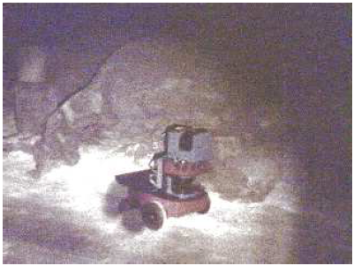
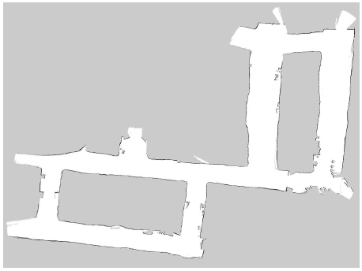
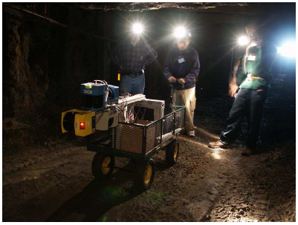
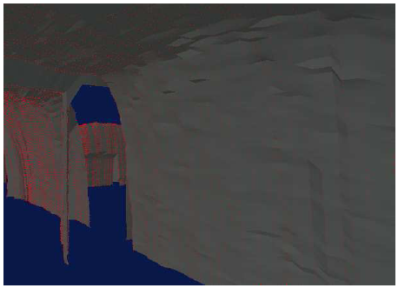
3D Robot Mapping of Underground Mines
Prototype 2: Additional Sensors
2 more SLAM sensors added 90 degrees offset to the forward pointing sensors to add 3D (one pointed to the left and to the right)
3D reconstruction not achieved merely by adding vertical cross sections, as real time sensing can cause quite a bit of error
Using the first two lasers, errors are removed by interpolation between adjacent sensor scans, and adding cross sections of the two scans match
SLAM (simultaneous localization and mapping)
Prototype 1: Modified Pioneer AT Robot
Equipped with 2 SICK laser range finders, one pointing forward parallel to the floor, and one pointing upward perpendicular to the robot’s heading direction
Equipped with 2 wheel encoders to measure approximate robot motion
Forward laser used for SLAM
Upward laser used to construct 3D shape of the walls
Jeffrey Skelnik jbskelni@uncc.edu
http://robots.stanford.edu/mines/mine-mapping/papers/thrun.mine-mapping.pdf

Slide 8
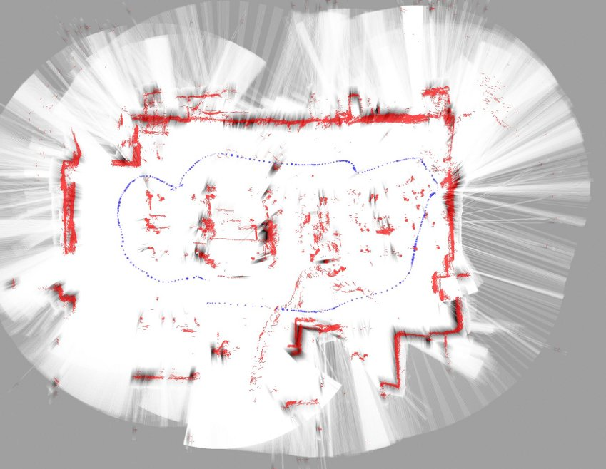
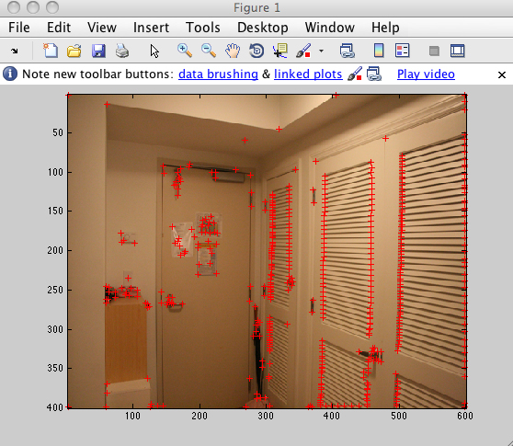
visual Simultaneous Localization and Mapping (vSLAM)
SLAM Algorithm
-Sensor Fusion (odometry, ranging, imaging)
-Find Features/Landmarks (application dependent)
-Merge with previously recorded data (landmark database)
[3] SLAM representation
[1] http://www.flickr.com/photos/hnam/4074588812/in/photostream
[2] http://www.youtube.com/watch?v=DUmLJapio7o&feature=related
[3] http://www.morengi.com/infotrick/tinySLAM/total_color.jpg
[4]http://www.google.com/url?sa=t&source=web&cd=1&sqi=2&ved=0CBoQFjAA&url=http%3A%2F%2Fciteseerx.ist.psu.edu%2Fviewdoc%2Fdownload%3Fdoi%3D10.1.1.87.4010%26rep%3Drep1%26type%3Dpdf&rct=j&q=the%20vslam%20algorithm%20for%20robust%20localization%20and%20mapping&ei=nYQxTqiYIsry0gHTuvSUDA&usg=AFQjCNFtGCNErTWWlpPsDIccr25WXmGZAQ
[1] Harris Corner Detector

Slide 9
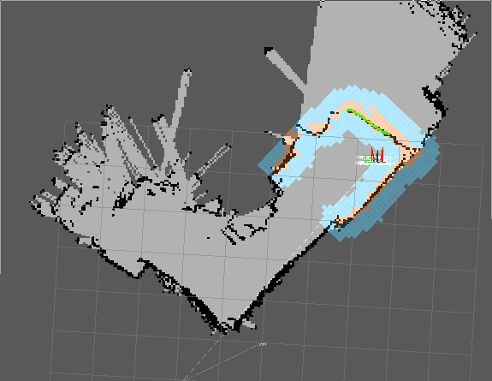
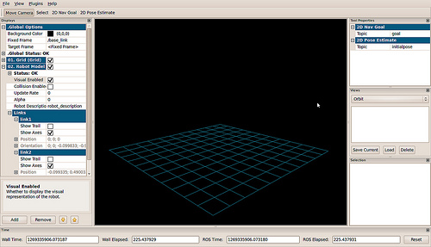
TurtleBot Mapping Using Kinect Sensor Bar
The TurtleBot uses information from the Kinect IR sensor bar and internal Gyro and encoders to build a map of its environment.
Using the GUI loaded in linux you must start the mapping program and then teleoperate the robot via an adhoc network and drive it around the area. The robot will then create the map based on its position given by the gyro and encoders, as well as any objects/walls given by the kinect sensor.
Navigation and Mapping
Sources/Videos
http://www.ros.org/wiki/Robots/TurtleBot (Video and Info)
http://profmason.com/?s=TurtleBot (Images/Video and Info)
http://www.youtube.com/watch?v=VIQChgUacJI&feature=player_embedded
http://www.youtube.com/watch?v=fljcaI4MDfA&feature=player_embedded
Map GUI

Slide 10
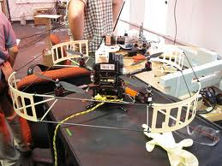
Mapping: IMU Combined with LIDAR
Integration about the three axes to determine telemetry
Must have a known starting point (or create a way-pointe)
A sparse 3D map is generated on the robot based on sensor data, enabling high-level planning and visualization
Planning and Mapping done onboard then sent to a home-base
Allows for object avoidance in real time example
"‪Autonomous Aerial Navigation in Confined Indoor Environments‬‏ - YouTube." YouTube - Broadcast Yourself. Web. 28 July 2011. <http://www.youtube.com/watch?v=IMSozUpFFkU>

Slide 11
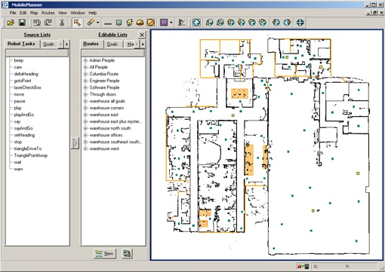
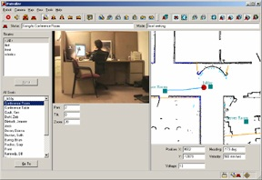
Motivity™ Software Mapping
Motivity Robot Core runs Mapping software
  MobilePlanner allows creation of mission and tasks appropriate for the workplace
  The software allows robots to learn room layout changes in minutes
  No need for reflective tape or lines on the floor
MobileEyes can be used for monitoring or manual control
"Million-mile Proven Motivity Robot Autonomy." Intelligent Mobile Robotic Platforms for Service Robots, Research and Rapid Prototyping. Web.
28 July 2011. <http://mobilerobots.com/Autonomous_Robotic_Platforms.aspx>.
Brandon McLean, July 2011

Slide 12
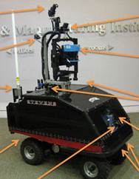
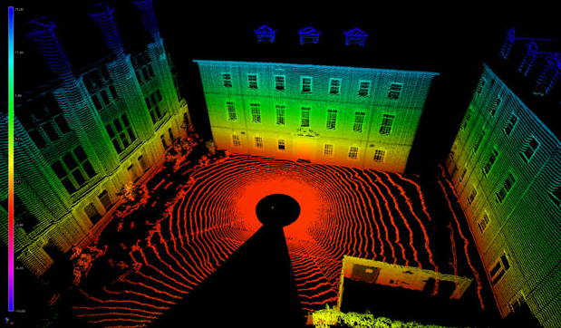
ROAMS (Remotely Operated and Autonomous Mapping System)
  Maps an environment while returning a real-time, detailed 3D view of the location
  2D LIDAR mounted on an adaptive three-degree of freedom rotating platform
  Integration of a 2D LIDAR, video camera, 3 servo motors and 3 angular position sensors are used to produce 3D color scans
  Challenges: - Imprecise position and pose
  - Non-unique solutions
  The partial solution utilizes hue and texture information from video
  Advantages: - Cheaper than other solutions
  - Greater autonom
  http://www.youtube.com/watch?v=Z_pWJxv3D5g
  1- http://research.stevens.edu/index.php/remote-robotics-and-innovative-mapping-t-1
  2- http://ieeexplore.ieee.org/xpl/freeabs_all.jsp?arnumber=5339624

Slide 13
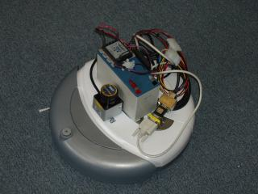
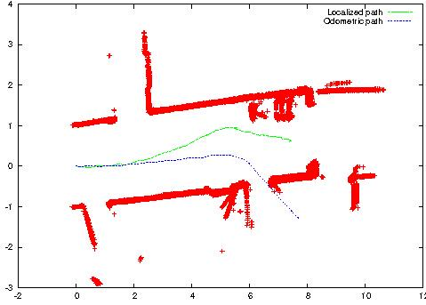
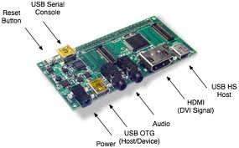
Mapping with the iRobot Roomba
Hardware required:
Roomba Discovery robotOne 12V SLA battery with a Vicor 12V to 5V DC/DC converter
Gumstix connex 400xm embedded computer
Hokuyo URG-04LX scanning laser range-finder.
The robot device server Player/Stage project
Player provides a network interface to a variety of robot and sensor hardware. Cross compile Player on Gumstix tutorial. Drivers needed:
Roomba
urglaser
vfh (for local navigation and obstacle avoidance)
Laserrescan (to convert URG laser data into the
SICK-like format required by vfh)
logfile (to log data to a file)
[1]SRI International: Artificial Intelligence Center, 2011, July 27. Mapping with the iRobot Roomba [Online] http://www.ai.sri.com/~gerkey/roomba/

