Slide 1
Support Vector Machine (SVM)
What it is?
Numerical classifier that draws a single decision boundary
that maximizes the margin between two classes of data
Classifier – Machine Learning Model

Slide 2
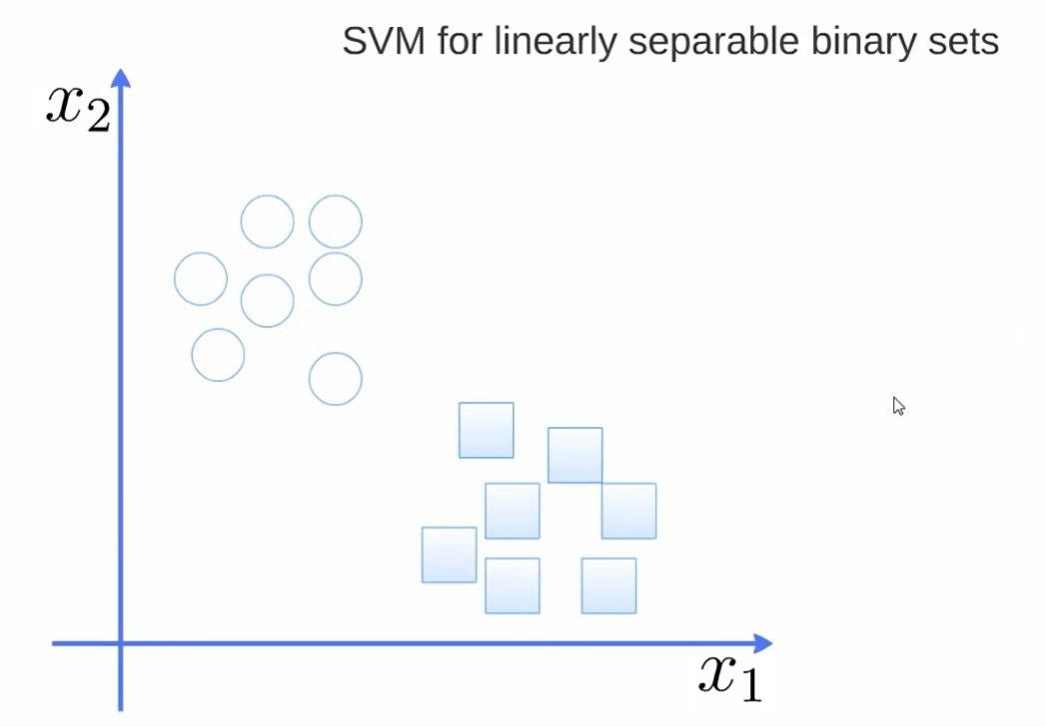

Slide 3
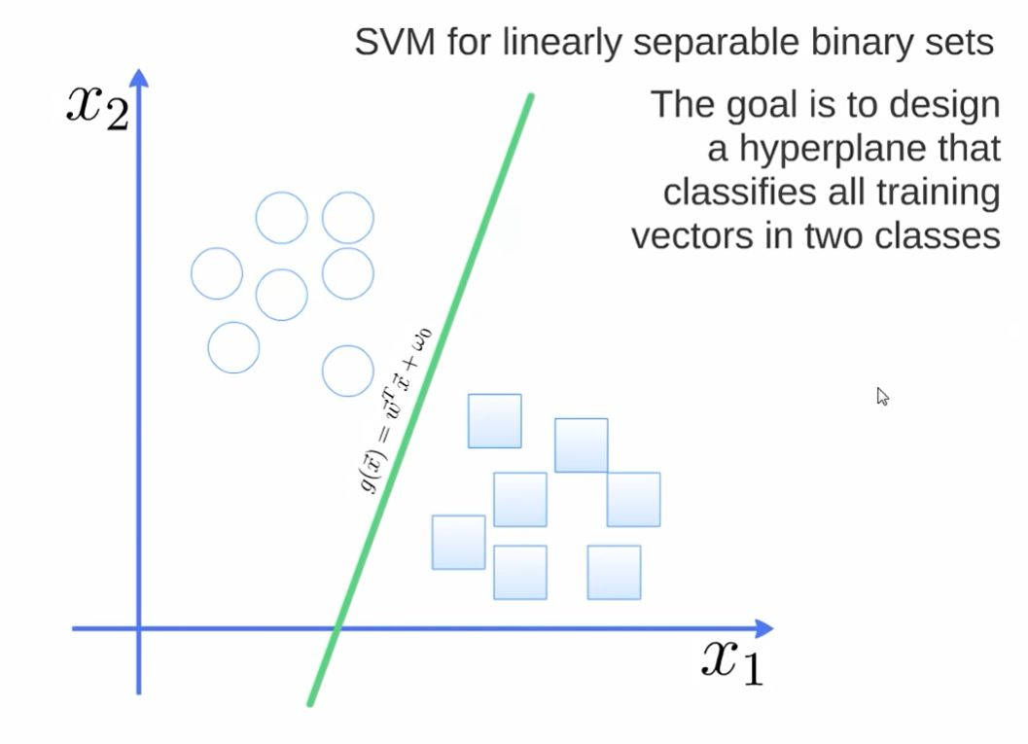

Slide 4
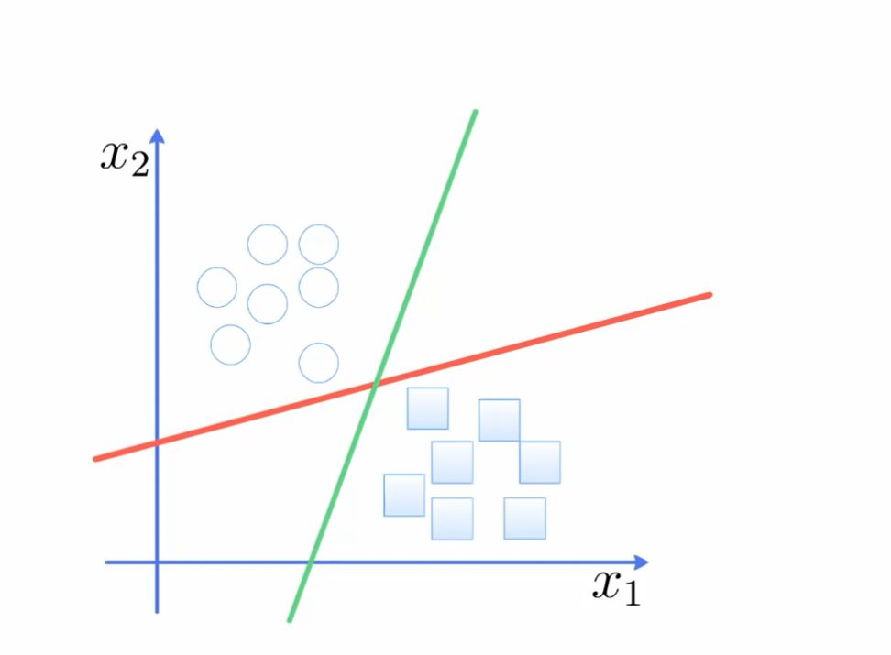

Slide 5
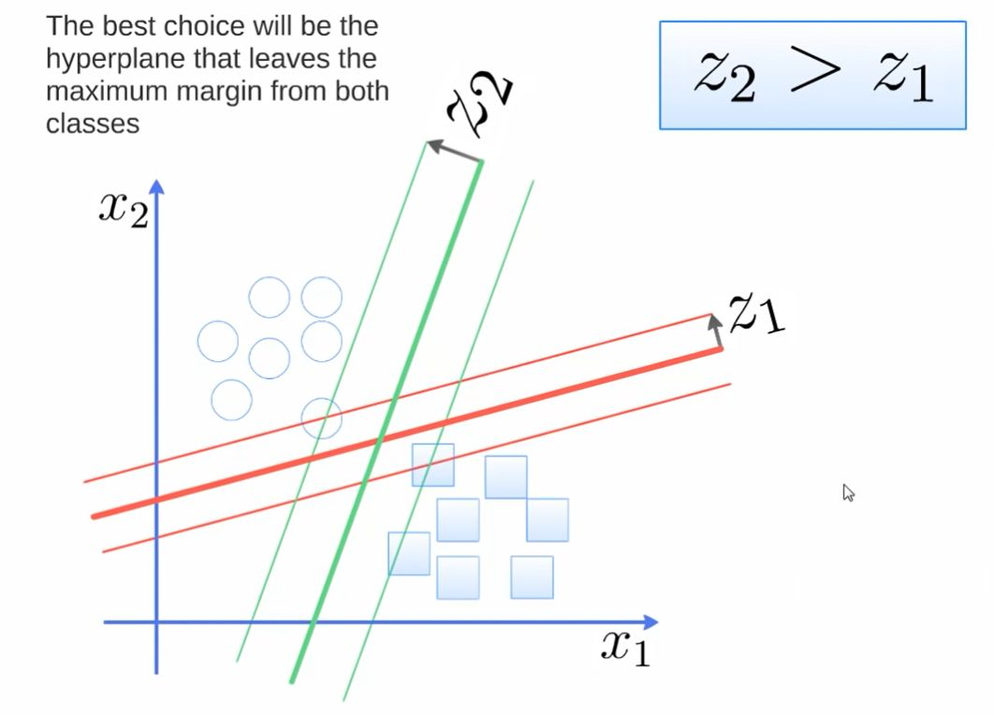

Slide 6
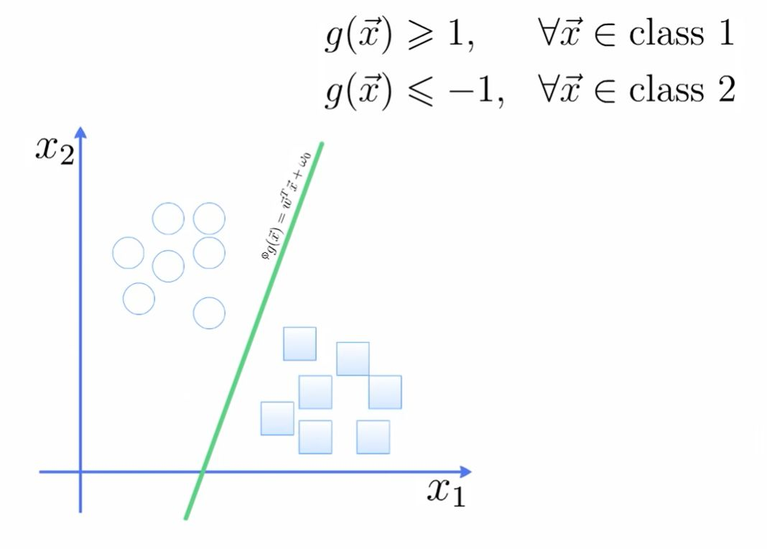

Slide 7
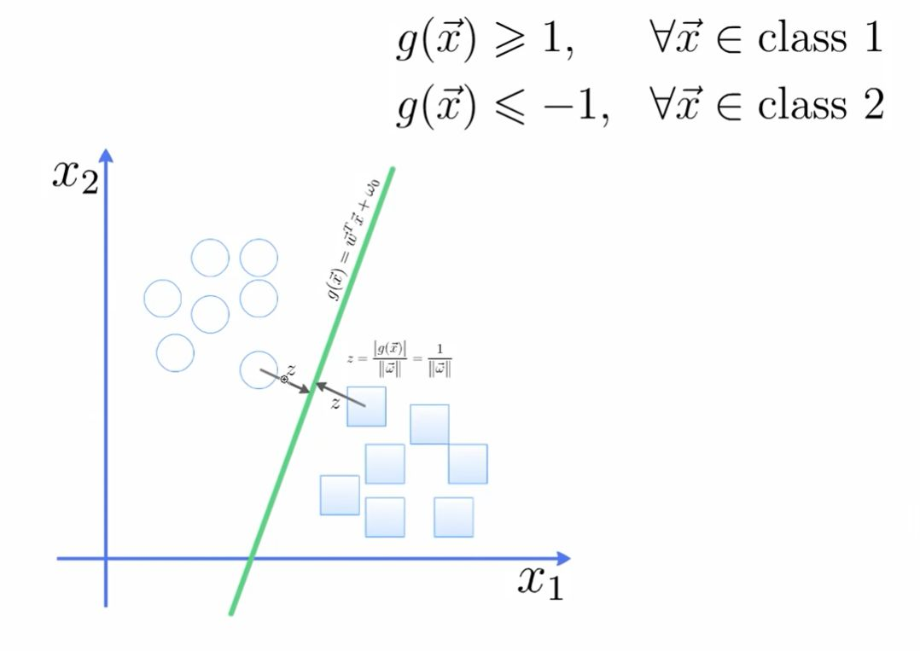

Slide 8
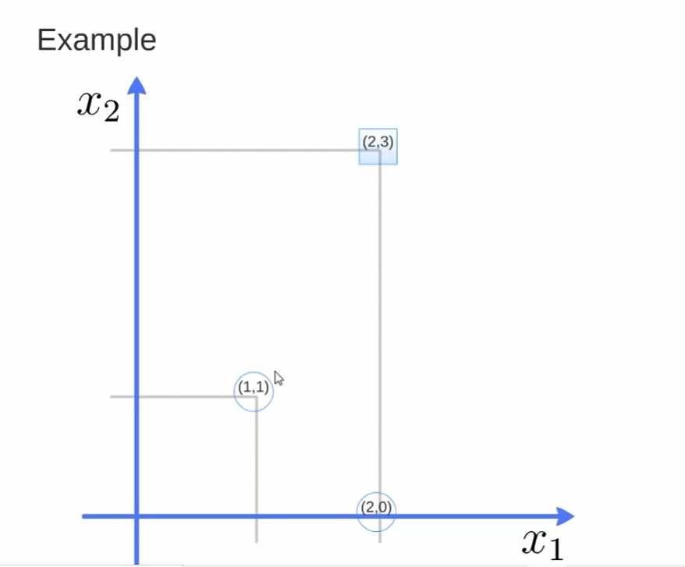

Slide 9
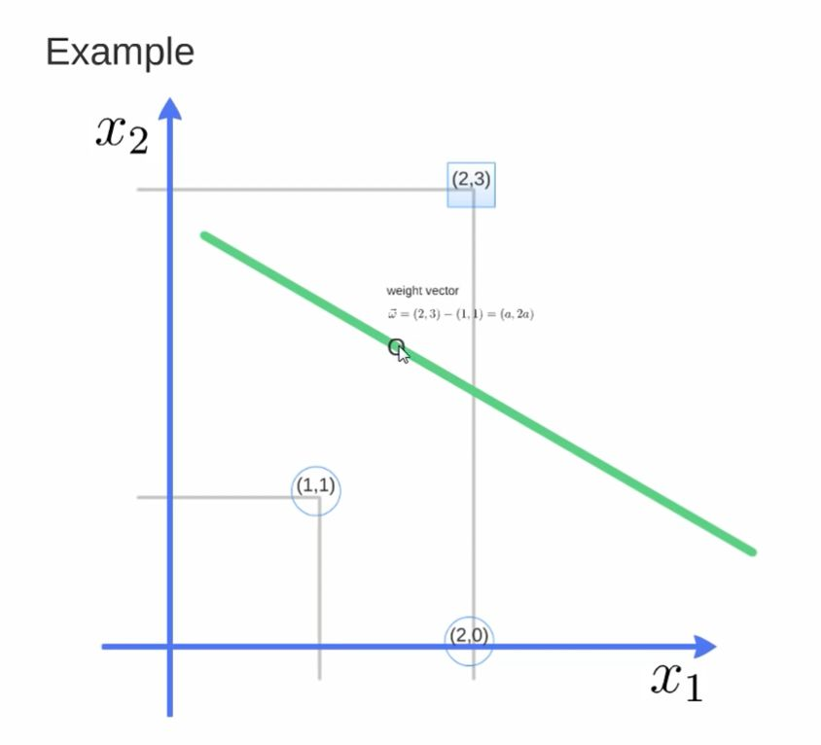

Slide 10
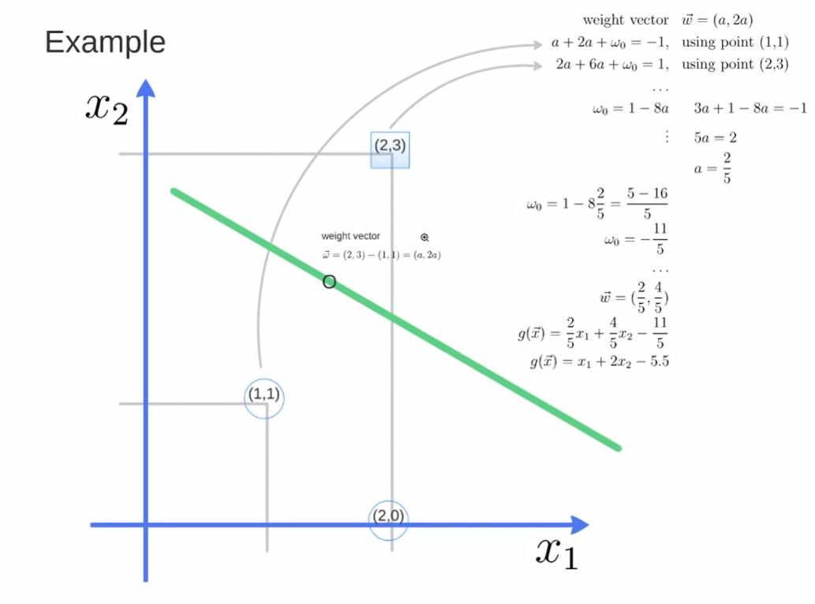
g(x1,x2)=a*x1 + b*x2 + wo =
a*x1 + 2a*x2 + wo

Slide 11
Kernel helps to find a hyperplane in the higher dimensional space
without increasing the computational cost much

Slide 12
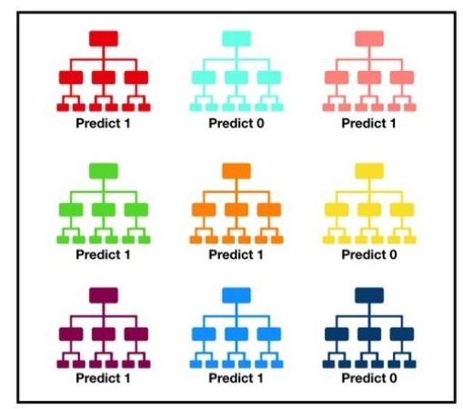

Slide 13
