Slide 1
Supervised Model for Predicting the Risk of Mortality and Hospital Readmissions for Newly Admitted Patients
Mamoun Al-Mardini & Zbigniew W. Ras
Dept. of Computer Science
University of North Carolina, Charlotte, USA
Sponsored by

Slide 2
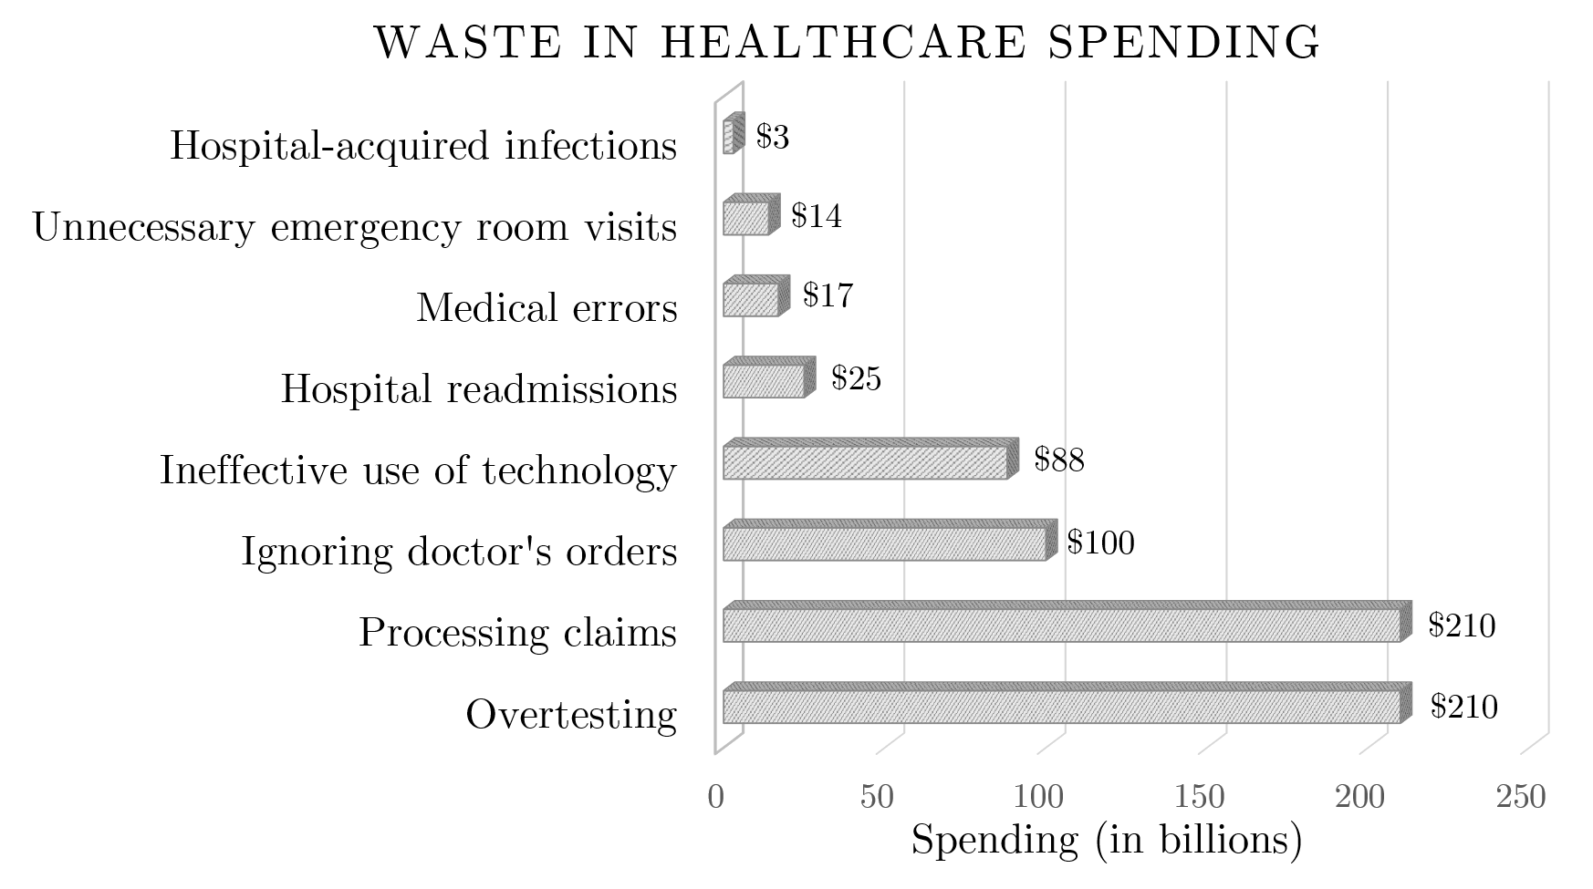
Waste in Healthcare
The projection of the growth rate in healthcare spending is 5.8 percent during the period 2014–2024, which means that the spending will rise to 5.4 trillion by 2024.
$25 billion are spent on hospital readmissions annually.
Clearly, we need to reduce the risk of mortality
Waste in healthcare spending as listed by
Price Waterhouse Coopers (PWC) research institute

Slide 3
HCUP Dataset
The largest collection of hospital care data in the United States
(200+ million surgeries).

Slide 4
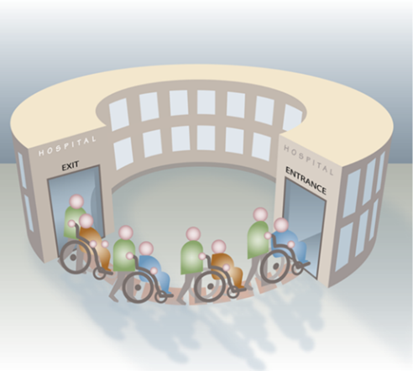
Problem Statement
Can we use data mining techniques on patients’ records in HCUP Database to reduce the number of readmissions & reduce risk of mortality in hospitals?
Provide treatment recommendations (actionable knowledge) to the physicians that can eventually minimize the anticipated number of hospital readmissions.

Slide 5
Hospital Readmissions
Hospital Readmission is defined as a re-hospitalization of a patient after being discharged from a hospital within a short period of time. The period in average is 30 days

Slide 6
Our Medical Dataset
Part of the Healthcare Cost and Utilization Project (HCUP).
A total of over 7.8 million visit discharges for over 3.6 million
patients in Florida.
.
Each patient can exhibit up to 31 diagnoses and up to 31 procedures.
(The first procedure is considered the main procedure).
Diagnoses/Procedures codes:
International Classification of Diseases, Ninth Revision, Clinical Modification (ICD-9-CM)
Clinical Classifications Software (CCS)
diagnostic code
surgery
Diagnoses: ~15k (ICD-9-CM), ~300 (CCS)
Procedure codes: ~4k (ICD-9-CM), 231 (CCS)

Slide 7
HCUP Dataset - Features Used
Features | Description
VisitLink | Patient’s identifier
DaysToEvent | Number of days between two consecutive visits
LOS | Length of Stay
DXCCSn | Diagnoses (up to 31)
PRCCSn | Procedures (up to 31)
DXPOAn | Present on admission indicator

Slide 8
How readmission is detected
V1
V2
V3
LOS1
LOS2
LOS3
Time
t₀
t₁
t₂
DaysToEvent₁
DaysToEvent₂
DischargeToReadmission = DaysToEvent₂ – DaysToEvent₁ – LOS₁
Yes, DischargeToReadmission ≤ 30
No, DischargeToReadmission > 30
ReadmissionIndicator =

Slide 9
Comorbid Conditions
(arthritis, diabetes, heart disease, cancer,..)

Slide 10
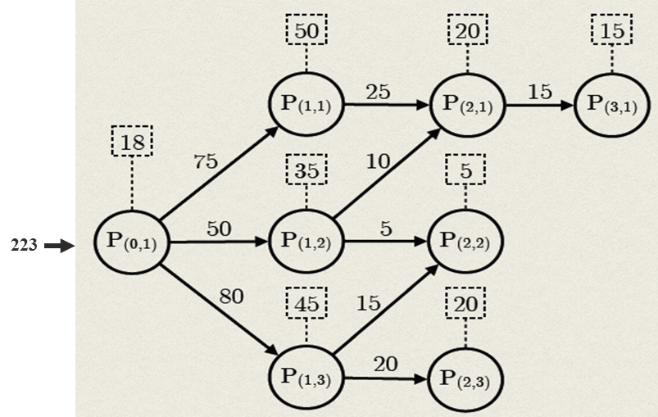
Procedure Graph
Procedure graph for a procedure p is defined as the tree of all possible procedure paths extracted from the dataset of patients who underwent procedure p as their first procedure
Notes:
This is the first step of the research, which is to find all possible paths that a new patient may undertake during the course of treatment.
Here I am showing a hypothetical example for all possible paths after performing P(0,1) as the first procedure. These paths form a tree that we call procedure graph.
Explain the Nodes, Length and numbers:
Nodes: The nodes in the graph represent the procedures. These procedures could be major like a surgery or minor such as x-ray
Length: The length of any given procedure path is an indicator of the number of readmissions that occurred or will occur throughout the course of treatment.
Numbers: Explain the numbers in the graph.

Slide 11
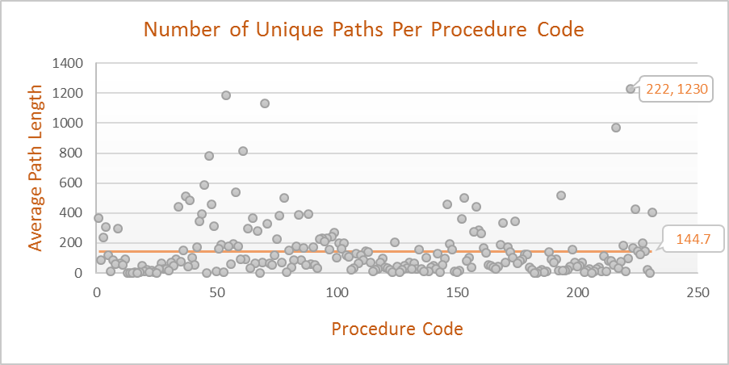
Procedure Graph-Extracted Information
The number of all procedure paths is extremely high.
It does not exist a single universal course of treatment that patients
typically follow to reach the desired state.
222 : Blood Transfusion

Slide 12
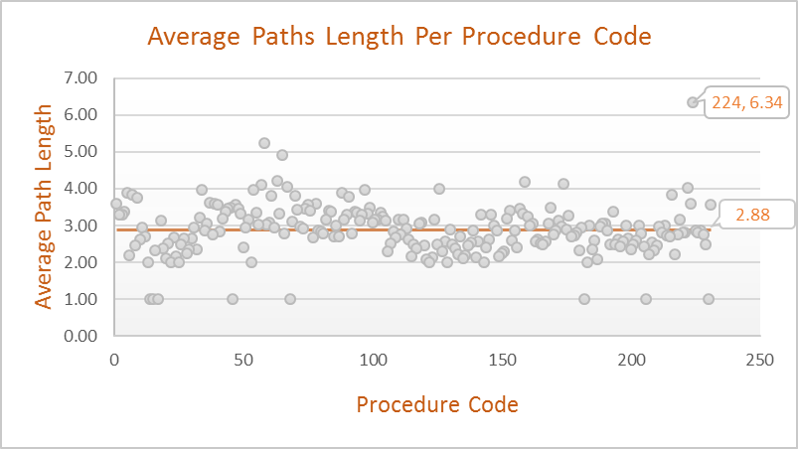
Procedure Graph-Extracted Information
The length of the procedure path is an indicator of the number of
readmissions during the course of treatment.
Path length (Number of readmission) = Number of nodes (procedures)-1
224 : Cancer chemotherapy
Notes:
Note that these numbers may include outliers, for example, there could be only one patient who had the maximum path length of 56. In Chapter 6, we will
provide a more robust mechanism that provides a score for each procedure, which represents the average number of hospital readmissions

Slide 13
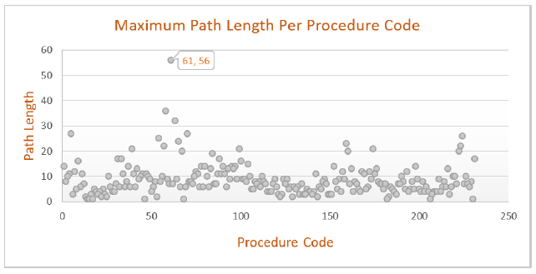
Procedure Graph-Extracted Information
Knowing that patient will undergo procedure 58 (Hemodialysis) as the initial procedure allows us to anticipate what could be the maximum and the average number of possible readmissions in general, which are 36 and 4.2 respectively.
61 : procedures on vessels other than head and neck

Slide 14
Predicting the risk of patient's readmission and mortality
(no data personalization; more than 300 features)
 | Mortality | Readmission
Naïve Bayes | 87.43% | 62.76%
Decision Tree | 96.29% | 91.38%
Logistic Regression | 84.65% | 64.57%
Neural Network | 84.64% | 64.38%
SVM | 95.21% | 76.75%
Classifiers Prediction Accuracy

Slide 15
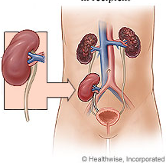
Example from the Dataset - Procedure Code 105 (Kidney Transplant)
1732 patients started with this procedure
106 unique procedure paths
Shortest path (length 1)
Longest path (length 10)
Average length = 3.11
Most probable 2-element paths
Procedure code | Explanation | Probability (%)
{105, 231} | 231: Therapeutic procedures | 0.404%
{105, 193} | 193: Ultrasound of heart echocardiogram | 0.231%
{105, 70, 54} | 70: Upper gastrointestinal endoscopy biopsy 54: Vascular catheterization not heart | 0.173%
{105, 110, 111} | 110: Diagnostic procedures of urinary tract 111: Therapeutic procedures of urinary tract | 0.115%
Probability is low. Personalization is needed!
Notes:
The process of selecting a certain path follows a probabilistic function, where the
probability of following any path can be calculated by dividing the number of patients at the end of the path by the number of patients who underwent the initial procedure,

Slide 18
Patients’ Personalization

Slide 19
Patients’ Clustering
Clustering criteria:
Race
Gender
Age
Diagnoses
Procedures
Stable
Flexible
. . .

Slide 20
Stable Features Clusters
Race | Code
White | 1
Black | 2
Hispanic | 3
Asian or Pacific Islander | 4
Native American | 5
Other | 6
Age | Range
Child | [0 – 17]
Young | [18 – 44]
Mature | [45 – 65]
Old | [65 – ]
.
.
.
White, Child | Black, Child | Hispanic, Child | Asian, Child | Native, Child | Other, Child
White, Young | Black, Young | Hispanic, Young | Asian, Young | Native, Young | Other, Young
White, Mature | Black, Mature | Hispanic, Mature | Asian, Mature | Native, Mature | Other, Mature
White, Old | Black, Old | Hispanic, Old | Asian, Old | Native, Old | Other, Old

Slide 21
Personalization Using Stable Features
Procedure Code | Number of Patients | Entropy
 |  | No Clustering | Clustering based on
 |  |  | Race only | Age only | Race and Age
48 | 15139 | 5.657 | 5.608 | 5.595 | 5.518
44 | 7705 | 5.684 | 5.604 | 5.615 | 5.495
58 | 9187 | 3.914 | 3.855 | 3.853 | 3.748
158 | 17129 | 5.29 | 5.249 | 5.181 | 5.103
39 | 8717 | 4.993 | 4.927 | 4.866 | 4.753
Slight decrease in entropy
48: Insertion; revision; replacement; removal of cardiac pacemaker or cardioverter/defibrillator,
44: Coronary artery bypass graft (CABG)
58: Hemodialysis, 158: Spinal fusion, 39: Incision of pleura; thoracentesis; chest drainage

Slide 22
Rough Clustering
Patients are clustered based on diagnoses.
We define two sets of diagnoses that will determine whether a patient belongs to a particular cluster or not:
Included set: describes the set of diagnoses that a patient has to exhibit to belong to a given cluster.
Excluded set: describes the set of diagnoses that a patient cannot exhibit to belong to a given cluster.
Notes:
We proposed an algorithm to cluster the patients based on the diagnoses that they have and they don’t have. So, we defined two sets: the included and excluded sets.

Slide 23
Rough Clustering - Example
{40391, 2749}
{-2859}
{2749}
{-2859, -32723}
{40391, 2749}
{-2859, -32723}
{}
{-2859, -32723,
-2749}
Notes:
So we proposed an algorithm to cluster the patients based on the diagnoses that they have and they don’t have. So we defined two sets: the included and excluded sets. The best way

Slide 24
Rough Clustering - Example
{40391, 2749}
{-2859}
{2749}
{-2859, -32723}
{40391, 2749}
{-2859, -32723}
{}
{-2859, -32723,
-2749}
Notes:
So we proposed an algorithm to cluster the patients based on the diagnoses that they have and they don’t have. So we defined two sets: the included and excluded sets. The best way

Slide 25
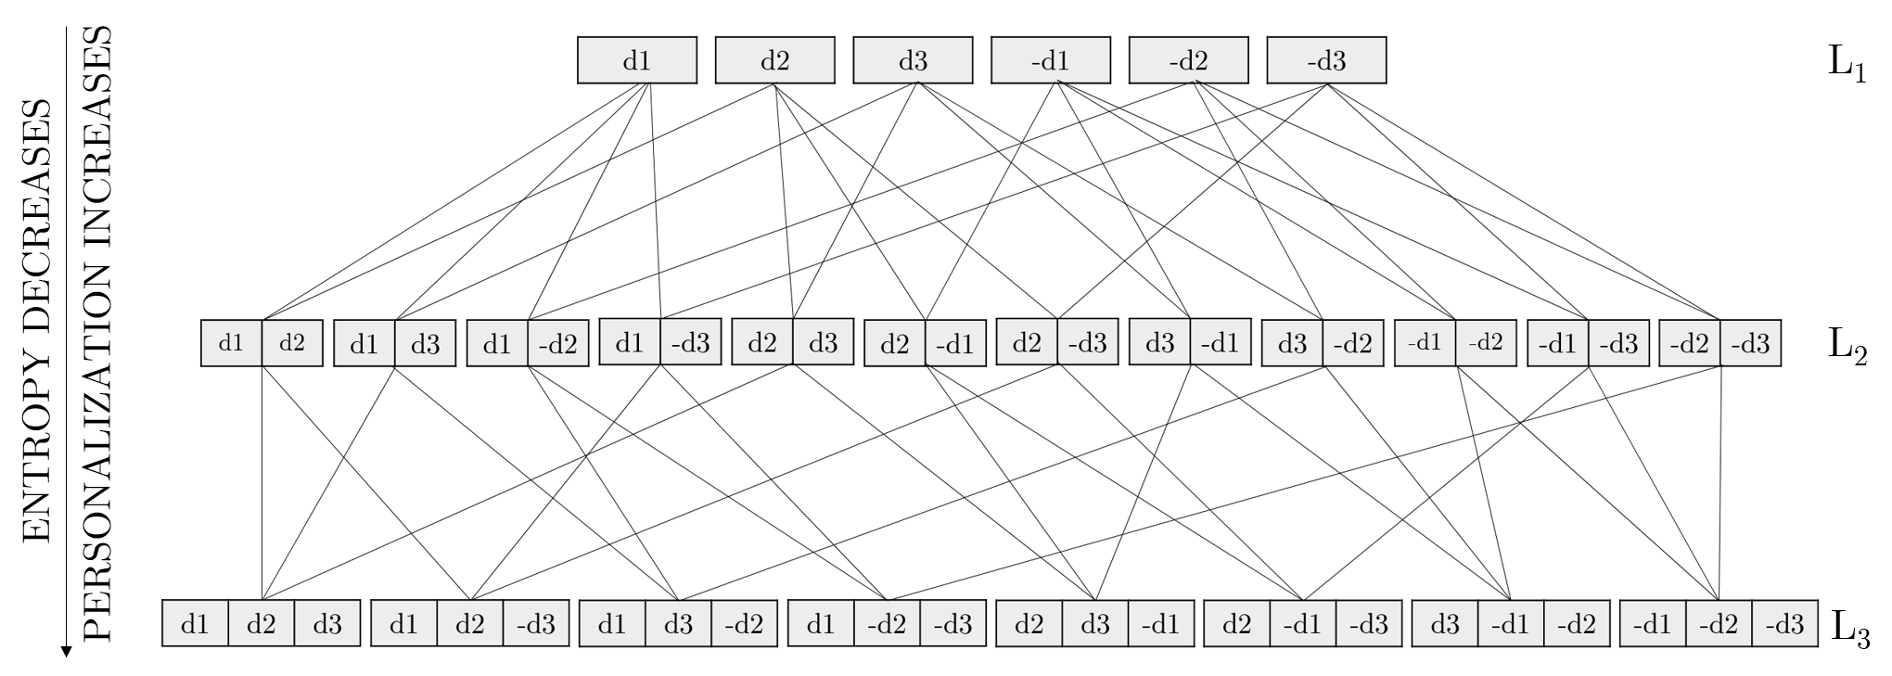
Rough Clustering - Implementation
.
.
.
Notes:
Constructing more combinations of the diagnostic codes enforces more personalization on the patients and as a result improves the predictability of the next procedure (the entropy decreases).

Slide 26
Rough Clustering - Filtering
Rough clustering generates a large number of clusters
Number of diagnoses = 283
Number of 1-element sets = 566
Number of 2-element sets = 159,612
Number of 3-element sets = 29,980,454
Number of clusters increases
ENTROPY INCREASES
ENTROPY INCREASES
ENTROPY INCREASES
NUMBER OF CLUSTERS
INCREASES
NUMBER OF CLUSTERS
INCREASES
Table 1. Number of clusters and entropy for different element sets and different ranges for procedure 158 (spinal fusion)
Notes:
In our approach of selecting t diagnostic codes candidates, we started by discarding the diagnostic codes that were either always or never evident in the set of diagnoses. Although this may seem counterintuitive at first, the reasoning behind doing so is rather logical.
if all patients have a common diagnosis, then this diagnosis will not play any role in
determining the state for which patients end up in.

Slide 27
Rough Clustering - Filtering
If all patients have a common diagnosis, then this diagnosis will not play any role in determining the state for which patients end up in.
We only considered diagnostic codes that lie within a specific range. For example, when we choose the allowed range to be between 20% and 80%, this means that we only consider diagnoses for which the number of patients that exhibit that diagnosis is between 20% and 80%.
This procedure is also applied to the excluded set, meaning that we only consider diagnoses that were missing from 20% to 80% of the total number of patients.
Number of clusters increases
ENTROPY INCREASES
NUMBER OF CLUSTERS
INCREASES

Slide 28
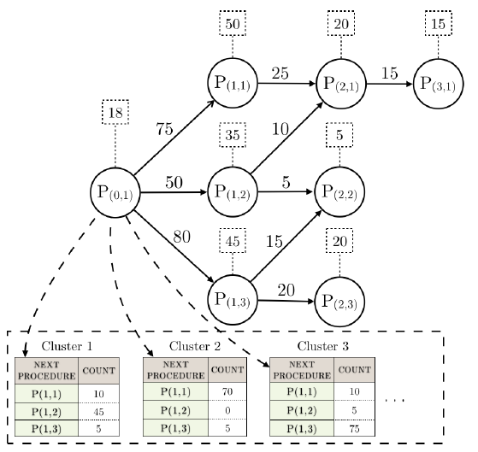
Rough Clustering – Procedure Graph
223
Notes:
The distribution of procedures in cluster 1 implies that if a new patient were to belong this cluster, then most likely he or she will undergo procedure P(1,2)

Slide 29
Scoring Function
We need a metric (score) system to evaluate the clusters that the patients belong to.
First: evaluate the procedures in the procedure graph
Second: evaluate the clusters

Slide 30
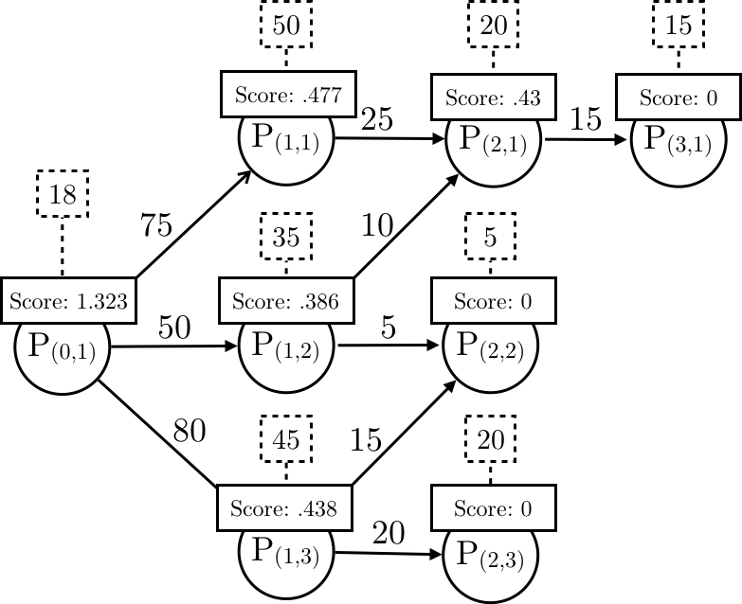
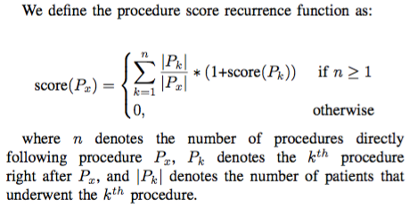
Calculating Procedure Graph Score
223
Notes:
This function assigns a score for each procedure in the procedure graph.
The score represent the average number of readmissions for patients at each procedure node.
The number 1.323 means that the patient will have on average 1.323 readmissions. Some may have more and some may have less.
Almost 58% of the patients who started P(0,1) had at least 1 readmission
Almost 8% didn’t return back
33% had at least 2 readmissions
6% had 3 readmissions
This function will reduce the effect of outliers

Slide 31
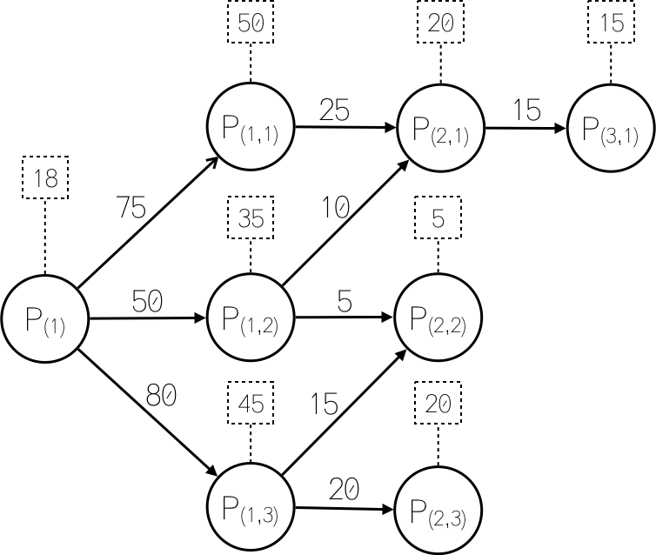
Calculating Procedure Graph Score
$Score$= 0
$Score\left(p(2,1)\right)=\left(\frac{20}{35}∗0\right)+\left(\frac{15}{35}∗(\text{1+}\text{cost}\text{(}P(3,1)))\right)$ = $\frac{15}{35}$ * (1+0)=0.43
$$Score\left(p(1,2)\right)=\left(\frac{35}{50}∗0\right)+\left(\frac{10}{50}∗(\text{1+}\text{cost}\text{(}P(2,1)))\right)+$$
$\left(\frac{5}{50}∗(\text{1+}\text{cost}\text{(}P(2,2)))\right)$= 0.386

Slide 32
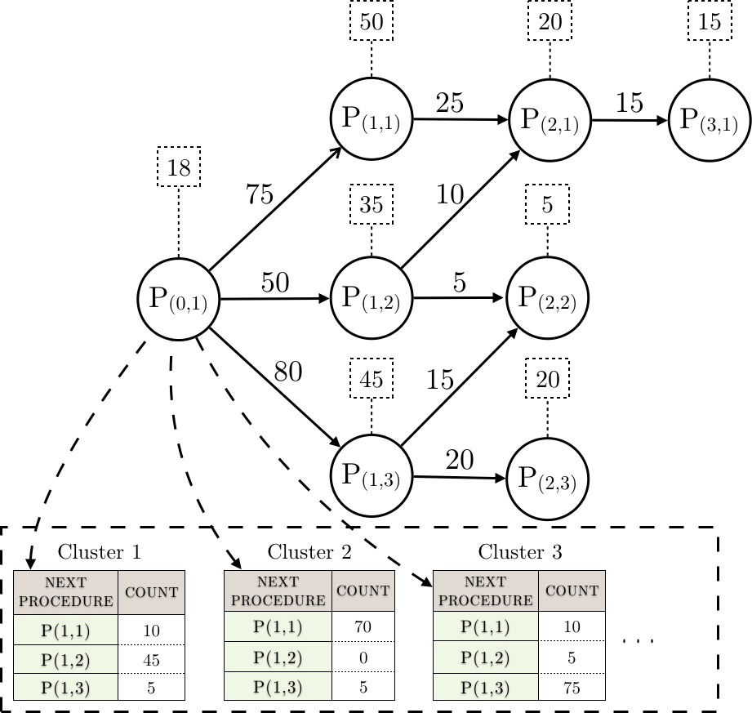
Calculating Clusters’ Score
Cluster 1$=\frac{10}{60}∗0.477+\frac{45}{60}∗0.386+\frac{5}{60}∗0.438=0.406$
Cluster 2$=\frac{70}{75}∗0.477+\frac{0}{75}∗0.386+\frac{5}{75}∗0.438=0.474$
Cluster 3$=\frac{10}{90}∗0.477+\frac{5}{90}∗0.386+\frac{75}{90}∗0.438=0.439$
0.4055
0.4744
0.4394
Cluster Score
Note: Lower score → more desired →less readmission
Notes:
The patients in each cluster share the same initial procedure, but they may differ in the next procedure
Therefore, the score of the cluster is defined as the sum of the weighted score of the procedures.
The most desired cluster is the one that has the minimum score.

Slide 33
Extracting Recommendations - Kidney Transplant
0.1136
0.5397
0.6149
Score
Clusters
{106}
{-53, -156}
{157}
{-3, -48}
{53, 106}
{-3}
Included/Excluded sets
No Recommendations
~ → 106
~ → -53
~ → -156
53 → -53
~ → -156
106 → 106
Recommendations
Fix diagnostic code 53 in patients from Green cluster who do not diagnostic code have 156
0.43
0.5
Readmission
Reduction
3: Bacterial infection, 48: Thyroid disorders, 53: Disorders of lipid metabolism, 106: Cardiac dysrhythmias, 156: Nephritis, nephrosis, renal sclerosis, 157: Acute and unspecified renal failure
Notes:
These are clusters extracted from patients who underwent procedure 105 (kidney transplant)
Based on the scores, the best cluster is the first one.
If the patient were to belong to the first cluster, then there are no recommendations to provide.
If the patient were to belong to cluster 2 or 3, then we can provide a set of recommendations to the physician to make the patient similar to the patients who belong to the first cluster.

Slide 34
Thank you

