Slide 1







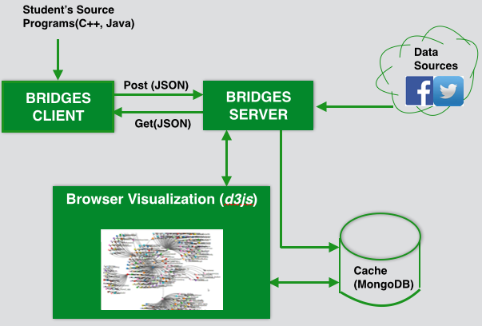
Building BRIDGES in Undergraduate Computer Science
K.R. Subramanian, Jamie Payton, Paula Goolkasian, David Burlinson, Mihai Mehedint, Chris Gafer ¹,
G. Michael Youngblood², Robert Kosara³
¹University of North Carolina at Charlotte | ²PARC | ³ Tableau Software
The Need to Increase Retention in CS
BRIDGES System Design
While enrollment in CS programs has been increasing, retention of CS majors remains a concern, especially at the freshmen/sophomore levels, with attrition rates of up to 66%. While the factors that motivate changing majors are many and varied, strategies to increase retention are crucial to increase the number of CS graduates.
Bridges<EarthquakeTweet> bridges =
new Bridges<Key, EarthquakeTweet>(1, "appl-id", "user@uncc.edu");
//retrieve a list of maxElements tweets
List<Tweet> TweetList = DataFormatter.getAssociations(new TwitterAccount("earthquake"), maxElements);
//convert to EarthquakeTweets (formatted with magnitude, location, date
List<EarthquakeTweet> EarthquakeTweetList =
DataFormatter.convertTweet (TweetList);
//adding tweets data to the BST tree using magnitude as key
root = buildBinarySearchTree(EarthquakeTweetList);
// provide BRIDGES a handle to the data structure
bridges.setDataStructure(root);
// visualize the tree
bridges.visualize();
Bridges Client
Post (JSON)
Bridges Server
Get(JSON)
The BRIDGES project aims to increase motivation, engagement,
and ultimately,
retention of CS majors
BRIDGES Viz Gallery (Browser)
Building BRIDGES to Increase Retention
Student’s Data Structure Implementation
BRIDGES (Bridging Real-world Infrastructure Designed to Goal-align, Engage, and Stimulate) targets retention of CS majors at the sophomore level, a particular point of vulnerability in our CS degree program.
The project introduces two key innovations:
the BRIDGES software infrastructure, which facilitates hands-on experience for solving traditional problems in CS using real-world information systems.
the use of peer mentoring in shared lab experiences between sophomore and senior students
BST Earthquake Tweets
Linked List of IMDB actor-movie pairs
Graph of IMDB actor-movie pairs for “Bacon number”
Results
We have piloted the use of the BRIDGES infrastructure in one section of a Data Structures course over 2 semesters. After each BRIDGES project assignment, we issued a survey for assessing attitudes and interests related to the assignment; selected results are below.
A release of the BRIDGES software infrastructure is available on GitHub for download. We are continuing to develop BRIDGES assignments and curricular materials. Stipends are available for instructors who are interested in using BRIDGES in data structures and algorithms courses. If you are interested in partnering with us on this CS education research project, please contact Dr. K.R. Subramanian at krs@uncc.edu.
For more information:
http://bridgesuncc.github.io
Take a Picture
Upload the picture to the server and Facebook
Invite other users to download the app and view the corresponding Facebook group page
BRIDGES assignment increased my interest in computing
BRIDGES assignment was relevant to my career goals
BRIDGES connects student programs to real-world data sets
Minimal client API so that sophomores can easily use BRIDGES to populate data structures
BRIDGES generates browser-based visualization for each execution of a student’s data structure implementation
Students can explore and share visualizations with friends and family
Easy install and configuration for instructors for classroom use

