Slide 1
How Do People Manage Their Digital Photographs?
PAPER BY:
KERRY RODDEN & KENNETH R. WOOD, CAMBRIDGE
PRESENTED BY:
SANDEEP GADI SURENDER

Slide 2
Synopsis
“How people manage their collection of personal digital photographs”?
Study Includes:
6 month – 13 participants study
Interviews and Questionnaire
Analysis of usage stats
‘Opinions’ Matter!
Shoebox and It’s features!
Difference in Managing Digital and Non digital photos
Results that suggest the design req. for Future Tools.

Slide 3
Introduction
Digital Cameras: Widely available, resulting large collection of digital photographs
Need for computer based systems to store these collection, browsing and retrieving.
Focus is on the personal photo collection than to the general-purpose collection.
Organizing and browsing digital photos compared to practices people follow for non digital photos.
Testing the usefulness of the system features.

Slide 4
Digital Photo Management Software:
Many commercial standalone and web-based tools are available.
Offer basic features like:
Thumb nail based: Organize, Label, View and Edit.
PhotoMesa:
Novel layout mechanisms, Best use of Screen space.
Fotofile and PhotoFinder:
Provide improved support for creating annotations.
PhotoTOC and AutoAlbum:
Clustering techniques for creating photo collection based on time stamp.

Slide 5
Digital Photo Management Software:
Digital Photo Management Software:
Graham & Colleagues:
Designed browsers with same functionality but different UI.
All these systems have been evaluated in small-scale experimental studies.
The base line:
“A simple chronologically ordered display of their photo collection”
This Paper is the only one which has published the field study, where as none were.

Slide 6
Introduction to The Shoebox System:
A digital photo management system.
Application for Organizing, Annotating, Indexing, Searching and Browsing images.
Developed at AT&T Laboratories Cambridge as part of DART project.
DART(Digital Asset Retrieval Technology):
Project concerned with management of digital media.
Text, Hypertext documents, image, audio and video recordings.
Aims to provide the means to index, annotate, navigate and retrieve diverse collections of these assets.

Slide 7
The Shoebox
The Shoebox System:
Essentially:
“A window graphical user interface on top of a object-oriented database designed for multimedia indexing”.
Provides conventional thumbnail based browsing tool:
Organizing, Labeling and Viewing.
As a research prototype has some additional features:
Audio Annotation capability:
Speech recognition is applied to audio annotations to generate a text transcript.
Image Analysis and Indexing tool:
Image segmentation is applied to generate indexing terms for content-based image searching.

Slide 8
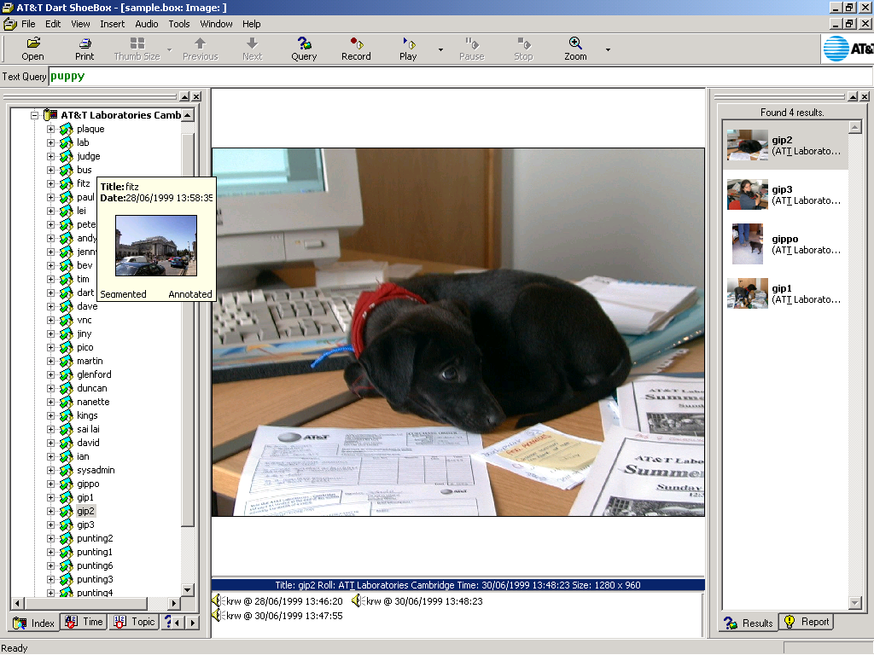

Slide 9
Browsing
It’s a very basic and important feature of any Photo Management Software.
Shoe box has several ways of Browsing:
1. Roll view
2. Timeline view
3. Topic view

Slide 10
Browsing > Roll view
For very quick browsing uses tooltips.
Tooltips:
Tool tip is a window that appears when cursor hovers on a item
Roll tooltips: Displays the source of the images
Photograph tooltips: Displays time, date, thumbnail of photograph and whether the photo is segmented or annotated
Annotation tooltips:
Display the name of the annotator, date and time when the annotation was made.
Text and Speech-recognized audio annotations display up to 5 nouns from the annotation.
Audio annotations audio is played on hover.

Slide 11
Browsing > Timeline view
Provides chronological navigation of photographs.
Groups photos as a calendar view or in date clusters where photos taken on consecutive days are grouped by month and year.

Slide 12
Browsing > Topic view
We create hierarchy of compound nouns extracted from the annotation text or speech transcripts.
This view gives a textual overview of the contents of the photo collection
Selecting a term from index will retrieve all photos containing them.

Slide 13
Searching
Two Primary methods for Searching:
Text and Speech Indexing:
Conventional full text indexing of roll and photograph titles, text annotations and automatic speech recognition transcripts of audio annotations.
Image Indexing:
Whole image and region based image retrieval to provide searching by visual similarity.

Slide 14
Text and Speech Indexing:
General:
Digital cameras with audio recording facility!
Quality not sufficient for adequate speech recognition
Users tendency to speak in informal conversational manner!
In Shoebox:
Audio annotations are done using a close talking headset microphone.
Entropic Truetalk Transcriber is used as a speech recognition engine.
Sophisticated
Has Trigram language model (using 60k vocabulary)
Has appropriate acoustic models for British english

Slide 15
Text and Speech Indexing:
The transcripts generated are stemmed using Porter stemmer
Indexing with the inverted-file index with position information to allow phrase searching
Search?
User enters the text query
Results are shown in the side panel
Any stop words are highlighted in green
Unfound words are marked in red

Slide 17
Image Indexing
As an alternative to the previous methods
Visual searching via image content analysis
Problems associated with Image search:
What properties suits for Image comparison?
What distance measures correspond to human perception?
How do we perform comparison quickly?
How to formulate the queries?
How Shoebox will answer these??

Slide 18
Image Indexing
Image Indexing
Properties:
Both Local and Global properties are investigated
Global: Properties are derived from image as whole
Local: Properties derived from regions within image
Properties extracted include: color, texture, spatial location and shape properties
These properties will facilitate, its easy to differentiate between the images or regions described

Slide 19
Image Indexing
Distance Measures:
The choice of the distance function should reflect the human perception
Similar vectors correspond to perceptually similar images or regions
Non-metric distance functions yield better results than metric distances (Euclidean Distance)
But non-metric distances prevent use of multidimensional index structures such as M-Tree
This makes it difficult to achieve high speed retrieval

Slide 20
Image Indexing
Query Formulation:
User must provide a starting image and request that the system finds similar images
If Local image properties are used?
User should select some regions from the starting image
Region Based Indexing and Global Color Histograms
Recent works suggest that Region Based Indexing performs as well as or better than Global Color Histograms
Here, region segmentation is used as an approximation to identify objects within the image

Slide 21
Image Indexing
Images are divided into a grid and computing image properties for these regions
Shoebox utilizes some computationally fast segmentation schemes.
Grid Segmentation
Simply divides image in an 8 by 8 grid
Voronoi Segmentation
Color based segmentation on an image thumbnail
Voronoi Grid Segmantation
Output of Voronoi is futher segmented using 8 by 8 grid

Slide 22
Image Indexing
Grid Segmentation
Voronoi Segmentation
Voronoi Grid Segmentation

Slide 23
Image Indexing
Now, two indexing schemes are applied extracted the feature vectors.
M-Tree with Euclidean Distance:
M-Tree doesn't suffers from any quantization problems
But slow when compared to B-Tree
Use of B-Tree though has quantization problems, makes image retrieval as fast as conventional text-retrieval
Feature vector is quantized coarsely and corresponding values are used as “words” in the inverted index

Slide 24
Our Study
We have two major research questions:
How do people organize and browse their collections of digital photos, and how do their practices compare to those used for their non-digital collections?
Is advanced multimedia processing (speech recognition and content-based image retrieval) useful in the context of personal photo collections?

Slide 25
Our Study
Thirteen Participants, 8 male and 5 female (24-38 age)
They were the employees at AT&T Laboratories Cambridge, volunteered to take part in study
Of 13: 8–Research staff, 3-Support engineers and
3-Administrative staff
Goal:
“to gain some initial insights into our research questions”
Estimated size of the participants’ existing (non-digital) collections ranged from 300 to 3000 pictures, with an average of about 1000

Slide 26
Our Study
Study carried out for 6months during spring/summer 2000
Participants were given Digital cameras and asked to start taking photos with them.
They received a version of Shoebox that was instrumented to record their actions in log files, which allowed us to measure how frequently different features were used!
In addition, they were interviewed twice, at the beginning and end of the study.

Slide 27
Our Study > First Interview
Took place after about the first month of usage
Participants were asked about their existing non-digital collections, so that their organizing and browsing practices could be compared with their digital collections
They were also briefly asked for their first impressions of digital photography and Shoebox
Participants also filled in two questionnaire sheets:
1 Q: To indicate their level of agreement or disagreement with a series of statements about their non-digital photo collections
2 Q: To indicate how useful they found each of a given set of Shoebox’s features
All questionnaire items used a seven point scale.

Slide 28
Our Study > Second Interview
Took at the end of the study
Participants were asked in more detail about their digital collections
Participants were also asked for their final verdict on Shoebox
Participants also filled in two questionnaire sheets:
1 Q: Asked them to indicate their level of agreement or disagreement with a series of statements about their digital photo collections -- The aim was to compare the participants’ opinions about their non-digital and digital collections
2 Q: Filled in the same Shoebox questionnaire used in the first interview -- to establish whether their opinions about its features had changed in the course of the study

Slide 29
Results and Discussion!
Concentrates mostly on qualitative findings and a very few selected quantitative.
Questionnaire responses are summarized in tables, giving the mean and median rating (Scale of 0 to 6)
Tables include the items where there is a significant difference in first and second interview
Also includes some quotes from transcriptions of the second interview
They represent the participants’ opinion
Identifier next to indicate the participants’ job:
R-Research, S-Support and A-Administration

Slide 30
Organizing Photographs > Non Digital Photos
Almost all of our participants had attempted to organize their prints by putting them into albums, and the prints may be kept for a long time in their original packets.
Usually only the “good” photos are placed into albums
Some participants throw the bad prints away, but others keep them in the original packets
Albums are mostly classified by specific events, such as holidays, often with one album per event
Within an album, the photos are usually kept in chronological order, with perhaps some small adjustments
When left in their packets, prints are usually kept in the original chronological order

Slide 31
Organizing Photographs > Digital Photos
Some participants separated them into folders (known as rolls in Shoebox) according to event
While others simply imported the entire contents of the camera’s flash memory into a single roll
The roll may contain photos of a number of different events, as is often the case with conventional film.
By default, the photos within a roll appear in chronological order, using the time stamps on the files.
R2: “I take a load of photos, and then I download them and I put them in a folder, and I label that with the date that I download it on, and that gives me as much organization as I want, really.”

Slide 32
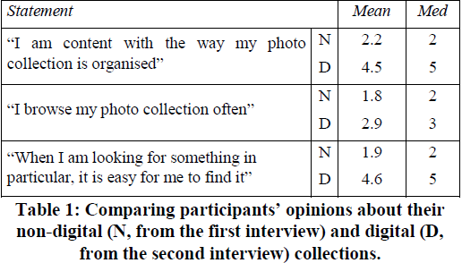
Organizing Photographs
Table 1 shows that participants said they were significantly more content with the organisation of their digital collections than their non-digital ones

Slide 33
Organizing Photographs > Annotations
Some said that they occasionally write notes (Such as names, places and dates) at back of prints
It will be like a remainder and as a guide to the people who inherit these photos
Others they just write broad titles on the album or packet as an indication of what the collection is
In Shoebox:
Rolls and Photos have name: by default these are the names from which they are imported
Longer descriptions can also be entered as text annotations(2 p) or Spoken annotations(8 p)

Slide 34
Organizing Photographs > Annotations
Digital photos doesn’t require the date to be recorded as they are time stamped by camera
When the photos are recent, these details are still fresh in the photographer’s mind, and therefore recording them may not seem worth the effort.
R3 : “That’s [my wife] and [son] with some foliage behind them, and if I just saw that on its own, I wouldn’t have a clue where it was, it would need to be annotated, but because it’s after a picture of the two French friends, and before the picture of [my son] on the Normandy beach, then I know that this is the botanic gardens in Cherbourg.”

Slide 35
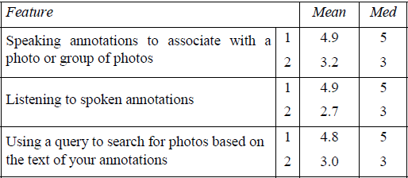
Organizing Photographs > Annotations
Comparison of Participants ratings of usefulness of the selected Shoebox features
Table 2
1: First Interview
2: Second Interview

Slide 36
Organizing Photographs > Annotations
From table 2:
Ratings for recording and listening to spoken annotations fell significantly over the course of the study
Opinion was divided on the usefulness of spoken annotations in principle
Some participants definitely disliked the idea
Others expressed enthusiasm for the facility, saying that it was easier to speak annotations than type them
All of the participants who tried Shoebox’s speech recognition facility
They felt that the level of inaccuracy was unacceptably high

Slide 37
Organizing Photographs > Annotations
A1 : “It gets the gist of most of it, apart from, the trouble is that you want it to recognize things like people’s names, and place names, because that's normally the core of it.”
Most participants considered it pointless to make spoken annotations without accurate speech recognition
Two participants mentioned that although they might not want to record spoken annotations for themselves, they could later be very special to children or grandchildren

Slide 38
Browsing and Querying Photographs
Within Shoebox, the user can browse through photos in thumbnail form, selecting individual ones to be displayed at full size
Shoebox can also set up a slide show to display a series of photos one after the other
The slide show facility was used at least once by all but two of the participants
Three basic types of requirements when searching a collection:
The set of photos from a particular event, e.g. a holiday
An individual remembered photo
A set of photos taken at different events, but all sharing a property, such as containing a certain person

Slide 39
Searching Non-Digital Photographs
Finding the photos of a particular event, the most common requirement, is relatively easy
Participants said they might remember the physical appearance of the right album or packet, and use this as a search clue
Occasionally, they want to search for a particular photo
Searching is made more difficult if the albums, packets, or photos are out of chronological order
If photos have been given to other people, or filed away elsewhere
Organisation involves effort

Slide 40
Searching Digital Photographs
Digital photos do not usually have any of these problems
They are automatically be sorted in chronological order, using their timestamps
They are easy to divide into named folders, such as Shoebox’s rolls
So that finding photos taken at a particular event is then simply a case of remembering which folder they are in

Slide 41
Searching Digital Photographs
Thumbnail view:
Shoebox can reduce the photos in a folder to thumbnail size
This allows a large number of them to be viewed at the same time, so that the user can scan them very quickly
Table 1 shows that the participants thought it was significantly easier to find what they were looking for in their digital collections than in their non-digital ones
This ease of browsing is another reason why participants felt that their digital collections were more organized than their non-digital collections

Slide 42
Searching Digital Photographs
A2 : “I wasn’t organized at all before, and if I did have any photos in any kind of album […] you’d have to remember maybe a particular color: “oh yes, those photos, they were in that red album”, or something like that. But here, obviously there’s a little title to every roll: “Holiday in Italy”, so you know. And then also when you click on it and then you see all the little thumbnails, just scroll down and you can pick out the photo straight away, so that’s really easy. […] I feel super-organized; I know exactly where a photograph is, and I can find it straight away, it’s really good.”

Slide 43
Searching Digital Photographs
Having the collection in chronological order is helpful for locating particular photos or events
Because it is easier to remember when an event occurred relative to other events, than to remember its absolute date and time
R3: “I’m browsing for an event, that I roughly know when it is, even if I just know relatively when it was compared with other events, I might not know the date, but I can quickly zoom through and find them.”

Slide 44
Searching Digital Photographs
The participants rarely wanted to find photos of requirement like the presence of a particular person in the picture
Satisfying this type of requirement is a tedious task in both non-digital and digital collections
Chronological ordering or classification by event does not help much
This task is probably easier with digital photos, since a large number of thumbnails can be assessed at once

Slide 45
Searching Digital Photographs
Usage of the Visual content based search:
Table 3

Slide 46
Querying
A system for managing personal digital photos should enable users to specify search criteria in a query
It should compare it to all of the items in the collection, and retrieve those that match
Annotations assigned to digital photos can be indexed, allowing the user to construct queries using words from the annotations
Something which cannot be done with (Non Digital photographs) handwritten notes on the back of prints

Slide 47
Querying > Text Annotations
At the beginning of the study, it’s expected that having text queries available would make the participants more likely to create annotations
They made very few annotations (either typed or spoken), and without these, text based queries were impossible
Participants’ ratings of all of Shoebox’s query facilities (text-based query, visual query-by example, and visual region query) dropped significantly over the course of the study (Table 2 and 3), and its browsing facilities were used far more frequently
The six participants who had used queries all said that they had done so just to play with them

Slide 48
Querying > Text Annotations
R5 : “I haven’t queried them, because probably I don’t have too many pictures, and they’re in, to me, a logical looking order. Getting back to them is quite easy.”
R8 : I don’t know, even if I could say “find all the photos of [my husband]”, which I probably can’t, I wonder if I’d ever use that. I don’t know, I’ve never thought, “oh, I wish I had that”.
Like annotations, queries might seem more important as a collection grows, and the photos get older and less familiar

Slide 49
Querying > Text Annotations
If only part of the collection has been annotated, queries will only return results from that part, giving a disappointingly low level of recall
A2: “I know that if I put some annotations in and then I
call them up [with a query], I won’t be calling them all
up because I haven’t annotated all of them. So then it
annoys me.”

Slide 50
Querying > Spoken Annotations
Names of people are likely to be common query terms, in order to retrieve all of the photos depicting them
Some times the annotator might neglect to mention names that are obvious to her and any family and friends
e.g.: “This is us at our hotel in Venice”
May use names inconsistently
e.g.: “David Smith might be referred to as “Dave”, “David”, “Dave S””

Slide 51
Querying > Other Systems
The FotoFile and PhotoFinder:
Allow the user to explicitly define her own set of keywords, such as names of people or places
Assign them to the photos to which they apply
The keywords then become virtual categories
When the user selects one, the photos that have been assigned that keyword are displayed
Retrieving all of the photos containing a particular person, then, is simply a case of selecting his or her name from the list

Slide 52
Querying > Visual queries
Visual queries can be used to specify general requirements involving visual properties of photos
At the first interview:
Many of the participants had still to try visual queries
Had unrealistically high expectations of them
Shoebox understandably did not live up to these!!
Explaining some of the drop in ratings for this feature
Even participants who tried visual queries with more realistic expectations (based primarily on color) found that the results were disappointing

Slide 53
Querying > Visual queries
R6 : “What it considered to be similar was rarely what I considered to be similar. I deliberately, when I got my
new car, I took a lot of photos of that, and I thought, right, it’s blue, it’s big, it’s very obvious… and it missed
loads of them, it only pulled up a very small handful of the car, which, I don’t know anything about the subject,
but it looked like quite an easy job to me. […] I just found it to be pretty much useless, I’m afraid. But also,
partly, I just didn’t really know what was going on, and how I could improve on what I was getting.”

Slide 54
Querying > Visual queries
Many of the participants simply realized that they had never wanted to use visual queries during the study
Only five had tried using them, and lowered their ratings for this reason.
When prompted, they could not think of occasions when visual queries might be useful to them
So even if Shoebox’s visual query tools had performed well for realistic requirements, they would probably not have been used much more often.
R2 : “I didn’t think it would come up with matches that I
would actually be interested in. There just seemed to be
more obvious ways of finding photos.”

Slide 55
Findings from the Study
Current image processing techniques cannot consistently extract enough semantics to be useful
Further advances in which allow photos to be automatically tagged with keywords indicating the presence of recognized objects, will be helpful
Kuchinsky et al: “If the user could select a person’s face,
provide a name for them, and then have the system recognize
and tag other photos in which that person appears, this could
potentially be a very useful feature, integrating automation
with the user’s own annotations”

Slide 56
Findings from the Study
It is likely easier to use a browsing strategy to recognize a familiar photograph, than attempt to construct a visual query from memory
Techniques developed for content-based image retrieval could instead be used to support browsing, automatically organizing thumbnails according to their visual similarity, using clustering or visualization algorithms
In the previous work it’s found that such layouts are a promising alternative to queries as a way of searching a general-purpose photo collection
Shoebox study found it difficult to imagine situations when they would want to look for personal photos in this way

Slide 57
Other Findings: Taking and Using Photographs
This study has also helped to find how the participants photo taking practices are effected while switching to the digital camera
The participants were much more prolific in taking photos after starting to use a digital camera
By the end of the study, the approximate size of participants’ digital photo collections ranged from
200 to 1000, with an average of about 500
Which was half the average size of their existing non-digital collections, showing per participant, the proportion ranged from 20% to 200%

Slide 58
Other Findings > Taking and Using Photographs
It costs nothing to take a digital photo, so the participants often took several digital photos where they would only have taken one with a conventional camera
With digital cameras, people are more willing to take “risky” photos , because if the picture does not turn out as intended, they have lost nothing
A3: “My daughter’s now got to the point where, if
someone gets a camera out, [she says] “can I see the
picture?” She hasn’t figured out that not all cameras
can show you the picture now.”

Slide 59
Other Findings > Taking and Using Photographs
Many participants had taken only digital photos during the study
Copying a digital photo is trivial compared to copying a print, and this may make people more likely to share their pictures
Almost all of the participants had sent small numbers of photos via e-mail, and some had created special web pages to make larger sets available
All of the participants still wanted to have prints of some photos for certain purposes
Several participants felt that not being forced to have a print of every photo was a definite advantage of digital photography.

Slide 60
Participant’s opinions about Shoebox
Shoebox crashed occasionally
Few said: “Even if it had been completely reliable, however, they would not have invested much more time and effort in organizing their collections”
A number of participants said:
“They were impressed by Shoebox’s speed and power, especially for fundamental functions like displaying thumbnails, and some said that they would continue using it for these reasons”
When asked about extra features to contain:
“Three participants said that it already had too many, suggesting that they would have preferred stability to be more of a priority than range of features”

Slide 61
Conclusions
One should ensure a system is efficient, reliable, and well-designed
Two important features that can be provided very easily:
Automatically sorting photos in chronological order
Displaying a large number of thumbnails at once
Browsing was more convenient than Text/Speech annotations
Shoebox’s more advanced multimedia features were not used very often
To be more useful in this domain,
Speech recognition would need to be far more reliable
Content-based image retrieval need to give meaningful results

Slide 62
References
DART Project, AT&T Laboratories Cambridge,
http://www.uk.research.att.com/dart/
Shoebox: A digital photo management system - Mills, Pye, et al. – 2000
How do people organize their photographs - Rodden – 1999
And others…

Slide 63
Thank you ! ☺

