Slide 1
ITCS 6190- Cloud Computing for Data Analysis CLUSTERING
FALL 2020

Slide 2
CLUSTERING DEFINITION
Clustering, is an unsupervised machine learning task that is machine learns on its own using the data.
(learning set), and will classify the objects into a particular class.
It involves automatically discovering natural grouping in data. Unlike supervised learning (like
predictive modeling), clustering algorithms only interpret the input data and find natural groups or
clusters in feature space.
It is helpful in Data Analysis, Image recognition, market research and many more.

Slide 3
TYPES OF CLUSTERING
5 Types of Clustering Algorithms:
Partitioning Clustering
Hierarchical clustering
Density-based clustering
Model-based clustering
K Means clustering

Slide 4
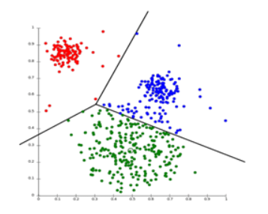
PARTITIONING CLUSTERING
It is a type of clustering technique, that divides the data set into a set groups. It can also be called as a centroid based method.
In this approach cluster [centroid] is formed such that the distance of data points in that cluster is minimum when calculated with other cluster centroids.

Slide 5
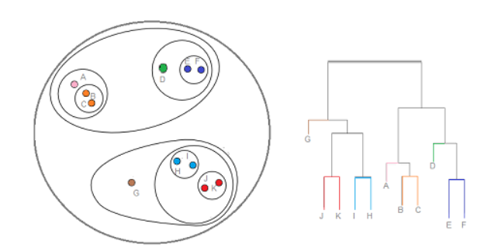
HIERARCHICAL CLUSTERING
It is a type of clustering technique, that divides the data set into a number of clusters, where the user doesn’t specify the number of clusters to be generated before training the model.
This type of clustering technique is also known as connectivity based methods
In this approach, simple partitioning of the data set will not be done, whereas it provides us with the hierarchy of the clusters that merge with each other after a certain distance.

Slide 6
DENSITY BASED CLUSTERING
Clustering based on density (local cluster criterion), such as density-connected points or based on an explicitly constructed density function
Major features:
Discover clusters of arbitrary shape
Handle noise
One scan
Need density parameters
Density-Based Spatial Clustering and Application with Noise (DBSCAN) - most used
Minimum number of points that contain in the neighbourhood of a given radius for each point in the cluster

Slide 7
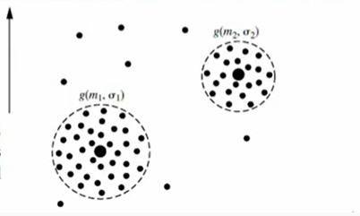
MODEL BASED CLUSTERING
Use probabilistic distributions to create cluster Ex. Mixture Models
Optimize the fit between data and mathematical model
Techniques
Conceptual Clustering
Neural Network Approach
Expectation-Maximization (EM) clustering using Gaussian Mixture Models (GMM)

Slide 8
K-MEANS CLUSTERING
Unsupervised Learning Algorithm
Classifies dataset through a certain number of clusters
A centroid-based algorithm, or a distance-based algorithm
Assumes k- clusters
Each cluster is associated with a centroid
Each point is assigned to the cluster with the closest centroid
Tries to minimize the sum of distances between the points and their respective cluster centroid

Slide 9
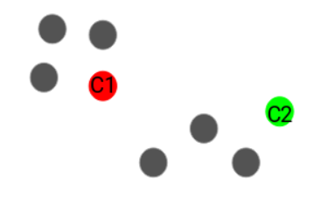
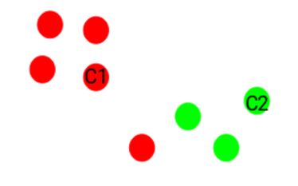
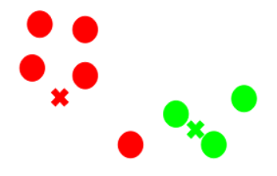
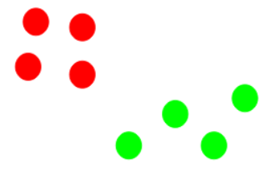
STEPS INVOLVED IN K-MEANS CLUSTERING
Steps involved in K-Means Clustering
Step 1: Choose the number of clusters - k
Step 2: Select k random points from the data as centroids
Step 3: Assign all the points to the closest cluster centroid
Step 4: Recompute the centroids of newly formed clusters
Step 5: Repeat steps 3 and 4
Step 6: Stopping criteria
Centroids of newly formed clusters do not change
Points remain in the same cluster
Maximum number of iterations are reached
Step 2
Step 3
Step 2
Step 3
Step 4
Step 4
Step 5

Slide 10
ADVANTAGES OF K-MEANS CLUSTERING
Easy to implement
Scales to large datasets
K-Means may produce tighter cluster than hierarchical clustering
An instance can change cluster when the centroids are re-computed

Slide 11
DISADVANTAGES OF K-MEANS CLUSTERING
Difficult to predict the number of clusters (K-Value)
Initial seeds have a strong impact on the final results
The order of the data has an impact on the final results
Sensitive to scale: rescaling the datasets (normalization or standardization) will completely change results

Slide 12
CLUSTERING EVALUATION STRATEGIES
Clustering Tendency
Before evaluating the clustering performance, we should make sure that data set we are working has clustering tendency and does not contain uniformly distributed points is very important.
Hopkins test: can be used to measure the probability of data points generated by uniform data distribution. (Null Hypothesis (Ho), Alternate Hypothesis (Ha))
If H>0.5 : null hypothesis can be rejected and it is very much likely that data contains clusters.
If H is more close to 0, then data set doesn’t have clustering tendency.

Slide 13
CLUSTERING EVALUATION STRATEGIES
Number of Optimal Clusters, k
There are two major approaches to find optimal number of clusters:
Domain knowledge : Domain knowledge might give some prior knowledge on finding number of clusters
Data driven approach : If the domain knowledge is not available, mathematical methods help in finding out right number of clusters.
Clustering quality
Extrinsic Measures which require ground truth labels.
Intrinsic Measures that does not require ground truth labels.

Slide 14
Clustering Algorithm Applications
Search Engines
Clustering algorithm is the backbone behind the search engines.
Search engines try to group similar objects in one cluster and the dissimilar objects far from each other. It provides result for the searched data according to the nearest similar object which are clustered around the data to be searched.
Hence, the definition of similar object play a crucial role in getting the search results, better the definition of similar object better the result is.
Identifying cancerous data
Initially we take known samples of cancerous and non cancerous data set. Label both the samples data set. We then randomly mix both samples and apply different clustering algorithms into the mixed samples data set and accordingly check the result for how many data set we are getting the correct results and hence we can calculate the percentage of correct results obtained.

Slide 15
Other Clustering Algorithm Applications
Marketing and Sales
Spam Filter
Identifying fraudulent or criminal activity
Classifying network traffic
Fantasy Football and Sports
Document analysis
Identifying Fake News

Slide 16
THANK YOU!

