Slide 1
LARGE-SCALE DATA ANALYSIS WITH APACHE SPARK
ALEXEY SVYATKOVSKIY

Slide 2
OUTLINE
This talk is intended to give a quick intro to the Spark programming model, give an overview of using Apache Spark on Princeton clusters, as well as explore it’s possible applications in the HEP
INTRO TO DATA ANALYSIS WITH APACHE SPARK
  SPARK SOFTWARE STACK
  PROGRAMMING WITH RDDS
  SPARK JOB ANATOMY: RUNNING LOCALLY AND ON A CLUSTER
  PRINCETON BIG DATA EXPERIENCE
REAL-TIME ANALYSIS PIPELINES USING SPARK STREAMING
MACHINE LEARNING LIBRARIES
  ANALYSIS EXAMPLES
SUMMARY AND POSSIBLE USE CASES IN HEP

Slide 3
WHAT IS APACHE SPARK
APACHE SPARK IS A FAST AND GENERAL PURPOSE CLUSTER COMPUTING FRAMEWORK FOR LARGE-SCALE DATA PROCESSING
  IT BECAME A DE-FACTO INDUSTRY STANDARD FOR DATA ANALYSIS, REPLACING MAPREDUCE COMPUTING ENGINE
  MAPREDUCE ENGINE IS GOING TO BE RETIRED BY CLOUDERA - A MAJOR HADOOP DISTRIBUTION PROVIDER – STARTING THE VERSION CDH5.5
SPARK DOES NOT USE THE MAPREDUCE AS AN EXECUTION ENGINE, HOWEVER, IT IS CLOSELY
INTEGRATED WITH HADOOP ECOSYSTEM AND CAN BE RUN VIA YARN, USE THE HADOOP FILE FORMATS, AND
HDFS STORAGE
ON THE OTHER HAND, IT CAN BE USED IN A STANDALONE MODE ON ANY HPC CLUSTERS
  E.G. VIA SLURM RESOURCE MANAGER AS IT IS DONE AT PRINCETON
SPARK IS BEST KNOWN FOR ITS ABILITY TO PERSIST LARGE DATASETS IN MEMORY BETWEEN JOBS
SPARK IS WRITTEN IN SCALA, BUT THERE ARE LANGUAGE BINDINGS FOR PYTHON, SCALA, AND JAVA

Slide 4
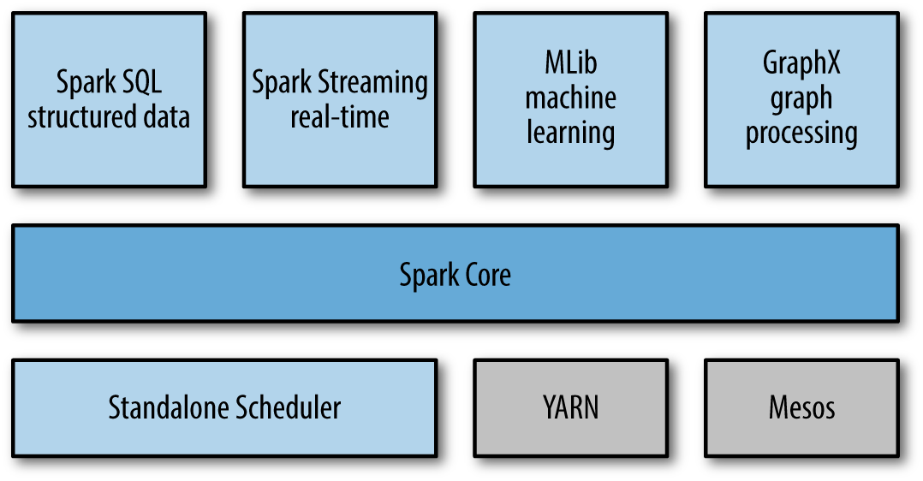
Red color: Specific to Princeton clusters
Spark R
Available
starting Spark 1.5
SPARK SOFTWARE STACK
HEP use case: possibility to run ROOT in a distributed way using Spark RDDs?
 | GPFS
Interconnect:
Read: Distributed Pandas Dataframe
Supports
Kafka, Flume sinks
Storage:
Infiniband
NFS
10g ethernet
HDFS
Cassandra
Use SLURM on general purpose HPC clusters
Use on Hadoop cluster
https://www.princeton.edu/researchcomputing/computational-hardware/hadoop/ https://www.princeton.edu/researchcomputing/computational-hardware/machine-2/

Slide 5

PROGRAMMING WITH RDDS (I)
RDDS (RESILIENT DISTRIBUTED DATASETS) ARE READ-ONLY PARTITIONED COLLECTIONS OF OBJECTS
EACH RDD IS SPLIT INTO PARTITIONS WHICH CAN BE COMPUTED ON DIFFERENT NODES OF A CLUSTER
PARTITIONS DEFINE THE LEVEL OF PARALLELISM IN A SPARK APP: IMPORTANT PARAMETER TO TUNE!
CREATE AN RDD BY LOADING DATA INTO IT, OR PARALLELIZING EXISTING COLLECTION OF OBJECTS (LIST, SET…)
•
When data has no parent RDD/input file the # of partitions is set according to the total number of cores on nodes which run executors on them.
Spark automatically sets the # of partitions according to
the number of file system block the file spans over. For reduce tasks, it is set according to the parent RDD
See “Learning Spark” to get started: https://github.com/holdenk/learning-spark-examples

Slide 6
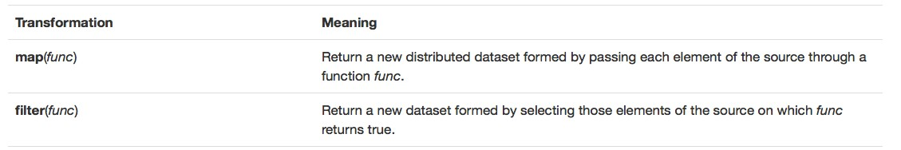
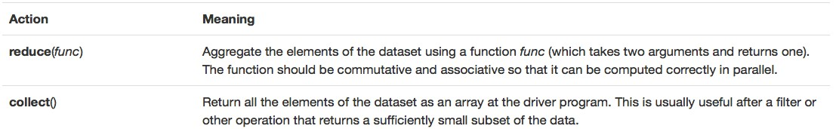
PROGRAMMING WITH RDDS (II)
TRANSFORMATIONS: OPERATIONS ON RDD THAT RETURN A NEW RDD. THEY DO NOT MUTATE THE OLD RDD, BUT RATHER RETURN A POINTER TO IT
Similar to Pythonic map,
filter and reduce syntax, except operator chaining is allowed in Spark.
I use lambda-functions
ACTIONS: ACTIONS FORCE PROGRAM TO PRODUCE SOME OUTPOUT (NOTE: RDDS ARE LAZILY EVALUATED)
most of the time
LAZY EVALUATION: RDD TRANSFORMATIONS ARE NOT EVALUATED UNTIL AN ACTION IS CALLED ON IT
PERSISTANCE/CACHING: UNLIKE MAPREDUCE, WHERE MAKING AN INTERMEDIATE RESULT OBTAINED ON THE ENTIRE DATASET AVAILABLE TO ALL NODES WOULD ONLY BE POSSIBLE BY SPLITTING THE CALCULATION INTO MULTIPLE MAP-REDUCE STAGES (CHAINING) AND PERFORMING AN INTERMEDIATE SHUFFLE
  CRUCIAL FEATURE FOR ITERATIVE ALGORITHMS LIKE, FOR INSTANCE, K-MEANS

Slide 7
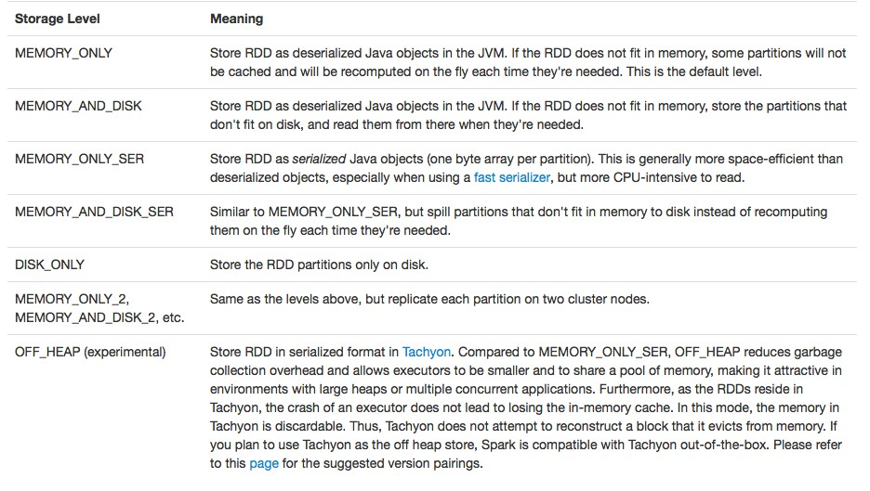
PROGRAMMING WITH RDDS (III)
SPARK ALLOWS TO PERSIST DATASETS IN MEMORY AS WELL AS MEMORY/DISK (SPLIT IN A SPECIFIED PROPORTION CONTROLLED IN CONFIG)
PYSPARK USES CPICKLE FOR SERIALIZING DATA
From Spark Manual

Slide 8
ANATOMY OF A SPARK APP: RUNING ON A CLUSTER (I)
SPARK USES MASTER/SLAVE ARCHITECTURE WITH ONE CENTRAL COORDINATOR (DRIVER) AND MANY DISTRIBTUED WORKERS (EXECUTORS)
DRIVER RUNS ITS OWN JAVA PROCESS, EXECUTORS EACH RUN THEIR OWN JAVA PROCESSES
FOR PYSPARK, SPARKCONTEXT USES PY4J TO LAUNCH A JVM AND CREATE A JAVASPARKCONTEXT
  EXECUTORS ALL RAN IN JVMS, AND PYTHON SUBPROCESSES (TASKS) WHICH ARE LAUNCHED COMMUNICATE WITH THEM USING PIPES
For Java/Scala (JVM) languages
Worker node/container
For Python
Worker node/container
Executor
Cache
Driver program
Executor,
in JVM
Cache
Driver program
 | SparkContext
Task
Task
Pipes
Cluster manager
SparkContext
Cluster manager
Subpr Subpr
Worker node/container
 | Executor | Cache
 | Task |  | Task
Worker node/container
Py4J launches JVM
Executor, in JVM
Cache
SparkContext
Pipes
See more here:
Subpr
Subpr
https://cwiki.apache.org/confluence/display/SPARK/PySpark+Internals

Slide 9
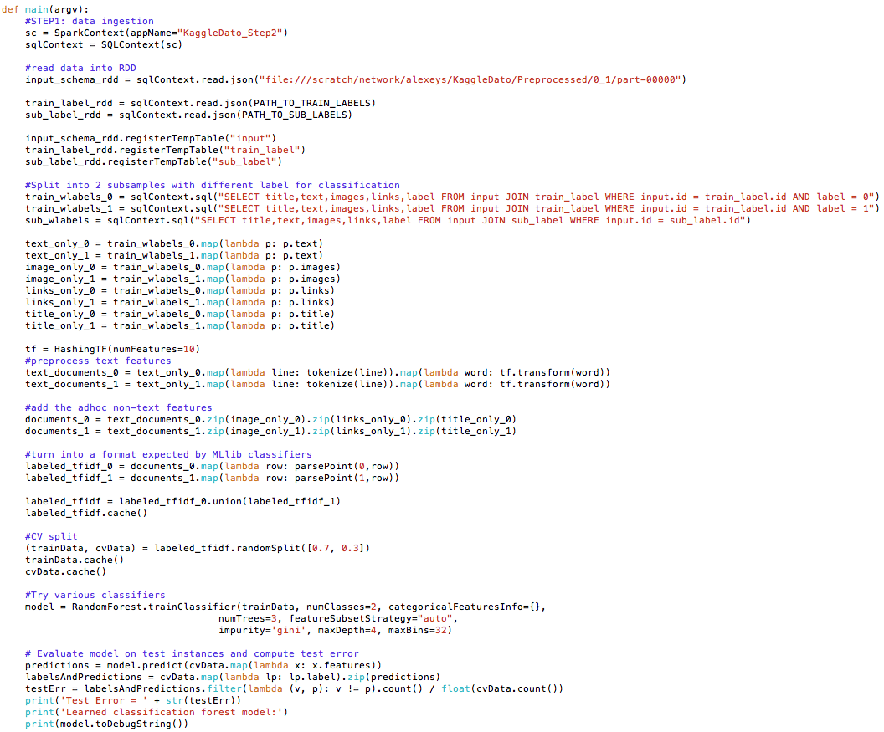
ANALYSIS EXAMPLE WITH SPARK, SPARK SQL AND MLLIB
MLLIB IS THE MAIN SPARK’S MACHINE LEARNING LIBRARY
IT CONTAINS MOST OF THE ML CLASSIFIERS:
Load scraped data
LOGISTIC REGRESSION, TREE/FOREST CLASSIFIERS, SVM, CLUSTERING ALGORITHMS…
INTRODUCES NEW DATA FORMAT: LABELEDPOINT (FOR SUPERVISED LEARNING)
AS AN EXAMPLE, LETS US TAKE A KAGGLE COMPETITION:
  HTTPS://WWW.KAGGLE.COM/C/DATO-NATIVE
DATASET FOR THAT COMPETITION CONSISTED OF OVER 300K RAW HTML FILES CONTAINING TEXT, LINKS, AND DOWNLOADABLE IMAGES
Select/Join as in Pandas
DataFrame are avail starting Spark 1.5
Feature engineering
THE CHALLENGE WAS TO IDENTIFY THE PAID CONTENT DISGUISED AS JUST ANOTHER INTERNET GEM (I.E. “NON-NATIVE” ADVERTISEMENT)
ANALYSIS FLOW:
SCRAPE THE DATA FROM THE WEB-PAGES: TEXT, IMAGES, LINKS…
FEATURE ENGINEERING: EXTRACT FEATURES FOR CLASSIFICATION
TRAIN/CROSS VALIDATE A MACHINE LEARNING MODEL
PREDICT
Train/predict

Slide 10
REAL-TIME ANALYSES WITH APACHE SPARK
MANY APPLICATIONS BENEFIT FROM ACTING ON DATA AS SOON AS IT ARRIVES
  NOT A TYPICAL CASE FOR PHYSICS ANALYSES AT CMS…
  HOWEVER, IT COULD BE A PERFECT FIT FOR EXOTICA HOTLINE OR ANY OTHER “HOTLINE” TYPE SYSTEMS OR ANOMALY DETECTION DURING DATA COLLECTION
SPARK STREAMING USES A CONCEPT OF DSTREAMS (SEQ. OF DATA ARRIVING OVER TIME)
  INGEST AND ANALYZE DATA COLLECTED OVER A BATCH INTERVAL
SUPPORTS VARIOUS INPUT SOURCES: AKKA, FLUME, KAFKA, HDFS
CAN OPERATE 24/7, BUT IS NOT TRULY REAL-TIME (LIKE E.G. APACHE STORM) – IT IS A MICRO- BATCH SYSTEM WITH A FIXED (CONTROLLED) BATCH INTERVAL
FULLY FAULT TOLERANT, OFFERING “EXACTLY ONCE” SEMANTICS, SO THAT THE DATA WILL BE ANALYSED FOR SURE EVEN IF A NODE FAILS
  SUPPORTS CHECKPOINTING – ALLOWING TO RESTORE DATA FROM A GIVEN POINT IN TIME

Slide 11
EXAMPLE OF A REAL-TIME PIPELINE USING APACHE KAFKA AND SPARK STREAMING
Data sources
(Kafka producers)
Worker node/container
Kafka cluster
Executor
Kafka broker
Long task
 | Receiver
Driver program
Kafka Consumer (some consumer apps)
StreamingContext
Process received
Worker node/container
Kafka broker
data
Executor
SparkContext
Task
Task
HDFS
(*) Kafka is good when message ordering matters
(*) Spark+Spark Streaming – use same programming model for online and offline analysis

