Slide 1
Computational Advertising
Group 7

Slide 2
Online Advertising
Advertising Opportunities :
On websites such as eBay, Craigslist or auto trading sites. These sites allow advertisers to post their ads directly, either for free or for a fee.
Display ads are placed on many Websites. Advertisers pay for the display at a fixed rate per impression
Online stores such as Amazon,Myntra. These ads are not paid by product manufacturers instead online stores to maximize their sales.
In the results of a search query. Advertisers bid for the right to have their ad shown in response to certain queries.
Notes:
Prashanth

Slide 3
Issues for Display Ads
Ranking the ads
Determining Attractiveness of an ad
Position of the ad in a list
Displaying of ads on targeted places
Privacy Issues
Matching Problem
Notes:
Prashanth

Slide 4
Question
Can anyone think of a scenario how online advertising is impacted by the customer activity?

Slide 5
Offline and Online Algorithms
Offline Algorithms
Data is present initially which is needed for the Algorithm.
As per the requirement, algorithm can access the data in any order.
At the end of algorithm, it produces an answer.
Online algorithms
Data is not present before the algorithm makes decision.
When a data is received, algorithm uses that data and produces an result.
Algorithm makes a decision before the future data is received.
Notes:
Maheshwar

Slide 6
Greedy Algorithm and Competitive Ratio
Majority of on-line algorithms are greedy algorithms.
These algorithms make their decision in response to each input element by maximizing some function of the input element and the past.
An online algorithm may not give the best result as compared to best off-line algorithm for the same problem.
However, we can expect that there will be some constant c less than 1 such that on any input, the result of an on-line algorithm is at least c times the result of the optimal offline algorithm.
The constant c is called as Competitive ratio for on-line algorithm.
Notes:
Maheshwar

Slide 7
Question
Major difference between Offline and Online algorithm?

Slide 8
The Matching Problem
It is one of the classic problems in probability theory
Example: How can large number of advertisers , advertise to large group of customers
Matching: Consider an undirected graph G = (V, E). A matching, M, of G is a subset of the edges E, such that no vertex in V is incident to more that one edge in M. In other words no two edges in M have a common vertex.
Maximal Matching: A matching M is said to be maximal if M is not properly contained in any other matching.
Perfect Matching: when every node appears in the matching.
Search queries were introduced by Overture in 2000 -> Google AdWords
Advertisers ”bid” on search keywords -> When someone searches for that keyword, the highest bidder’s ad is shown -> Advertiser is charged only if the ad is clicked on.
Notes:
Venkata

Slide 9
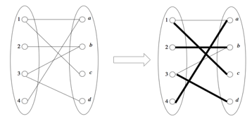
Maximal Matching
Problem Statement :Given a graph and weights We ≥ 0 for the edges, the goal is to find a matching of large weight.
The greedy approach starts by sorting the edges by weight, and then adds edges to the matching in this order as long as the set of a matching.
Steps:
1.For Matching M = ∅ (empty set)
2.For all edge ∈ E in decreasing order of We
add edge to M if it forms a matching
Perfect Match: Ford-Fulkerson, Augmenting Path, and Hopcroft-Karp algorithms.
Notes:
Venkata

Slide 10
Is Greedy approach for Maximal matching optimal?.Any issue with this approach you can think of?
Question

Slide 11
Adwords Problem
Online Advertising Service where advertisers bid for queries on the search engine.
Search engine selects and displays ads for a small subset of the bidders in a purpose of achieving the goal of maximizing search engine’s revenue
The order of the ad’s must be determined by an on-line algorithm that must consider:
The limited number of advertisement slots for any given query.
The budget on how much a company will pay for all the uses of their ad.
The total amount expected to be made by the ad and by not which company bid the highest.
Notes:
Tejaswini

Slide 12
Solution
Advertisers: A and B
A bids on query x and B bids on queries x and y
Sequence of queries: xxyy
Greedy Algorithm : Queries are assigned to any advertiser who has bid 1 for that query
Competitive Ratio = 1/2
Balance Algorithm - Improvement to the Greedy Algorithm
Queries are assigned to the advertisers that bid on the query with the largest remaining budget.
Uses some of each advertisers budget
Competitive Ratio = ¾
Notes:
Tejaswini

Slide 13
Question
Which is the best: Greedy Algorithm or Balanced Algorithm?

Slide 14
AdWords Implementation: Matching Bids and Search Queries
As long as bids are for the exact set of words in a query, the solution is relatively easy. However there are a number of extensions to the query/bid matching process that are not as simple.
Matching Bids: We can avoid having to deal with word order by storing all sets of words representing a bid in alphabetic order. The list of words in sorted order forms the hash-key for the bid, and these bids may be stored in a hash table used as an index.
Search queries: They have their words sorted prior to lookup. When we hash the sorted list, we find in the hash table all the bids for exactly that set of words. They can be retrieved quickly, since we have only to look at the contents of that bucket.
If there are a million advertisers, each bidding on 100 queries, and the record of the bid requires 100 bytes, then we require ten gigabytes of main memory, which is well within the limits of what is feasible for a single machine.
Search queries can be hashed and sent to the appropriate machine.
Notes:
Nusrath

Slide 15
AdWords Implementation: More Complex Matching Problems
Matching problem seems harder but we can still maintain a hash-table index for the bids, however the number of subsets of words in a hundred-word email is much too large to look up all the sets, or even all the small sets of about three words.
All the number of other potential applications of this sort of matching involves “standing queries.”
Example:
Twitter allows one to follow all the “tweets” of a given person. However, it is feasible to allow users to specify a set of words, such as “New Iphone”
Online news sites often allow users to select from among certain keywords or phrases, e.g., “covid-19” or “corona” and receive alerts whenever a new news article contains that word or consecutive sequence of words.
Notes:
Nusrath

Slide 16
Question
What do you mean by standing queries?

Slide 17
A Matching Algorithm for Documents and Bids
What is a bid ?
What is a document ?
Where is it used ?
How does it work?
Notes:
Adwait

Slide 18
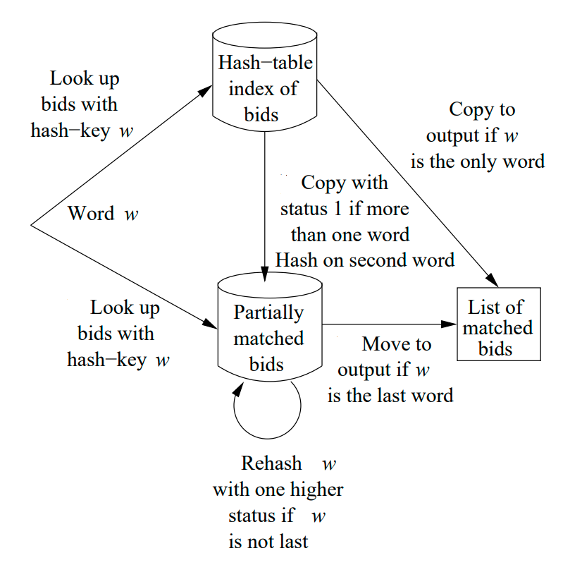
Bid Algorithm
Notes:
Adwait

Slide 19
MapReduce Solution to Graph Model
Why Map Reduce ?
The MapReduce solution to the graph model is used to decrease the communication and the movement of large data
Map - The input data is first split into smaller blocks. Each block is then assigned to a mapper for processing.
Combine - Runs individually on each mapper server. It reduces the data on each mapper further to a simplified form before passing it downstream.
Partition - the process that translates the <key, value> pairs resulting from mappers to another set of <key, value> pairs to feed into the reducer.
Reduce - All the map output values that have the same key are assigned to a single reducer, which then aggregates the values for that key.
Notes:
Sindhu

Slide 20
The Bulk-Synchronous Parallel for Graph Model
Processing occurs in a series of supersteps.
In every super step, a user defined function is executed in parallel on every active vertex.
All graph vertices are partitioned and loaded into local memories of machines (hosts).
Graph processing is organized by means of messages sent across machines with individual graph nodes.
At every super step, each host receives messages from other hosts that are related to nodes preserved by this host.
Program terminates when there are no more messages to send b/w hosts or maximum iterations reached.
Notes:
Sindhu

Slide 21
Issues and Challenges
Content level targeting, is a combination of retrieval and ranking problem.
However, unlike document retrieval, the ads are short and noisy.
Hence, apart from the challenges faced in organic search, ad retrieval involve additional challenges.
Based on the content to be targeted, following are the impediments and challenges in CA:
Short Ad text: Ad text is short and is intended to attract the user, hence it contains short non-grammatical English phrases. This leads to a lot of challenges in content level targeting.
Notes:
Tanmay

Slide 22
Sparse queries (Vocabulary mismatch): As the name suggests, vocabulary mismatch implies that the ad and query are semantically related but there is no syntactic similarity (word overlap) between them. For example, a query ‘Camera’ should also retrieve ads bidding on terms like ‘Sony Cyber-shot’ or ‘Sony EOS’.
Noisy Web content
No Page Rank!
Ad Spam and Click Spam
Opinionated Content
Dealing with new Ads in Ranking
Notes:
Tanmay

Slide 23
Question
Can you tell me what is short Ad text issue?

