Slide 1
Cloud Computing
Group 7

Slide 2
Advertising on the web
•Sites such as eBay, OLX allow advertising for free or for charge
•Companies like Amazon, Alibaba use ads to increase the sales
•Ads placed on the search results
•Factors that affect the advertisements
Position of the ad
-sports.yahoo.com/golf than yahoo homepage
Query terms
- apt to search queries

Slide 3
ONLINE – OFFLINE algorithms
Matching of search queries to advertisements algorithms categorized
OFFLINE
•All the input data is available
•Processed and made decision
•Reliable and stable
ONLINE
•All input data is not available
•On each stream decision needs to take place
•Greedy approach
•Not reliable but necessity

Slide 4
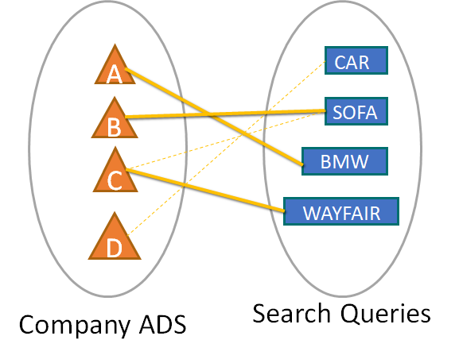
Maximal Matching
•Matching ads to search queries for maximal matching using bipartite graph
•Perfect Matching : All nodes appear in the matching
{A,CAR} {A,BMW}
{B,SOFA}
{C,SOFA} {C,WAYFAIR}
{D,CAR}
{A,BMW} {B,SOFA} {C,WAYFAIR} {D,CAR} MM=4
{A,CAR}{B,SOFA}{C,WAYFAIR} MATCHING=3
{A,CAR}{B,SOFA} MATCHING=2

Slide 5
Competitive Ratio
Comparing the performance of online algorithm with corresponding offline algorithm for same problem instance.
Competitive ratio = min over all possible inputs sequences ( | M online | / | M opt| )
where | M online | = cardinality of online algorithm
where | M opt| = cardinality of optimal offline algorithm
There will be some constant c<1 such that for any input, the result of online algorithm is atleast c times the result of optimum offline algorithm.

Slide 6
Adwords
Google’s Online Advertising Service
Advertisers bid for queries on the search engine
Search engine selects and displays ads for a small subset of the bidders
Goal: Maximize search engine’s revenue
Need for an online algorithm for maximizing revenue
Metric used:
AD RANK = CPC BID X QUALITY SCORE

Slide 7
Adwords Algorithm
The Balance Algorithm
Scenario:
Advertisers: A and B; A bids on query x and B bids on queries x and y
Sequence of queries: xxyy
Query assigned to advertiser who has the maximum remaining budget
Competitive Ratio = 3/4

Slide 8
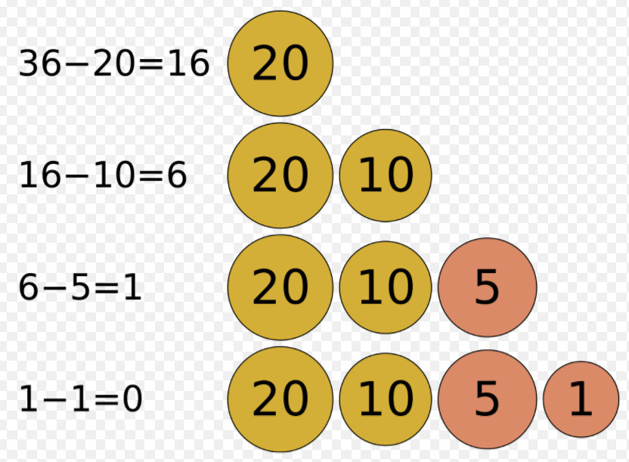
Greedy Algorithm
These algorithms make their decision to an object one step at a time, at each step choosing the locally best option.
Problem solving heuristic to optimize choice.
In some cases, greedy algorithms construct the globally best choice by repeatedly choosing the locally best option.
Traveling salesman problem
Decision tree learning

Slide 9
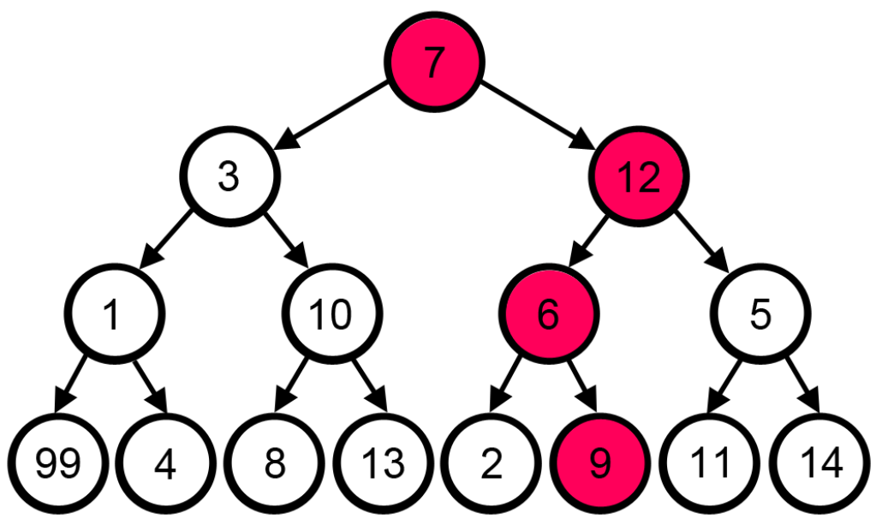
Advantages and Disadvantages - Greedy Algorithm
Pros
Simplicity -- greedy algorithms are easier to describe and code than others
Efficiency -- greedy algorithms can be implemented more efficiently than others
Cons
Simplicity -- it works to construct local optimal steps and not the global optimal result (short sighted optimization)
Efficiency -- when its wrong its severely wrong

Slide 10
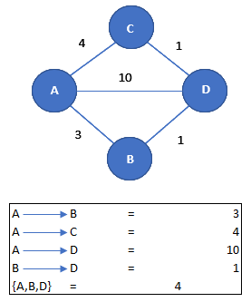
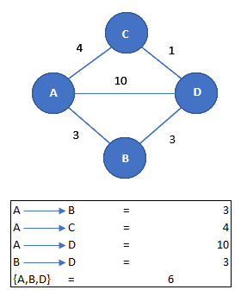
Example
Exp. 1
Recap -- A greedy algorithm always makes the choice that looks best at that junction.
The algorithm works based on the following properties:
Greedy choice
It makes the locally optimal choice in the hope that this choice leads to the globally optimal solution
Optimal substructure
Optimal solution is made up of optimal subsolutions
Exp. 2

Slide 11
Performance-based advertising
Introduced by Overture around the year 2000.
Advertisers bid on keywords that we search in browser.
Advertiser is charged only when there is an action on the link
Google adopted this technique as “adwords”.
Google observes CTR (click through rate),based on history
Algorithms are developed to build keywords and ads to display for related keywords.

Slide 12
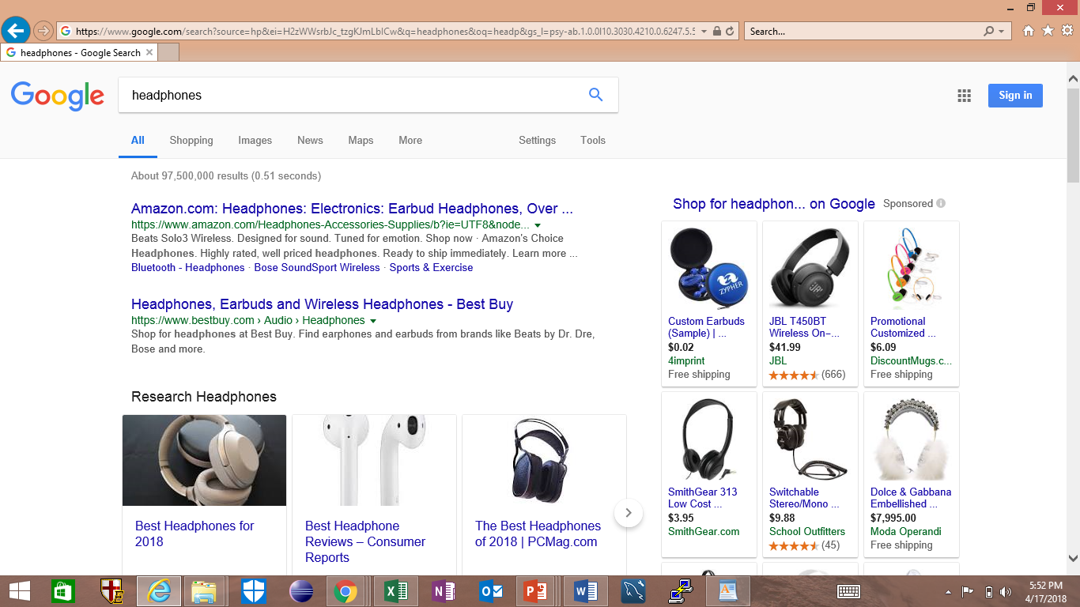
Google is displaying other competitor’s ads and prices
Amazon is highest bidder among all paid to google.

Slide 13
A More Balanced Approach
Advertiser A
Bids on x
Advertiser B
Bids on x, y
Balance Algorithm
Improvement to the Greedy Algorithm
Queries are assigned to the advertisers that bid on the query with the largest remaining budget.
Uses some of each advertisers budget
Budget A: $2
Budget B: $2
Queries: x, x, y, y
Greedy (Possible Outcome):
B is assigned x
B Budget - $1
B is assigned x
Budget - $1
No Further Bids Available
Balanced:
A or B is assigned x
A Budget - $1
The other is assigned x
B Budget - $1
B is assigned y
B Budget - $0
Overall Earnings $2
Overall Earnings $3

Slide 14
Generalized Balanced Algorithm
Why generalization? In Balanced algorithms, different values of bids can produce terrible BALANCE.
Solution: Allocate query q to bidder i with largest value of y_{i}(q).
x_{i} = bid b_{i} = budget.
m_{i} = Amount spent so far
Fraction of remaining budget, fi = 1-mi/bi.
A1: Bid = $1, budget = $110 | A2: Bid = $10, balance = $100
Incase of 10 instances of a query, A1 is always selected.
Balance earn: $10 | Optimal earn: $100
y_{i}(q) = x_{i}(1-e^{-fi})
Worst case competitive ratio (1-1/e)

Slide 15
Example
Advertiser A bids on query X
Advertiser B bids on query X and Y
Budget: $6
Budget: $4
Bids: $1 per query
Query Stream: x y x y x y x y x y
Balance choice: A B A B A B A B A B
Total yield: $9

Slide 16
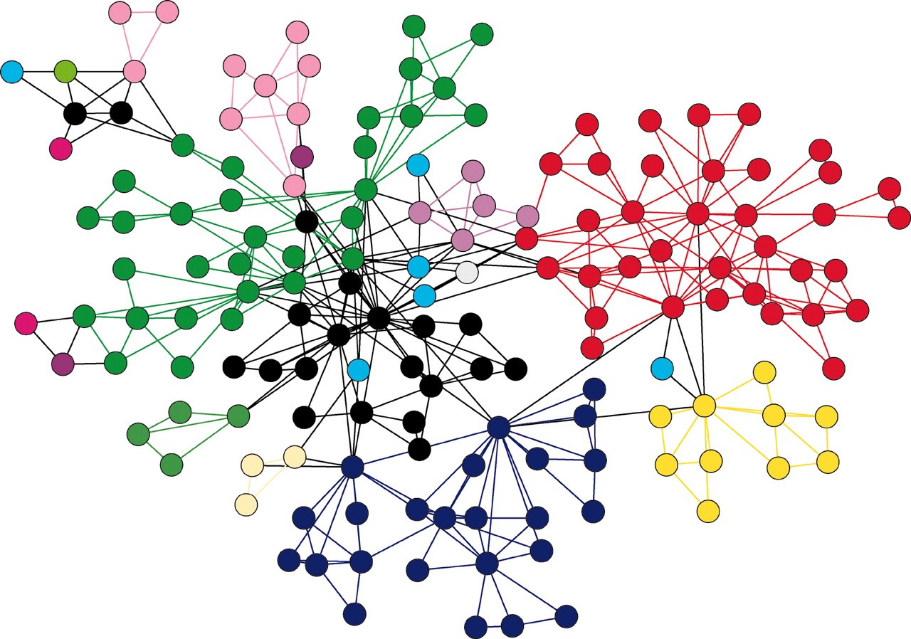
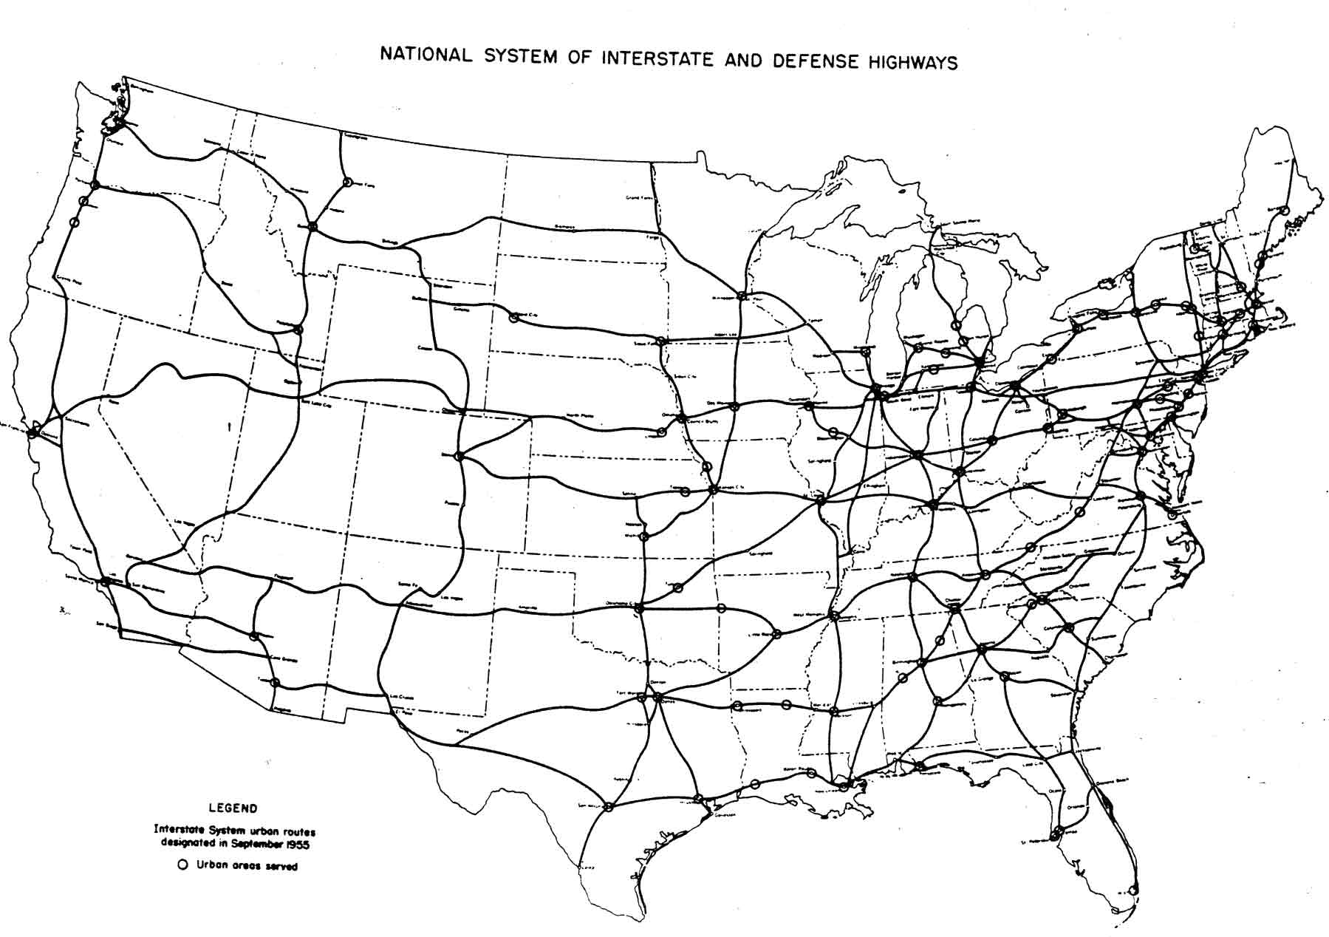
Graph
Examples of Graphs
Graph is a non-linear data structure.
It is a pictorial representation of a set of objects where some pairs of objects are connected by links. The inter- connected objects are called vertices, and the links that connect the vertices are called edges.
Facebook
Physical Structure of the computers on the Internet
Interstate Highway system
Recommendations on e-commerce websites
Used to study molecules in Chemistry and Physics

Slide 17
Graph Problems
Processing Graph Data
Finding Shortest Path
Routing Internet Traffic and Logistics
Finding Minimum Spanning Trees
Telephone Network Design
Maximum Flow Problem
Airline Scheduling
Bipartite Matching
Monster.com, Match.com
PageRank
As the size of the graph data is very large. Parallel processing has to be used for efficient computation.
Techniques Used : MapReduce, Bulk-Synchronous Systems

Slide 18
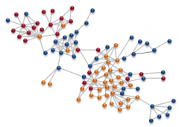
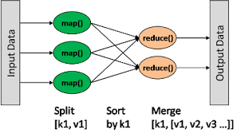
Map Reduce Programming Model for Graph Problems
Graph algorithms typically involve:
Performing computations at each node: based on node features, edge features, and local link structure
Propagating computations: “traversing” the graph
MapReduce Approach:
Represent graphs as adjacency lists
Perform local computations in mapper
Pass along partial results via outlinks, keyed by destination node
Perform aggregation in reducer on inlinks to a node
Iterate until convergence: controlled by external “driver”

Slide 19
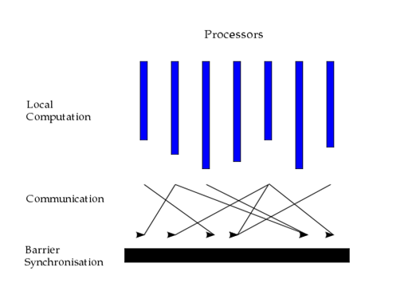
Bulk Synchronous Systems
●Also known as BSP(Bulk Synchronous Parallel ), is a programming model developed in the early 1980’s.
●It is a programming paradigm for designing parallel algorithms.
●Unlike Map-Reduce, BSP based systems
works in super steps, message passing and
barrier synchronization.
●These features make BSP based
systems very powerful and efficient for
graph processing.

Slide 20
Challenges in Graph Processing
For most of the graph related algorithms, we face the following challenges
●Computation driven by data - algorithms execute based on the structure of graph, computation for each next vertex is strictly dependent on results calculated for all its ancestors. Partition is highly impossible.
●Diverse and unbalanced data structure – graph is highly unstructured data with skewed distribution of vertices degree.
●Data communication in comparison to computation

Slide 21
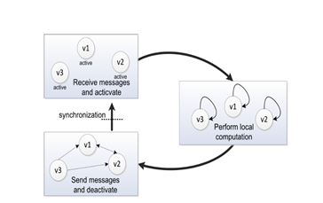
BSP model for Graph Processing
●Processing occurs in a series of supersteps.
●In every super step, a user defined function
is executed in parallel on every active
vertex.
●Before any computation, all graph vertices
are partitioned and loaded into local
memories of machines(hosts).
●Graph processing organized by means of messages sent across machines with individual graph nodes.
●At every super step, each host receives messages from other hosts that are related to nodes preserved by this host.
●Program terminates when there are no more messages to send b/w hosts or maximum iterations reached.

