Slide 1
Computational Advertising and Bulk Synchronous Operations

Slide 2
Topics for Discussion
Foundations
Bipartite Graph
Competitive Ratio
AdWords Problem
Algorithms
Greedy Algorithm
Performance Based Advertising
Balanced Algorithm
Generalized Balanced Algorithm
Bulk Synchronous Operations and MapReduce
GraphX Code Examples

Slide 3
Foundations: Online and Offline Algorithms
OFFLINE
ONLINE
Performed on static data
See whole data set
Find optimal function for the whole dataset
Performed on incomplete data
Streaming data, with partial results
Future data unknown
Algorithms will always be less optimal than offline
Make irrevocable decisions on imperfect data

Slide 4
Foundations: Bipartite Matching
Set of nodes (T)
Set of nodes (P)
Goal: Match professors with TA’s
Constraints:
Can only be matched if edge exists
Each professor can only be matched with one TA
1
a
2
b
3
c
4
d
TA’s
Professors

Slide 5
What are some of the paths we can use to match professors and TA’s?
1
a
2
b
3
c
4
d
TA’s
Professors

Slide 6
Foundations: Bipartite Matching
Cardinality | M |:
The number of matches made from the graph
M = {(1,a),(2,b),(3,d)} is a matching of cardinality |M| = 3
1
a
2
b
3
c
4
d
TA’s
Professors

Slide 7
Foundations: Bipartite Matching
Cardinality | M |:
The number of matches made from the graph
M = {(1,a),(2,b),(3,d)} is a matching of cardinality |M| = 3
Perfect Matching | M|
M = {(1,c),(2,b),(3,d),(4,a)}
Maximum Matching:
The largest number of matches that can be made between two sets
1
a
2
b
3
c
4
d
TA’s
Professors

Slide 8
Foundations: Competitive Ratio
A comparison of an online algorithm with the best possible offline algorithm
Competitive ratio = min _{all possible inputs I} ( | M _{online} | / | M _{opt}| )
Where | M _{online} | = cardinality of online algorithm
Where | M _{opt}| = cardinality of optimal offline algorithm
Ex. Competitive ratio = ¾
Online algorithm best result = cardinality of
offline algorithm
1
a
2
b
3
c
4
d
TA’s
Professors

Slide 9
Question: What is the competitive ratio of these graphs?
1
a
1
a
2
b
2
b
3
c
3
c
4
d
4
d
TA’s
Professors
TA’s
Professors

Slide 10
Question: What is the competitive ratio of these graphs?
A: 3 actual / 3 possible = 1
A: 3 actual / 4 possible = 3/4
1
a
1
a
2
b
2
b
3
c
3
c
4
d
4
d
TA’s
Professors
TA’s
Professors

Slide 11
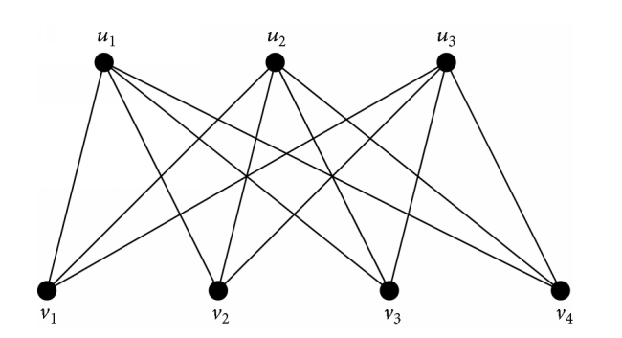
Why Do We Care?
Some real world examples:
Assigning tasks to servers
Sports competitions
Employees in jobs
Others?
Computational advertising is a matching problem !
Image Source: https://www.researchgate.net/figure/260946774_fig15_Complete-bipartite-graph-K34

Slide 12
A Brief History of Web Advertising
BANNER ADS
PERFORMANCE BASED ADVERTISING
Ads prices based on impressions
Cost per thousand impressions (CPM) = $X for 1000 impressions
ROI calculated by click-through rate
Limited targeting capabilities
Broad demographics only
Ads bid on search keywords
User is shown ad of highest bidder for purchased keywords
Advertiser charged if ad is clicked

Slide 13
Question
WHAT ARE CHALLENGES FACED BY ADVERTISERS?
WHAT ARE CHALLENGES FACED BY SEARCH ENGINES?

Slide 14
Question
WHAT ARE CHALLENGES FACED BY ADVERTISERS?
WHAT ARE CHALLENGES FACED BY SEARCH ENGINES?
What search terms should I bid on?
How much should I bid for terms?
Which advertiser’s ad do I show for a particular search term?

Slide 15
The AdWords Problem: Overview
GIVEN A SET OF CONSTRAINTS:
GOAL = RESPOND TO QUERY WITH AD, SUCH THAT:
A set of bids for search queries
Click-Through Rate for each ad
Budget for each advertiser
Limit on number of ads to show for each query
Size of set <= limit on number of ads per query (constraint 4)
Each advertiser has bid on query
Each advertiser has enough budget to pay for clicks

Slide 16
The AdWords Problem: How It Works
This would be much simpler if we knew all the search queries we would receive at the beginning
A query stream is received by a search engine
Search engine must select the ad to show
Goal: Maximize ad revenue for the search engine
Expected Revenue:
Advertiser | Bid
A | $1.00
B | $ 0.75
C | $ 0.50

Slide 17
The AdWords Problem: Simple Algorithm
A query stream is received by a search engine
Search engine must select the ad to show
Goal: Maximize ad revenue for the search engine
Expected Revenue:
Advertiser | Bid | Click-Through Rate
A | $1.00 | 1 %
B | $ 0.75 | 2 %
C | $ 0.50 | 2.5 %

Slide 18
The AdWords Problem: Simple Algorithm
A query stream is received by a search engine
Search engine must select the ad to show
Goal: Maximize ad revenue for the search engine
Expected Revenue:
Advertiser | Bid | Click-Through Rate | Expected Revenue
A | $1.00 | 1 % | 1 cent
B | $ 0.75 | 2 % | 1.5 cents
C | $ 0.50 | 2.5 % | 1.125 cents

Slide 19
The AdWords Problem: Overview
WHAT ARE CHALLENGES WITH CALCULATING CTR?
WHAT ARE CHALLENGES WITH SIMPLE ALGORITHM?
CTR is position dependent
Ad in position 1 gets clicked more often than position 2
Explore vs Exploit trade-off
Show existing ad with known CTR to exploit ad, or show new ad to explore CTR of new ad?
CTR of a new ad is unknown
Advertisers have limited budgets and bid on multiple ads

Slide 20
Algorithms for Solving AdWords Problem: Greedy Algorithm
Our setting: Simplified environment
There is 1 ad shown for each query
All advertisers have the same budget B
All ads are equally likely to be clicked
Value of each ad is the same (=1)
Simplest algorithm is greedy:
For a query pick any advertiser who has bid 1 for that query
Competitive ratio of greedy is 1/2

Slide 21
Greedy Algorithm: Calculating Competitive Ratio
For input I, suppose greedy produces matching M_{greedy} while an optimal matching is M_{opt}.
Competitive ratio = min_{all possible inputs I} (|M_{greedy}|/|M_{opt}|).
Where | M _{greedy} | = cardinality of greedy algorithm
Where | M _{opt}| = cardinality of optimal offline algorithm

Slide 22
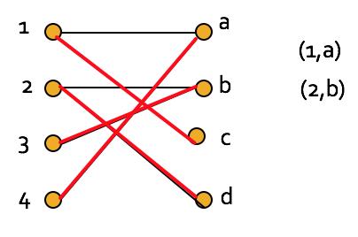
Calculating the competitive ratio (Greedy) = 1/2
Let O be the optimal matching, and G the matches produced by a run of the greedy algorithm.
Consider the sets of Professors:
A: Matched in G, not in O.
B: Matched in both.
C: Matched in O, not in G.
During the greedy matching, every Professor in C found their match in the optimal solution taken by another Professor.
Hence, |A| + |B| > |C|.
Also, |A| + |B| > |B|.
Thus, |G| = |A| + |B| > (|B| + |C|)/2 = |O|/2.
If you’re greater than each of two things, you are greater than their average.
Worst-case Scenario
|Greedy|= 2
|Opt|= 4, Competitive ratio = 2/4 = 1/2
Optimal
Greedy
A
B
C

Slide 23
Algorithms for Solving AdWords Problem:
Balance Algorithm
This is a simple improvement to greedy algorithm
Improved competitive ratio, than greedy algorithm
The competitive ratio is 75% for the case of two advertisers
The competitive ratio is about 63% for more number of advertisers
For each query, the advertiser with the largest remaining budget will be picked
Break the ties arbitrarily

Slide 24
Balance Algorithm vs Greedy Algorithm
GIVEN INPUTS FOR SCENARIO
Two advertisers A and B.
A bids on query x, B bids on x and y
Both have budgets of $4
Query stream: x x x x y y y y
WORST CASE SCENARIO FOR GREEDY ALGORITHM
BALANCE ALGORITHM FOR SAME SCENARIO
Possible greedy choice: B B B B _ _ _ _
Optimal: A A A A B B B B
Competitive ratio = 1/2
Balance choice: B A B A B B _ _
Optimal: A A A A B B B B
Competitive ratio = 3/4
The worst case of this algorithm is (1-1/e) = 0.63

Slide 25
Problem with Balance Algorithm
Example: Consider two advertisers A1 and A2, each bidding on query q.
A1: bid = 1, balance = 110.
A2: bid = 10, balance = 100.
First 10 occurrences of query q, all go to A1, and A1 then gets 10 q’s for every one that A2 gets.
What if there are only 10 occurrences of q?
Optimal yields $100 whereas Balance yields only $10.

Slide 26
Generalized Balance Algorithm
The bid amount is also considered, in addition to the budget.
A component y is calculated factoring the budget and the bid.
Consider query q, bidder i.
Bid = x_{i}.
Budget = b_{i}.
Amount spent so far = m_{i}.
Fraction of budget remaining f_{i} = 1-m_{i}/b_{i}.
Define y_{i}(q) = x_{i}(1-e^{-fi}).
Allocate query q to bidder i with largest value of y_{i}(q).
Same worst case competitive ratio (1-1/e).

Slide 27
Question:
Two advertisers A and B
A bids on query x, B bids on query x and y
A and B have budgets of $6 and $4 respectively
Bids are $1 per query for both advertisers
Query stream: x y x y x y x y x y
What is the total yield?

Slide 28
Question:
Two advertisers A and B
A bids on query x, B bids on query x and y
A and B have budgets of $6 and $4 respectively
Bids are $1 per query for both advertisers
Query stream: x y x y x y x y x y
What is the total yield?
Balance choice: A B A B A B A B A _
Total yield = $9

Slide 29
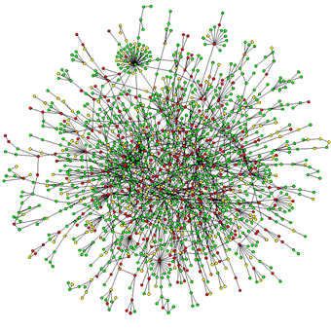
What is a Graph?
Graph is a non linear data structure
Collection of vertices and edges

Slide 30
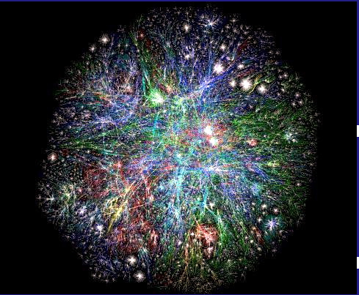
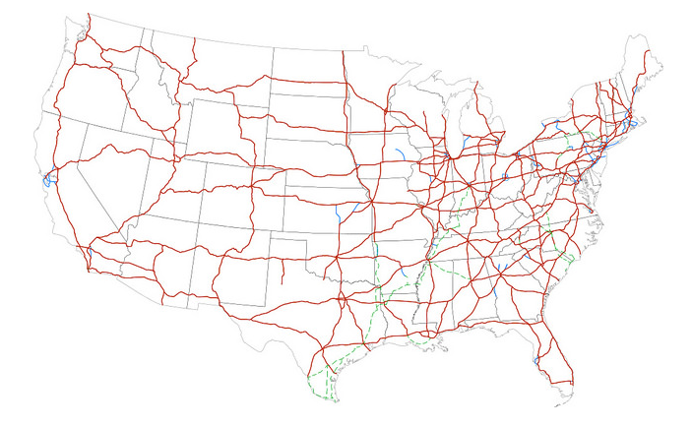
Examples of Graphs
Hyperlink structure of the Web
Physical structure of computers on the Internet
Interstate highway system
Social networks
Image sources:
https://myhero.com/T_Berners_Lee2_dnhs_US_2012
http://www2.lawrence.edu/fast/GREGGJ/CMSC150/101Graphs/Graphs.html
https://www.pinterest.com/franciverr/social-media-icons/?lp=true

Slide 31
Graph Problems
Finding shortest paths
Routing Internet traffic and UPS trucks
Finding minimum spanning trees
Telco laying down fiber
Finding Max Flow
Airline scheduling
Identify “special” nodes and communities
Breaking up terrorist cells, spread of avian flu
Bipartite matching
Monster.com, Match.com
PageRank

Slide 32
Ways to process Graph Data
Due to the size of graph data, they often require usage of parallel processing for efficient computation
Two techniques:
MapReduce
Bulk-Synchronous Systems

Slide 33
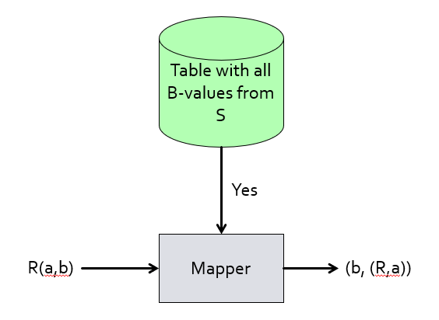
Map Reduce Solution to Graph Model
It helps in decreasing the communication and movement of large data
Uses the concept of semi-join
Consider the join of R(a,b) and S(b,c)
It finds all ‘b’ in S and the map function process only those records in R which has a corresponding ‘b’ value
If most of the records in R do not have a corresponding b value, it saves substantial communication

Slide 34
Bulk Synchronous Parallel
• A bridging model for designing parallel algorithms
• Addresses the problem of MapReduce inefficiency for iterative graph processing.
• Computation process in BSP :
○ Processing occurs in a series of super steps (equivalent to MapReduce iterations)
○ In every super step, a user defined function is executed in parallel on every item from the dataset
○ Before any computation, all graph nodes are partitioned and loaded into local memories of machines (hosts)
○ Graph processing organized by means of messages sent between machines hosting individual graph nodes
○ At every super step, each host receives messages from other hosts that are related to nodes preserved by this host and executes a user defined computation function

Slide 35
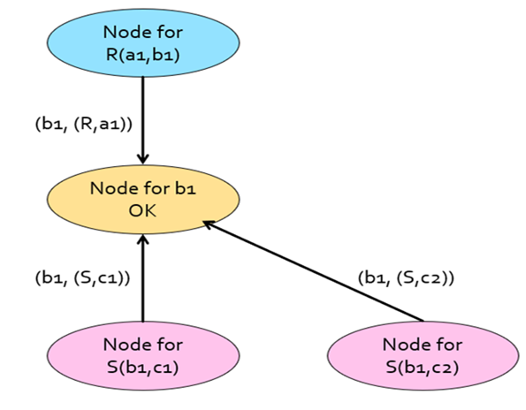
Bulk Synchronous Parallel Solution to Graph Model
Create a graph node for every tuple in R and S
Create a graph node for every B-value.
Tuples from S send a message to its corresponding B-value
Similarly, Tuples from R send a message to its corresponding b in B-value.
Now, the node for 'b' sends message to R, if it has received at least a single request from S
Atlast, the traditional map-reduce operation is performed without considering the non-dangling tuples in S

Slide 36
Project Code Demo:

Slide 37
References
Mining of Massive Datasets- Stanford University
Computation Advertising Bipartite Graph Problem: https://www.youtube.com/watch?v=h0fBgE1tp3Y
The AdWords Problem: https://www.youtube.com/watch?v=vKz3EwibNAw&index=64&list=PLLssT5z_DsK9JDLcT8T62VtzwyW9LNepV
The Balanced Algorithm:
https://www.youtube.com/watch?v=9orfibrnIRk&list=PLLssT5z_DsK9JDLcT8T62VtzwyW9LNepV&index=65
Mapreduce:
http://www.umiacs.umd.edu/~jbg/teaching/INFM_718_2011/lecture_5.pdf
i.stanford.edu/~ullman/cs246slides/mr-bulk.pptx
BSP: https://arxiv.org/pdf/1306.0326v1.pdf

