Slide 1
Cloud Computing for Data Analysis

Slide 2
Recommendation Systems
Information filtering system that predicts the user preference
The most common example for the recommendation systems is offering customers of an online retailer suggestions about what they might like to buy, based on their past history of purchases and/or product searches.
We consider two classes of entities, which we shall refer to as users and items.
We represent the data in the utility matrix, we check for different attributes which defines the users interest to buy product. Sometimes, we might have the data from user for certain products which he doesn’t provide any ratings.
Later, we compare the utility matrix between different products and check if we have any
similarity between the products and conclude if user is willing to buy certain product.
There is phenomenon called Long tail which discuss the distinction between physical and online worlds.

Slide 3
Few Applications for Recommendation Systems:-
Product Recommendations :- We have noted how Amazon or similar online vendors strive to present each returning user with some suggestions of products that they might like to buy
Movie Recommendations :- Netflix offers its customers recommendations of movies they might like. These recommendations are based on ratings provided by users
News Articles:- News services have attempted to identify articles of interest to readers, based on the articles that they have read in the past. The similarity might be based on the similarity of important words in the documents, or on the articles that are read by people with similar reading tastes
Types of Recommendation Systems:-
Content-based systems examine properties of the items recommended. For instance, if a Netflix user has watched many cowboy movies, then recommend a movie classified in the database as having the “cowboy” genre.
Collaborative filtering systems recommend items based on similarity measures between users and/or items. The items recommended to a user are those preferred by similar users. This sort of recommendation system can use the groundwork on similarity search and clustering. However, these technologies by themselves are not sufficient, and there are some new algorithms that have proven effective for recommendation systems..

Slide 4
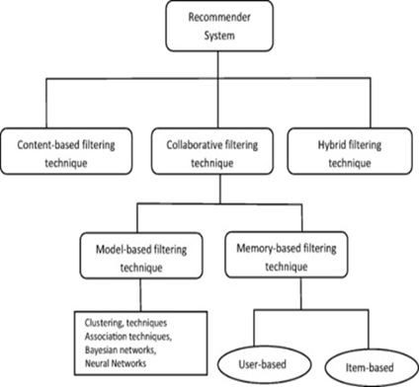

Slide 5
Content Based System - Introduction
Content Based Recommendations are the systems which focus on properties of items. Similarity of items is determined by measuring the similarity in their properties.
Item Profiles:
In a content-based system, we must construct for each item a profile, which is a record or collection of records representing important characteristics of that item.
Documents and Images:
➔ For documents like news articles, we use distance measure as a measure of similarity, namely Jaccard distance and Cosine distance.
➔ For images, tag words are used in the form of words or phrases that describe the image item.

Slide 6
Content Based System - Introduction
User Profiles
Involves creating vectors with same components that describe the user’s preferences.
We use a utility matrix to represent the connection between users and items.
Recommending items based on content
Involves two kinds of vectors - user vector and item vector.
We can estimate the degree to which a user would prefer an item by computing the cosine distance between the user’s and item’s vectors.
Classification Algorithms
A different approach to a recommendation system is to treat the problem as one of machine learning.
The given data is treated as a training set, and for each user, we build a classifier that predicts the rating of all items.

Slide 7
Content Based System - Use Case
Zanardi V, Capra L. Social ranking: uncovering relevant content using tag-based recommender systems. InProceedings of the 2008 ACM conference on Recommender systems 2008 Oct 23 (pp. 51-58).
Cantador I, Bellogín A, Vallet D. Content-based recommendation in social tagging
systems. InProceedings of the fourth ACM conference on Recommender systems 2010 Sep 26 (pp. 237-240).
Bellogín A, Cantador I, Castells P. A study of heterogeneity in recommendations for
a social music service. InProceedings of the 1st International Workshop on Information Heterogeneity and Fusion in Recommender Systems 2010 Sep 26 (pp. 1-8).
Pera MS, Ng YK. A group recommender for movies based on content similarity and
popularity. Information Processing & Management. 2013 May 1;49(3):673-87.

Slide 8
Content Based System - Use Case
Pros:
User independence
Transparency
No cold start
Cons:
Limited content analysis
Over-specialization
New user

Slide 9
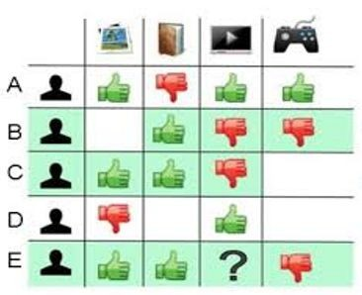
Collaborative Filtering - Introduction
Use ratings from other users
Focus on relationship between users and items
Two main entities:
User: Any individual who provides ratings to a system
Item: Anything for which a human can provide rating
Basic assumptions:
Users with similar interests have common preferences
Sufficiently large number of user preferences are available

Slide 10
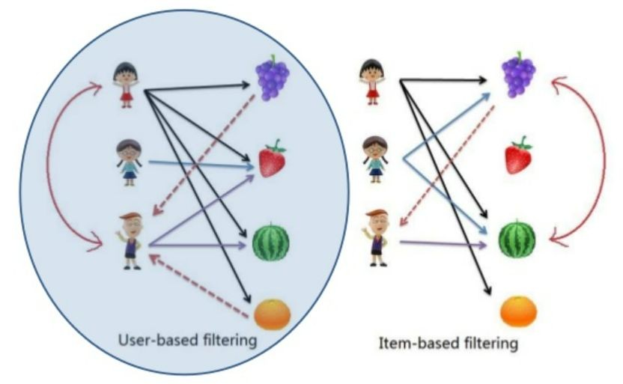
Types of Collaborative ﬁltering
User-based collaborative filtering
Look for users who share the same rating patterns with the active user
Use the ratings from like-minded users to calculate the prediction for the active user
Item-based collaborative filtering
Build an item-item matrix determining relationships between pairs of items
Infer the tastes of the current user by examining the matrix and matching that users data

Slide 11
Collaborative Filtering - Pros & Cons
Pros:
No domain Knowledge necessary.
Great Starting point.
Serendipity.
Cons:
Cold Start
Scalability
Sparsity

Slide 12
Collaborative Filtering - Use Case
Amazon and all other e-commerce websites.
Application on social web like youtube, Reddit etc. Netflix and entertainment websites.

Slide 13
Summary
Recommender systems usually make use of either or both collaborative filtering and content-based filtering, as well as other systems such as knowledge-based systems.
In content-based filtering, the model does not need data on other users since the recommendations are specific to that user, it is at the heart of the collaborative filtering algorithm. However, a thorough knowledge of the elements is essential for the content-based algorithm, whereas only element evaluations are required in the collaborative filtering method.
Closely related to this point is the issue of introducing new elements, also known as the “cold start problem”. If an element is not seen during the training, the system cannot create an embedding for it and cannot query the model with that element. While some techniques exist as projection in WALS or heuristics to generate new embeddings, the addition to a new feature will strengthen the
content-based filtering method.

Slide 14
THANK YOU

