Slide 1
Recommender Systems
Group 6
ITCS / DSBA 6190 Cloud Computing for Data Analysis - Fall 2018 - Sec 091.
Javier Velasco
Anusha Sama
Vidhushini Srinivasan
Kyle Thompson
Priyanka Sharma
Prutha Shirodkar

Slide 2
RECOMMENDATION SYSTEM
Information filtering system that seeks to predict the "rating" or "preference" a user would give to an item.
Used in scenarios where many users interact with many items.
Captures the past behavior of a customer and based on that, recommends products which the users might be likely to buy.
Movie Recommendation systems, E-commerce product
recommendations, Music Recommendation systems

Slide 3
UTILITY MATRIX
The data used in a recommendation system is divided in two categories: the users and the items. Each user likes certain items, and rates the item, every entry thus represents how much the user appreciates the item. These rating values are collected in matrix, called utility matrix R
User profiles are stored in form of utility matrix.

Slide 4
CONTENT BASED FILTERING
They examine the properties of an item and user’s profile.
Recommends similar items preferred by the user.
The similarity is determined by considering the characteristics of an item.

Slide 5
Example: Netflix User watches Narcos, and Netflix gives recommendations of shows with similar genre

Slide 6
NETFLIX CHALLENGE
Algorithm to show 10% improvement
AT&T Labs- Chris and Robert
Singular Value Decomposition
Exception- Polarizing rating (Napoleon Dynamite)

Slide 7
COLLABORATIVE FILTERING
Collaborative filtering, also referred to as social filtering, filters information by using the recommendations of other people.
People who agreed in their evaluation of certain items in the past are likely to agree again in the future.
Uses “User Behavior” for recommending items.
Commonly used algorithms in the industry as it is not dependent on any additional information
Two types of Filtering: User-User collaborative filtering, Item-Item collaborative filtering

Slide 8
MEASURING SIMILARITY
Jaccard Distance: It mainly deals with sets of rated items rather the values in the matrix.
Cosine Distance: Considers the null values as 0. This is incorrect sometimes, because if the user doesn’t rate a movie doesn’t mean he/she doesn’t like it.

Slide 9
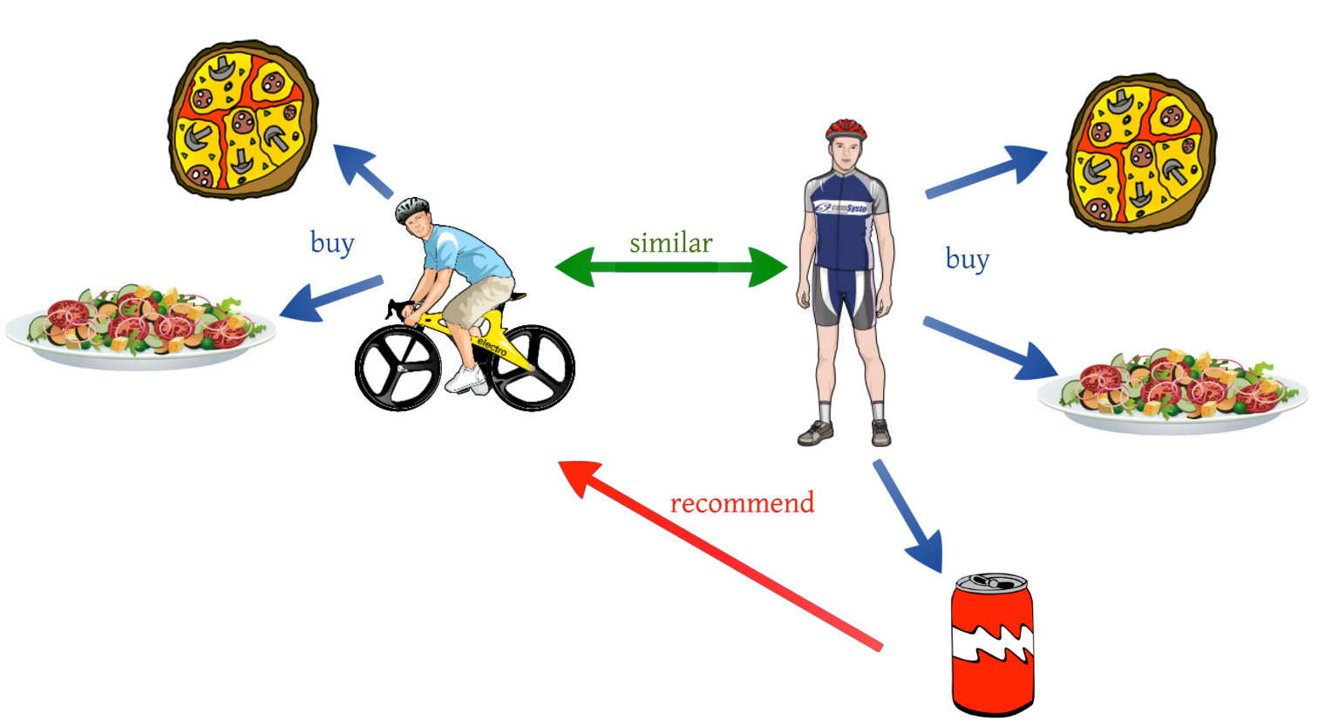
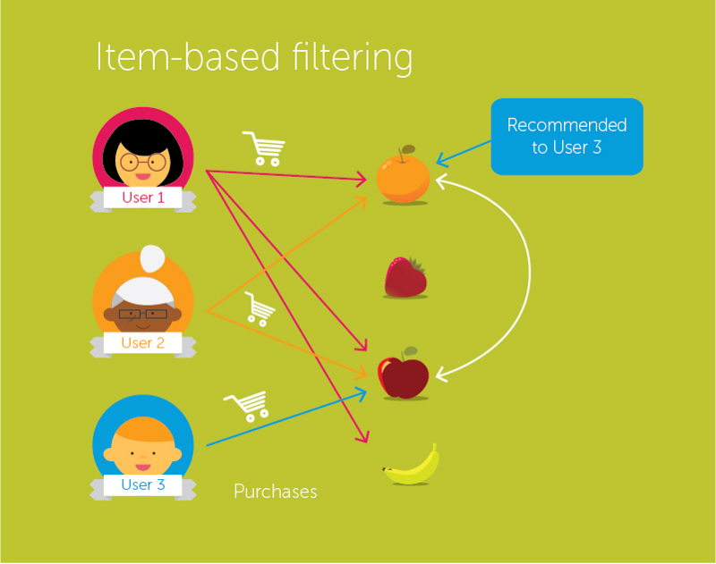
USER BASED & ITEM BASED FILTERING
User-User Collaborative Filtering
Item-Item collaborative filtering
Find the similarity score between users.
Based on this similarity score, it then picks out the most similar users and recommends products which these similar users have liked or bought previously
Compute the similarity between each pair of items
Recommend similar movies which are liked by the users in the past

Slide 10
CLASSIFICATION ALGORITHMS
Uses the machine learning approach by treating the user profiles as training set.
Build classifier on each user that predicts the ratings of all items.
Most popular and commonly used classifier is Decision Tree.

Slide 11
DECISION TREES
A decision tree is a collection of nodes, arranged as a binary tree.
The leaves render decisions; here the decision would be “likes” or “doesn’t like.”
Each interior node is a condition on the objects being classified; here, the condition may be one or more features of an item.
Construction of a decision tree requires selection of a predicate for each interior node.

Slide 12
DECISION TREE TO PLAY GOLF

Slide 13
UV DECOMPOSITION
Useful when a relatively small set of features of items and users determine the reaction of most users to most items
Suppose for utility matrix M, with n rows and m columns:
identify matrix U with n rows and d columns and a matrix V with d rows and m columns
Establishes that there are d dimensions that allow us to characterize both users and items closely.
Can use the entry in the product UV to estimate corresponding blank entry in utility matrix M. This process is called UV-Decomposition of M

Slide 14
ROOT MEAN SQUARE ERROR
Common measure to evaluate how close the product UV is to M
Sum, over all non blank entries in M the square of the difference between that entry and the corresponding entry in the product UV.
Mean of these squares by dividing by the number of terms in the sum.
Square root of the mean.
Finding the UV-decomposition with the least RMSE involves starting with some arbitrarily chosen U and V , and repeatedly adjusting U and V to make the RMSE smaller

Slide 15
Questions???

