Slide 1
Recommender’s System

Slide 2
Why Recommendations?
Matching consumers with the most appropriate products is key to enhancing user satisfaction and loyalty!
Notes:
Bharadwaj
1.Consumers are inundated with choices
2.Content providers offer a huge selection of products

Slide 3
Why Recommendations?
Notes:
Bharadwaj

Slide 4
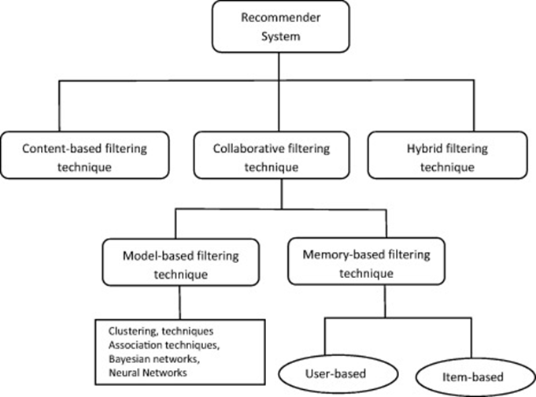
Recommender System
Extensive class of web application that involve predicting user response to options which is called recommendation systems.
Two types:
Content-Based Systems
Collaborative filtering
One chart:
The Utility Matrix
Notes:
Bharadwaj

Slide 5
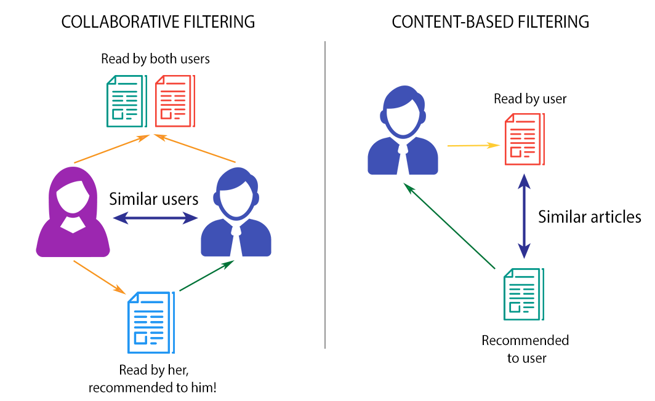
Notes:
Bharadwaj

Slide 6
The Utility Matrix
Matrix of value representing each user’s level of affinity to each item.
Recommendation engine needs to predict the values for the empty cells based on available cell values
Denser the matrix, better the quality of recommendation
In Fig. 9.1 we see an example utility matrix, representing users’ ratings of movies on a 1–5 scale, with 5 the highest rating. Blanks represent the situation where the user has not rated the movie. The movie names are HP1, HP2, and HP3 for Harry Potter I, II, and III, TW for Twilight, and SW1, SW2, and SW3 for Star Wars episodes 1, 2, and 3. The users are represented by capital letters A through D.
Notes:
Kelly

Slide 7
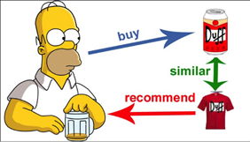
Collaborative Filtering
Collaborative-filtering systems focus on the relationship between users and items. Similarity of items is determined by the similarity by the similarity of the ratings of those items by the user who rated both items.
Basic Assumptions:
Users with similar interests have common preferences
Sufficiently large number of user preference are available
Notes:
Kelly

Slide 9
Collaborative Filtering
Collaborative filtering (CF) is a technique commonly used to build personalized recommendations on the Web. Some popular websites that make use of the collaborative filtering technology include Amazon, Netflix, iTunes,etc. In collaborative filtering, algorithms are used to make automatic predictions about a user's interests by compiling preferences from several users.
For example, a site like Amazon may recommend that the customers who purchase books A and B purchase book C as well. This is done by comparing the historical preferences of those who have purchased the same books.

Slide 10
Different types of collaborative filtering
Memory Based: This method makes use of user rating information to calculate the likeness between the users or items. This calculated likeness is then used to make recommendations.
Model Based: Models are created by using data mining, and the system learns algorithms to look for habits according to training data. These models are then used to come up with predictions for actual data.
Hybrid: Various programs combine the model-based and memory-based CF algorithms.

Slide 11
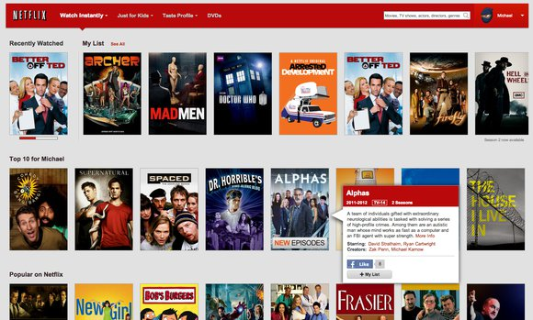
Content based Filtering
Content-Based Systems examine the properties of the items recommended. Similarity of items is determined by measuring the similarity in their properties.
Example:If a Netflix user has watched many gossip girl shows, then recommend a movie or show classified in the database as having “gossip girl” traits or genre.
Notes:
Kelly

Slide 12
Content-Based System
Content-based filtering methods are based on a description of the item and a profile of the user's preferences. In a content-based recommender system, keywords are used to describe the items and a user profile is built to indicate the type of item this user likes.
The technology behind Netflix and Pandora’s recommendation engines.
Notes:
Kelly

Slide 13
Challenges of Content-Based Filtering
Lack of novelty and diversity
Scalability is a challenge
Attributes may be incorrectly or inconsistently applied
Notes:
Kelly
Lack of novelty and diversity. Relevance is important, but it’s not all there is. If you watched and liked Star Wars, the odds are pretty good that you’ll also like The Empire Strikes Back, but you probably don’t need a recommendation engine to tell you that. It’s also important for a recommendation engine to come up with results that are novel (that is, stuff the user wasn’t expecting) and diverse (that is, stuff that represents a broad selection of their interests).
Scalability is a challenge. As we’ve seen, the key requirement when it comes to content-based filtering is exceptional domain-specific knowledge. Hiring subject-matter experts can be a labor-intensive and expensive process, making it impractical for many businesses who are just trying to build an MVP. Furthermore, manual tagging of attributes has to continue as new content is added.
Attributes may be incorrectly or inconsistently applied. Content-based recommendations are only as good as the subject-matter experts who are tagging items. When you have hundreds of thousands (or millions) of items, it can be a challenge to ensure attributes are applied consistently or accurately.

Slide 14
Item Profiles
Profiles : Collection of Records Representing important Characteristics of all items
Example: Movies Profiles-We can Collection of Movies and for each movie attributes like genre,director,year,cast can be stored.
Other Examples: Music,Products,Books
Notes:
bhanu

Slide 15
Discovering Features of Documents
Many new articles published each day and We can’t read all of them
A Recommender System can suggest articles on topics of user’s interest
Identification of Topics in Documents:
Eliminate stop Words
Calculate TF.IDF score remaining words
Words with highest score characterize document
Calculate similarity between documents : use either jaccard or cosine distance
Notes:
bhanu

Slide 16
Obtaining Features from Tags
An Array of pixels does not tell us anything about image’s features
Inviting users to tag items by entering words or phrases
Del.icio.us:users tag web pages
Goal is to make way for new method of search
Numbers of tags should be higher so that erroneous tags does not bias the
System and users should be willing to tag items
Notes:
bhanu

Slide 17
User Profiles
Need to store Preferences of user
We have Utility Matrix representing the connection between users and items
Suppose if items are movies,We can Store ratings users have given to movies in utility matrix
 | Movie1 | Movie2 | Movie3 | Movie4
User1 | 4 |  | 3 | 5
User2 | 3 | 4 |  | 2
User3 |  | 4 | 4 | 5
User3 | 4 | 3 | 5
Notes:
bhanu

Slide 18
Classification Algorithms
Another approach to a recommendation system using item profiles and utility matrices is to treat the problem as one of machine learning. Regard the given data as a training set, and for each user, build a classifier that predicts the rating of all items.
A decision tree is a collection of nodes arranged as a binary tree. The leaves render decisions and each interior node is a condition on the objects being classified.We start at the root to classify an item and apply the predicate at the root to the item. If the predicate is true, go to the left child. If it is false, go to the right child. Repeat the same process at the node visited, until a leaf is reached. That leaf will classify the item as liked or not.
Construction of a decision tree requires selection of a predicate for each interior node. There are lots of ways to pick the best predicate, but they all try to arrange it so one of the children gets all or most of the positive examples in the training set and the other child gets all or most of the negative examples.

Slide 19
Measuring Similarity
Jaccard Distance: ignore the values in the matrix and focus on the sets of the rated items
Cosine Distance: treats the blanks as a value of 0, it is unorthodox because it has the effect of treating the lack of a rating as more similar to disliking the movie than liking it

Slide 20
The Duality of Similarity
The utility matrix can be viewed as telling us about users or about items, or even both. There are two ways similarity is broken in practice:
1)We can use information about users to recommend items
2)There’s a difference in the typical behavior of user and items
Notes:
Netflix and Spotflux are good examples of each

Slide 21
Clustering Users and Items
Problem: If two items belong to the same genre, there are likely to be very few users who bought or rated both. Even if two users both like a genre(s), they may not have bought any items in common.
Solution: By selecting any of the distance measures suggested, or any other ones, we can use it to perform a clustering of users/items.

Slide 22
UV-Decomposition
Consider movies as a case in point. Most users respond to a small number of features; they like certain genres, famous actors or actresses that they like.
If we start with the utility matrix M, with n rows and m columns (i.e., there are n users and m items), then we might be able to find a matrix U with n rows and d columns and a matrix V with d rows and m columns, such that UV closely approximates M in those entries where M is non blank
If so, then we have established that there are d dimensions that allow us to characterize both users and items closely. We can then use the entry in the product UV to estimate the corresponding blank entry in utility matrix M. This process is called UV- decomposition of M

Slide 23
Root-Mean-Square-Error & Incremental Computation of UV-Decomposition
While the root-mean-square error (RMSE), where we
Sum, over all non blank entries in M the square of the difference between that entry and the corresponding entry in the product UV
Take the mean of these squares by dividing by the number of terms in the sum
Take the square root of the mean
Minimizing the sum of the squares is the same as minimizing the square root of the average square, so we generally omit the last two steps in our running example
Finding the UV-decomposition with the least RMSE involves starting with some arbitrarily chosen U and V , and repeatedly adjusting U and V to make the RMSE smaller
we can pick among several measures of how close the product UV is to M, the typical choice is

