Slide 1
Recommender Systems 01 , Content Based , Collaborative Filtering
Group 6

Slide 2
9.1.1 Recommender System
Extensive class of web application that involve predicting user response to options which is called recommendation systems.
Two types:
Content-Based Systems
Collaborative filtering
One chart:
The Utility Matrix

Slide 3
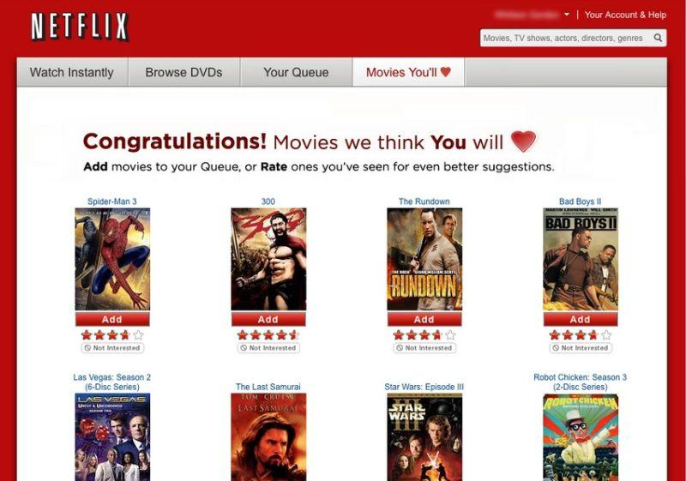
9.1.2 Content-Based System
Content-Based Systems examine the properties of the items recommended. Similarity of items is determined by measuring the similarity in their properties.
Example:
If a Netflix user has watched many gossip girl shows, then recommend a movie or show classified in the database as having “gossip girl” traits or genre.

Slide 4
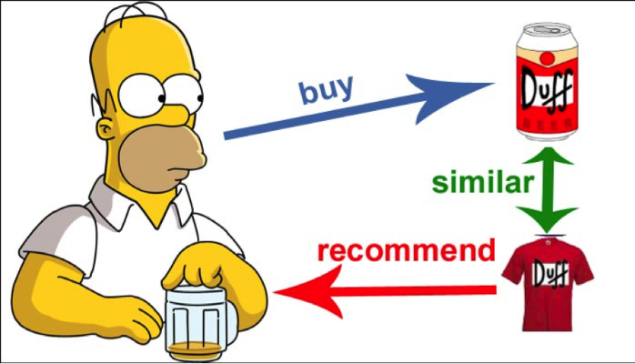
9.2.2 Collaborative Filtering
Collaborative-filtering systems focus on the relationship between users and items. Similarity of items is determined by the similarity by the similarity of the ratings of those items by the user who rated both items.
Basic Assumptions:
-Users with similar interests have common preferences
-Sufficiently large number of user preference are available

Slide 5
9.1.3 The Utility Matrix
Matrix of value representing each user’s level of affinity to each item.
Recommendation engine needs to predict the values for the empty cells based on available cell values
Denser the matrix, better the quality of recommendation
In Fig. 9.1 we see an example utility matrix, representing users’ ratings of movies on a 1–5 scale, with 5 the highest rating. Blanks represent the situation where the user has not rated the movie. The movie names are HP1, HP2, and HP3 for Harry Potter I, II, and III, TW for Twilight, and SW1, SW2, and SW3 for Star Wars episodes 1, 2, and 3. The users are represented by capital letters A through D.

Slide 6
Popcorn Time

Slide 7
9.2.1 Item Profiles
Profiles
which is a record or collection of records representing important characteristics of that item
Movies
The set of actors of the movie. Some viewers prefer movies with their favorite actors
The director. Some viewers have a preference for the work of certain directors.
The year in which the movie was made. Some viewers prefer old movies; others watch only the latest releases.
The genre or general type of movie. Some viewers like only comedies, others dramas or romances.
Other Examples
Products - descriptions written by the manufacturer.
Music - artist, composer, and genre.
Books - author, year of publication, and genre.

Slide 8
9.2.2 Discovering Features of Documents
Document Collections
There are many news articles published each day, and we cannot read all of them. A recommendation system can suggest articles on topics a user is interested in.
Identification
First, eliminate stop words – the several hundred most common words, which tend to say little about the topic of a document.
For the remaining words, compute the TF.IDF score for each word in the document. The ones with the highest scores are the words that characterize the document.
To measure the similarity
1. We could use the Jaccard distance between the sets of words.
2. We could use the cosine distance between the sets.

Slide 9
9.2.3 Obtaining Item Features From Tags
Images
typically an array of pixels, does not tell us anything useful about their features.
inviting users to tag the items by entering words or phrases that describe the item
but one picture with a lot of red might be tagged “Tiananmen Square,” while another is tagged “sunset at Malibu.”
Del.icio.us
invited users to tag Web pages
The goal of this tagging was to make a new method of search available
only works if users are willing to take the trouble to create the tags
there are enough tags that occasional erroneous ones will not bias the system

Slide 10
9.2.4 Representing Item Profiles
Our ultimate goal for content-based recommendation is to create both an item proﬁle consisting of feature-value pairs and a user proﬁle summarizing the preferences of the user, based of their row of the utility matrix.
We will try to generalize this vector approach to all sorts of features. It is easy to do so for features that are sets of discrete values. For example, if one feature of movies is the set of actors, then imagine that there is a component for each actor, with 1 if the actor is in the movie, and 0 if not. Likewise, we can have a component for each possible director.
Another class of features that is not readily represented by boolean vectors is numerical features.
Example 9.2: Suppose the only features of movies are the set of actors and the average rating. Consider two movies with ﬁve actors each. Two of the actors are in both movies. Also, one movie has an average rating of 3 and the other an average of 4. The vectors look something like
0 1 1 0 1 1 0 1 3α 1 1 0 1 0 1 1 0 4α
However, there are, in principle, an infinite number of additional components, each with 0’s for both vectors, representing all the possible actors that neither movie has.

Slide 11
9.2.5 User Profiles
We not only need to create vectors describing items but also we need to create vectors with the same components that describe the user’s preferences. We have the utility matrix representing the connection between users and items.
Example 9.3: Suppose items are movies, represented by boolean proﬁles with components corresponding to actors. Also, the utility matrix has a 1 if the user has seen the movie and is blank otherwise. If 20% of the movies that user U likes have Julia Roberts as one of the actors, then the user profile for U will have 0.2 in the component for Julia Roberts.
Example 9.4: Consider the same movie information as in Example 9.3, but now suppose the utility matrix has entries that are ratings in the 1–5 range. Say user U gives an average rating of 3. There are three movies with Julia Roberts as an actor, and those movies got ratings of 3, 4, and 5. Then in the user proﬁle of U, the component for Julia Roberts will have value that is the average of 3−3, 4−3, and 5−3, that is, a value of 1.
On the other hand, user V gives an average rating of 4, and has also rated three movies with Julia Roberts (it doesn’t matter whether or not they are the same three movies U rated). User V gives these three movies ratings of 2, 3, and 5. The user profile for V has, in the component for Julia Roberts, the average of 2−4, 3−4, and 5−4, that is, the value −2/3.

Slide 12
9.2.6 Recommending Items to Users Based on Content
With profile vectors for both users and items, we can estimate the degree to which a user would prefer an item by computing the cosine distance between the user’s and item’s vectors.
Example 9.5: Consider first the data of Example 9.3. The user’s profile will have components for actors proportional to the likelihood that the actor will appear in a movie the user likes. Thus, the highest recommendations (lowest cosine distance) belong to the movies with lots of actors that appear in many of the movies the user likes. As long as actors are the only information we have about features of movies, that is probably the best we can do.
Now, consider Example 9.4. There, we observed that the vector for a user will have positive numbers for actors that tend to appear in movies the user likes and negative numbers for actors that tend to appear in movies the user doesn’t like. Consider a movie with many actors the user likes, and only a few or none that the user doesn’t like. The cosine of the angle between the user’s and movie’s vectors will be a large positive fraction. That implies an angle close to 0, and therefore a small cosine distance between the vectors. Next, consider a movie with about as many actors that the user likes as those the user doesn’t like. In this situation, the cosine of the angle between the user and movie is around 0, and therefore the angle between the two vectors is around 90 degrees.

Slide 13
9.2.7 Classification Algorithms
Another approach to a recommendation system using item profiles and utility matrices is to treat the problem as one of machine learning.
Regard the given data as a training set, and for each user, build a classifier that predicts the rating of all items.
A decision tree is a collection of nodes arranged as a binary tree.
The leaves render decisions and each interior node is a condition on the objects being classified.
We start at the root to classify an item and apply the predicate at the root to the item. If the predicate is true, go to the left child. If it is false, go to the right child. Repeat the same process at the node visited, until a leaf is reached. That leaf will classify the item as liked or not.
Construction of a decision tree requires selection of a predicate for each interior node. There are lots of ways to pick the best predicate, but they all try to arrange it so one of the children gets all or most of the positive examples in the training set and the other child gets all or most of the negative examples.

Slide 14
Collaborative Filtering (9.3.1 - 9.3.3)
Instead of using features of items to determine their similarity, this section focuses on the similarity of the user ratings for two items
Users are similar if their vectors are close according to some distance (this could be Jaccard or cosine distance)
This process is called collaborative filtering

Slide 15
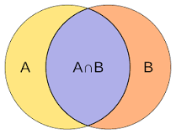
Measuring Similarity
Jaccard Distance: ignore the values in the matrix and focus on the sets of the rated items
Cosine Distance: treats the blanks as a value of 0, it is unorthodox because it has the effect of treating the lack of a rating as more similar to disliking the movie than liking it

Slide 16
The Duality of Similarity
The utility matrix can be viewed as telling us about users or about items, or even both. There are two ways similarity is broken in practice:
We can use information about users to recommend items
There’s a difference in the typical behavior of user and items

Slide 17
Clustering Users and Items
Problem: If two items belong to the same genre, there are likely to be very few users who bought or rated both. Even if two users both like a genre(s), they may not have bought any items in common.
Solution: By selecting any of the distance measures suggested, or any other ones, we can use it to perform a clustering of users/items.

Slide 18
UV-Decomposition
Consider movies as a case in point.
Most users respond to a small number of features; they like certain genres, famous actors or actresses that they like.
If we start with the utility matrix M, with n rows and m columns (i.e., there are n users and m items), then we might be able to find a matrix U with n rows and d columns and a matrix V with d rows and m columns, such that UV closely approximates M in those entries where M is non blank
If so, then we have established that there are d dimensions that allow us to characterize both users and items closely. We can then use the entry in the product UV to estimate the corresponding blank entry in utility matrix M. This process is called UV- decomposition of M

Slide 19
Root-Mean-Square Error & Incremental Computation of UV-Decomposition
While we can pick among several measures of how close the product UV is to M, the typical choice is the root-mean-square error (RMSE), where we
Sum, over all non blank entries in M the square of the difference between that entry and the corresponding entry in the product UV
Take the mean of these squares by dividing by the number of terms in the sum
Take the square root of the mean
Minimizing the sum of the squares is the same as minimizing the square root of the average square, so we generally omit the last two steps in our running example
Finding the UV-decomposition with the least RMSE involves starting with some arbitrarily chosen U and V , and repeatedly adjusting U and V to make the RMSE smaller

