Slide 1
Market Basket, Frequent Itemset, Association Rules, Apriori, Other Algorithms

Slide 2
What is Market Basket Analysis?
Market Basket Analysis is one of the key techniques to uncover associations between items.
It works by looking for combinations of items that occur together frequently in transactions.
It is a modelling technique based upon the theory that if you buy a certain group of items, you are more (or less) likely to buy another group of items.

Slide 3
How Market Basket Analysis works?
This technique determines relationships between the products purchased. Market Basket Analysis takes data at transaction level and lists all items in a single purchase.
If-Then rules of the purchased items are listed.
The rules could be written as:
If {A} Then(=>) {B}
Example:
Rule: {Bread, Jam} => {Butter}.

Slide 4
Support and Confidence
Support: The percentage of transactions that contain all of the items in an itemset
Example:
Support {a1} = 3/5 = o.6
Support {a2,a3} = 3/5 = 0.6
Confidence: The probability that a transaction that contains the items on the left hand side of the rule also contains the item on the right hand side
Example:
Confidence {a1} -> {a4} = 3/3 = 100%
Confidence {a2} -> {a3) = 3/4 = 75%
a1 | a2 | a3 | a4
a1 | a4 | a5 | a6
a1 | a2 | a4 | a7
a2 | a3 | a4 | a7
a2 | a3 | a5 | a6

Slide 5
Applications of Market Basket Analysis
Super Market Shopping
Analysis of credit card purchases.
Analysis of telephone calling patterns.
Identification of fraudulent medical insurance claims.
Analysis of telecom service purchases.

Slide 6
What are frequent sets?
Association Mining searches for frequent items in the data-set.
A frequent itemset is an itemset whose support is greater than some predefined user-specified threshold support.
Frequent mining is generation of association rules from a Transactional Dataset. If there are 2 items X and Y purchased frequently then its good to put them which helps in increasing the sales.

Slide 7
Finding frequent itemsets
Support: It is one of the measure of interestingness. This tells about usefulness and certainty of rules. 5% Support means total 5% of transactions in database follow the rule.
Support = p(A∩B) = $\frac{Number of transactions containing both A and B}{Total Number of Transactions}$
Confidence: A confidence of 60% means that 60% of the customers who purchased jam and bread also bought butter.
Confidence = p(B|A) =$\frac{\text{p}\text{(}\text{A}\text{∩}\text{B}\text{)}}{p(A)}$ = $\frac{Number of transactions containing A \& B}{Total Number of Transactions containing A}$
If a rule satisfies both minimum support and minimum confidence, it is a strong rule.

Slide 8
Example on finding frequent itemsets
1-frequent:
{a1} = 3/5 = 0.6
{a2} = 4/5 = 0.8
2-frequent:
{a1,a2} = 2/5 = 0.4
{a3,a4} = 2/5 = 0.4
3- frequent:
{a2,a3,a4} = 2/5 = 0.4
a1 | a2 | a3 | a4
a1 | a4 | a5 | a6
a1 | a2 | a4 | a7
a2 | a3 | a4 | a7
a2 | a3 | a5 | a6

Slide 9
Association Rules
Association Rule is a way to find patterns or relation in data by using features which are correlated and occur together.
Useful for analysing and predicting Customer behavior
If/then statements that help uncover relationships between unrelated data in a set of data.
Examples:
If a customer buys bread he/she is likely to buy butter
Buys{bread} => buys {butter}

Slide 10
Association Rules (contd.)
Parts of Association rule:
Using the bread and butter example:
a1 => a2 [30%, 60%]
a1 -> Ancedent
a2 -> Consequent
30% -> Support
60% -> Confidence

Slide 11
Types of Association rules
1. Single Dimensional Rule
Bread => Jam : (Buy)
2. Multi Dimensional Rule
Student(I.T), Age(>18) => buys (laptop). Dimensions are not repeated
3. Hybrid Association Rule
Time(Evening), buys (tea) => buys (biscuits)

Slide 12
Applications
Market Basket Analysis
Bioinformatics
Intrusion Detection
Web Usage analysis

Slide 13
Apriori Algorithm
An algorithm for frequent item set mining and association rule learning over relational databases.
It proceeds by identifying the frequent individual items in the database and extending them to larger and larger item sets as long as those item sets appear sufficiently often in the database.
It is used in Market Basket Analysis domain
Apriori Property:
All subsets of a frequent itemset must be frequent(Apriori propertry). If an itemset is infrequent, all its supersets will be infrequent.

Slide 14
Steps:
Build a candidate list for K itemset and extract a frequent list of k-elements using support count
Use the frequent list of k itemsets in the determining the candidate and the frequent list of k+1 itemsets
Check support, use pruning
Repeat until an empty candidate or frequent support of k itemsets is available
Return the list of k-1 itemsets

Slide 15
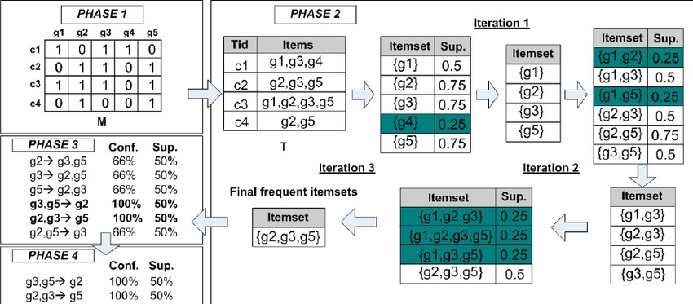
Example:

Slide 16
Advantages & Disadvantages
Pros:
Easy to understand
Easy to implement pruning steps on large itemsets in large databases
Cons:
It requires high computation if the itemsets are very large and the minimum support is kept very low.
The entire database needs to be scanned.

Slide 17
Applications:
Education Field: Extracting association rules in data mining of admitted students through characteristics and specialties.
Medical field: Analysis of the patient's database.
Forestry: Analysis of probability and intensity of forest fire with the forest fire data.
Recommender System and auto-complete feature.

Slide 18
Other Algorithms
FP Growth Algorithm: An efficient and scalable method for mining the complete set of frequent patterns by pattern fragment growth, using an extended prefix-tree structure for storing compressed and crucial information about frequent patterns named frequent-pattern tree (FP-tree).
It is an improvement on Apriori Algorithm. It is used for finding frequent itemset in a transaction database without candidate generation.

Slide 19
Why FP growth is better than Apriori?
Both Apriori and FP-Growth are aiming to find out complete set of patterns but, FP-Growth is more efficient than Apriori in respect to long patterns.
FP growth uses less memory compared to apriori algorithm.
It has better execution time compared to apriori algorithm
Only 2 passes over data-set than repeated database scan apriori

Slide 20
Thank You

