Slide 1
Market Basket , Frequent Itemsets, Association Rules , Apriori , Other Algorithms

Slide 2
Market Basket
Many-to-many relationship between different objects
The relationship is between items and baskets (transactions)
Each basket contains some items (itemset) that is typically less than the total amount of items
Example: customers could buy a combination of multiple products
The items can be milk, bread, juice
The baskets can be {milk, bread}, {bread}, {milk,juice}
Support is needed to gather more information about the baskets
If one combination appears more than the support level, then it is considered frequent

Slide 3
Frequent Itemsets
The problem of finding sets of items that appear in many of the same “baskets”
Sets of items (eg. Grocery store items - 1 Dimensional Array)
Sets of baskets (eg. Groups of items - 2 Dimensional Array)
A Support variable is used
If I is a set of items, Support of I is the number of baskets for which I is a subset
A Support threshold helps determine if I is frequent
If I is >= support threshold, I is determined to be frequent
Else not considered frequent
Original Application of Frequent Itemset was for Market Basket
Other applications include plagiarism, biomarkers, related concepts

Slide 4
Frequent Itemset Example
Items = {“The”, “cloud”, “is”, “a”, “place”, “where”, “magic”, “happens”}
B1 = {“Where”, “is”, “a”, “magic”, “cloud”}
B2 = {“Magic”, “happens”, “in”, “a”, “place”, “called”, “Narnia”}
B3 = {“Where”, “is”, “my”, “magic”, “stick”}
B4 = {“Where”, “is”, “Magic”, “Johnson”}
With a support of 3 Baskets, Frequent Itemsets include:
{“Where”}, {“is}, {“Magic”}
{“Where”, “is”}, {“is”, “Magic”}, {“Where”, “Magic”}
{“Where”, “is”, “Magic”}

Slide 5
Association Rules
Association Rules are if/then statements that help uncover relationships between seemingly unrelated data.
A common example of association rules is the Market Basket Analysis
Ex. If a customer buys a brand new laptop, he/she is 70% likely to buy a case as well.
Ex. If a customer buys a mouse, he/she is 95% likely to buy a keyboard as well.
2 Main Components:
Antecedent
Found in the data
Can be viewed as the “If”
Consequent
Item found in combination with the Antecedent
Can be viewed as the “then”

Slide 6
Association Rules Cont’d
Support and Confidence help identify relationship between items
Support - The number of times an item appears in a dataset
Confidence - Indicates the number of times the if/then statements have been found to be true.
Ex. Rule A ⇒B
Support = frq (A,B)/N, (N = total # of transactions)
Confidence = frq(A,B)/A
http://searchbusinessanalytics.techtarget.com/definition/association-rules-in-data-mining

Slide 7
Apiori
Algorithm for mining frequent itemsets and association rule learning
Apriori Principle: If an itemset is frequent, then all of its subsets must also be frequent
If {I1,I2} is a frequent itemset, the {I1} and {I2} should be frequent itemsets
Designed to operate on databases containing transactions
i.e. collections of items bought by customers
Frequent subsets are extended one item at a time and tested against data
If {1}, {2}, {3} are frequent itemsets, then itemsets {1,2}, {1,3}, {2,3} would be generated and tested against data and support
Extends them to larger and larger item sets as long as those itemsets appear sufficiently often in the database

Slide 8
Apriori Example
Support = 2
CL1
FL1
TID | Items
100 | 1 2 4
200 | 1 3 2
300 | 1 2 3
Itemset | Support
1 | 3
2 | 3
3 | 2
4 | 1
Itemset | Support
1 | 3
2 | 3
3 | 2
CL2
Itemset | Support
{1,2} | 3
{1,3} | 2
{2,3} | 2
Terminate when no further successful extensions are found

Slide 9
Other Algorithms

Slide 10
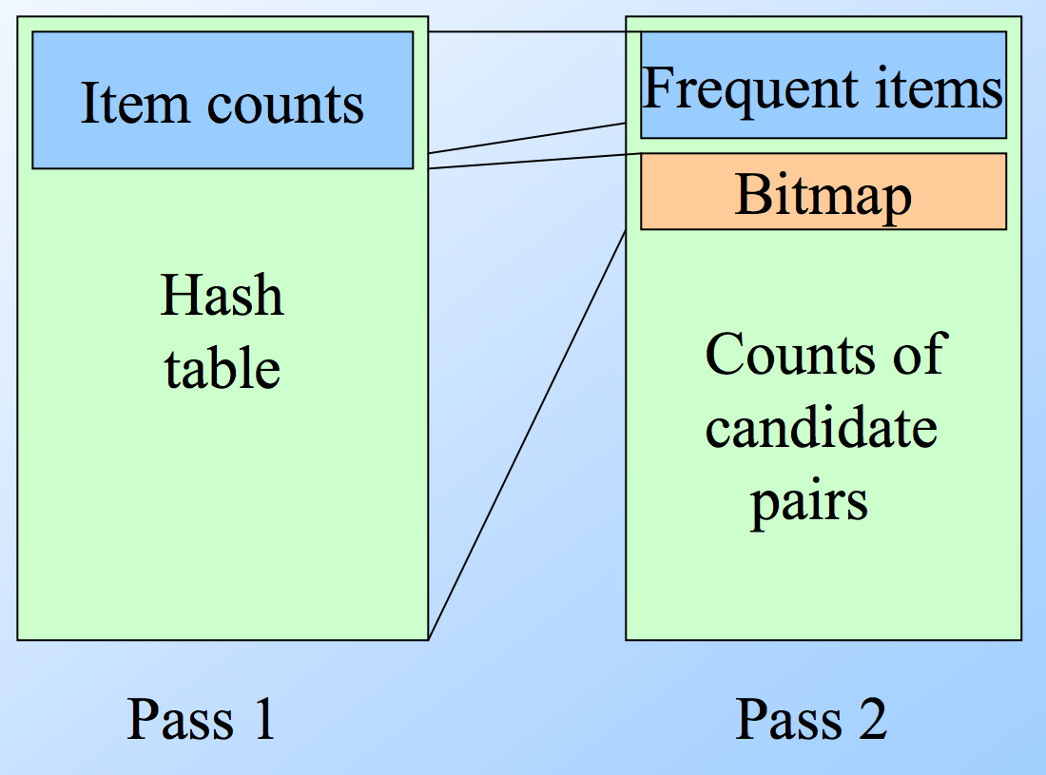
PCY (Park-Chen-Yu) Algorithm
Accomplishes more on the first pass
Uses an array disguised as a hash table (where indices represent keys)
On first pass, hashes each pair of items and increments the count at that hash if item pairs occurs more than once
After first pass, has a hash of pairs
Integers are replaced by bits

Slide 11
Simple Algorithm
The simple algorithm applies the Apriori algorithm to a smaller random subset of data.
Chunks are chosen at random across the entire dataset to account for non-uniform data distribution.
The entire dataset is scaled and random chunks are chosen with probability p.
This creates a subset of size mp where m is the size of the dataset and p is the probability of a chunk being chosen.
Minimum support for the entire dataset is multiplied by the ratio of the (subset size/dataset size).
Ex. if subset is 1% of the dataset, support should be adjusted to s/100 where “s” is the original minimum support.
Smaller support thresholds will recognize more frequent itemsets but require more memory.

Slide 12
SON Algorithm
Pass 1
The first pass of the SON Algorithm performs the Simple algorithm on subsets that compose partitions of the dataset.
Processing the subsets in parallel is more efficient.
Pass 2
The second pass counts the output from the first pass and determines if an itemset is frequent across all subsets.
This denotes a frequent itemset across the entire dataset.
If a frequent itemset is not present in any subset, then it cannot be frequent across the entire dataset.

Slide 13
Toivonen’s Algorithm
First start as the simple algorithm discussed earlier
Lower the support threshold
Example: if 1%, then make it s/125 not s/100
Goal is to prevent false negatives and ensure that itemsets are frequent
If an item has a support that is close to the support threshold but is not equal to or greater than, then it would be considered frequent in this algorithm
Negative border - when a set (basket) is not frequent in the sample but all of its immediate subsets are
{A,B,C,D} is not frequent but {A,B,C}, {A,B,D}, {A,C,D}, {B,C,D} are frequent, then {A,B,C,D} is frequent
In the second pass, count all of the frequent itemsets from the first pass, and the negative borders
If there is a negative border as the frequent itemset, then you have to start over with a different support threshold level

Slide 14
Video

