Slide 1
Support Vector Machine
ITCS 6190 - Cloud Computing in Data Analysis

Slide 2
Contents
Support Vector Machine
Hyperplane & N-Dimensional Space
Linear SVM
Linear SVM :Non-separable case
Learning a Linear SVM Model-
Example of Linear SVM
Issues and Kernel Trick
Nonlinear Support Vector Machines
Learning Nonlinear SVM Model
Example of Nonlinear SVM
Advantages and disadvantages of SVM
Characteristics & Applications of SVM

Slide 3
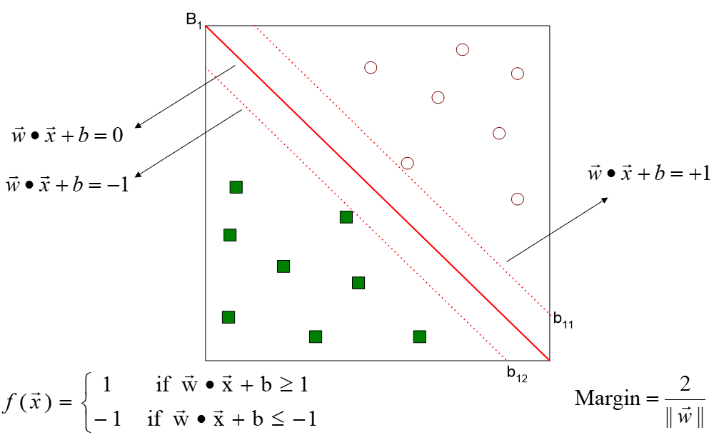
Support Vector Machine
What is Support Vector Machine ?
The process of finding a hyperplane in an N-dimensional space(N — the number of features) that distinctly classifies the data points is called Support Vector Machine.

Slide 4
Characteristics of SVM
Since the learning problem is formulated as a convex optimization problem, efficient algorithms are available to find the global minima of the objective function (many of the other methods use greedy approaches and find locally optimal solutions)
Overfitting is addressed by maximizing the margin of the decision boundary, but the user still needs to provide the type of kernel function and cost function
Difficult to handle missing values
Robust to noise
High computational complexity for building the model

Slide 5
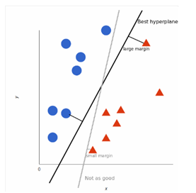
Hyperplane & N-Dimensional Space
What is the best possible hyperplane ?
Many possible hyperplanes that could be chosen but we need to find the maximum margin so that future data points can be classified with more confidence.
Hyperplane in N-dimensional Space
Dimensions of the hyperplane depends upon the number of features.
Number of input features is 2 : hyperplane is just a line.
Number of input features is 3 : hyperplane is a 2D plane.

Slide 6
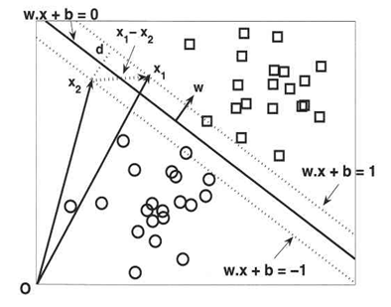
Linear SVM
Linear SVM is the newest extremely fast machine learning (data mining) algorithm for solving multiclass classification problems from ultra large data sets that implements an original proprietary version of a cutting plane algorithm for designing a linear support vector machine. Linear SVM is a linearly scalable routine meaning that it creates an SVM model in a CPU time which scales linearly with the size of the training data set.
Features
•Efficiency in dealing with extra large data sets (say, several millions training data pairs),
•Solution of multiclass classification problems with any number of classes,
•Working with high dimensional data (thousands of features, attributes) in both sparse and dense format,
•No need for expensive computing resources (personal computer is a standard platform),
•Ideal for contemporary applications in digital advertisement, e-commerce, web page categorization, text classification, bioinformatics, proteomics, banking services and many other areas.

Slide 7
Learning a Linear SVM Model
The training phase of SVM involves estimating the parameters w and b of the decision boundary from the training data. The parameters must be chosen in such a way that the following two conditions are met:
These conditions impose the requirements that all training instances from class gr : 1 (i.e., the squares) must be located on or above the hyperplane w.x* b: L, while those instances from class U: -I (i.e., the circles) must be located on or below the hyperplane w .x * b - -1.
Although the preceding conditions are also applicable to any linear classifiers (including perceptrons), SVM imposes an additional requirement that the margin of its decision boundary must be maximal. Maximizing the margin, however, is equivalent to minimizing the following objective function:

Slide 8
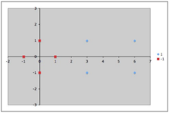
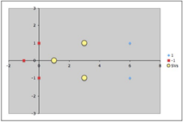
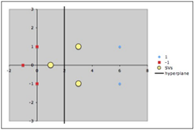
Linear SVM Example
Assume our dataset has two classes as follows:
Class A data = Class B =
The dataset can be visually plotted on the x-y plane as seen in the Fig. 1 below:
Fig 1. Fig 2. Fig 3
❖Our objective is to find a linear SVM which can classify the given dataset.
❖Assume that our support vectors are chosen to be as seen in Fig. 2 above;
Notes:
So in this example we have given 4 -ve labeled data points and 4 +ve labeled data points.
First we need to plot these data points and then we need to identify the nearest data points to both of these classes

Slide 9
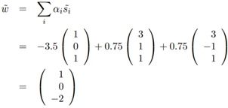
From the 3 support vectors, we get 3 equations.
Assume ɸ as Identity, we get the equations as follows:
Finally substituting the dataset into the above equations and solving for solution. We get the values of ɑ1, ɑ2 and ɑ3 as -3.5, 0.75 and 0.75 respectively. Finally, we can get the hyperplane that classifies the dataset using the line equation. The hyperplane is shown in Fig 3 - of previous slide.
Notes:
Here 1 is added as a bias input which is known as a dimension. Then we need to calculate 3 variables. Alpha 1 2 and 3. These variables are required to calculate the weight vector.
If you see, in the first equation, we have s1 as common. Since s1 is present in the negative side, we equate the particular equation to -1
I is the number of nearest data points

Slide 10
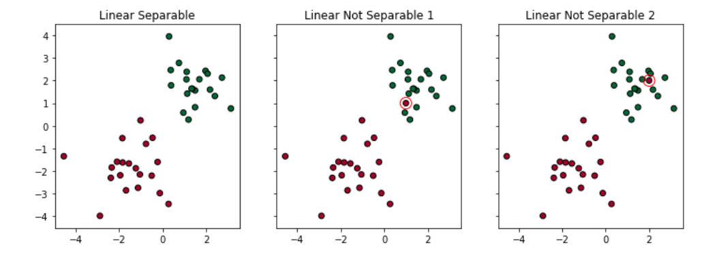
Linear SVM non separable case
1.SVM address non-linearly separable cases by introducing two concepts: Soft Margin and Kernel Tricks.
2.Let’s use an example. If I add one red dot in the green cluster, the dataset becomes linear non-separable anymore. Two solutions to this problem:

Slide 11
Soft Margin
Two types of misclassifications are tolerated by SVM under soft margin:
1.The dot is on the wrong side of the decision boundary but on the correct side/ on the margin (shown in left)
2.The dot is on the wrong side of the decision boundary and on the wrong side of the margin (shown in right)
3.Applying Soft Margin, SVM tolerates a few dots to get misclassified and tries to balance the trade-off between finding a line that maximizes the margin and minimizes the misclassification.

Slide 12
Non Linear SVM
Non Linear SVM are used to project data that is not linearly separable into a higher dimensional space.
A non linear transformation is needed to map the date from its original feature space into new space where the decision boundary becomes linear.
Different methodologies are used to find a linear decision boundary in the transformed space after performing the above transformation.
Parameters can be found in the transformed space.
One potential problem with this approach is that it may suffer from the curse of dimensionality problem often associated with high-dimensional data.
Non linear SVM can avoid this problem by using kernel trick.

Slide 13
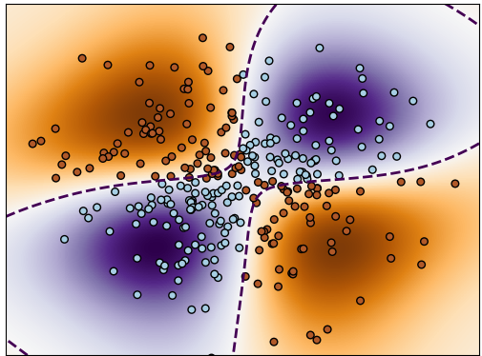
Learning a Non-linear SVM model
In Non-Linear SVM model, we use φ(x) instead of x to represent the transformed high-dimensional features. Assuming φ(x) is already known.φ
The Expression for non-linear SVM learning problem is:
Where

Slide 14
Kernel Trick
Kernel trick method is used by SVM to perform a non-linear classification.
Kernel trick is used to learn a linear classifier to classify a non-linear dataset.
It transforms the linearly inseparable data into a linearly separable one by projecting it into a higher dimension.
A kernel function is applied on each data instance to map the original non-linear data points into some higher dimensional space in which they become linearly separable.

Slide 15
Issues in Non-Linear SVM
ISSUE: One problem with non-linear is that it may suffer with dimensionality problem which is problem related with high-dimensional data.
One possible way is to transform the data into an infinite dimensional space, but still it may not be easy to work with such a high-dimensional space.
Second, even though we know the appropriate mapping function, It is still computationally expensive to solve the constrained optimization problem in the high-dimensional feature space. After the transformation the linear decision boundary in the transformed space has the following form:

Slide 16
Advantages and Disadvantages of SVM
Advantages
SVM works relatively well when there is clear margin of separation between classes.
SVM is more efficient in high dimensional spaces.
Disadvantages
SVM algorithm is not suitable for large data sets.
SVM does not perform very well when the data set has more noise i.e target classes are overlapping.

Slide 17
Real World Applications of SVM
Face detection - SVM classify parts of the image as a face and non face and create a square boundary around the face
Classification of images - use of SVM’s provide better search accuracy for image classification. It provides better accuracy in terms in comparison to the traditional based query-based searching techniques.
Handwriting recognition - We use SVMs to recognize handwritten characters used widely.

