Slide 1
Naive Bayes Classification
(Group 12)

Slide 2
Motivation - Classification
The purpose of classification algorithms is to make sense of and extract value from large sets of structured and unstructured data. If working with huge volumes of unstructured data, it only makes sense to try to partition the data into some sort of logical groupings before attempting to analyze it.
Using classification algorithms, text analysis software can perform things like sentiment analysis to categorize unstructured text by polarity of opinion (positive, negative, neutral, and beyond).
There are three methods to define a classification algorithm:
Model a classification rule directly
Model the probability of class memberships given input data
Make a probabilistic model of data within each class

Slide 3
Classification
Classification is a technique where we categorize data into a given number of classes. The main goal of a classification problem is to identify the category/class to which a new data will fall under.
Classification can be performed on structured or unstructured data.

Slide 4
Steps in the classification model
Initialize the classifier to be used.
Train the classifier: All classifiers in scikit-learn uses a fit(X, y) method to fit the model(training) for the given train data X and train label y.
Predict the target: Given an unlabeled observation X, the predict(X) returns the predicted label y.
Evaluate the classifier model

Slide 5
Naive Bayes
It is a classification technique based on Bayes’ Theorem with an assumption of independence among predictors. In simple terms, a Naive Bayes classifier assumes that the presence of a particular feature in a class is unrelated to the presence of any other feature.
Advantages: This algorithm requires a small amount of training data to estimate the necessary parameters. Naive Bayes classifiers are extremely fast compared to more sophisticated methods.

Slide 6
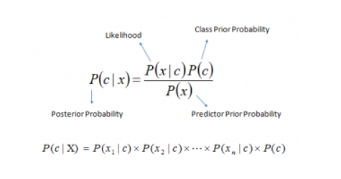
P(c|x) is the posterior probability of class (c, target) given predictor (x, attributes).
P(c) is the prior probability of class.
P(x|c) is the likelihood which is the probability of predictor given class.
P(x) is the prior probability of predictor.

Slide 7
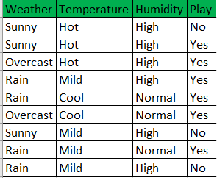
Naive Bayes Example
Simple Example - Here the Target variable is Play. We will
predict if players will play, based on the weather conditions (Weather, Temperature, Humidity)

Slide 8
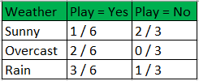
Naive Bayes Example
Learning
P (Play=Yes) = 6/9 P (Play=No) = 3/9

Slide 9
Naive Bayes Example
Testing
Predict a Label for a new instance:
x = (Weather=Sunny, Temperature=Cool, Humidity=High)
Probabilities from Learning phase -
P(Yes|x) ≈ [P(Sunny|Yes)P(Cool|Yes)P(High|Yes)] P(Play=Yes) = 0.0185
P(No|x) ≈ [P(Sunny|No) P(Cool|No)P(High|No)] P(Play=No) = 0.0740
As P(No|x) > P(Yes|x), Predicted Label = No
P(Weather=Sunny|Play=Yes) = 1/6
P(Temperature=Cool|Play=Yes) = 2/6
P(Humidity=High|Play=Yes) = 3/6
P(Weather=Sunny|Play=No) = 2/3
P(Temperature=Cool|Play=No) = 1/3
P(Humidity=High|Play=No) = 3/3

Slide 10
Text Classification using Naive Bayes
Naive Bayes classifier is a type of text classifier that classifies taking into account, the probability values of the events. It is one of the most common methods of text classification.
It works by using the fundamental rule of Naive bayes theorem:
p(A/B) = p(B/A).p(A)
p(B)
Where A and B are events, and the function p() is probability value of the respective events.
Naive Bayes classifier needs less training data and time to train the model, hence requires less CPU and memory usage.

Slide 11
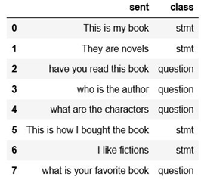
Example for Text Classification using Naive Bayes
P(Stmt|What is the price of the book) or P(Ques|What is the price of the book)
Denominator is Same for both, we can ignore denominator and have to find the values of numerator

Slide 12
Applications of Text classification
Spam/ham classification
Sentiment analysis
Topic classification
Identifying demographics based on writing style

Slide 13
Steps for naive bayes text classification
Identify the classes
Compute the Term-Document Matrix for each individual class by tokenizing
Compute the frequency of each term
Compute the probability of a term occurring and its classification result using Naive Bayes
Notes:
https://towardsdatascience.com/implementing-a-naive-bayes-classifier-for-text-categorization-in-five-steps-f9192cdd54c3

Slide 14
Why is tokenization performed?
The algorithm can only handle features with numerical vectors. The string has to be converted into a number before the model can be built
Notes:
https://towardsdatascience.com/implementing-a-naive-bayes-classifier-for-text-categorization-in-five-steps-f9192cdd54c3

Slide 15
Conclusion

