Slide 1
Naïve Bayes Text Classification

Slide 2
Text Classification and idea of Relevance
Text classification is the process of assigning tags or categories to text based on its content
Sentiment analysis, topic labeling, spam detection, relevance
Relevance is when search engine returns a set of documents relevant to user’s query.
User manually marks result as relevant or not and search engine re-computes based on user’s input
Further new results have (hopefully) better recall

Slide 3
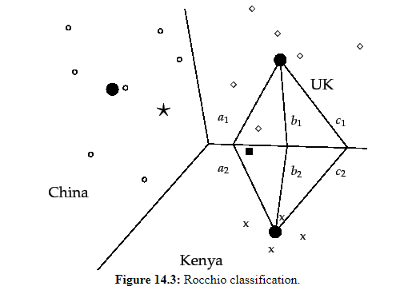
Rocchio classification
Consider 3 classes, China, UK and Kenya in a 2D space.
Documents are shown as circle, diamonds and X’s
Boundaries are called decision boundaries to separate the 3 classes
New document (‘star’) to be assigned to class
of that region, China in this case
Rocchio classification computes boundaries to classify
unseen data
It uses centroids to define boundaries.
Centroid c of a class is center of mass (vector average)
of its members

Slide 4
Query expansion at search engines
Example1: after searching ‘herbs’ user frequently search ‘herbal remedies’
→’herbal remedies’ is potential expansion of ‘herb’
Example2: user who search for ‘flower pic’ frequently clicks on a specific URL.
Users searching for ‘flower clipart’ also frequently click the same URL
→ ‘flower clipart’ and ‘flower pic’ are potential expansion of each other

Slide 5
Naïve Bayes – Text classification - Idea
Given:
A document space X
Documents are represented in this space – typically some high dimensional space
A fixed set of classes C = [c₁, c₂, …. c_{n}]
Classes are human defined for the needs of an application i.e. (spam vs. non-spam)
A training set D of labeled documents. Each labeled document belong to class
Using a learning method, we wish to develop a classifier ‘y’ that maps documents to a class
y : X→C

Slide 6
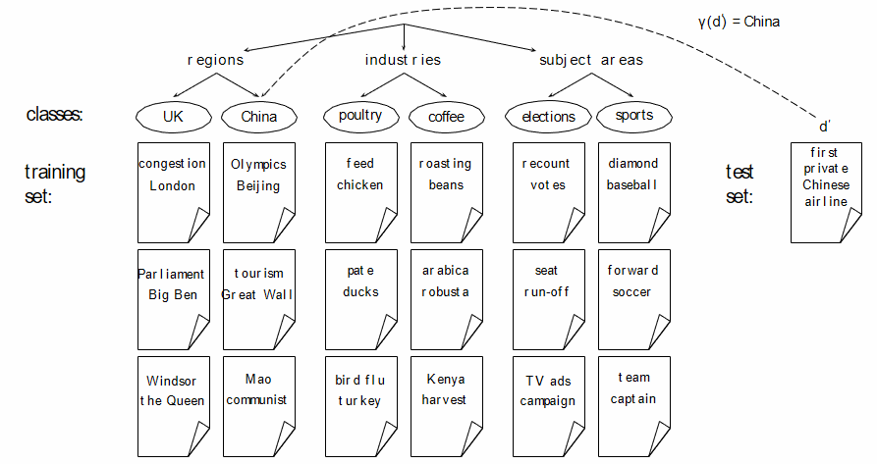

Slide 7
Naïve Bayes classifier
Naïve Bayes classifier is a probabilistic classifier
Probability of a document ‘d’ being in a class ‘c’ is as follows:
N_{d} is the length of the document (number of tokens)
P(t_{k} | c) is the probability of term t_{k} occurring in document of class c
P(t_{k} | c) as a measure of how much evidence t_{k} contributes that c is correct class
P(c) is prior probability of c

Slide 8
Maximum a posteriori class
Our goal in Naïve Bayes classification is to find the ‘best’ class
The best class is the most likely or maximum a posteriori (MAP) class

Slide 9
Taking the log
Multiplying lots of small probabilities can give floating point underflow
Since log(xy) = log(x)+log(y), we can assume log probabilities
Since log is a monotonic function, class with highest score don’t change
Thus our MAP formula becomes:
Notes:
Simple interpretation:
Each conditional parameter log P^{ˆ} (t_{k} |c) is a weight that indicates how good an indicator t_{k} is for c.
The prior log P^{ˆ} (c) is a weight that indicates the relative frequency of c.
The sum of log prior and term weights is then a measure of how much evidence there is for the document being in the
class.
We select the class with the most evidence.

Slide 10
Parameter Estimation
Estimate parameters P(c) and P(t_{k} | c) from train data
Prior:
P(c) = N_{c} / N
N_{c} = number of docs in class c, N = total number of docs
Conditional probability:
P(t | c) = T_{ct} / _{Tct’}
T_{ct} is the number of tokens t in training documents from class c

Slide 11
P(China|d) ∝ P(China) . P(Beijing | China) . P(and | China) . P(Taipei | China) . P(join | Chiina) . P(WTO | China)
If WTO never occurs in class China in the train set:
P(WTO | China) = 0 / T_{china, t’} = 0
Thus we will get P(china | d) = 0 for any document that contains WTO
C =China
X₁ =Beijing
X₂ =and
X₃ =Taipei
X₄ =join
X₅=WTO

Slide 12
To avoid zeros: add-one smoothing
Before:
P(t | c) = T_{ct} / _{Tct’}
After:
P(t | c) = T_{ct} + 1 / _{Tct’} + 1 → T_{ct} +1 / _{Tct’} + B
B is the number of bins – in this case is the number of different words or the size of the vocabulary

Slide 13
Naïve Bayes: Summary
Estimate parameters from the training corpus using add-one smoothing
For a new document, for each class, compute sum of (i) log of prior and (ii) logs of conditional probabilities of the terms
Assign the document to the class with the largest score

Slide 14
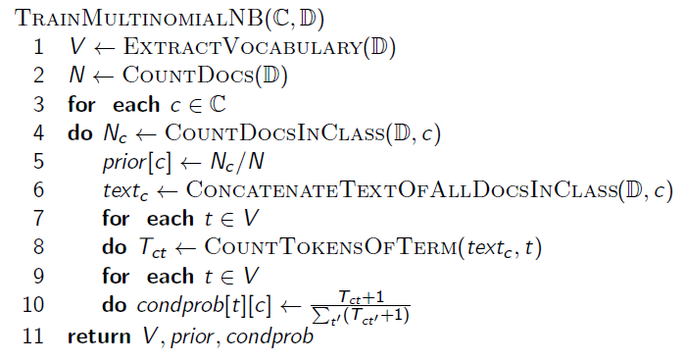
Naïve Bayes: Training

Slide 15
Naïve Bayes: Testing
ApplyMultinomialNB(C, V , prior , condprob, d )
W ← ExtractTokensFromDoc(V , d )
for each c ∈ C
do score[c] ← log prior [c]
for each t ∈ W
do score[c]+ = log condprob[t][c]
return arg max_{c∈C} score[c]

Slide 16
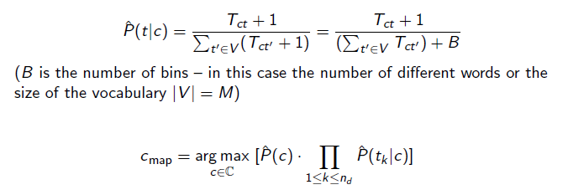
Example:
 | Doc ID | Words in document | In c = China?
Training set | 1 | Chinese Beijing Chinese | Yes
 | 2 | Chinese Chinese Shanghai | yes
 | 3 | Chinese Macao | Yes
 | 4 | Tokyo Japan Chinese | No
Test set | 5 | Chinese Chinese Chinese Tokyo Japan | ???

Slide 17
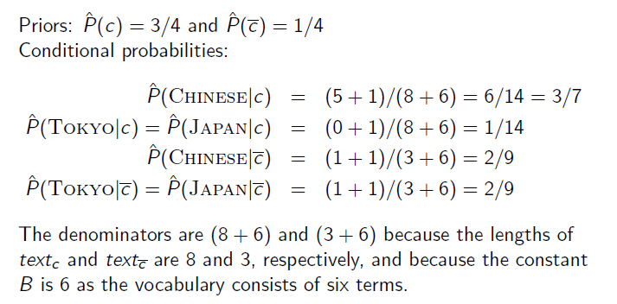

Slide 18
Thus, classifier assigns the test document to c = China. The reason for this classification decision is that the three occurrences of positive indicator Chinese is document 5 outweigh the occurrences of the two negative indicators of Japan and Tokyo

Slide 19
Time complexity of Naïve Bayes
L_{ave}: average length of training doc, L_{a}: length of test doc, M_{a}: number of distinct terms in test doc, D: training set, V : vocabulary, C: set of classes
Θ(|D|L_{ave}) is the time it takes to compute all counts. Θ(|C||V |) is the time it takes to compute the parameters from the counts.
Generally: |C||V | < |D|L_{ave}
Test time is also linear (in the length of the test document). Thus: Naive Bayes is linear in the size of the training set
(training) and the test document (testing). This is optimal.

