Slide 1
Group 9 – Data Mining: Data

Slide 2
Data
Attributes
It is collection of data objects and attributes as shown below:
Attribute is a characteristic of an object
Collection of attributes describe an object.
Objects
Notes:
What else can we refer to an object? Record, case, observation

Slide 3
Question 1
Example of attribute ?

Slide 4
Types of Attributes
Nominal
It only provides information to differentiate between objects
Categories with no order
Ordinal
It provides enough information to order objects
Categories with a meaningful order
Interval
The difference between values are meaningful (unit of measurements)
Ratio
Both differences and ratios are meaningful
Notes:
What can be an example of nominal? Eye color, zip code or ID numbers

Slide 5
Question 2:
What can be an example of nominal attribute?

Slide 6
Experimental vs. Observational Data
Experimental
Data which is collected and which is exercised with a control over all attributes
Observational
Data which is collected with no such control and most of all data in data mining is observational data.
Notes:
Example can be: diet coke vs. weight or co2 in atmosphere vs. earth’s temperature

Slide 7
Question 3:
What type of study this can be:
Students drinking tea before bedtime.

Slide 8
Types of data sets
Record
Data Matrix
Document Data
Transaction Data
Graph
World Wide Web
Molecular Structures
Ordered
Spatial Data
Temporal Data
Sequential Data
Genetic Sequence Data
Notes:
Example can be: diet coke vs. weight or co2 in atmosphere vs. earth’s temperature

Slide 9
Question 4:
What is Record Data?

Slide 10
Data Preprocessing
Aggregation
Combining two or more attributes into a single attribute
Sampling
Main technique employed for data selection, used in data mining because processing the entire set of data of interest is too expensive and time consuming.
Dimensionality Reduction
It reduces amount of time and memory required by data mining algorithms and allow the data to be more visualized.
Feature Subset Selection
It is another way of reducing dimensionality of data
Notes:
What can be the purpose of aggregation: Data reduction, change of scale, and more stable data

Slide 11
Question 5:
What can be the purpose of aggregation

Slide 12
Data Preprocessing
Feature creation
Creates new attributes that can capture important information in data set
Discretization
Transform a continuous attribute into categorical attribute
Binarization
Both continuous and discrete attribute may need to transform one or more binary attributes
Attribute Transformation
A function that maps entire set of values of given attributes to a new set of replacement values.
Notes:
What is important about feature subset selection: It removes duplicate information and removes information that is not necessary for data mining.

Slide 13
Question 6:
What is important about feature subset selection

Slide 14
Similarity and Dissimilarity
Similarity
Numerical measure of how data are alike
Value is higher when objects are more alike
Dissimilarity
Numerical measure of how 2 data objects can be different
Lower when data objects are more alike
Minkowski Distance
Is a generalization of Euclidean Distance
Notes:
What should be minimum dissimilarity is like? 0

Slide 15
Question 7:
What should be minimum dissimilarity be like?

Slide 16
Common Properties
Euclidean Distance have some well known properties such as:
d(p, q) ≥ 0 for all p and q and d(p, q) = 0 only if p = q. (Positive definiteness)
d(p, q) = d(q, p) for all p and q. (Symmetry)
d(p, r) ≤ d(p, q) + d(q, r) for all points p, q, and r. (Triangle Inequality)
where d(p, q) is the distance (dissimilarity) between points (data objects), p and q.
A distance that satisfies these properties is a metric

Slide 17
Question 8:
What is Euclidean distance ?

Slide 18
Similarity
Similarities, also have some well known properties.
s(p, q) = 1 (or maximum similarity) only if p = q.
s(p, q) = s(q, p) for all p and q. (Symmetry)

Slide 19
Question 9:
What does s(p,q) equal to?

Slide 20
Correlation
Correlation measures the linear relationship between objects
Compute correlation, we standardize data objects by taking their dot product.
Attributes are different, but similarity is needed.

Slide 21
Question 10:
To compute correlation, what rule do we use ?

Slide 22
Visually Evaluating Correlation
Scatter plots showing the similarity from –1 to 1.

Slide 23
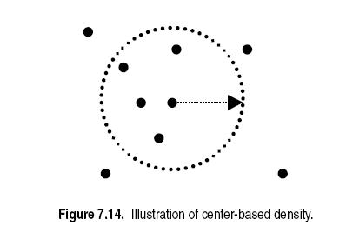
Density
Density-based clustering require a notion of density
Euclidean Density is a simplest approach to divide region into number of rectangular cells of equal volume and define density.
Is the number of points within specified radius of point.
Euclidean Density
Notes:
Simply put, density-based clustering groups together points that are closely packed together, aka high-density regions, and identifies outliers that are in low-density regions
There are a few methods and the Euclidean distance method is the simplest way of determining clusters
Works more efficiently when there’s a low level of dimensionality; otherwise it faces the curse of dimensionality
It’s also sensitive to parameters, so the selection and tuning of the parameters can become difficult

Slide 24
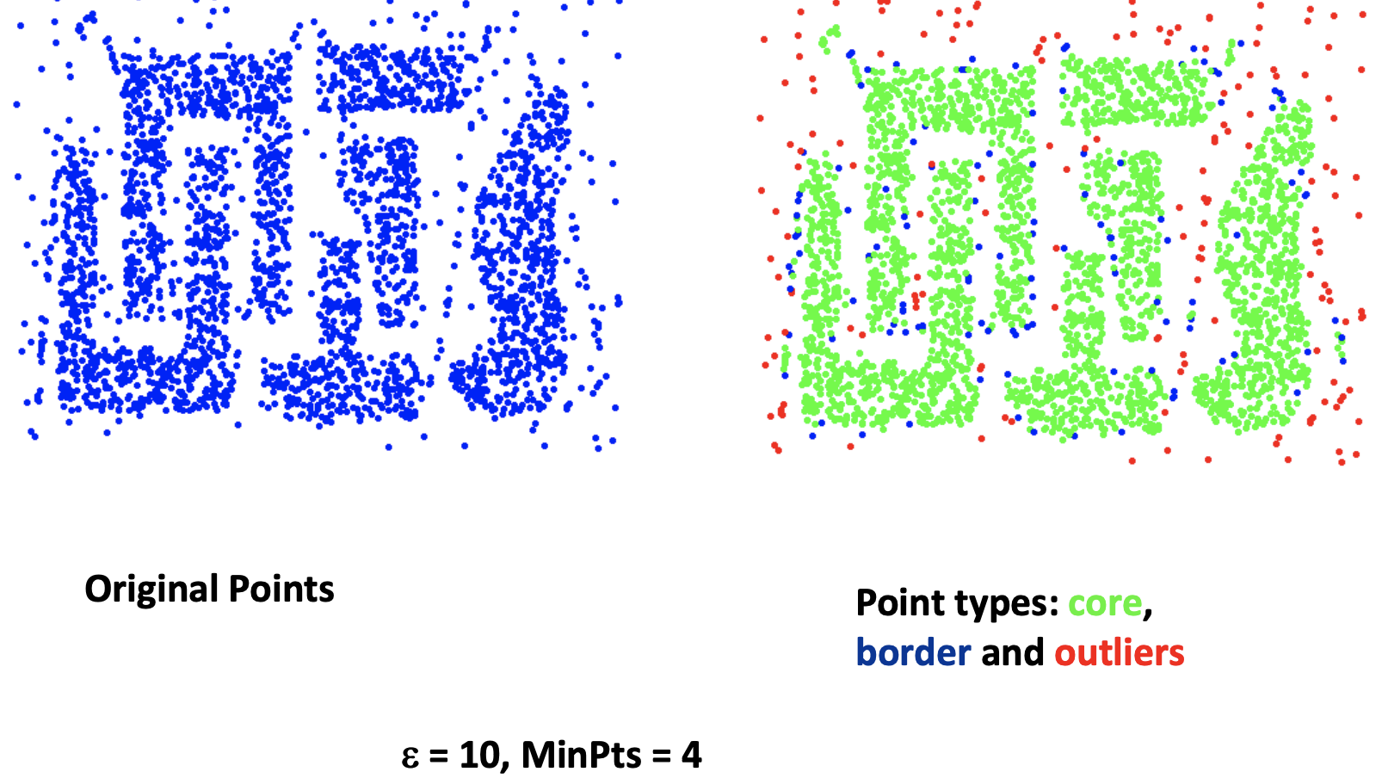
Examples
Euclidean
Graph
Notes:
Example 1 – Density Based Clustering
Example 2 – Graph Based Clustering
Based on distances & can use tree-based algorithms to construct the graph
Example 3 – Probabilistic Model Based Clustering

