Slide 1
Boolean Retrieval Term Vocabulary and Posting Lists Web Search Basics

Slide 2
Information Retrieval
Information Retrieval is is finding material of an unstructured nature that satisfies an information need from within large collections.
It is used retrieve data from large collection of data.
Information Retrieval can also be used to retrieve data from the semi-structured data which contains java in the title and threading in the body.
Information Retrieval can distinguished on the scale on which they operate like the Web Search, Personal Information Retrieval, Domain-specific search.

Slide 3
Boolean Retrieval
Boolean Retrieval Model is the simplest model to base an Information Retrieval Model.
This model consists of terms like AND, OR, NOT.
In this the result will be the documents which satisfy the Boolean expression.
This is one of the precise retrieval tool.
Eg: Brutus AND Calpurnia.
In the above example Brutus is searched in the Dictionary and then Calpurnia and from the result we search the intersection which contains both Brutus and Calpurnia.

Slide 4
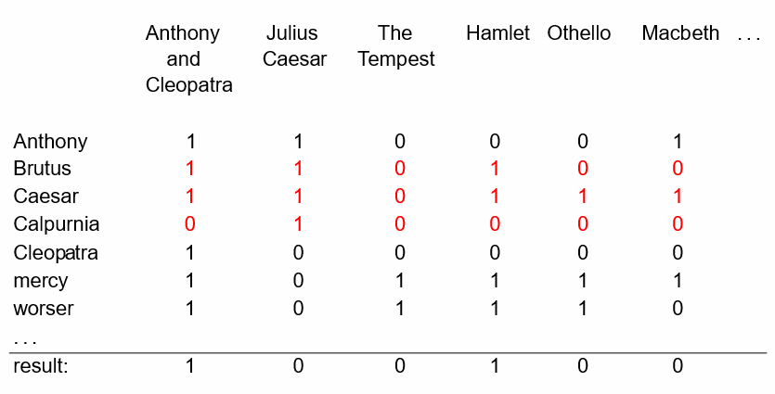
Incidence Matrix
Grep: Linear Scan from beginning through all text by grep. But its slow, line-oriented, less flexible.
Incidence Matrix: Represent the documents via a boolean stating on if a word is present or not.
The statement “Brutus AND Caesar AND NOT Calpurnia” becomes
110100 AND 110111 AND 101111 = 100100

Slide 5
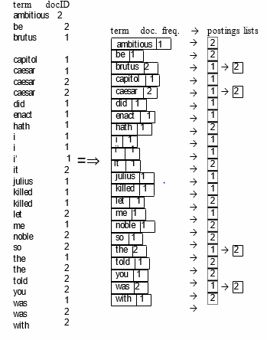
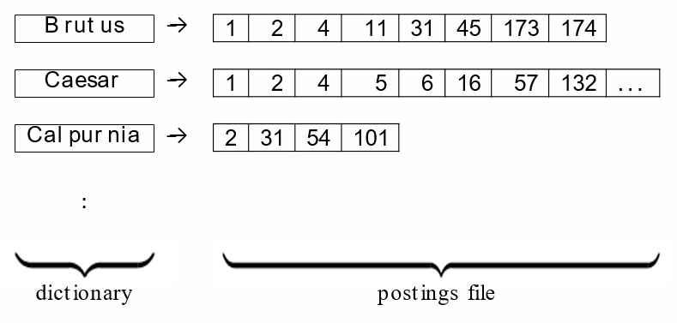
Inverted Index
Ideal for large collections.
Collect Documents
Tokenize & Preprocess
Generate & Sort Postings
Create Posting Lists
Determine Document frequency
Inverted Index (Dictionary + Postings File)

Slide 6
Determining the Vocabulary of Terms
Given a character sequence and a defined document unit, tokenization is the task of chopping it up into pieces, called tokens.
Token normalization is the process of canonicalizing tokens so that matches occur despite superficial differences in the character sequences of the tokens.

Slide 7
Stop Words, Stemming And Lemmatization
Some extremely common words which would appear to be of little value in helping select documents matching a user need are excluded from the vocabulary entirely. These words are called stop words.
The goal of both stemming and lemmatization is to reduce inflectional forms and sometimes derivationally related forms of a word to a common base form.

Slide 8
Index Size and Estimation
The size of the index of a web search engine can be used to determine the quality of the web search engines.
Given two search engines, what are the relative sizes of their indexes? Even this question turns out to be imprecise, because:
In response to queries a search engine can return web pages whose contents it has not (fully or even partially) indexed.
Search engines generally organize their indexes in various tiers and partitions, not all of which are examined on every search.
Assumption: there is a finite size for the Web from which each search engine chooses a subset, and second, that each engine chooses an independent, uniformly chosen subset.
Based on these assumptions, we can invoke a classical estimation technique known as the capture-recapture method.

Slide 9
Near-duplicates and Shingling
The web contains multiple copies of the same content. It is estimated that 40% of pages on the web are duplicates of other pages.
Search engines try to avoid indexing multiple copies of the same content, to keep down storage and processing overheads.
A solution to resolve this problem is a technique known as Shingling.
What is Shingling?
In natural language processing a w-shingling is a set of unique shingles (therefore n-grams) each of which is composed of contiguous subsequences of tokens within a document, which can then be used to ascertain the similarity between documents.
Notes:
Reference: https://en.wikipedia.org/wiki/W-shingling

Slide 10
Posting Lists
Each item in the list which record that a term appeared in a document is called as posting.
the list in then is called posting list and all posting lists taken together are referred as posting lists.
Faster Posting List interaction via skip pointers -
Walk through two posting simultaneously in time linear in total number of posting entries is bit time consuming.
Hence to improve the the efficiency we use fast posting via skip pointers
How it works -
Take the list and augment it with skip pointers at indexing time.
Skip pointers points to a random node in the list far ahead by skipping some node in between.
2 4 8 41 48 64 128
1 2 3 8 11 17 21 31

Slide 11
Positional Posting and Phrase queries -
Complex and technical terms with multi word compounds or phrases.
e.g "Stanford university”
To be able to support such queries, it is no longer sufficient for postings lists to be simply lists
of documents that contain individual terms.
A search engine should not only support phrase queries, but implement them efficiently.
Biword Indexes -
Index every consecutive pair of terms in the text as phrase
Positional Indexes -
In the posting, store for each term the position which token of it appear

Slide 12
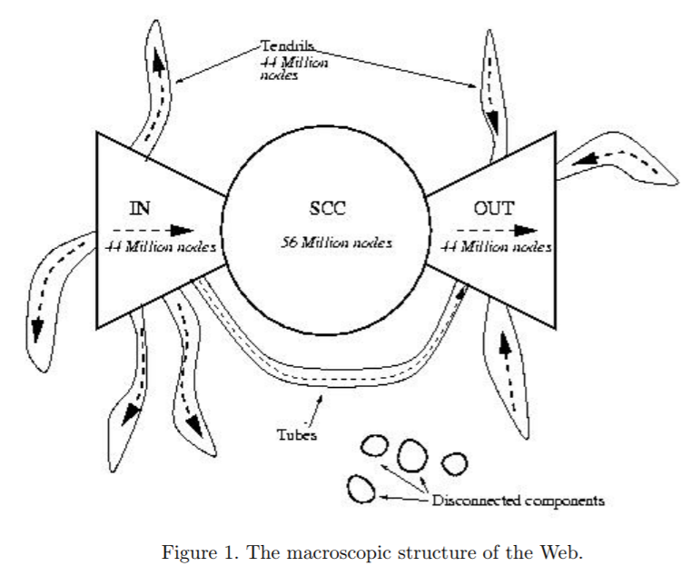
Web search basics
Anchor text is the clickable text in a hyperlink. Anchor text is relevant to the page the user is linking to, rather than generic text.
The keywords in anchor text are one of the many signals search engines use to determine the topic of a web page.
Anchor text is the clickable text in a hyperlink. Anchor text is relevant to the page the user is linking to, rather than generic text.
The keywords in anchor text are one of the many signals search engines use to determine the topic of a web page.

Slide 13
The search user experience
Google identified 2 principles :
A focus on relevance, specifically precision rather than recall in the first few results.
A user experience that is lightweight, meaning that both the search query page and the search results page are uncluttered and almost entirely textual, with very few graphical elements.
Three broad categories into which common web search queries can be grouped:
Informational
To obtain general information on a broad list of topics that returns multiple web pages.
example: laptop
Navigational :
to obtain the website or the home page of a single entity
example: unc charlotte
Transactional
To obtain a list of services that provide the interface for various transactions
example: purchasing a product

Slide 14
Page Rank
PageRank (PR) is an algorithm used by Google Search to rank web pages in their search engine results.
PageRank works by counting the number and quality of links to a page to determine a rough estimate of how important the website is. The underlying assumption is that more important websites are likely to receive more links from other websites.
The websites whose links are posted in other pages seem to rank higher and this lead to a lot of spamming low quality links to eradicate this Google came up with a fix in their algorithm and released an update called panda which removed all low quality links and emphasized getting high quality links over low quality links.

Slide 15
THANK YOU

