Slide 1
Boolean Retrieval
Term Vocabulary and Posting Lists
Web Search Basics

Slide 2
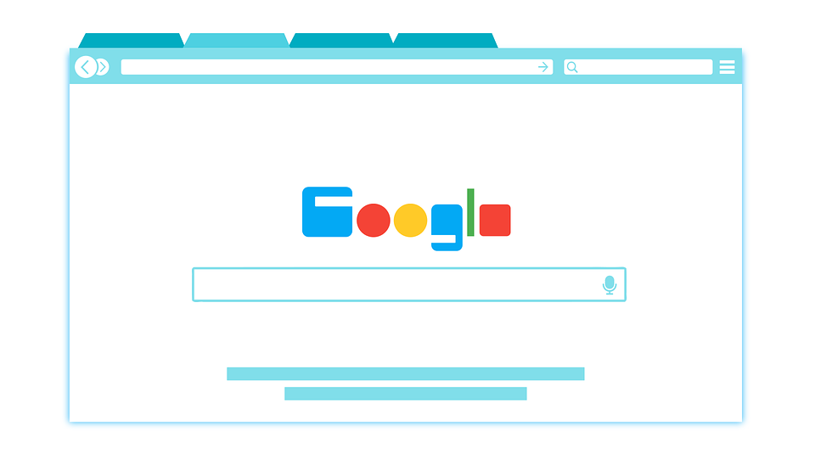
What is Information Retrieval?
“Information Retrieval is finding material (documents) of an unstructured nature (text) that satisfies an information need from within large collections (in computers)”
What was previously held to few professions is now widespread
Librarians, paralegals, etc → Everyday digital web surfers
Information Retrieval Systems have three distinguishable scales:
Web Search
Billions of documents stored in millions of computers
Personal Information Retrieval
Most OS have integrated IR. Same with Email programs.
Enterprise, Institutional, and Domain-Specific Search
Internal documents, database of patents, research articles, etc...

Slide 3
An Example of Information Retrieval Problem
Simplest form of document retrieval is a linear scan: grepping. However, for many purposes we will need more.
Amount of data has grown as quickly as computer speeds.
More flexible matching operations: (NEAR...5 words...same sentence?)
Allow ranked retrieval: Best answer among many
To avoid Linear scans, we need to index the documents in advance.
Intro to Boolean Retrieval: Shakespeare’s Collected Works
Create an incidence Matrix (Words and Works).
We now have a vector for each term. This shows whether it appeared in a work.
Ad-hoc Retrieval: Standard IR task. From collection, retrieves relevant documents based on arbitrary IN.
Information Need: Topic user wishes to know more about → communicated to machine // not a query.
So what happens when we try to create an incidence matrix in a much larger fashion? Too large to store.
Inverted Matrix: A dictionary of terms. Each term is a list of documents it occurs in.

Slide 4
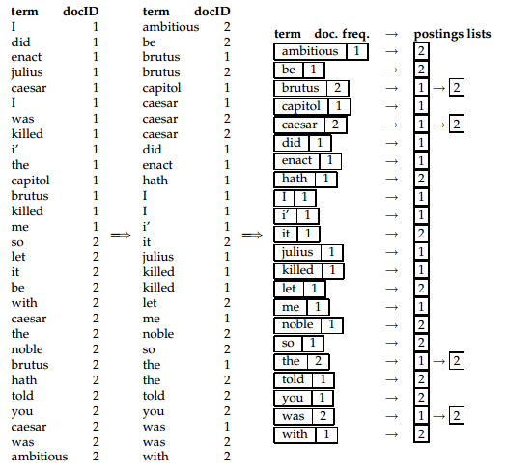
A First Take at Building an Inverted Index
Collect the documents to be indexed
Tokenize the text, turning each document into a list of tokens
Do linguistic preprocessing, producing a list of normalized tokens (indexing terms)
Index the documents that each term occurs in by creating an inverted index consisting of a dictionary and postings.

Slide 5
Processing Boolean Queries
Boolean queries are queries that use AND, OR and NOT.
Primary commercial retrieval tool for 3 decades.
Precise and you will get the results you want.
Consider the query: BRUTUS AND CALPURNIA
The steps will be:
Locate BRUTUS in the dictionary
Retrieve its posting list from the postings file
Locate CALPURNIA in the dictionary
Retrieve its posting list from the Postings file
Intersect the two posting lists.

Slide 6
The Extended Boolean Model vs Ranked Retrieval
Boolean Retrieval Model will:
Represent each document unweighted
Represent the query unweighted
Retrieve an unordered set of documents containing the query words.
Ranked Retrieval Model will:
Represent each document weighted based on document frequency
Represent the query unweighted
Retrieve a ranking documents containing the query words.

Slide 7
Document Delineation and Character Sequence Decoding
Digital documents are typically bytes in a file or on a web server
Step 1 - Determine the correct encoding (Unicode, ASCII, MME, etc)
Step 2 - Decode the byte sequence to a linear character sequence
Characters may have to be decoded out of some binary representation like Microsoft Word DOC files or zip files and additional decoding may need to be done on character entities
Textual part of the document may need to be extracted out of other material that will not be processed
Step 3 - Determine the document unit for indexing
Decoding documents with attachments - regard each as a separate document or as one single document
Decoding a single document, such as a PowerPoint, and split it into separate files
Granularity - determine whether to index each chapter, paragraph or sentence as separate files to improve relevance of search queries

Slide 8
Determining the Vocabulary of Terms
Tokenization - task of chopping a character sequence into little pieces (tokens)
Input: Friends, Romans, Countrymen,
Output: Friends | Romans | Countrymen
Type - class of all tokens containing same character sequence
Term - Type included in the system’s dictionary
Computer technology has introduced new tokenizers that should tokenize into a single token such as email addresses and web URLs. Other new updates include
Hyphenation (i.e. co-education, Hewlett-Packard)
Compound words in foreign languages (i.e. Lebensversicherungsgesellschaftsangestellter)

Slide 9
Faster Postings List Intersection via Skip Pointers
If we have a size X posting lists and size Y postings lists and the intersection takes X+Y operations. By using the skip pointers can make the intersection in less than X+Y operations. For example, First we start normal intersection and matched 12 and in car list, next is 48, in repairs list the next one is 13 and we have a skip pointer on 13 then we move to next skip pointer which is 29 and it’s still smaller than 48. Thus we skip 14, 15, 17 those 3 items which means we shorter the intersection operations.
But if the next skip pointer is 49 instead of 29 then we have to back to 13 and do the normal intersection operation. For now the operations may larger than X+Y since we have one step to check the skip pointer.

Slide 10
Positional Postings and Phrase Queries
Phrase Queries
Want to be able to answer queries such as “University of North Carolina at Charlotte”. Then the sentence “I went to university at Charlotte” is not match.
Biword indexes
One approach to handing phrases is to consider every pair of consecutive terms in a document as a phrae. For example, the text”A B C” would generate the biword: “AB” and “BC”. When we have longer queries then we get more biword which were treated as vocabulary term.
Positional Postings
Since the Biword indexes is still not a standard solution. Positional Postings put each distinct term into posting list then record their frequency and the position in the document. For example we have “A B” and then we are going to seek the position of A, and then going to find the term B which has 1 position higher than A. Thus we can find “A B”.

Slide 11
Web Search Basics
The client (browser) sends an http request to a web server - specifying the URL
Domain - https://mail.google.com/mail/u/0/#inbox - that specifies the the root of a hierarchy of web pages
Path in the hierarchy - https://mail.google.com/mail/u/0/#inbox - that contains the information to be returned by the server
Making web information “discoverable”
Full text index search engines - presented the user with a keyword search interface supported by inverted indexes and ranking mechanisms (Altavista, Excite and Infoseek)
Taxonomies - trees whose nodes are labelled with entities that are expected to occur in a web search query
populated with web pages in categories organized by topic or type (Yahoo, Bing, Google)
Notes:
https://youtu.be/qRF_tZkV2TY

Slide 12
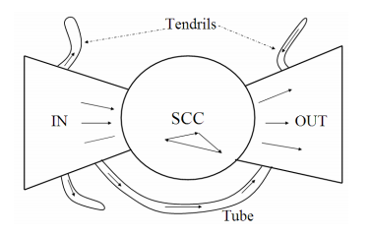
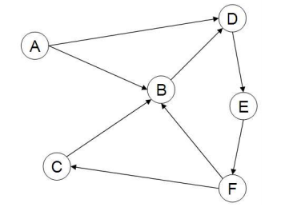
Web Characteristics
Dynamic Web App
“Bowtie Graph”
Static Web App Graph
Notes:
A sample small web graph.In this example we have six pages labeled A-F. Page B has in-degree 3 and out-degree 1. This example graph is not strongly connected: there is no path from any of pages B-F to page A.

Slide 13
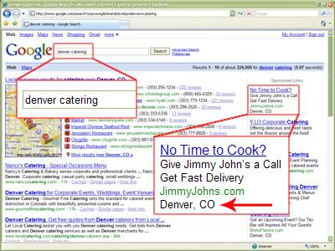
Advertising as the Economic Model
Advertising pricing models:
Cost Per Mil (CPM): The cost to the company to display banner 1000 times
Cost per Click (CPC): Cost based on number of clicks ad receives.
Search Engine Marketing: How search engines implement algorithm ranking and how to allocate marketing campaign budgets to different keywords.
Understand common search engine queries
Recognize “Click Spam”
Pure vs impure search engines

Slide 14
The Search User Experience:
What are you really looking for?
User web queries are grouped into three categories
Informational - seeking information on a broad topic
Ex: Infuenza, World War 2
Navigational - seeing a website or entity that the user has in mind
Ex: Lufthansa airlines
Transactional - a prelude to the user performing a transaction on the Web
Ex: purchasing a product, making a reservation, downloading a file
Fun Fact: Web search engines have a histories of bragging right battles over who can index more web pages. Why should we care? Because if we notice the comprehensiveness of our search, this forces search engines to pay more attention to their index sizes vs. their competitors.

Slide 15
Index Size and Estimation:
What is the size of the web ?
The web is really infinite Dynamic content
Soft 404: www.yahoo.com/<anything> is a valid page
Search engine indexes include multiple classes of indexed pages, so that there is no single measure of index size. These issues notwithstanding,
What can we attempt to measure?
The relative sizes of search engines , The notion of a page being indexed is still reasonably well defined
Search engines generally organize their indexes in various tiers and partitions, not all of which are examined on every search. For instance, a web page deep inside a website may be indexed but not retrieved on general web searches; it is however retrieved as a result on a search that a user has explicitly restricted to that website

Slide 16
Index size and Estimation:
Estimates of the ratio of the index sizes of two search engines is E1 and E2.
Suppose that we could pick a random page from the index of E1 and test whether it is in E2 ’s index and symmetrically, test whether a random page from E2 is in E1 . These experiments give us fractions x and y such that our estimate is that a fraction x of the pages in E1 are in E2 , while a fraction y of the pages in E2 are in E1 . Then, letting |Ei| denote the size of the index of search engine Ei , we have x|E1| ≈ y|E2| , from which we have the form we will use |E1| / |E2| ≈ y / x
There is two approaches to Generate a random URL and check for containment in each index.
But Problem is that Random URLs are hard to find! Enough to generate a random URL contained in a given Engine.
Approach 1: Generate a random URL contained in a given engine
Suffices for the estimation of relative size
Approach 2: Random walks / IP addresses
In theory: might give us a true estimate of the size of the web (as opposed to just relative sizes of indexes)

Slide 17
Near-Duplicates and Shingling:
Duplication : the Web contains multiple copies of the same content. By some estimates, as many as 40% of the pages on the Web are duplicates of other pages. Many of these are legitimate copies; for instance, certain information repositories are mirrored simply to provide redundancy and access reliability. Search engines try to avoid indexing multiple copies of the same content, to keep down storage and processing overheads.
We now describe a solution to the problem of detecting near-duplicate web pages. The answer lies in a technique known as shingling.
Given a positive integer k and a sequence of terms in a document d , define the k -shingles of d to be the set of all consecutive sequences of k terms in d . As an example, consider the following text: a rose is a rose is a rose . The 4-shingles for this text (k = 4 is a typical value used in the detection of near-duplicate web pages) are a rose is a , rose is a rose and is a rose is . The first two of these shingles each occur twice in the text. Intuitively, two documents are near duplicates if the sets of shingles generated from them are nearly the same.

