Slide 1
Recap
Text classification
Naive Bayes
NB theory
Evaluation of TC
Introduction to Information Retrieval
http://informationretrieval.org
IIR 13: Text Classification & Naive Bayes

Slide 2
Recap
Text classification
Naive Bayes
NB theory
Evaluation of TC
Overview
1
Recap
2
Text classification
3
Naive Bayes
NB theory
Evaluation of TC

Slide 3
Recap
Text classification
Naive Bayes
NB theory
Evaluation of TC
Outline
1
Recap
2
Text classification
3
Naive Bayes
NB theory
Evaluation of TC

Slide 4
Relevance feedback: Basic idea
Recap Text classification Naive Bayes NB theory Evaluation of TC
The user issues a (short, simple) query.
The search engine returns a set of documents.
User marks some docs as relevant, some as nonrelevant. Search engine computes a new representation of the
information need – should be better than the initial query.
Search engine runs new query and returns new results. New results have (hopefully) better recall.

Slide 5
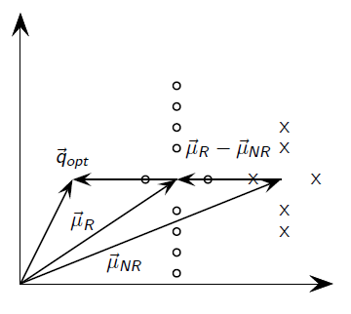
Recap Text classification Naive Bayes
Rocchio illustrated
NB theory
Evaluation of TC
5 / 58

Slide 6
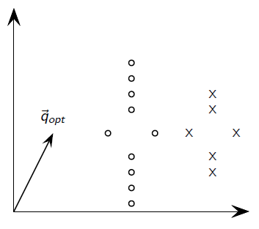
Recap Text classification Naive Bayes
Rocchio illustrated
NB theory
Evaluation of TC
5 / 58

Slide 7
Recap Text classification Naive Bayes NB theory
Types of query expansion
Evaluation of TC
Manual thesaurus (maintained by editors, e.g., PubMed) Automatically derived thesaurus (e.g., based on co-occurrence
statistics)
Query-equivalence based on query log mining (common on the web as in the “palm” example)

Slide 8
Query expansion at search engines
Recap Text classification Naive Bayes NB theory Evaluation of TC
Main source of query expansion at search engines: query logs Example 1: After issuing the query [herbs], users frequently
search for [herbal remedies].
→ “herbal remedies” is potential expansion of “herb”.
Example 2: Users searching for [flower pix] frequently click on the URL photobucket.com/flower. Users searching for [flower clipart] frequently click on the same URL.
→ “flower clipart” and “flower pix” are potential expansions of each other.

Slide 9
Recap Text classification Naive Bayes
Take-away today
NB theory
Evaluation of TC
Text classification: definition & relevance to information retrieval
Naive Bayes: simple baseline text classifier
Theory: derivation of Naive Bayes classification rule & analysis Evaluation of text classification: how do we know it worked /
didn’t work?
8 / 58

Slide 10
Recap
Text classification
Naive Bayes
NB theory
Evaluation of TC
Outline
1
Recap
2
Text classification
3
Naive Bayes
NB theory
Evaluation of TC

Slide 11
A text classification task: Email spam filtering
Recap Text classification Naive Bayes NB theory Evaluation of TC
From: ‘‘’’ <takworlld@hotmail.com>
Subject: real estate is the only way... gem oalvgkay
Anyone can buy real estate with no money down Stop paying rent TODAY !
There is no need to spend hundreds or even thousands for similar courses I am 22 years old and I have already purchased 6 properties using the
methods outlined in this truly INCREDIBLE ebook.
Change your life NOW !
=================================================
Click Below to order: http://www.wholesaledaily.com/sales/nmd.htm
=================================================

Slide 12
Formal definition of TC: Training
Recap Text classification Naive Bayes NB theory Evaluation of TC
Given:
A document space X
Documents are represented in this space – typically some type of high-dimensional space.
A fixed set of classes C = {c₁, c₂, . . . , c_{J} }
The classes are human-defined for the needs of an application (e.g., spam vs. nonspam).
A training set D of labeled documents. Each labeled document (d , c) ∈ X × C
Using a learning method or learning algorithm, we then wish to learn a classifier γ that maps documents to classes:
γ : X → C
11 / 58

Slide 13
Formal definition of TC: Application/Testing
Recap Text classification Naive Bayes NB theory Evaluation of TC
Given: a description d ∈ X of a document
Determine: γ(d ) ∈ C, that is, the class that is most appropriate for d

Slide 14
Recap Text classification Naive Bayes
Topic classification
NB theory
Evaluation of TC
γ(d ′) =China
regions
industries
subject areas
elections ^{sports}
classes:
UK
China
poultry
coffee
_{d} ′
congestion London
Olympics Beijing
feed chicken
roasting beans
recount votes
diamond baseball
first private Chinese airline
training set:
test set:
Parliament
tourism
pate ducks
arabica robusta
seat run-off
forward soccer
Big Ben
Great Wall
Windsor
Mao communist
bird flu
Kenya harvest
TV ads
team captain
the Queen
turkey
campaign

Slide 15
Recap
Text classification
Naive Bayes
NB theory
Evaluation of TC
Exercise
Find examples of uses of text classification in information retrieval

Slide 16
Examples of how search engines use classification
Recap Text classification Naive Bayes NB theory Evaluation of TC
Language identification (classes: English vs. French etc.) The automatic detection of spam pages (spam vs. nonspam) Sentiment detection: is a movie or product review positive or
negative (positive vs. negative)
Topic-specific or vertical search – restrict search to a “vertical” like “related to health” (relevant to vertical vs. not)
15 / 58

Slide 17
Classification methods: 1. Manual
Recap Text classification Naive Bayes NB theory Evaluation of TC
Manual classification was used by Yahoo in the beginning of the web. Also: ODP, PubMed
Very accurate if job is done by experts
Consistent when the problem size and team is small Scaling manual classification is difficult and expensive.
→ We need automatic methods for classification.
16 / 58

Slide 18
Classification methods: 2. Rule-based
Recap Text classification Naive Bayes NB theory Evaluation of TC
E.g., Google Alerts is rule-based classification.
There are IDE-type development enviroments for writing very complex rules efficiently. (e.g., Verity)
Often: Boolean combinations (as in Google Alerts) Accuracy is very high if a rule has been carefully refined over
time by a subject expert.
Building and maintaining rule-based classification systems is cumbersome and expensive.
17 / 58

Slide 19
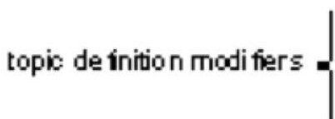
Text class1f1cat1on .. ,
J 1
1 I
A Verity topic (a complex classification rule)
ccmmemline
top·hneltopie
# Beginning of art topic definition
art ACCRUE
/author "' "fsmith"
/date • "30-Dec-01 "
/annotation = "Topic crea ted
by ISII\ith "
* 0.70 performing-art s ACCRUE
0.50 \lORD
/ward text •ballet
0.50 STEM
/ward text • dance
0.50 \lORD
rubtopll
* 0.70 fihl ACCRUE
0.50 STEM
/ word text "' f il11
0 . 50 motion-picture PHRAS
1.00 VORD
subtopctopic
ev encetopi c
.,picdl!tnitOn modifil!r ev encetopi c 10picdl!tnit0n modifier
ev encetopio
.,picdl!tnitOn modifier
ev;.Jencetopic
10picdetnit0n modifier sublO pi:::
subtoptl
/word text
1.00 VORD
/word text
** 0.50 STEM
motion
/ward text
0.30 \lORD
/word text
OJ::era
picture
/ word text movie
symphony
* 0 50 video ACCRUE
0.50 STEM
* 0 . 70 visual-arts ACCRUE
0.50 \lORD
/word text video
/ward text
0.50 \lORD
/vardtext
painting
0.50 STEM
/word text vcr
# End of art topic
sculpture
Schutze Text class1f1cat1on & Na1ve Bayes
18 j 58

Slide 20
Classification methods: 3. Statistical/Probabilistic
Recap Text classification Naive Bayes NB theory Evaluation of TC
This was our definition of the classification problem – text classification as a learning problem
Supervised learning of a the classification function γ and
application of γ to classifying new documents
We will look at two methods for doing this: Naive Bayes and SVMs
No free lunch: requires hand-classified training data
But this manual classification can be done by non-experts.
19 / 58

Slide 21
Recap
Text classification
Naive Bayes
NB theory
Evaluation of TC
Outline
1
Recap
2
Text classification
3
Naive Bayes
NB theory
Evaluation of TC

Slide 22
Recap Text classification Naive Bayes NB theory
The Naive Bayes classifier
Evaluation of TC
The Naive Bayes classifier is a probabilistic classifier.
We compute the probability of a document d being in a class
c as follows:
n_{d} is the length of the document. (number of tokens)
P (t_{k} |c) is the conditional probability of term t_{k} occurring in a document of class c
P (t_{k} |c) as a measure of how much evidence t_{k} contributes that c is the correct class.
P (c) is the prior probability of c.
If a document’s terms do not provide clear evidence for one class vs. another, we choose the c with highest P (c).
21 / 58

Slide 23
Recap Text classification Naive Bayes NB theory
Maximum a posteriori class
Evaluation of TC
Our goal in Naive Bayes classification is to find the “best” class.
The best class is the most likely or maximum a posteriori (MAP) class c_{map}:
22 / 58

Slide 24
Recap
Text classification Naive Bayes
NB theory
Evaluation of TC
Taking the log
Multiplying lots of small probabilities can result in floating point underflow.
Since log(xy ) = log(x ) + log(y ), we can sum log probabilities instead of multiplying probabilities.
Since log is a monotonic function, the class with the highest score does not change.
So what we usually compute in practice is:
23 / 58

Slide 25
Recap Text classification Naive Bayes
Naive Bayes classifier
NB theory
Evaluation of TC
Classification rule:
Simple interpretation:
Each conditional parameter log P^{ˆ} (t_{k} |c) is a weight that indicates how good an indicator t_{k} is for c.
The prior log P^{ˆ} (c) is a weight that indicates the relative frequency of c.
The sum of log prior and term weights is then a measure of how much evidence there is for the document being in the
class.
We select the class with the most evidence.
24 / 58

Slide 26
Parameter estimation take 1: Maximum likelihood
Recap Text classification Naive Bayes NB theory Evaluation of TC
Estimate parameters P^{ˆ} (c) and P^{ˆ} (t_{k} |c) from train data: How? Prior:
P^{ˆ} (c) = ^{Nc}
N
N_{c} : number of docs in class c; N: total number of docs Conditional probabilities:
Tct
P^{ˆ} (t|c) =
t′ ∈V ^{Tct′}
T_{ct} is the number of tokens of t in training documents from class c (includes multiple occurrences)
We’ve made a Naive Bayes independence assumption here:
P^{ˆ} (t_{k} |c) = P^{ˆ} (t_{k} |c), independent of position
25 / 58

Slide 27
The problem with maximum likelihood estimates: Zeros
Recap Text classification Naive Bayes NB theory Evaluation of TC
C =China
X₁ =Beijing
X₂ =and
X₃ =Taipei
X₄ =join
X₅=WTO
P (China|d ) ∝
P (China) · P (Beijing|China) · P (and|China)
P (Taipei|China) · P (join|China) · P (WTO|China)
If WTO never occurs in class China in the train set:
^{T}China,WTO
t′ ∈V ^{T}China,t′
0
t′ ∈V ^{T}China,t′
P^{ˆ} (WTO|China) =
=
= 0
26 / 58

Slide 28
Recap Text classification Naive Bayes NB theory Evaluation of TC
The problem with maximum likelihood estimates: Zeros (cont)
If there are no occurrences of WTO in documents in class China, we get a zero estimate:
^{T}China,WTO
P^{ˆ} (WTO|China) =
= 0
t′∈V ^{T}China,t′
→ We will get P (China|d ) = 0 for any document that contains WTO!
27 / 58

Slide 29
To avoid zeros: Add-one smoothing
Recap Text classification Naive Bayes NB theory Evaluation of TC
Before:
Tct
P^{ˆ} (t|c) =
t′ ∈V ^{Tct′}
Now: Add one to each count to avoid zeros:
T_{ct} + 1 T_{ct} + 1
P^{ˆ} (t|c) =
=
_{t}′_{∈V} (T_{ct}′ + 1) ( _{t}′_{∈V} T_{ct}′ ) + B
B is the number of bins – in this case the number of different words or the size of the vocabulary |V | = M
28 / 58

Slide 30
Recap Text classification Naive Bayes
Naive Bayes: Summary
NB theory
Evaluation of TC
Estimate parameters from the training corpus using add-one smoothing
For a new document, for each class, compute sum of (i) log of prior and (ii) logs of conditional probabilities of the terms
Assign the document to the class with the largest score
29 / 58

Slide 31
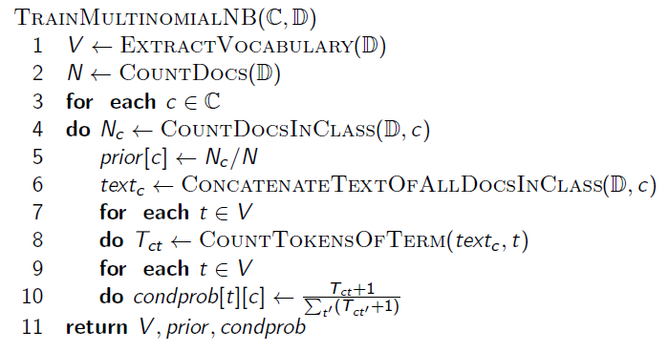
Recap Text classification Naive Bayes NB theory
Naive Bayes: Training
Evaluation of TC

Slide 32
Recap Text classification Naive Bayes
Naive Bayes: Testing
NB theory
Evaluation of TC
ApplyMultinomialNB(C, V , prior , condprob, d )
W ← ExtractTokensFromDoc(V , d )
for each c ∈ C
do score[c] ← log prior [c]
for each t ∈ W
do score[c]+ = log condprob[t][c]
return arg max_{c∈C} score[c]

Slide 33
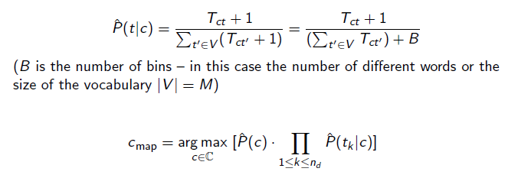
Exercise: Estimate parameters, classify test set
Recap Text classification Naive Bayes NB theory Evaluation of TC
 | docID | words in document | in c = China?
training set | 1 | Chinese Beijing Chinese | yes
 | 2 | Chinese Chinese Shanghai | yes
 | 3 | Chinese Macao | yes
 | 4 | Tokyo Japan Chinese | no
test set | 5 | Chinese Chinese Chinese Tokyo Japan | ?
P^{ˆ} (c) = ^{Nc}
N

Slide 34
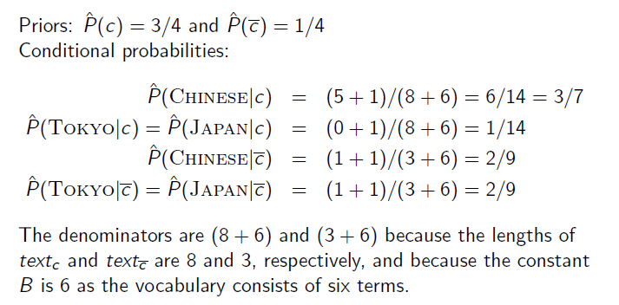
Recap Text classification Naive Bayes NB theory
Example: Parameter estimates
Evaluation of TC

Slide 35
Recap Text classification Naive Bayes
Example: Classification
NB theory
Evaluation of TC
Thus, the classifier assigns the test document to c = China. The reason for this classification decision is that the three occurrences of the positive indicator Chinese in d₅ outweigh the occurrences of the two negative indicators Japan and Tokyo.

Slide 36
Time complexity of Naive Bayes
Recap Text classification Naive Bayes NB theory Evaluation of TC
mode
time complexity Θ(|D|L_{ave} + |C||V |)
training testing
Θ(L_{a} + |C|M_{a}) = Θ(|C|M_{a})
L_{ave}: average length of a training doc, L_{a}: length of the test doc, M_{a}: number of distinct terms in the test doc, D: training set, V : vocabulary, C: set of classes
Θ(|D|L_{ave}) is the time it takes to compute all counts. Θ(|C||V |) is the time it takes to compute the parameters
from the counts.
Generally: |C||V | < |D|L_{ave}
Test time is also linear (in the length of the test document). Thus: Naive Bayes is linear in the size of the training set
(training) and the test document (testing). This is optimal.
36 / 58

Slide 37
Recap
Text classification
Naive Bayes
NB theory
Evaluation of TC
Outline
1
Recap
2
Text classification
3
Naive Bayes
NB theory
Evaluation of TC

Slide 38
Recap Text classification Naive Bayes
Naive Bayes: Analysis
NB theory
Evaluation of TC
Now we want to gain a better understanding of the properties of Naive Bayes.
We will formally derive the classification rule . . .
. . . and make our assumptions explicit.
38 / 58

Slide 39
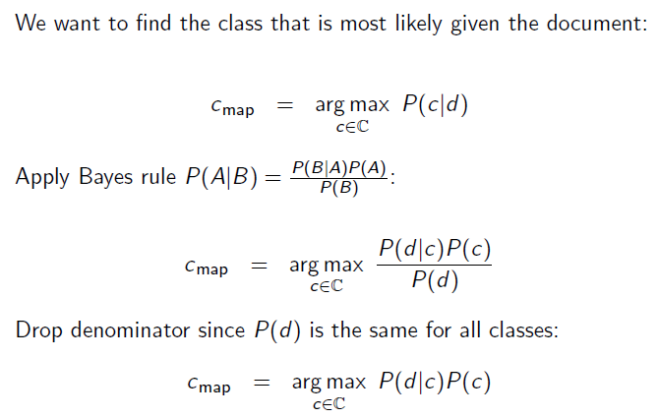
Recap Text classification Naive Bayes NB theory
Derivation of Naive Bayes rule
Evaluation of TC

Slide 40
Too many parameters / sparseness
Recap Text classification Naive Bayes NB theory Evaluation of TC
40 / 58

Slide 41
Naive Bayes conditional independence assumption
Recap Text classification Naive Bayes NB theory Evaluation of TC

Slide 42
Recap Text classification Naive Bayes
Generative model
NB theory
Evaluation of TC
C =China
X₁ =Beijing X₂ =and X₃ =Taipei X₄ =join X₅=WTO
P (c|d ) ∝ P (c) ^{n}_{1≤k≤nd} P (t_{k} |c)
Generate a class with probability P (c)
Generate each of the words (in their respective positions), conditional on the class, but independent of each other, with probability P (t_{k} |c)
To classify docs, we “reengineer” this process and find the class that is most likely to have generated the doc.
42 / 58

Slide 43
Second independence assumption
Recap Text classification Naive Bayes NB theory Evaluation of TC
P^{ˆ} (X_{k1} = t|c) = P^{ˆ} (X_{k2} = t|c)
For example, for a document in the class UK, the probability of generating queen in the first position of the document is the same as generating it in the last position.
The two independence assumptions amount to the bag of words model.
43 / 58

Slide 44
A different Naive Bayes model: Bernoulli model
Recap Text classification Naive Bayes NB theory Evaluation of TC
C =China
^{U}Alaska⁼⁰
UBeijing=1
^{U}India⁼⁰
Ujoin=1
UTaipei=1
U_{WTO}=1

Slide 45
Violation of Naive Bayes independence assumptions
Recap Text classification Naive Bayes NB theory Evaluation of TC
Conditional independence:
Positional independence:
P^{ˆ} (X_{k1} = t|c) = P^{ˆ} (X_{k2} = t|c)
The independence assumptions do not really hold of documents written in natural language.
Exercise
Examples for why conditional independence assumption is not really true?
Examples for why positional independence assumption is not really true?
How can Naive Bayes work if it makes such inappropriate assumptions?
45 / 58

Slide 46
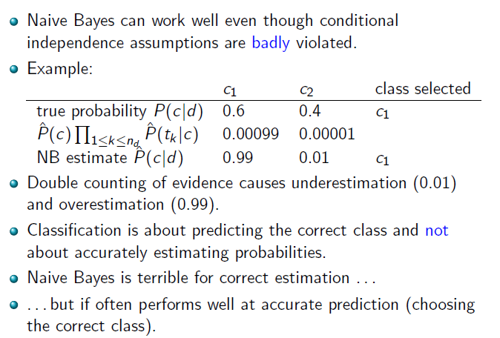
Why does Naive Bayes work?
Recap Text classification Naive Bayes NB theory Evaluation of TC
46 / 58

Slide 47
Recap Text classification Naive Bayes NB theory
Naive Bayes is not so naive
Evaluation of TC
Naive Bayes has won some bakeoffs (e.g., KDD-CUP 97) More robust to nonrelevant features than some more complex
learning methods
More robust to concept drift (changing of definition of class over time) than some more complex learning methods
Better than methods like decision trees when we have many equally important features
A good dependable baseline for text classification (but not the best)
Optimal if independence assumptions hold (never true for text, but true for some domains)
Very fast
Low storage requirements
47 / 58

Slide 48
Recap
Text classification
Naive Bayes
NB theory
Evaluation of TC
Outline
1
Recap
2
Text classification
3
Naive Bayes
NB theory
Evaluation of TC

Slide 49
Recap Text classification Naive Bayes
Evaluation on Reuters
NB theory
Evaluation of TC
γ(d ′) =China
regions
industries
subject areas
elections ^{sports}
classes:
UK
China
poultry
coffee
_{d} ′
congestion London
Olympics Beijing
feed chicken
roasting beans
recount votes
diamond baseball
first private Chinese airline
training set:
test set:
Parliament
tourism
pate ducks
arabica robusta
seat run-off
forward soccer
Big Ben
Great Wall
Windsor
Mao communist
bird flu
Kenya harvest
TV ads
team captain
the Queen
turkey
campaign

Slide 50
Example: The Reuters collection
Recap Text classification Naive Bayes NB theory Evaluation of TC
symbol | statistic | value
N | documents | 800,000
L | avg. # word tokens per document | 200
M | word types | 400,000
type of class | number | examples
region | 366 | UK, China
industry | 870 | poultry, coffee
subject area | 126 | elections, sports
50 / 58

Slide 51
A Reuters document
REUTERS :i
Vou m-e here: Home J> News Jt ScicllCe )t Arlk;. lc
Gok:ln So:tbn U.S 1nternntbnil1 Bu:s ness Milrke1s F'ot1l::s Entertilllment Technob'Jy Splr1s Oct:Hf En
Extreme conditions create rare Anta rctic clouds
TlJe Aug 1. 2XE 3:20am ET
Ema This Arti::: PrlltTh lsArli:: A fils
SYDNEY (Reut ers) - Rare, mo1her -o1-pear1 co1ore:::1 clouds
caused by extreme weather condi1ions above A ntarct ica are a possible indication ot global warming,Australian scientist s said on Tuesday.
-)Text -+I
Known as nacreous clouds,the spa:;1acular formations sha.,ving delicat e wisps ci colors _were ph?! ra.ph in the sky over an Auslralian
Schulze Text cldSSiflcdtlon & N<11ve B<1yes
51 I 58

Slide 52
Recap Text classification Naive Bayes NB theory
Evaluating classification
Evaluation of TC
Evaluation must be done on test data that are independent of the training data, i.e., training and test sets are disjoint.
It’s easy to get good performance on a test set that was available to the learner during training (e.g., just memorize the test set).
Measures: Precision, recall, F₁, classification accuracy
52 / 58

Slide 53
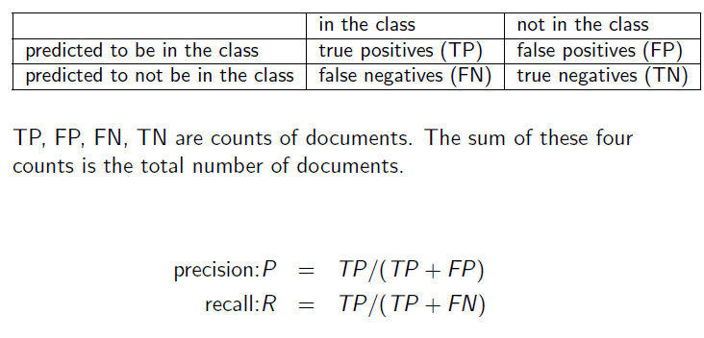
Recap Text classification Naive Bayes NB theory
Precision P and recall R
Evaluation of TC

Slide 54
Recap Text classification Naive Bayes NB theory
A combined measure: F
Evaluation of TC
F₁ allows us to trade off precision against recall.
1 2PR
^{F1 =} 1 1 1 1 ⁼
P + R
2 P ⁺ 2 R
This is the harmonic mean of P and R : ¹ = ¹ ( ¹ + ¹ )
F 2 P R
54 / 58

Slide 55
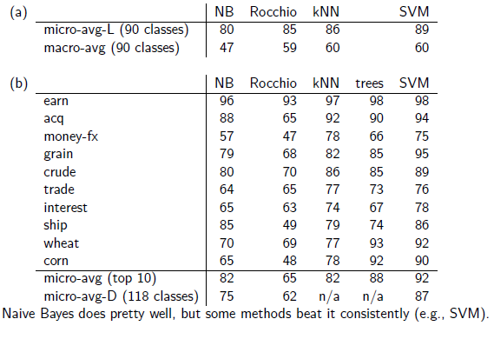
F₁ scores for Naive Bayes vs. other methods
Recap Text classification Naive Bayes NB theory Evaluation of TC
56 / 58

Slide 56
Recap Text classification Naive Bayes
Take-away today
NB theory
Evaluation of TC
Text classification: definition & relevance to information retrieval
Naive Bayes: simple baseline text classifier
Theory: derivation of Naive Bayes classification rule & analysis Evaluation of text classification: how do we know it worked /
didn’t work?

