Slide 1
Introduction to Information Retrieval
http://informationretrieval.org
IIR 1: Boolean Retrieval
Hinrich Schu¨tze
Center for Information and Language Processing, University of Munich

Slide 2
Take-away
Boolean Retrieval: Design and data structures of a simple information retrieval system
What topics will be covered in this class?

Slide 3
Outline
1
Introduction
2
Inverted index
Processing Boolean queries
Query optimization
5
Course overview

Slide 4
Definition of information retrieval
Information retrieval (IR) is finding material (usually documents) of an unstructured nature (usually text) that satisfies an information need from within large collections (usually stored on computers).

Slide 5
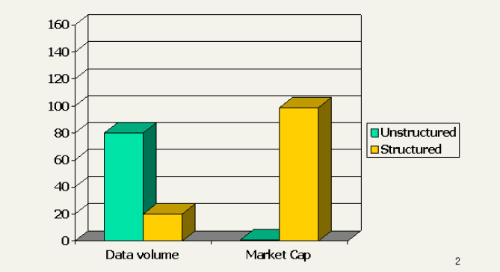
Unstructured (text) vs. structured (database) data in 1996

Slide 6
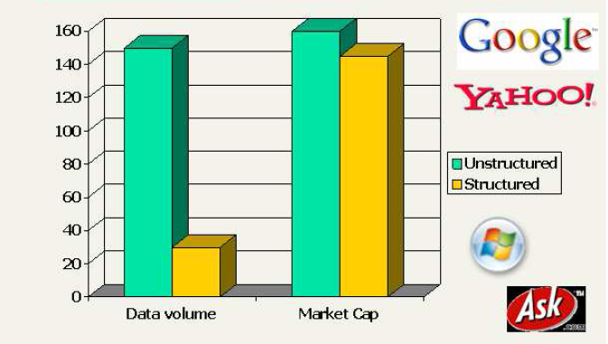
Unstructured (text) vs. structured (database) data in 2006

Slide 7
Boolean retrieval
The Boolean model is arguably the simplest model to base an information retrieval system on.
Queries are Boolean expressions, e.g., Caesar and Brutus
The seach engine returns all documents that satisfy the Boolean expression.
Does Google use the Boolean model?

Slide 8
Does Google use the Boolean model?
On Google, the default interpretation of a query [w₁ w₂
. . . w_{n}] is w₁ AND w₂ AND . . . AND w_{n}
Cases where you get hits that do not contain one of the w_{i} :
anchor text
page contains variant of w_{i} (morphology, spelling correction, synonym)
long queries (n large)
boolean expression generates very few hits
Simple Boolean vs. Ranking of result set
Simple Boolean retrieval returns matching documents in no particular order.
Google (and most well designed Boolean engines) rank the result set – they rank good hits (according to some estimator of relevance) higher than bad hits.

Slide 9
Outline
1
Introduction
2
Inverted index
Processing Boolean queries
Query optimization
5
Course overview

Slide 10
Unstructured data in 1650: Shakespeare
10/60

Slide 11
Unstructured data in 1650
Which plays of Shakespeare contain the words Brutus and Caesar, but not Calpurnia?
One could grep all of Shakespeare’s plays for Brutus and Caesar, then strip out lines containing Calpurnia. Why is grep not the solution?
Slow (for large collections)
grep is line-oriented, IR is document-oriented “not Calpurnia” is non-trivial
Other operations (e.g., find the word Romans near
countryman) not feasible

Slide 12
Term-document incidence matrix
 | Anthony and Cleopatra | Julius Caesar | The Tempest | Hamlet | Othello | Macbeth | . . .
Anthony | 1 | 1 | 0 | 0 | 0 | 1
Brutus | 1 | 1 | 0 | 1 | 0 | 0
Caesar | 1 | 1 | 0 | 1 | 1 | 1
Calpurnia | 0 | 1 | 0 | 0 | 0 | 0
Cleopatra | 1 | 0 | 0 | 0 | 0 | 0
mercy | 1 | 0 | 1 | 1 | 1 | 1
worser | 1 | 0 | 1 | 1 | 1 | 0
. . .
Entry is 1 if term occurs. Example: Calpurnia occurs in Julius Caesar. Entry is 0 if term doesn’t occur. Example: Calpurnia doesn’t occur in The tempest.

Slide 13
Incidence vectors
So we have a 0/1 vector for each term.
To answer the query Brutus and Caesar and not Calpurnia:
Take the vectors for Brutus, Caesar, and Calpurnia
Complement the vector of Calpurnia
Do a (bitwise) and on the three vectors 110100 and 110111 and 101111 = 100100

Slide 14
0/1 vectors and result of bitwise operations
 | Anthony and | Julius Caesar | The Tempest | Hamlet | Othello | Macbeth | . . .
Anthony | Cleopatra 1 | 1 | 0 | 0 | 0 | 1
Brutus | 1 | 1 | 0 | 1 | 0 | 0
Caesar | 1 | 1 | 0 | 1 | 1 | 1
Calpurnia | 0 | 1 | 0 | 0 | 0 | 0
Cleopatra | 1 | 0 | 0 | 0 | 0 | 0
mercy | 1 | 0 | 1 | 1 | 1 | 1
worser | 1 | 0 | 1 | 1 | 1 | 0
. . .
result: | 1 | 0 | 0 | 1 | 0 | 0

Slide 15
Answers to query
Anthony and Cleopatra, Act III, Scene ii
Agrippa [Aside to Domitius Enobarbus]:
Why, Enobarbus,
When Antony found Julius Caesar dead, He cried almost to roaring; and he wept When at Philippi he found Brutus slain.
Hamlet, Act III, Scene ii
Lord Polonius:
I did enact Julius Caesar: I was killed i’ the Capitol; Brutus killed me.

Slide 16
Bigger collections
Consider N = 10⁶ documents, each with about 1000 tokens
⇒ total of 10⁹ tokens
On average 6 bytes per token, including spaces and punctuation ⇒ size of document collection is about 6 · 10⁹ = 6 GB
Assume there are M = 500,000 distinct terms in the collection (Notice that we are making a term/token distinction.)

Slide 17
Can’t build the incidence matrix
M = 500,000 × 10⁶ = half a trillion 0s and 1s. But the matrix has no more than one billion 1s.
Matrix is extremely sparse.
What is a better representations?
We only record the 1s.

Slide 18
Inverted Index
For each term t, we store a list of all documents that contain t.
Brutus −→
Caesar −→
Calpurnia −→
1 | 2 | 4 | 11 | 31 | 45 | 173 | 174
1 | 2 | 4 | 5 | 6 | 16 | 57 | 132 | . . .
2 | 31 | 54 | 101
.
.
dictionary
postings

Slide 19
Inverted index construction
1
Collect the documents to be indexed:
Friends, Romans, countrymen. So let it be with Caesar . . .
Tokenize the text, turning each document into a list of tokens: Friends Romans countrymen So . . .
Do linguistic preprocessing, producing a list of normalized tokens, which are the indexing terms: friend roman
countryman so . . .
Index the documents that each term occurs in by creating an inverted index, consisting of a dictionary and postings.
2
3
4

Slide 20
Tokenization and preprocessing
Doc 1. I did enact Julius Caesar: I
Doc 1. i did enact julius caesar i was
was killed i’ the Capitol; Brutus killed me.
Doc 2. So let it be with Caesar. The noble Brutus hath told you Caesar was ambitious:
_{=⇒} killed i’ the capitol brutus killed me
Doc 2. so let it be with caesar the noble brutus hath told you caesar was ambitious

Slide 21
Generate postings
term docID
i did
enact julius caesar i
was killed i’ the
capitol brutus
1
1
1
1
1
1
1
1
1
1
1
1
1
1
so 2
let 2
it 2
be 2
with 2
caesar 2
the 2
noble 2
brutus 2
hath 2
told 2
you 2
caesar 2
was 2
ambitious 2
Doc 1. i did enact julius caesar i was
killed
killed i’ the capitol brutus killed me
Doc 2. so let it be with caesar the =⇒ ^{me}
noble brutus hath told you caesar was ambitious

Slide 22
Sort postings
term docID term docID
i did
enact julius caesar i
was killed i’ the
capitol brutus killed me
so 2
let 2
it 2
be 2
with 2
caesar 2
the 2
noble 2
brutus 2
hath 2
told 2
you 2
caesar 2
was 2
ambitious 2
1
1
1
1
1
1
1
1
1
1
1
1
ambitious 2
be 2
brutus 1
brutus 2
capitol 1
caesar 1
caesar 2
caesar 2
did 1
enact 1
hath 1
i 1
1
1
2
1
1
1
2
1
2
2
1
2
2
2
1
2
2
1
i
1 _{=⇒} i’
it julius killed killed let me noble so the the told you was was with

Slide 23
Create postings lists, determine document frequency
term docID
ambitious 2
be 2
brutus 1
term doc. freq. → postings lists
ambitious 1
→
→
→
→
→
→
→
→
→
→
→
→
→
→
→
→
→
→
→
→
→
→
2
2
1
1
1
1
1
2
1
1
2
1
1
2
1
2
2
1
2
2
1
2
capitol caesar caesar caesar did enact hath
i i i’ it
julius killed killed let me noble so the the told you was was with
1
1
2
2
1
1
1
1
1
be 1
brutus 2
→ 2
capitol 1
caesar 2
→ 2
did 1
enact 1
hath 1
i 1
i’ 1
¹ =⇒ it 1
2
1
1
1
2
1
2
2
1
2
2
2
1
2
2
julius 1
killed 1
let 1
me 1
noble 1
so 1
the 2
→ 2
told 1
you 1
was 2
→ 2
with 1

Slide 24
Split the result into dictionary and postings file
Brutus
−→
1 | 2 | 4 | 11 | 31 | 45 | 173 | 174
Caesar
−→
1 | 2 | 4 | 5 | 6 | 16 | 57 | 132 | . . .
Calpurnia −→
2 | 31 | 54 | 101
.
.
dictionary
postings file

Slide 25
Later in this course
Index construction: how can we create inverted indexes for large collections?
How much space do we need for dictionary and index? Index compression: how can we efficiently store and process
indexes for large collections?
Ranked retrieval: what does the inverted index look like when we want the “best” answer?

Slide 26
Outline
1
Introduction
2
Inverted index
Processing Boolean queries
Query optimization
5
Course overview

Slide 27
Simple conjunctive query (two terms)
Consider the query: Brutus AND Calpurnia
To find all matching documents using inverted index:
1
2
3
4
5
6
Locate Brutus in the dictionary
Retrieve its postings list from the postings file Locate Calpurnia in the dictionary Retrieve its postings list from the postings file
Intersect the two postings lists
Return intersection to user

Slide 28
Intersecting two postings lists
→
Brutus
−→ 1 → 2 → 4 → 11 → 31
2 → 31 → 54 → 101
2 → 31
45 → 173 → 174
Calpurnia −→
Intersection =⇒
This is linear in the length of the postings lists. Note: This only works if postings lists are sorted.

Slide 29
Intersecting two postings lists
Intersect(p₁, p₂)
answer ← ( )
while p₁ I= nil and p₂ I= nil
do if docID(p₁) = docID(p₂)
then Add(answer , docID(p₁))
p₁ ← next(p₁)
p₂ ← next(p₂)
else if docID(p₁) < docID(p₂)
then p₁ ← next(p₁)
else p₂ ← next(p₂)
return answer

Slide 30
Query processing: Exercise
Compute hit list for ((paris AND NOT france) OR lear)

Slide 31
Boolean retrieval model: Assessment
The Boolean retrieval model can answer any query that is a Boolean expression.
Boolean queries are queries that use and, or and not to join query terms.
Views each document as a set of terms.
Is precise: Document matches condition or not.
Primary commercial retrieval tool for 3 decades
Many professional searchers (e.g., lawyers) still like Boolean queries.
You know exactly what you are getting.
Many search systems you use are also Boolean: spotlight, email, intranet etc.

Slide 32
Commercially successful Boolean retrieval: Westlaw
Largest commercial legal search service in terms of the number of paying subscribers
Over half a million subscribers performing millions of searches a day over tens of terabytes of text data
The service was started in 1975.
In 2005, Boolean search (called “Terms and Connectors” by Westlaw) was still the default, and used by a large percentage of users . . .
. . . although ranked retrieval has been available since 1992.

Slide 33
Westlaw: Example queries
Information need: Information on the legal theories involved in preventing the disclosure of trade secrets by employees formerly employed by a competing company Query: “trade secret” /s
disclos! /s prevent /s employe! Information need: Requirements
for disabled people to be able to access a workplace Query: disab!
/p access! /s work-site work-place (employment /3 place)
Information need: Cases about a host’s responsibility for drunk guests Query: host! /p (responsib! liab!) /p (intoxicat! drunk!)
/p guest

Slide 34
Westlaw: Comments
Proximity operators: /3 = within 3 words, /s = within a sentence, /p = within a paragraph
Space is disjunction, not conjunction! (This was the default in search pre-Google.)
Long, precise queries: incrementally developed, not like web search
Why professional searchers often like Boolean search: precision, transparency, control
When are Boolean queries the best way of searching? Depends on: information need, searcher, document collection, . . .

Slide 35
Outline
1
Introduction
2
Inverted index
Processing Boolean queries
Query optimization
5
Course overview

Slide 36
Query optimization
Consider a query that is an and of n terms, n > 2
For each of the terms, get its postings list, then and them together
Example query: Brutus AND Calpurnia AND Caesar
What is the best order for processing this query?

Slide 37
Query optimization
Example query: Brutus AND Calpurnia AND Caesar
Simple and effective optimization: Process in order of increasing frequency
Start with the shortest postings list, then keep cutting further In this example, first Caesar, then Calpurnia, then
Brutus

Slide 38
Optimized intersection algorithm for conjunctive queries
Intersect((t₁, . . . , t_{n}))
1 terms ← SortByIncreasingFrequency((t₁, . . . , t_{n})) 2
3
4
5
6
7
result ← postings(first(terms)) terms ← rest(terms)
while terms I= nil and result I= nil
do result ← Intersect(result, postings(first(terms))) terms ← rest(terms)
return result

Slide 39
More general optimization
Example query: (madding or crowd) and (ignoble or strife)
Get frequencies for all terms
Estimate the size of each or by the sum of its frequencies (conservative)
Process in increasing order of or sizes

Slide 40
Outline
1
Introduction
2
Inverted index
Processing Boolean queries
Query optimization
5
Course overview

Slide 41
Course overview
We are done with Chapter 1 of IIR (IIR 01).
In what follows: teasers for most chapters – to give you a sense of what will be covered.

Slide 42
IIR 02: The term vocabulary and postings lists
Phrase queries: “Stanford University”
Proximity queries: Gates near Microsoft
We need an index that captures position information for phrase queries and proximity queries.

Slide 43
IIR 03: Dictionaries and tolerant retrieval

Slide 44
IIR 04: Index construction
splits
assign
master
assign
postings
parser
a-f g-p q-z
inve rter
a-f
parser
a-f g-p q-z
inve rter
g-p
inve rter
q-z
parser
a-f g-p q-z
segment files
reduce phase
map phase

Slide 45
IIR 05: Index compression
7
6
5
log10 cf
4
3
2
1
0
0
1
2
3 4
log10 rank
5
6
7
Zipf’s law

Slide 46
IIR 06: Scoring, term weighting and the vector space model
Ranking search results
Boolean queries only give inclusion or exclusion of documents.
For ranked retrieval, we measure the proximity between the query and each document.
One formalism for doing this: the vector space model
Key challenge in ranked retrieval: evidence accumulation for a term in a document
1 vs. 0 occurence of a query term in the document 3 vs. 2 occurences of a query term in the document Usually: more is better
But by how much?
Need a scoring function that translates frequency into score or weight

Slide 47
IIR 07: Scoring in a complete search system
Parsing Linguistics
Documents
user query
 | Results page
Free text query parser
Scoring and ranking
Document cache
Indexers
Spell correction
Metadata in zone and field indexes | Inexact top K retrieval | Tiered inverted positional index | k-gram
Indexes
Scoring
parameters
training set
MLR

Slide 48
IIR 08: Evaluation and dynamic summaries
Coogle Imanitoba second largest city
]ISearch IAdvanced Search
Web i±IShow options... Results 1- 11
Manitoba - Wikipedia.the free encyclopedia
Manitoba's capitalandlargest city, Winnipeg, ....According to Environment Canada,
Manitoba ranked first for clearest skies year round, and ranked second ...
Geography - History - Demographics - Economy
en.wikipedia.org/wiki/ Manitoba - Cached- Similar
List of cities in Canada - Wikipedia.the free encyclopedia
Cities and towns in Manitoba. See also: List of communities in Manitoba ....Dartmouth ­
formerly the second largest city in Nova Scotia, now a Metropolitan ...
en.wikipedia.org/wiki/List_of_cities_in_Canada- Cached- Sim i ar
i±iShow more results from en.wikipedia.org
CanadianImmigration lnfomnaUon - Manitoba
The largest city in the province is the capital, Winnipeg,with a population exceeding 706900. The second largest city is Brandon. Manitoba has received...
www.canadav isa.com/about-manitoba.html- Cached- Similar
CBC Manitoba IEAL
Lesson 57: Brandon- Manitoba's Second Largest City. For Teachers; For Students. Step
One Open the Lesson: PDF (194kb) PDF WORD (238kb) Microsoft Word ...
www.cbc.ca/manitoba/.../lesson-57-brandon--manitobas-second-largest.html- Cached

Slide 49
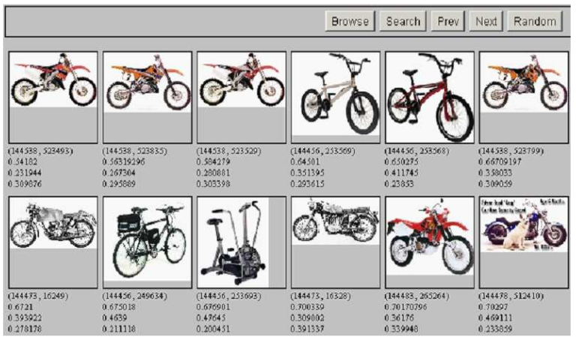
IIR 09: Relevance feedback & query expansion

Slide 50
IIR 12: Language models
w | P (w |q₁) | w | P (w |q₁)
STOP | 0.2 | toad | 0.01
the | 0.2 | said | 0.03
a | 0.1 | likes | 0.02
frog | 0.01 | that | 0.04
 |  | . . . | . . . | This
q₁
is a one-state probabilistic finite-state automaton – a unigram language model – and the state emission distribution for its one state q₁. STOP is not a word, but a special symbol indicating that
the automaton stops. frog said that toad likes frog STOP
P (string) = 0.01 ·0.03 ·0.04 ·0.01 ·0.02 ·0.01 ·0.2
= 0.0000000000048

Slide 51
IIR 13: Text classification & Naive Bayes
Text classification = assigning documents automatically to predefined classes
Examples:
Language (English vs. French) Adult content
Region

Slide 52
IIR 14: Vector classification
X
X
X
X
X
X
X
∗
X
X
X X

Slide 53
IIR 15 : Support vector machines
Support vectors
oo
oo
0 0 0
Maximize
margm
,.,.,

Slide 54
IIR 16: Flat clustering
4IDI Search
.:J
.. Advanced
lrheWeb
·
Clustered Results
Top 208 results of at least 20,373,974 retrieved for the query J•gu•r (Details)
:· (208)
® •cars(74)
® ,.. Club (34J
® · (23)
® •Animal (13)
® •Restoration (10)
® •Mac as X (ll)
$ •Jaguar Model(II
® •Request (S)
® •Mark Webber (6)
· (5)
t M.._
1. Jag-lovers - TH E source for all Jaguar information [newwondow][!r.sme ] [cacheJ IP•viilw] [dustars]
...Internet! Serving Enthusiasts since 1993 The Jag- overs Web Currently with 40661 members The Premier Jaguar Cars web resource f or all enthusiasts Lists and Forums Jag- overs originally evo ved around its.
'M'M'.jag-lovers.org O nDirecklfy 2. Wisefliq Ask Jeevec 8. M5N9. L..oolo; mnrt 12, MSN rch 18
2. Jaguar Cars [new window] [hamel [cache] P11i1vlew] [clusteiB]
[...}redirected to WVM.jaguar.c om
www.jaguarcars.com Looksmart 1. MSN 2. Lycos 3. W1semA6.MSN Search9 MSN 29
3. http://www .jaquar.com/ [rwwwindowJ [fram$] [PflfviawJ [cklstous]
www.jaguar.com MSN 1 As"- Jee\'es 1 MSN Seorch 3.Lycos 9
4. Apple ·Mac OS X [new window] (frame] [P,.vi:lw] [cluste!Sj
Learn about the new OS X Server,designed for the Internet,digitalmedia and wo roup management.
Download a technical factsheet.
www.apple.com/macosx·Wisenut \. MSN 3. Looksmart 2E
! Enter Keywords

Slide 55
IIR 17: Hierarchical clustering
http://news.google.com

Slide 56
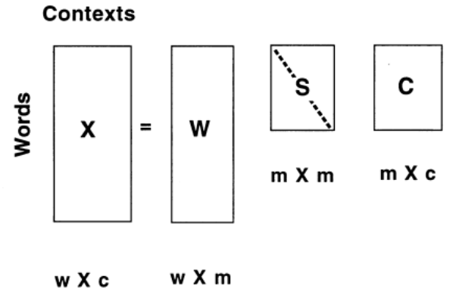
IIR 18: Latent Semantic Indexing
56 /ffJ

Slide 57
IIR 19: The web and its challenges
Unusual and diverse documents
Unusual and diverse users and information needs Beyond terms and text: exploit link analysis, user data How do web search engines work?
How can we make them better?
57 / 60

Slide 58
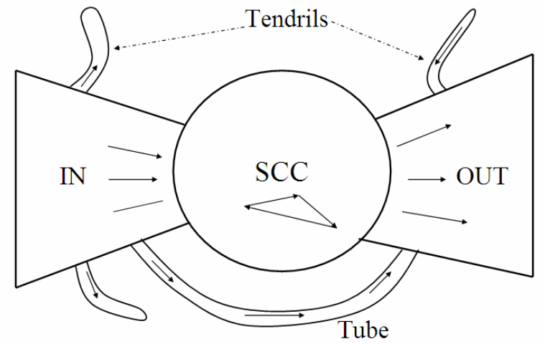
IIR 21: Link analysis / PageRank

Slide 59
Take-away
Boolean Retrieval: Design and data structures of a simple information retrieval system
What topics will be covered in this class?

