Slide 1
Spark and Scala

Slide 2
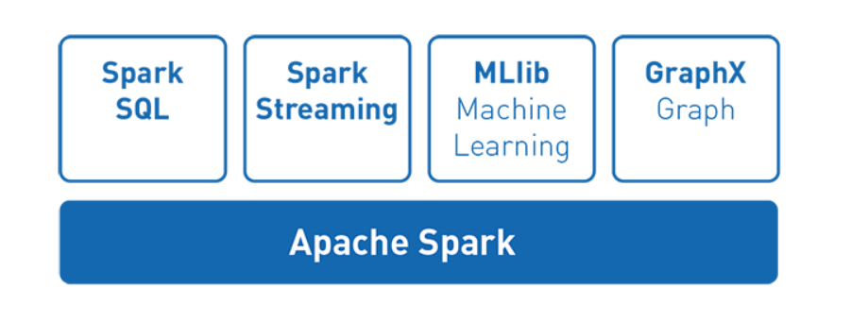
Spark - What is it? Why does it matter?
Spark is a general-purpose distributed data processing engine that is suitable for use in a wide range of circumstances. On top of the Spark core data processing engine, there are libraries for SQL, machine learning, graph computation, and stream processing, which can be used together in an application.
Programming languages supported by Spark include: Java, Python, Scala, and R. Application developers and data scientists incorporate Spark into their applications to rapidly query, analyze, and transform data at scale.
Tasks most frequently associated with Spark include ETL and SQL batch jobs across large data sets, processing of streaming data from sensors, IoT, or financial systems, and machine learning tasks.

Slide 3
Name a few programming languages supported by Spark?

Slide 4
Layers and Packages in Spark
Spark SQL - Queries can be made on structured data using both SQL(Structured Query Language) and HQL (Hive Query Language).
MLlib - designed to support multiple machine learning algorithms.
It runs 100 times faster than Hadoop’s MapReduce.
Spark Streaming - Spark allows Streaming for the creation of interactive applications that can perform data analysis operations on live streamed data.
GraphX - is an engine supported by Spark that allows the user to make computations using graphs.

Slide 5
What are the names of the layers and packages in Spark?

Slide 6
Downloading Spark And Installation
Go to the Link: https://spark.apache.org/downloads.html and click the download button.
Spark requires Java to run and Spark is implemented using Scala. So make sure you have both installed on your computer.
Spark Environment can be configured according to your preferences using SparkConf or Spark Shell tools. It can also be done while the Installation Wizard is installing Spark.
You need to initialize a new SparkContext using your preferred language (i.e. Python, Java, Scala, R). This will set up services and connects to an execution environment for Spark applications.

Slide 7
Simple Spark Application
Spark application can be developed in three of the following supported languages: 1) Scala 2)Python 3)Java
It provides two abstraction in its application:
RDD(Resilient Distributed Dataset)
Two types of shared variable in parallel Operation:
Broadcast variable
Accumulators
3 basic steps for completing an application:
1) Writing the Application
2) Compiling and packaging the Scala and Java Applications
3) Running the application
Notes:
Dataset in the newest version. Broadcast variable can be stored in the cache of each system. Accumulators can help with aggregation function such as addition.

Slide 8
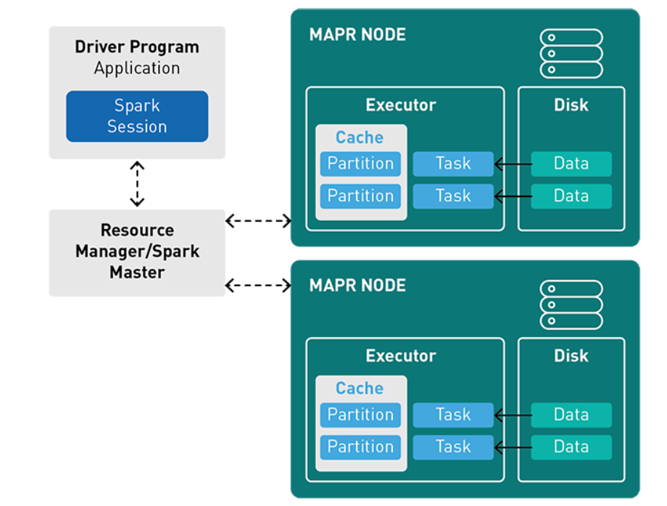
How a Spark Application Runs on a cluster?
A Spark application runs as independent processes, coordinated by the SparkSession object in the driver program.
The resource or cluster manager assigns tasks to workers, one task per partition.
A task applies its unit of work to the dataset in its partition and outputs a new partition dataset. Because iterative algorithms apply operations repeatedly to data, they benefit from caching datasets across iterations.
Results are sent back to the driver application or can be saved to disk.

Slide 9
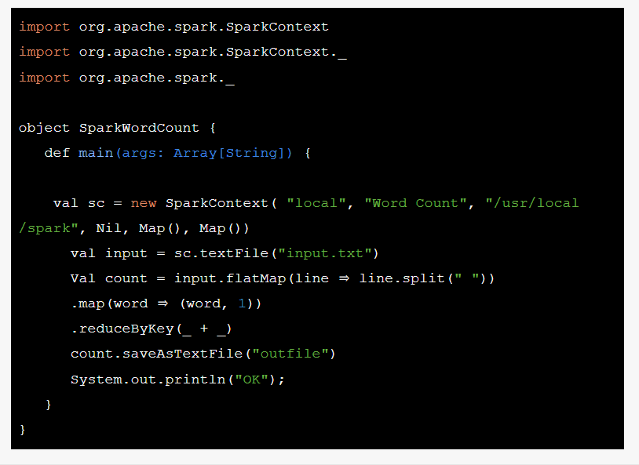
Simple Spark Application Continued
After linking the spark library The next step is to create a Spark context object with the desired spark configuration that tells Apache Spark on how to access a cluster.
“Word Count” – This is the name of the application that you want to run.
“local”- This parameter denotes the master URL to connect the spark application to.
/usr/local/spark- This parameter denotes the home directory of Apache Spark.
Map() – The first map specifies the environment whilst the second one specifies the variables to work nodes.\
Creating a Spark RDD
The next step in the Spark Word count example creates an input Spark RDD that reads the text file input.txt using the Spark Context created in the previous step-
Spark RDD Transformations in Wordcount Example
Spark application code transform the input RDD to count RDD -
In this piece of code, flatMap () is used to tokenize the lines from input text file into words.
Map () method counts the frequency of each word.
reduceByKey () method counts the repetitions of word in the text file.
Running Spark Application
We will submit the word count example in Apache Spark using the Spark shell instead of running the word count program as a whole
$ spark-shell
Notes:
# create Spark context with Spark configuration
# get threshold
# read in text file and split each document into words
# count the occurrence of each word
# filter out words with fewer than threshold occurrences
# count characters

Slide 10
True or False: In order to run Spark, you don’t need Java.

Slide 11
Spark Abstraction
Resilient Distributed Database (RDD)
It is the fundamental abstraction in Apache Spark. It is the basic data structure. RDD in Apache Spark is an immutable collection of objects which computes on the different node of the cluster.
Resilient- i.e. fault-tolerant ,so able to recompute missing or damaged partitions due to node failures.
Distributed- since Data resides on multiple nodes.
Dataset -represents records of the data you work with. The user can load the data set externally which can be either JSON file, CSV file, text file or database via JDBC with no specific data structure.

Slide 12
Spark Abstraction
Data Frame
We can term DataFrame as Dataset organized into columns. DataFrames are similar to the table in a relational database or data frame in R /Python.
Spark Streaming
It is a Spark’s core extension, which allows Real-time stream processing from several sources. To offer a unified, continuous DataFrame abstraction that can be used for interactive and batch queries these two sources work together. It offers scalable, high-throughput and fault-tolerant processing.
GraphX
It is one more example of specialized data abstraction. It enables developers to analyze social networks. Also, other graphs alongside Excel-like two-dimensional data.

Slide 13
Which Spark Abstraction is known to be fault tolerant?

Slide 14
PYSPARK
PySpark in an interactive shell for Spark in Python.
Using Pyspark we can work with RDD’s in python programming language by using Pyj4 library.
Pyspark offers pyspark shell which links the Python API to the spark core and initializes the spark context.
The PySpark supports Python 2.6 and above.
The Python shell can be used explore data interactively and is a simple way to learn the API

Slide 15
Example:
from pyspark import SparkContext sc = SparkContext("local", "count app") words = sc.parallelize ( ["scala", "java", "hadoop", "spark", "akka", "spark vs hadoop", "pyspark", "pyspark and spark"] ) counts = words.count() print "Number of elements in RDD -> %i" % (counts)
Output is :
Number of elements in RDD → 8

Slide 16
Question
What are the languages supported by Apache Spark for developing big data applications?

Slide 17
Python API
In PySpark, RDDs support the same methods as their Scala counterparts but take Python functions and return Python collection types.
It is dynamically typed hence because of that RDDs can hold objects of multiple types.
You can also pass functions that are defined with the def keyword; this is useful for longer functions that can’t be expressed using lambda.

Slide 18
Python API
Functions can access objects in enclosing scopes, although modifications to those objects within RDD methods will not be propagated back:
PySpark will automatically ship these functions to workers, along with any objects that they reference. Instances of classes will be serialized and shipped to workers by PySpark, but classes themselves cannot be automatically distributed to workers.

Slide 19
Question
Do, we have machine learning API in Python?
(True/False)

Slide 20
What is Scala?
Scala is a general purpose language that can be used to develop solutions for any software problem.
Scala combines object-oriented and functional programming in one concise, high-level language. Scala's static types help avoid bugs in complex applications, and its JVM and JavaScript runtimes let you build high-performance systems with easy access to huge ecosystems of libraries.
Scala offers a toolset to write scalable concurrent applications in a simple way with more confidence in their correctness. Scala is an excellent base of parallel, distributed, and concurrent computing, which is widely thought to be a very big challenge in software development but by the unique combination of features has won this challenge.
Scala can also be termed as a machine compiled language.

Slide 21
Why Scala?
Using Scala apps are less costlier to maintain and easier to evolve Scala because Scala is a functional and object-oriented programming language that makes light bend reactive and helps developers write code that's more concise than other options.
Scala is used outside of its killer-app domain as well, of course, and certainly for a while there was a hype about the language that meant that even if the problem at hand could easily be solved in Java, Scala would still be the preference, as the language was seen as a future replacement for Java.
It reduces the amount of code developers to write the code.

Slide 22
What is a drawback of Scala?

Slide 23
Example programs with Scala and Python
WordCount:
In this example we use few transformations to build a dataset of (String, int) pairs called counts and save it to a file.
Scala:
val textFile = sc.textFile("hdfs://...") val counts = textFile.flatMap(line => line.split(" ")) .map(word => (word, 1)) .reduceByKey(_ + _) counts.saveAsTextFile("hdfs://...")
Python:
text_file = sc.textFile("hdfs://...") # Read data from file
counts = text_file.flatMap(lambda line: line.split(" ")) \ .map(lambda word: (word, 1)) \ .reduceByKey(lambda a, b: a + b)
counts.saveAsTextFile("hdfs://...") #Save output into the file

Slide 24
Prediction with Regressions utilizing MLlib
Scala:
// Read data into dataframe
val df = sqlContext.createDataFrame(data).toDF("label", "features") val lr = new LogisticRegression().setMaxIter(10)
val model = lr.fit(df)
val weights = model.weights
// Predicting the results using the model model.transform(df).show()
Python:
#Read data into dataframe
df = sqlContext.createDataFrame(data, ["label","features"])
lr = LogisticRegression(maxIter=10) #Fit the model to the data
model = lr.fit(df) # Predicting the results using the model model.transform(df).show()

Slide 25
Questions?

