Slide 1
Spark and Scala

Slide 2
Topics to Discuss:
What is Spark?
Layers and Packages in Spark
Spark Download and Installation
Simple Spark Applications
Spark Abstractions
Example Programs with Scala and Python
Example Programs Visualization
What is Scala?
Why Scala?
Video Link
Code Demonstration
Q&A

Slide 3
What is Spark?
Spark is a high speed in-memory data processing engine
Runs on Hadoop
Uses APIs to help execute workloads
SQL workloads, machine learning algorithms, and streaming
Meant for large-scale data processing
Allows for rapid, repeated querying of large data sets
It has been claimed to be 100 times faster than Hadoop’s MapReduce
Supports Java, Python, R, and Scala programming languages

Slide 4
Layers and Packages in Spark
Spark SQL - allows queries to be made on structured data using both SQL and HQL (Hive Query Language).
MLlib - a library designed to support the execution/creation of multiple machine learning algorithms.
Estimated to run 100 times faster than Hadoop’s MapReduce.
Spark Streaming - allows for the creation of interactive applications designed to run data analysis operations on live streamed data.
GraphX - an engine that allows the user to make computations using graphs.

Slide 5
Spark Download and Installation
Go to the Apache Spark website and click the download button.
Link: https://spark.apache.org/downloads.html
Prior to downloading, ensure that Java JDK is installed on your machine. Spark requires Java to run.
Prior to downloading, ensure that Scala is installed on your machine. Scala is used to implement Spark.
Configure the environment according to your needs/preferences using options such as the SparkConf or the Spark Shell tools. You should also be able to configure the settings using the Installation Wizard for the Spark application.
Initialize a new SparkContext using your preferred language (i.e. Python, Java, Scala, R). SparkContext sets up services and connects to an execution environment for Spark applications.

Slide 6
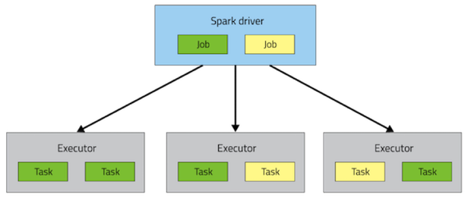
Simple Spark Application
Spark’s highest unit is an application
Every application is self-contained that runs code for a result
Each application can be used once or constantly on a server filling jobs
Applications can have processes running in the background
Multiple tasks can run in one executor.
Spark application uses concepts like driver, executor, task, job, and stage.
Notes:
Rdd - immutable distributed collection of objects. Divided logically and computed on different nodes (keeps the stuff on ram instead of the disk) makes it faster
Broadcast variables - read only
Accumulator - useful for counter or sums
Driver submits jobs to the executor that runs stages of tasks

Slide 7
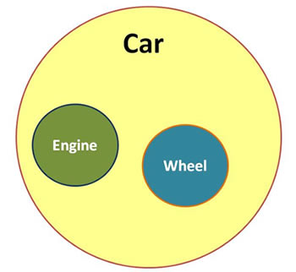
Spark Abstractions
Spark provides a resilient distributed dataset (RDD)
Spark provides shared variables for use in parallel operation
Broadcast variables - caches read-only on each machine
Accumulators - a variable that is adds to a variable defined by the driver
Spark apps must initialize the SparkConfig and SparkContext class usually defined as conf and sc in examples
Notes:
Rdd - immutable distributed collection of objects. Divided logically and computed on different nodes (keeps the stuff on ram instead of the disk) makes it faster
Broadcast variables - read only
Accumulator - useful for counter or sums

Slide 8
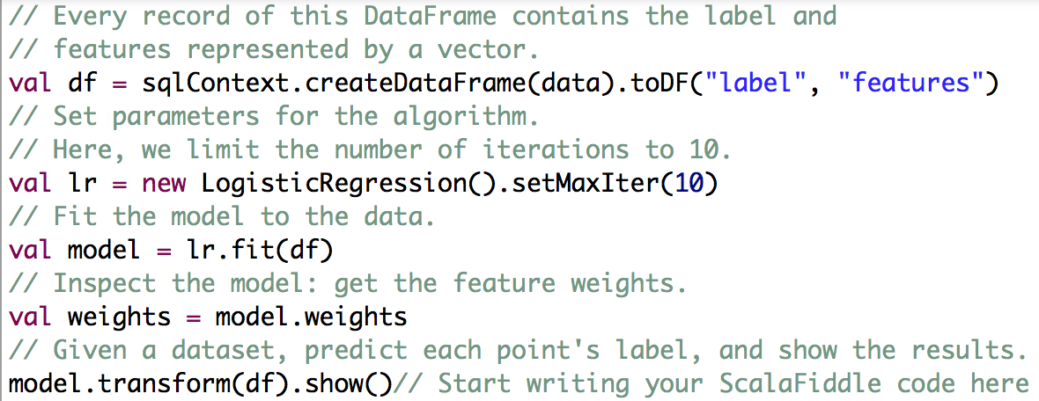
Example Programs with Scala and Python
Python
Pi Estimation (Monte Carlo Method) π/4 in circle
Scala
Prediction with Regressions utilizing MLlib

Slide 9
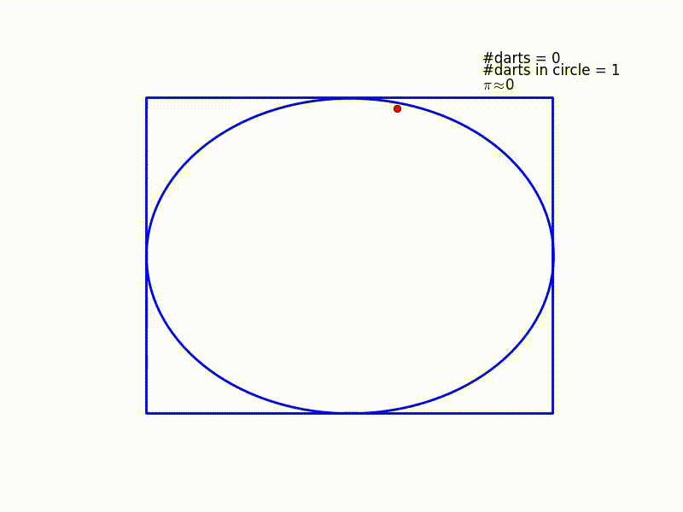
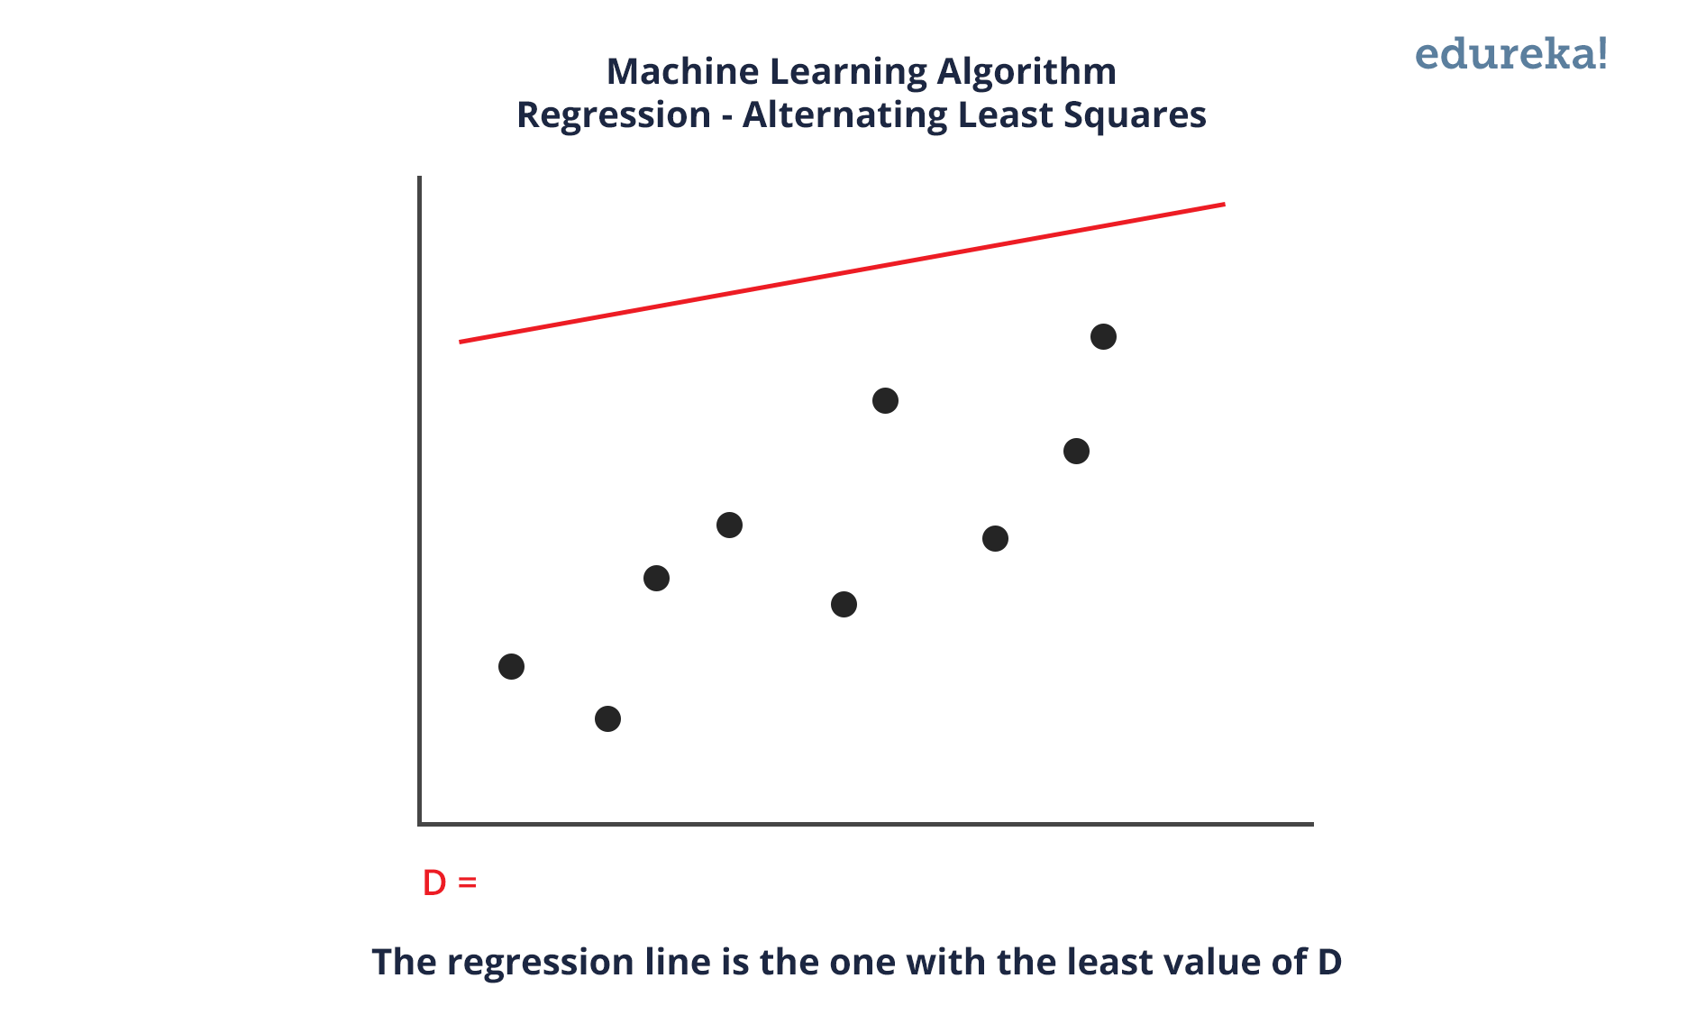
Example Programs Visualization
Pi Estimation (Monte Carlo Method) π/4 in circle
Prediction with Regressions utilizing MLlib

Slide 10
What is Scala?
Scala (scalable language) was designed to address the problems with Java
Object oriented and functional programming language
Completely compatible with java consequently runs on JVM
Less verbose
Statically typed
Executed in Spark environment
Notes:
Java lacks in functional programming, better string comparison/pattern matching, Mixins
Statically typed see errors at compile.

Slide 11
Why Scala?
Fully compatible with Java
It excels at concurrent and parallel programming
Robust XML API
Static typing making it less verbose and easier to read
Mixin’s allow inheritance without having a parent class
Scala Interpreter
LinkedIn, Twitter, Netflix, Apple, Verizon, The Guardian, Blizzard use Scala
Notes:
Xml - used metadata, web publishing, pervasive computing
Mixin take functions from another class
Scala interpreter interactive shell
Why would blizzard use scala over something else?
Big data scalability over its distributed system, it is ideally designed for map reduce programs big and small.

Slide 12
Video Link:
https://youtu.be/y6gTsj6okHE

Slide 13
Code Demonstration

Slide 14
Questions?

