Slide 1
Introduction to PIG, HIVE, HBASE & ZOOKEEPER

Slide 2
What is PIG?
Apache Pig is a platform for analyzing large data sets that consists of a high-level language for expressing data analysis programs, coupled with infrastructure for evaluating these programs.
The salient property of Pig programs is that their structure is amenable to substantial parallelization, which in turns enables them to handle very large data sets.
Apache Pig creates a simpler procedural language abstraction over MapReduce to expose a more SQL-like interface for Hadoop applications.
PIG Latin - A high-level language developed by Pig where programmers can develop their own functions for reading, writing and processing data.

Slide 3
PIG Characteristics
Operator Set - Many operations like join, filter and sort can be performed through these operators.
Programming ease - Pig Latin closely resembles to SQL. It is also easy to write a Pig script if you’re good at SQL.
User defined functions – Through Pig developers can create UDFs in other programming languages like Java and invoke them in Pig scripts.
Extensibility – Developers can develop their own functions to read, process and write data.
Optimization opportunities – Pig tasks optimize their execution automatically. The programmers only need to focus on semantics of the language.

Slide 4
Pig Latin - Data Flow:
A LOAD statement to read data from the system
A series of “transformation” statement to process the data
A DUMP statement to view results or STORE statement to save the result

Slide 5
PIG Pros and Cons:
Pros:
It has many advanced features built-in such as joins, secondary sort, many optimizations, predicate push-down, etc.
Provides a decent abstraction for Map-Reduce jobs, allowing for a faster result than creating your own MR jobs
Can handle large and unstructured datasets.
Cons:
There is not a good ide or plugin for Vim which provides more functionality than syntax completion to write the pig scripts.
Not mature. Even if it has been around for quite some time, it is still in the development.
Pig does not support random writes to update small portions of data, all writes are bulk, streaming writes, just like MapReduce.

Slide 6
What is Hive?
Apache Hive is a data warehouse software project built on top of Apache Hadoop
Used for data query and analysis
Developed by Facebook
Provides SQL type language for querying called HiveQL or HQL
The Hive shell is the primary way that we will interact with Hive

Slide 7
Hive Features
It stores schema in a database and processed data into HDFS
It is designed for OLAP
It provides SQL type language for querying called HiveQL or HQL
It is familiar, fast, scalable, and extensible
Automatic and configurable sharing of tables
Automatic failover support
Strictly consistent read and writes

Slide 8
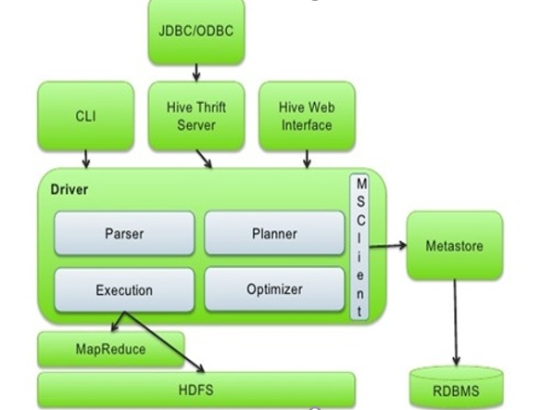
Hive architecture or data flow
UI: Users submits queries and other operations to the system
Driver: Session handles, executes and fetches APIs modeled on JDBC/ODBC interfaces
Metastore: Stores all the structure information of the various tables and partitions in the warehouse
Compiler: Converts the HiveQL into a plan for execution
Execution Engine: Manages dependencies between these different stages of the plan and executes these stages on the appropriate system components

Slide 9
Hive Pros and Cons
Pros
Easy way to process large scale data
Converting variety of format within Hive is simple
Supports SQL based queries
Multiple users can simultaneously query the data using HiveQL
Allows to write custom MapReduce framework processes to perform more detailed data analysis
Cons
Not designed for Online transaction processing (OLTP)
Hive supports overwriting or apprehending data, but not updates and deletes
Subqueries are not supported
No easy way to append data

Slide 10
Hive vs relational database
By using Hive, we can perform some peculiar functionality that is not achieved in Relational Databases
Relational databases are of “Schema on READ and Schema on Write” Hive is "Schema on READ only”
No support for Update or Delete in HIVE
No support for inserting single rows
Supports Partitioning and Bucketing

Slide 11
Hive vs pig
Pig | Hive
Procedural Data Flow Language | Declarative SQL Language
It expects good development environments and debuggers. | It expects better integration with technologies.
Operates on client side of a cluster | Operates on server side of a cluster
Used for data analysis | Used for creating reports
It is used to build complex data pipelines and Machine learning such as researchers and programmers. | This is used to analyze the data that is available such as Business Analysts.
Does not have a thrift server | Thrift Server

Slide 12
What is HBase?
•HBase is a column-oriented non-relational database management system that runs on top of Hadoop Distributed File System (HDFS)
•Bigtable like capabilities - read/write access to Big Data.
•It is an open source project and is horizontally scalable.
•HBase isn’t a relational data store.
•HBase applications are written in Java.
•Hbase does support writing applications in Apache Avro, REST and Thrift.

Slide 13
Hbase Features
Linear and modular scalability.
Integrates with Hadoop both as a source and a destination
Automatic and configurable sharding of tables.
Automatic failure support.
Provides data replication across clusters.
Easy to use Java API for client access.

Slide 14
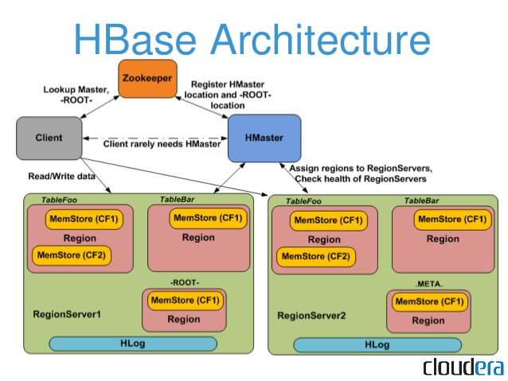
HBase architecture or data flow
HMaster: HMaster is a lightweight process that assigns regions to region servers in the Hadoop cluster for load balancing.
Region Server: These are the worker nodes which handle read, write, update, and delete requests from clients. Region Server process, runs on every node in the hadoop cluster. Region Server runs on HDFS DataNode
ZooKeeper: ZooKeeper service keeps track of all the region servers that are there in Hbase cluster.

Slide 15
Hbase Pros and Cons:
• Handles Large datasets.
• Fast processing.
• Failover support and load sharing.
• Easy to use Java API for client access.
• Consistency, Schema-less and scalability.

Slide 16
Zookeeper: Introduction
ZooKeeper is an open source Apache™ project that provides a centralized infrastructure and services that enable synchronization.
ZooKeeper provides an infrastructure for cross-node synchronization by maintaining status type information in memory on ZooKeeper servers.

Slide 17
Features of Zookeeper:
Fast Processing: Zookeeper is especially fast in "read-dominant" workloads (i.e. workloads in which reads are much more common than writes).
Reliable System: This system is very reliable as it keeps working even if a node fails.
Scalable: The performance of ZooKeeper can be improved by adding nodes.
Simple Architecture: The architecture of ZooKeeper is quite simple as there is a shared hierarchical namespace which helps coordinating the processes.

Slide 18
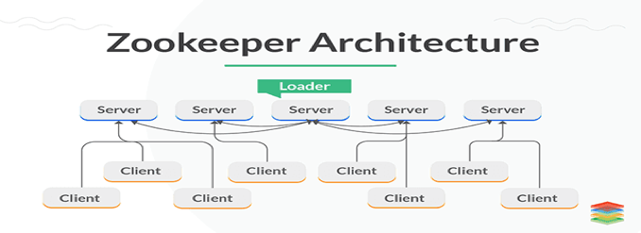
One leader Zookeeper server synchronizes a set of follower Zookeeper servers to be accessed by clients.
Clients access Zookeeper servers to retrieve and update synchronization information of the entire cluster.
Clients only connect to one server at a time.

Slide 19
Components of Zookeeper:
Client: Node in our distributed application cluster, access information from the server. Interacts with the server to know that the connection is established.
Server: Node in our ZooKeeper ensemble, provides all the services to clients. Gives acknowledgement to client to inform that the server is alive.
Ensemble: Ensemble are group of ZooKeeper servers. The minimum number of nodes that is required to form an ensemble is 3
Leader: Server node which performs automatic recovery if any of the connected node failed. Leaders are elected on service startup.
Follower: Server node which follows leader instruction.

Slide 20
References
PIG : https://www.tutorialspoint.com/apache_pig/index.htm
https://youtu.be/rxnXHlaSohM
HIVE : https://www.tutorialspoint.com/hive/index.htm
https://youtu.be/uY7Rr7ru9E4
Hbase : https://www.tutorialspoint.com/hbase/index.htm
https://youtu.be/kN01ELCAsn8
ZooKeeper : https://www.tutorialspoint.com/zookeeper/index.htm
https://youtu.be/Kgf9EjTNucM

Slide 21
Thank You!!!
QUESTIONS??

