Slide 1
Introduction to
Pig Hive HBase Zookeeper

Slide 2
Apache Pig
A platform to create programs that run on top of Hadoop in order to analyze large sets of data
Pig has two main things:
Pig Latin - a high level language for writing data analysis programs
Pig Engine - Execution environment to run Pig Latin programs
Execution Types:
Local Mode: Need access to single machine. Pig runs in a single JVM and accesses the local filesystem
Hadoop (MapReduce) Mode: Need access to hadoop cluster and HDFS installation. Pig translates queries into MapReduce jobs and runs them on a Hadoop cluster.

Slide 3
Pig Latin - Features and Data Flow
Advantage over MapReduce framework
Features:
Pig Latin provides various operators that allows flexibility to developers to develop their own functions for processing, reading and writing data
Pig Latin script is made up of a series of operations, or transformations, that are applied to the input data to produce output
Data Flow:
A LOAD statement to read data from the system
A series of “transformation” statement to process the data
A DUMP statement to view results or STORE statement to save the result

Slide 4
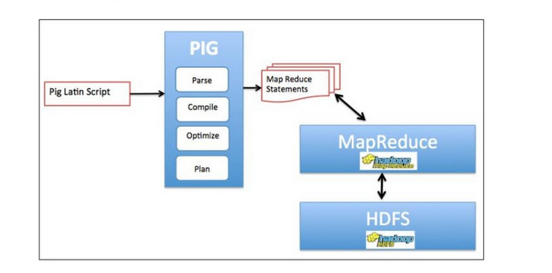
Pig Architecture and Components
Components:
Parser
Compiler
Optimizer
Execution Engine

Slide 5
Execution Steps
Limitations
Programmers write scripts in Pig Latin language to analyze data.
All these scripts are converted to Map and Reduce tasks.
The component Pig Engine accepts the Pig Latin scripts as input and converts them to MapReduce jobs.
Pig does not support random reads or queries in the order of tens of milliseconds.
Pig does not support random writes to update small portions of data, all writes are bulk, streaming writes, just like MapReduce.
Low latency queries are not supported in Pig, making it not suitable for OLAP and OLTP.

Slide 6
Introduction to HIVE
Mapreduce, where users have to understand advanced styles of Java programming in order to successfully query data
ETL and Data warehousing tool on top of Hadoop
Data summarization and analysis of structured data
Organizing data by partitioning and bucketing
HiveQL: Query the data

Slide 7
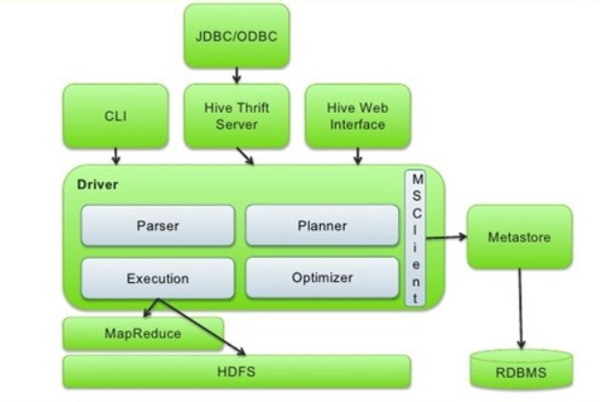
Components in HIVE
Hadoop core components
Metastore
Driver
Hive Clients

Slide 8
Components
Hadoop Components
HDFS Data that is loaded will be internally stored into HDFS
Query will internally run a mapreduce job by compiling as java code and building Jar files
Metastore: Stores information like tables, partition, columns, location.
Columns: Column name and datatype
TBLS: Name, owner
Managed Table:The metadata information along with the table data will be deleted when we drop table.
External Table: The metadata information will be deleted but the table data will be untouched.
DBS: All the database information

Slide 9
Components
Drivers:
Receives all the instructions from HiveQL, parses the query and performs the semantic analysis.
Acts as a controller and observes the progress and life cycle of various actions by creating sessions.
Jar files that are part of hive package help in converting these HiveQL queries into equivalent MapReduce jobs.
Hive Clients:
It is the interface through which we can submit the hive queries
Example: hive CLI, beeline

Slide 10
Pig vs Hive
Pig | Hive
Procedural Data Flow Language | Declarative SQL Language
Operates on client side of a cluster | Operates on server side of a cluster
Used for data analysis | Used for creating reports
It is used to build complex data pipelines and Machine learning such as researchers and programmers. | This is used to analyse the data that is available such as Business Analysts.
It expects good development environments and debuggers. | It expects better integration with technologies.

Slide 11
HBase
HBase is a distributed column-oriented database built on top of the HDFS. It is an open-source project and horizontally scalable.
HBase is a data model that is similar to Google’s big table that designed to provide quick random access to huge amounts of structured data.
HBase is a part of Hadoop ecosystem that provides real-time read/write access to data in the Hadoop File System.
HBase stores its data in HDFS.

Slide 12
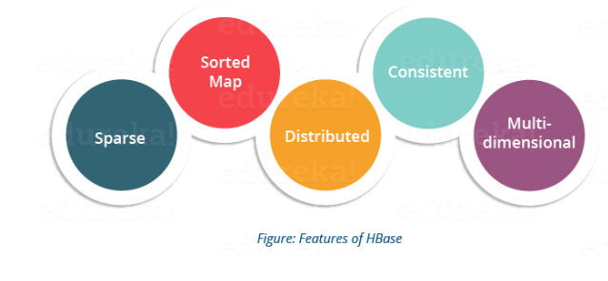
Features of Hbase
HBase is sparse, multidimensional, sorted map-based database, which supports multiple versions of the same record.
HBase provides atomic read and write.
HBase provides consistent reads and writes due to above feature.
HBase is linearly scalable.
It has automatic failure support.
It integrates with Hadoop, both as a source and a destination.
It has easy java API for client.
It provides data replication across clusters.

Slide 13
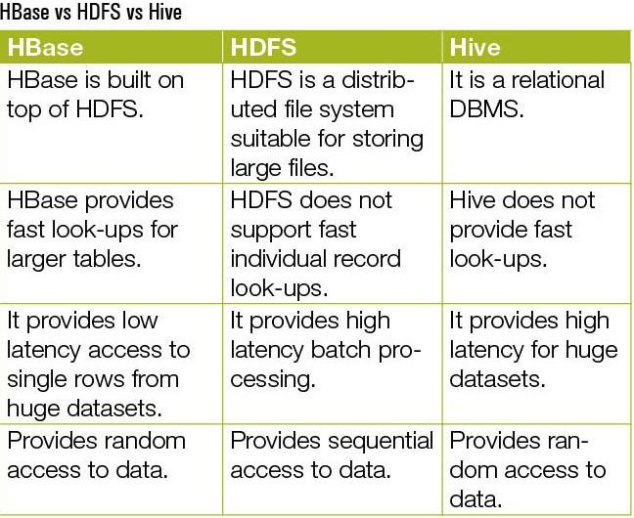
Hbase vs HDFS vs Hive

Slide 14
Zookeeper
ZooKeeper is a centralized service for maintaining configuration information, naming, providing distributed synchronization, and group services.
ZooKeeper provides an infrastructure for cross-node synchronization by maintaining status type information in memory on ZooKeeper servers.

Slide 15
Components of ZooKeeper
Client - node in our distributed application cluster, access information from the server. Interacts with the server to know that the connection is established.
Server - node in our ZooKeeper ensemble, provides all the services to clients. Gives acknowledgement to client to inform that the server is alive.
Ensemble - Group of ZooKeeper servers. The minimum number of nodes that is required to form an ensemble is 3
Leader - Server node which performs automatic recovery if any of the connected node failed. Leaders are elected on service startup.
Follower - Server node which follows leader instruction.

Slide 16
Znode(ZooKeeper Node)
Every znode in the ZooKeeper data model maintains a stat structure
ZooKeeper data model maintains a stat structure of every node :
Version number - every time the data associated with the znode changes, its corresponding version number will be updated.
Action Control List (ACL) - authentication mechanism for accessing the znode to govern its R/W operations.
Timestamp - represents time elapsed from znode creation and modification
Data length - amount of the data stored in a znode, maximum 1 MB.

Slide 17
ZooKeeper
ZooKeeper Command Line Interface (CLI) is used to interact with the ZooKeeper ensemble for development purpose for debugging.
To perform ZooKeeper CLI operations, the server and client are turned on and then the client can perform the following operations :
Create Znode
Ephemeral znodes (flag e): will delete once the session expires.
Sequential znodes (flag s): to specify a unique path.
Get data
Watch znode
Set data
Create children of a znode
List children of a znode
Check Status
Delete a znode

Slide 18
ZooKeeper
Using ZooKeeper API, an application can connect, interact, manipulate data, coordinate, and finally disconnect from a ZooKeeper ensemble.
Rich set of features to get all functionalities of Zookeeper ensemble in a simple and safe manner.
ZooKeeper API provides a small set of methods to manipulate all the details of znode with ZooKeeper ensemble.
Steps followed to interact with ZooKeeper:
Connect to the ZooKeeper ensemble. ZooKeeper ensemble assign a Session ID for the client.
Send heartbeats to the server periodically. Otherwise, the ZooKeeper ensemble expires the Session ID and the client needs to reconnect.
Get / Set the znodes.
Disconnect once all the tasks are completed.

Slide 19
Resources and Video Links
Apache PIG: http://pig.apache.org
Apache Hive: https://hive.apache.org/
Apache Zookeeper: https://zookeeper.apache.org/
Apache Hbase: https://www.edureka.co/blog/hbase-architecture/
PIG- https://youtu.be/rxnXHlaSohM
HIVE- https://youtu.be/uY7Rr7ru9E4
HBase- https://youtu.be/kN01ELCAsn8
ZooKeeper- https://youtu.be/Kgf9EjTNucM

Slide 20
THANK YOU!!!
Questions???

