Slide 1
Pig - Hive - HBase - Zookeeper

Slide 2
Hadoop Ecosystem

Slide 3
What is Apache Pig ?
A platform for creating programs that run on Apache Hadoop.
Two important components of Apache Pig are:
Pig Latin language and the Pig Run-time Environment
Pig Latin is a high level language.(Designed for the ease of programming)
Programmers write scripts using Pig Latin to analyze data.
Pig scripts are compiled into sequence of MapReduce programs.(Tasks are encoded in such a way that permits the system to optimize their execution automatically)
Pig Latin is extensible(Users can create their own functions).
Notes:
Pig converts its operators into MapReduce code. So instead of needing Java programming
skills and an understanding of the MapReduce coding infrastructure, people with little
programming skills, can simply invoke SORT or FILTER operators without having to code
a MapReduce application to accomplish those tasks.
One of the strong features of Pig is that the developer / analyst does not have to depend
solely on the Pig-supplied operators. It is possible to extend the language by coding
one’s own user-defined functions.
Executing Pig Pig can run in interactive mode or in script
mode. Both of these ways have two options. Local mode gives you access to data in your
local file system. It runs in a single Java virtual machine. This mode is normally used
for testing against a limited amount of data. The second option, MapReduce mode, runs on
a Hadoop cluster and converts the Pig statements into MapReduce code.
To invoke Pig in interactive mode, just execute pig and you are then placed into the Grunt
shell. By default you will be running in MapReduce mode. To execute Pig interactively in local
mode, execute pig –x local. To invoke a Pig script, just include the name
of the script when you invoke pig. For example to run a pig script called myscript.pig in
local mode, execute pig –x local myscript.pig. To run the same script in MapReduce mode,
execute pig myscript.pig. It is also possible to invoke pig using a
Java command as well.

Slide 4
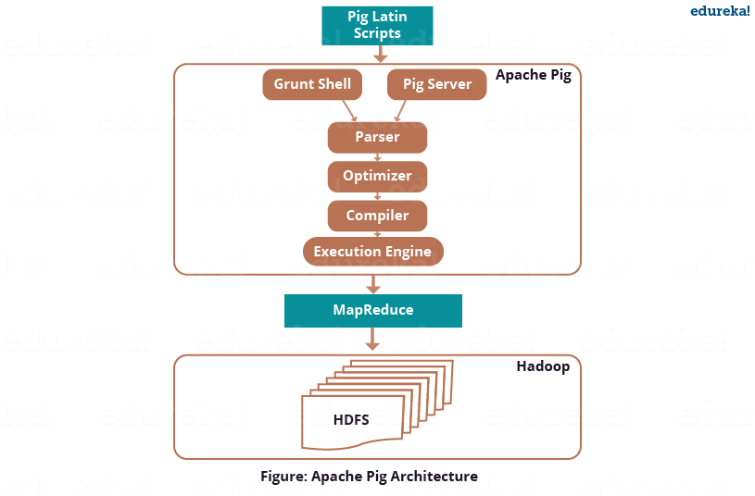
Architecture of Pig
Notes:
Parser
Initially the Pig Scripts are handled by the Parser.
It checks the syntax of the script, does type checking, and other miscellaneous checks.
The output of the parser will be a DAG (directed acyclic graph), which represents the Pig Latin statements and logical operators.
In the DAG, the logical operators of the script are represented as the nodes and the data flows are represented as edges.
Optimizer
The logical plan (DAG) is passed to the logical optimizer, which carries out the logical optimizations such as projection and pushdown.
Compiler
The compiler compiles the optimized logical plan into a series of MapReduce jobs.
Execution engine
Finally the MapReduce jobs are submitted to Hadoop in a sorted order.
Finally, these MapReduce jobs are executed on Hadoop producing the desired results.

Slide 5
Pig Data Basics
Pig Statement Basics
Scalar Types:
Int , chararray, double etc
Tuple:
(15, Jim, 10.9)
Load & Store Operators
LOAD operator (load data from the file system)
STORE operator (saves results into file system)
Both these operators use several built-in functions for handling different data types
BinStorage()
PigStorage()
TextLoader()
JsonLoader()
Diagnostic Operators
DUMP operator (writes results to the console)
Describe Operators
DESCRIBE operator is used to view the schema of a relation.
EXPLAIN operator is used to display the logical, physical, and MapReduce execution plans of a relation.
ILLUSTRATE operator gives you the step-by-step execution of a sequence of statements.
Bag:
(15, Jim, 10.9)
(5, Jose, 18.8)
(10, Alb, 100.9)
relation:
(Mary,{1,3,4 })
(Bob,{7,8,9})
map:
[1#red, 2#blue, 3#yellow]
Notes:
First look at Pig data As you might expect, the Pig language has a number of scalar data types used to define individual fields. Some examples are int for integers, chararray for string data, double and float for numbers with decimal points. Fields are grouped together into tuples. You might think of a tuple as a row in a relational data table or a record in a file. Pig has greater flexibility over a relational table in that all tuples do not have to contain the same number of fields. Tuples are grouped into a bag. Now this is where it can get a little complex. I just said that a bag is a group of tuples, but a “field” in a tuple can actually be a bag that contains other tuples. In this case, the bag is an inner bag. The bag, that contains the tuples that correlate to a row in a relational table, is known as an outer bag. It is also known as a relation. Map data is also supported in Pig. A map is a set of key / value pairs. Accessing a map with a specify key will return the value associated with that key.

Slide 6
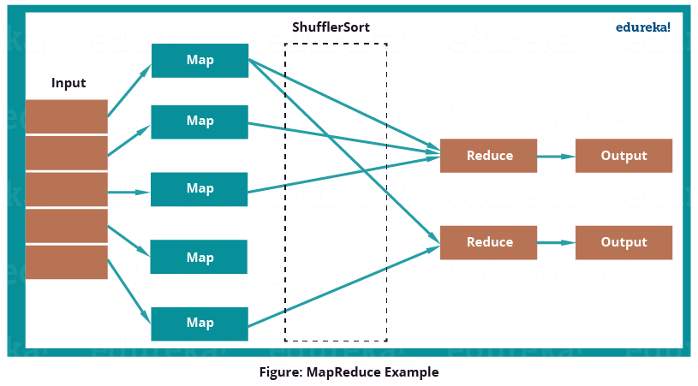
Apache Pig: Twitter Case Study
Notes:
MapReduce program first inputs the key as rows and sends the tweet table information to mapper function. Then the Mapper function will select the user id and associate unit value (i.e. 1) to every user id. The Shuffle function will sort same user ids together. At last, Reduce function will add all the number of tweets together belonging to same user. The output will be user id, combined with user name and the number of tweets per user.
But while using MapReduce, they faced some limitations:
Analysis needs to be typically done in Java.
Joins, that are performed, needs to be written in Java, which makes it longer and more error-prone.
For projection and filters, custom code needs to be written which makes the whole process slower.
The job is divided into many stages while using MapReduce, which makes it difficult to manage.

Slide 7
Apache Pig: Twitter Case Study
Notes:
Twitter had both semi-structured data like Twitter Apache logs, Twitter search logs, Twitter MySQL query logs, application logs and structured data like tweets, users, block notifications, phones, favorites, saved searches, re-tweets, authentications, SMS usage, user followings, etc. which can be easily processed by Apache Pig.
Twitter dumps all its archived data on HDFS. It has two tables i.e. user data and tweets data. User data contains information about the users like username, followers, followings, number of tweets etc. While Tweet data contains tweet, its owner, number of re-tweets, number of likes etc. Now, twitter uses this data to analyse their customer’s behaviors and improve their past experiences.

Slide 8
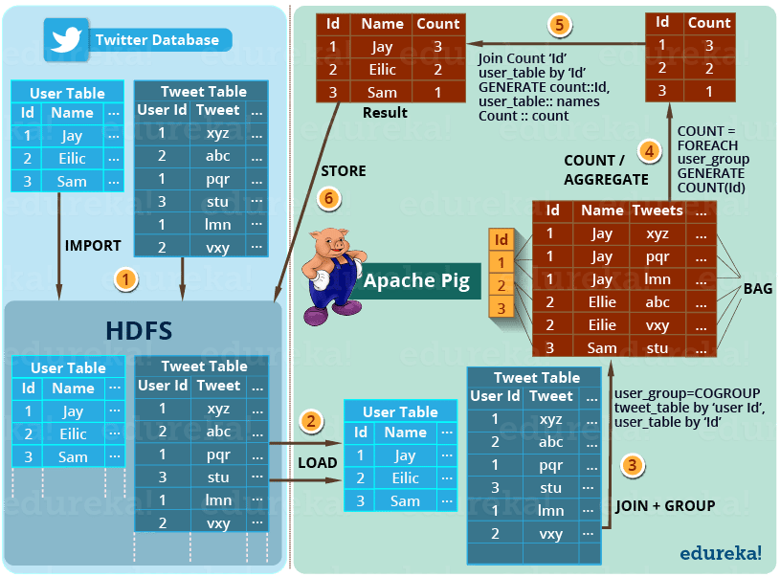
Apache Pig: Twitter Case Study
Notes:
Question: Analyzing how many tweets are stored per user, in the given tweet tables?
The below image shows the approach of Apache Pig to solve the problem:
The step by step solution of this problem is shown in the above image.
STEP 1– First of all, twitter imports the twitter tables (i.e. user table and tweet table) into the HDFS.
STEP 2– Then Apache Pig loads (LOAD) the tables into Apache Pig framework.
STEP 3– Then it joins and groups the tweet tables and user table using COGROUP command as shown in the above image.
This results in the inner Bag Data type, which we will discuss later in this blog.
Example of Inner bags produced (refer to the above image) –
(1,{(1,Jay,xyz),(1,Jay,pqr),(1,Jay,lmn)})
(2,{(2,Ellie,abc),(2,Ellie,vxy)})
(3, {(3,Sam,stu)})
STEP 4– Then the tweets are counted according to the users using COUNT command. So, that the total number of tweets per user can be easily calculated.
Example of tuple produced as (id, tweet count) (refer to the above image) –
(1, 3)
(2, 2)
(3, 1)
STEP 5– At last the result is joined with user table to extract the user name with produced result.
Example of tuple produced as (id, name, tweet count) (refer to the above image) –
(1, Jay, 3)
(2, Ellie, 2)
(3, Sam, 1)
STEP 6– Finally, this result is stored back in the HDFS.
Pig is not only limited to this operation. It can perform various other operations which I mentioned earlier in this use case.
These insights helps Twitter to perform sentiment analysis and develop machine learning algorithms based on the user behaviors and patterns.

Slide 9
Apache Hive
Hive : Data Warehousing package built on top of Hadoop
Developed by Facebook and contributed to Apache open source.
Used for data analysis
Targeted towards users comfortable with SQL
It is similar to SQL and called HiveQL
For managing and querying structured data
Abstracts complexity of Hadoop

Slide 10
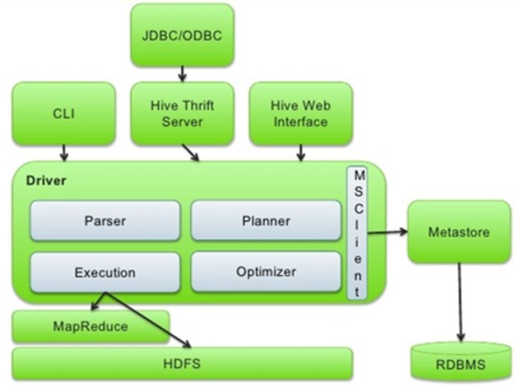
Hive Architecture
Compiler: The Compiler is assigned with the task of converting the HiveQL query into MapReduce input.
Optimizer: This performs the various transformation steps for aggregating, pipeline conversion by a single join for multiple joins.
Executor: The Executor executes the tasks after the compilation and the optimization steps. The Executor directly interacts with the Hadoop Job Tracker for scheduling of tasks to be run.
CLI, UI, and Thrift Server: the Command Line Interface and the User Interface submits the queries, process monitoring and instructions so that external users can interact with Hive. Thrift lets other clients to interact with Hive.
Metastore: It is the repository for metadata. This metadata consists of data for each table like its location and schema.
Driver: The driver receives the HiveQL statements and works like a controller.

Slide 11
Hive Data Model
Tables: Data is stored as a directory in HDFS
Partitions: Table of Hive is organized in partitions by grouping same types of data together based on any column or partition key. Every table has a partition key for identification. Partitions can speed up query and slicing process.
Create Table tablename(var String,var Int) Partitioned BY (partition1 String, partition2 String);
Partitioning increases the speed of querying by reducing its latency as it only scans relevant data rather than scanning full data.
Buckets: Tables or partitions can again be sub-divided into buckets in Hive for that you will have to use the hash function. Following syntax is used to create table buckets:
Create Table tablename Partitioned BY (partition1 data_type, partition2 data_type )
Clustered BY (column1, column2) Sorted BY(column_name Asc:Desc,___) Into num_buckets Buckets;
Hive buckets are just files in the table directory which may be partitioned or unpartitioned. You can even choose n buckets to partition the data.

Slide 12
PIG Vs HIVE
PIG
Procedural Data Flow Language
For Programming
Mainly used by Researchers and Programmers
Operates on the client side of a cluster.
Does not have a dedicated metadata database.
Pig is SQL like but varies to a great extent.
Pig supports Avro file format.
Can handle both structured and unstructured data.
Hive
Declarative SQLish Language
For creating reports
Mainly used by Data Analysts
Operates on the server side of a cluster.
Makes use of exact variation of dedicated SQL DDL language by defining tables beforehand.
Directly leverages SQL and is easy to learn for database experts.
Hive does not support it.
Can handle only structured data

Slide 13
HIVE Pros and Cons
Pros
Helps querying large datasets residing in distributed storage
It is a distributed data warehouse.
Queries data using a SQL-like language called HiveQL (HQL).
Table structure/s is/are similar to tables in a relational database.
Multiple users can simultaneously query the data using Hive-QL.
Data extract/transform/load (ETL) can be done easily.
It provides the structure on a variety of data formats.
Allows access files stored in Hadoop Distributed File System (HDFS) or also similar others data storage systems such as Apache HBase.
Cons
It's not designed for Online transaction processing (OLTP), it is only used for the Online Analytical Processing (OLAP).
Hive supports overwriting or apprehending data, but not updates and deletes.
Sub-queries are not supported, in Hive
Joins (left and right joins) are very complex, space consuming and time consuming

Slide 14
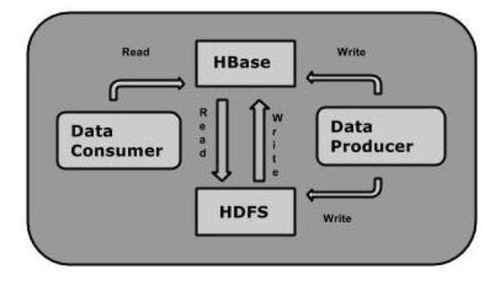
Hbase
Base is a column-oriented database management system that runs on top of Hadoop Distributed File System (HDFS). It is well suited for sparse data sets, which are common in many big data use cases.
It is a part of the Hadoop ecosystem that provides random real-time read/write access to data in the Hadoop File System.
One can store the data in HDFS either directly or through HBase. Data consumer reads/accesses the data in HDFS randomly using HBase. HBase sits on top of the Hadoop File System and provides read and write access.

Slide 15
HBase and RDBMS
HBase | RDBMS
HBase is schema-less, it doesn't have the concept of fixed columns schema; defines only column families. | An RDBMS is governed by its schema, which describes the whole structure of tables.
It is built for wide tables. HBase is horizontally scalable. | It is thin and built for small tables. Hard to scale.
No transactions are there in HBase. | RDBMS is transactional.
It has de-normalized data. | It will have normalized data.
It is good for semi-structured as well as structured data. | It is good for structured data.

Slide 16
HBase vs Hive
Basis of comparison | Hive | HBase
Database type | It is not database | It supports NoSQL database
Type of processing | It supports Batch processing i.e OLAP | It supports real-time data streaming i.e OLTP
Database model | Hive supports to have schema model | Hbase is schema-free
Latency | Hive has low latency | Hbase have high latency
Cost | It is more costly when compared to HBase | It is cost effective
when to use | Hive can be used when we do not want to write complex MapReduce code | HBase can be used when we want to have random access to read and write a large amount of data
Use cases | It should be used to analyze data that is stored over a period of time | It should be used to analyze real-time processing of data.
Examples | Hubspot is example for Hive | Facebook is the best example for Hbase

Slide 17
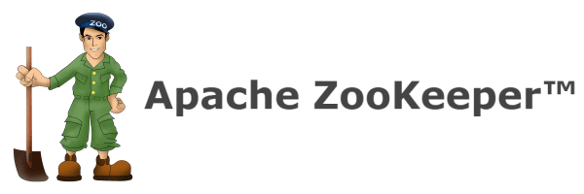
What is Zookeeper?
A centralized, scalable service for maintaining configuration information, naming, providing distributed synchronization and coordination, and providing group services.

Slide 18
Zookeeper (cont.)
Zookeeper provides a scalable and open-source coordination service for large sets of distributed servers.
Zookeeper servers maintain the status, configuration, and synchronization information of an entire Hadoop cluster.
Zookeeper defines primitives for higher level services for:
Maintaining configuration information.
Naming (quickly find a server in a thousand-server cluster).
Synchronization between distributed systems (Locks, Queues, etc.).
Group services (Leader election, etc.).
Zookeeper APIs exist for both C and Java.

Slide 19
Zookeeper Architecture
One leader Zookeeper server synchronizes a set of follower Zookeeper servers to be accessed by clients.
Clients access Zookeeper servers to retrieve and update synchronization information of the entire cluster.
Clients only connect to one server at a time.

Slide 20
Zookeeper Use Cases within Hadoop Ecosystem:
HBase:
Zookeeper handles master-node election, server coordination, and bootstrapping.
Process execution synchronization and queueing.
Hadoop:
Resource management and allocation.
Synchronization of tasks.
Adaptive Mapreduce.
Flume:
Supports Agent configuration via Zookeeper.

Slide 21
References
www.tutorialspoint.com
www.ibm.com/analytics/hadoop/
https://www.youtube.com/watch?v=tKNGB5IZPFE&t=1223s
https://www.educba.com/apache-pig-vs-apache-hive/
https://www.educba.com/hive-vs-hbase/
https://www.edureka.co/blog/pig-tutorial/

