Slide 1
Utilizing Orange Software to build the Models
Group 5

Slide 2
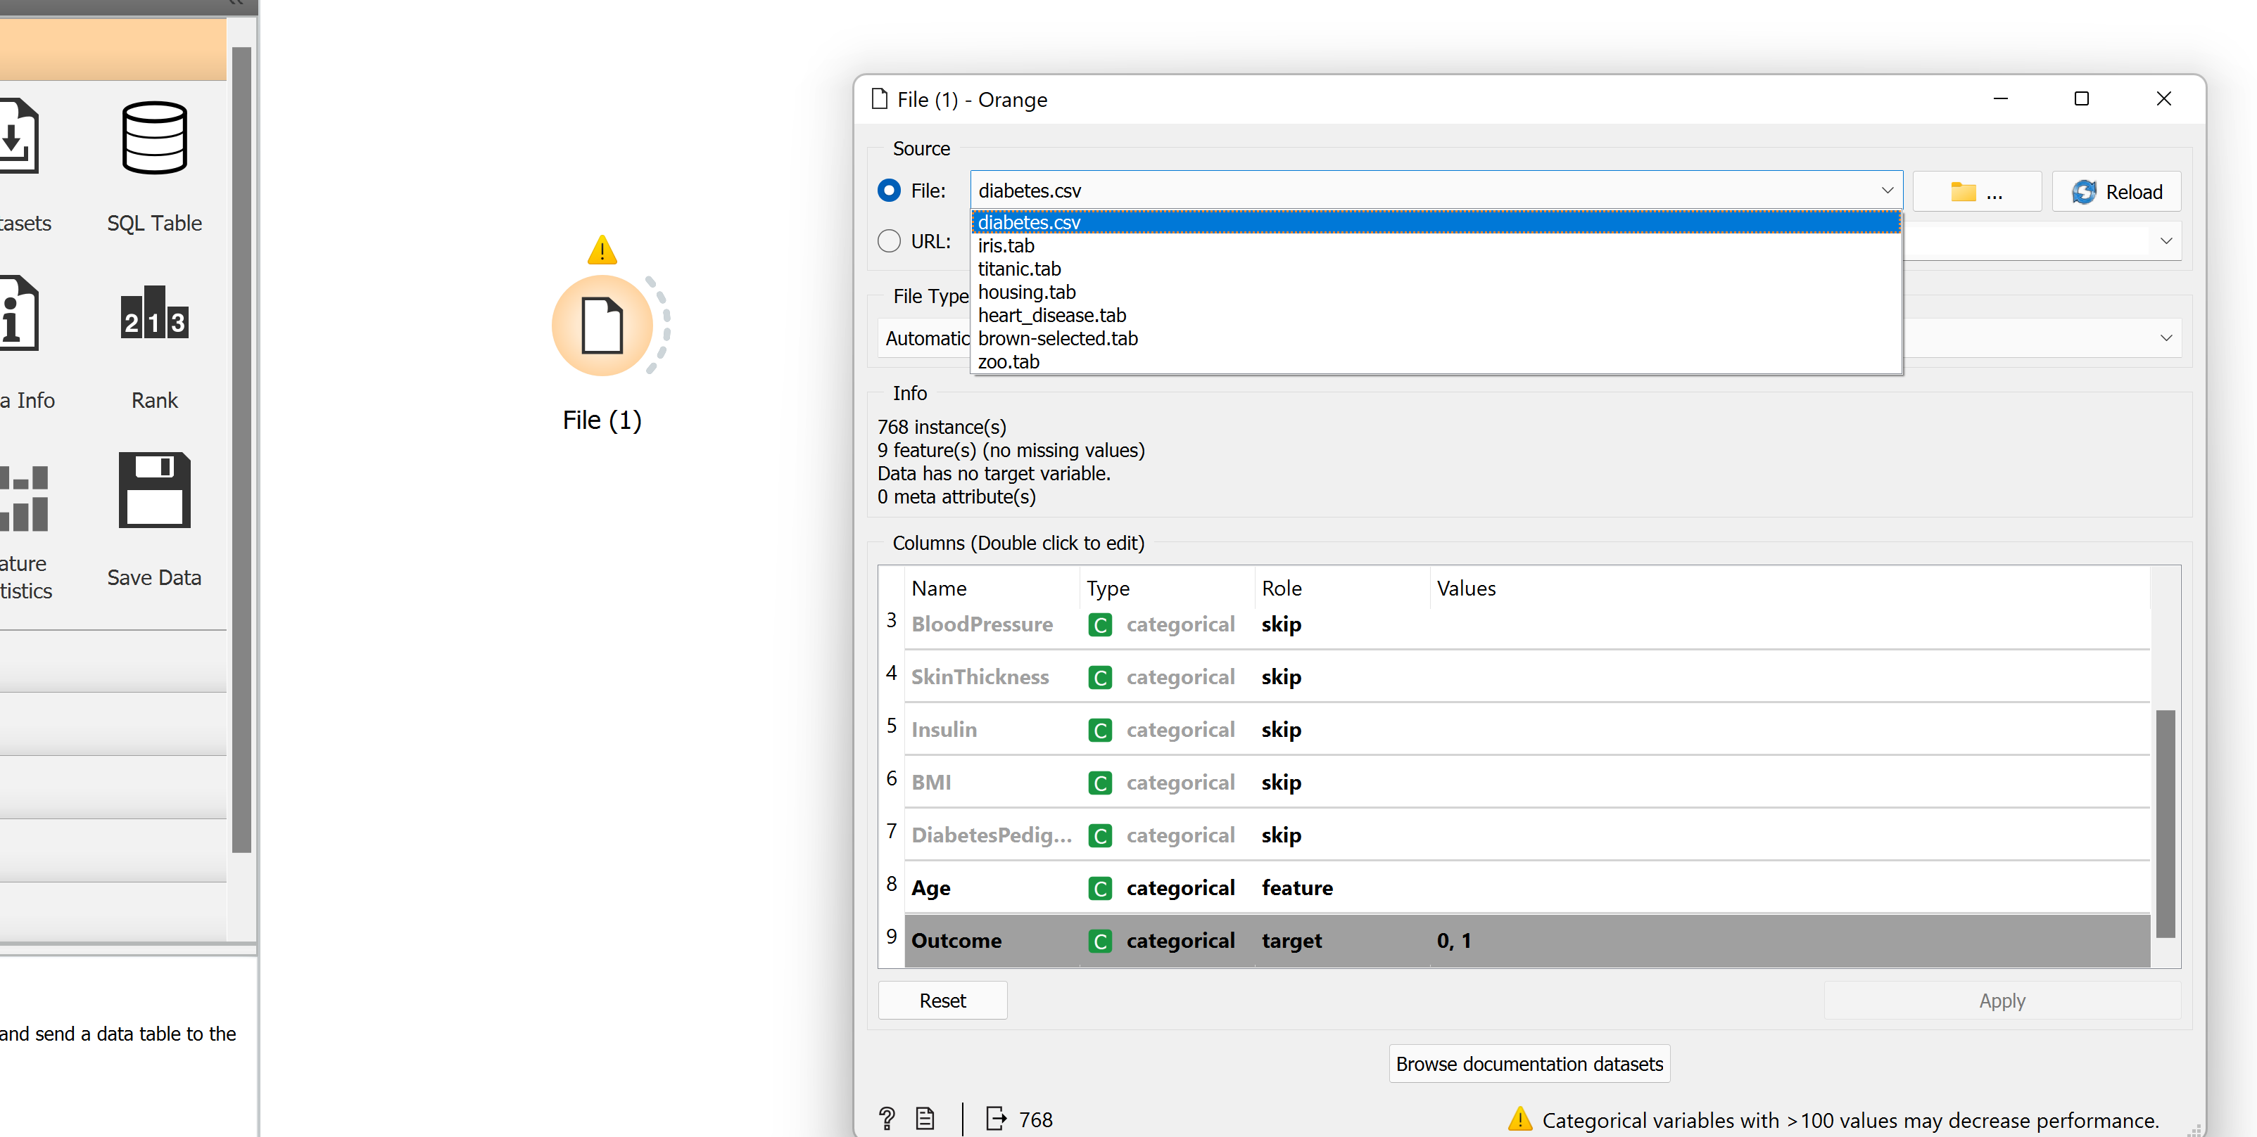
Importing the Data

Slide 3
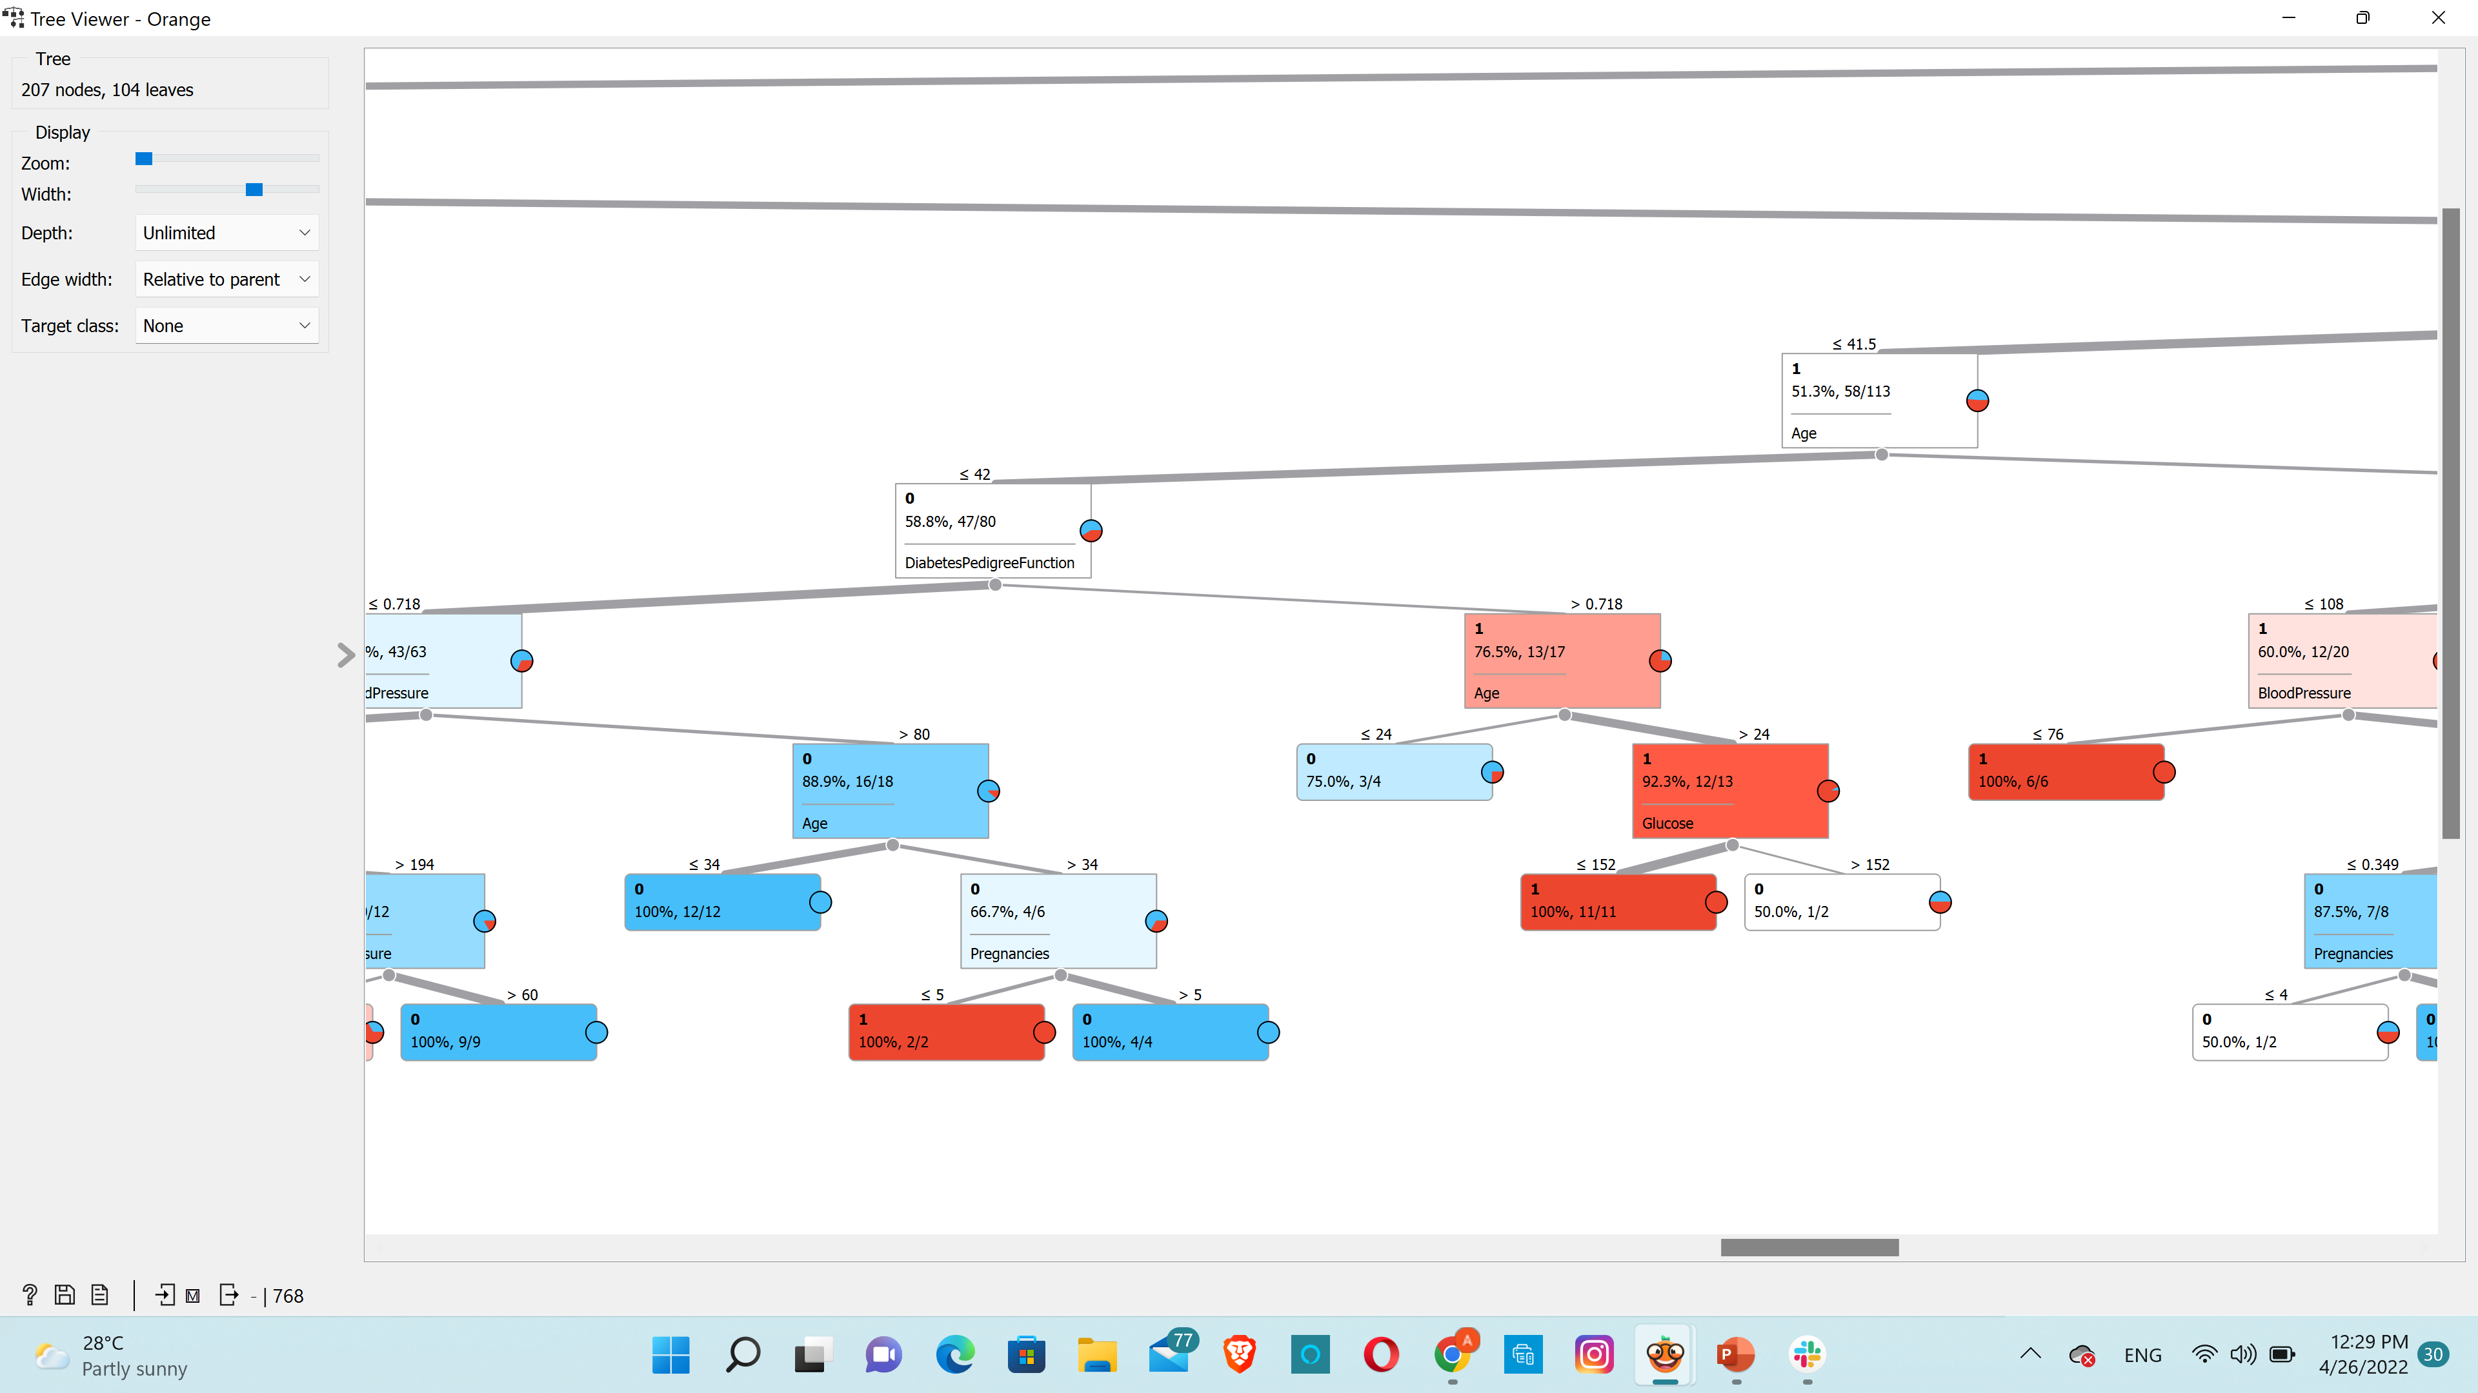
Building Decision tree

Slide 4
Hierarchical Clustering

Slide 5
Hierarchical Clustering and Scatter Plot

Slide 6
Association Rules

