Slide 1
Association Rules Discovery: WEKA

Slide 2
Introduction:
What are association rules?
Association analyses are studies that try to uncover if-else rules hidden within the dataset.
It usually yields good results with categorical data.
The most common example on association analysis is basket analysis.
In addition, it has a wide range of uses such as bioinformatics, disease diagnosis, web-mining and text-mining.

Slide 3
WHAT IS WEKA AND WHY?
Weka represents Waikato Environment for Knowledge Analysis. It has multiple built-in functions to implement a wide range of machine learning algorithms from linear regression to neural networks.
With weka data can be preprocessed, classified, grouped and also can be viewed. It supports different file formats like ARFF, CSV, C4.5 and JSON

Slide 4
WEKA INTERFACE

Slide 5
Loading Dataset in Weka
Used PIMA Diabetes dataset

Slide 6
Association rules for given Dataset

Slide 7
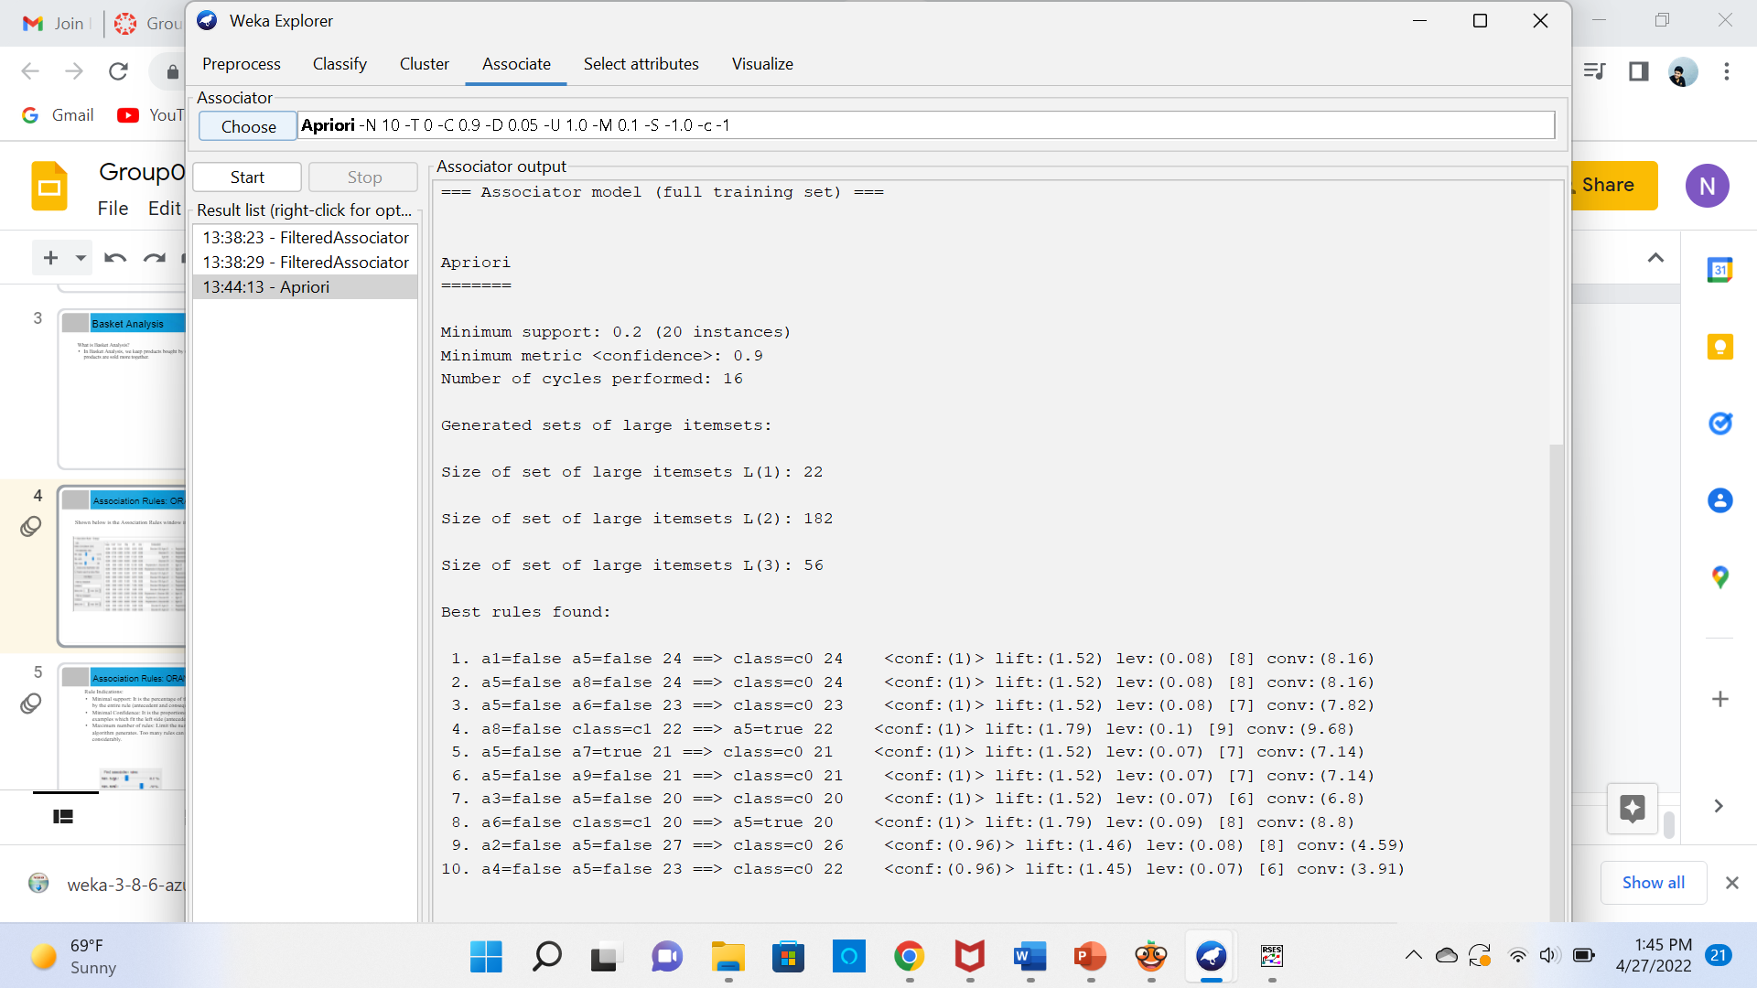
Association Rules: ORANGE
Rule Indications:
Minimal support: It is the level of the whole informational collection covered by the whole rule (precursor and subsequent).
Insignificant Confidence: It is the proportionof the quantity of models which fit the left side (precursor).
Most extreme number of rules: Limit the quantity of rules the calculation produces. Such a large number of rules can dial back the gadget extensively.
Snippets from project

Slide 8
Thank You!

