Slide 1
WEKA and ORANGE software -
run clustering, association rules discovery, and a decision tree
Group 5 Presentation

Slide 2
Cluster Analysis
Clustering Algorithms are unsupervised learning algorithms used to create groups of data with similar characteristics. It aggregates objects with similarities into groups and subgroups thus leading to the partitioning of datasets. Cluster analysis is the process of portioning of datasets into subsets. These subsets are called clusters and the set of clusters is called clustering.
Cluster Analysis is used in many applications such as image recognition, pattern recognition, web search, and security, in business intelligence such as the grouping of customers with similar likings.

Slide 3
K-means Clustering
K means clustering is the simplest clustering algorithm. In the K-Clustering algorithm, the dataset is partitioned into K-clusters. An objective function is used to find the quality of partitions so that similar objects are in one cluster and dissimilar objects in other groups.
In this method, the centroid of a cluster is found to represent a cluster. The centroid is taken as the center of the cluster which is calculated as the mean value of points within the cluster. Now the quality of clustering is found by measuring the Euclidean distance between the point and center. This distance should be maximum.

Slide 4
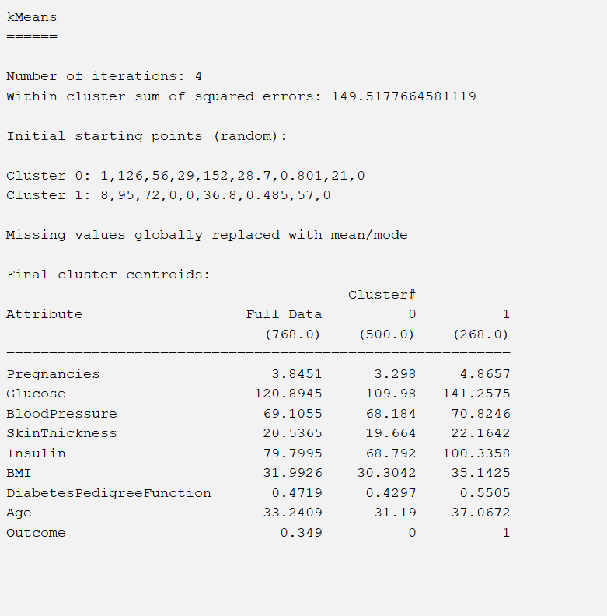
K-means Clustering Implementation Using WEKA
Distance function as Euclidian
The number of clusters as 2. With more number of clusters, the sum of squared error will reduce

Slide 5
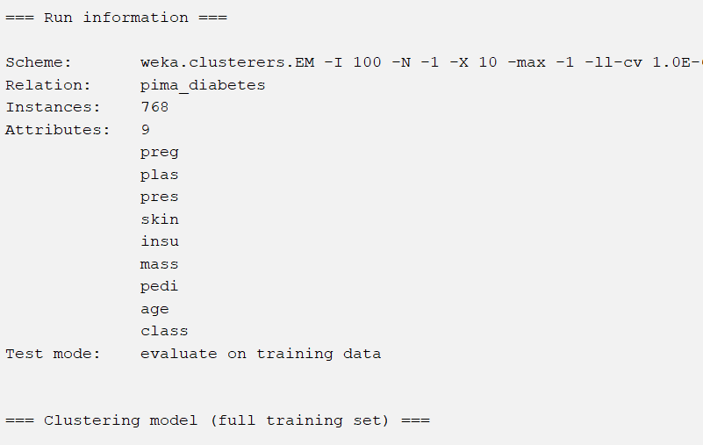
Examining Output
Scheme, Relation, Instances, and Attributes describe the property of the dataset and the clustering method used. In this case, diabetes.arff dataset has 768 instances and 9 attributes.
With the Kmeans cluster, the number of iterations is 4.
The sum of the squared error is 149.517. This error will reduce with an increase in the number of clusters.
Clustered instances represent the number and percentage of total instances falling in the cluster.

Slide 6
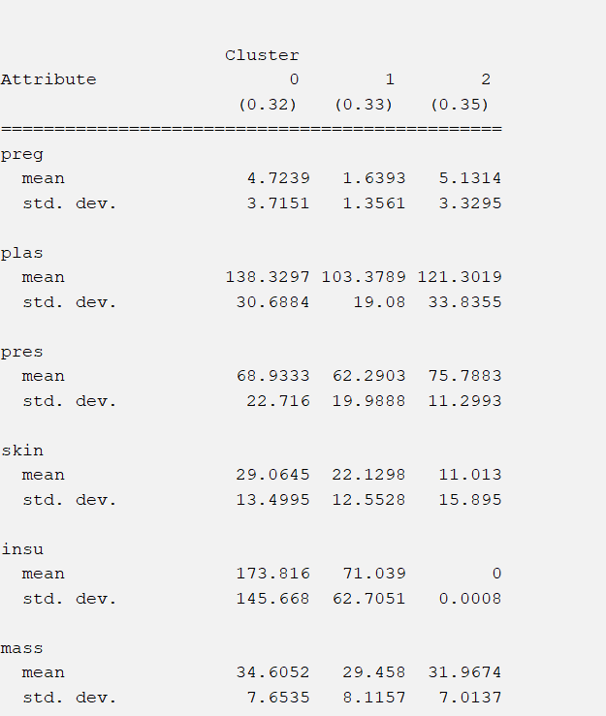
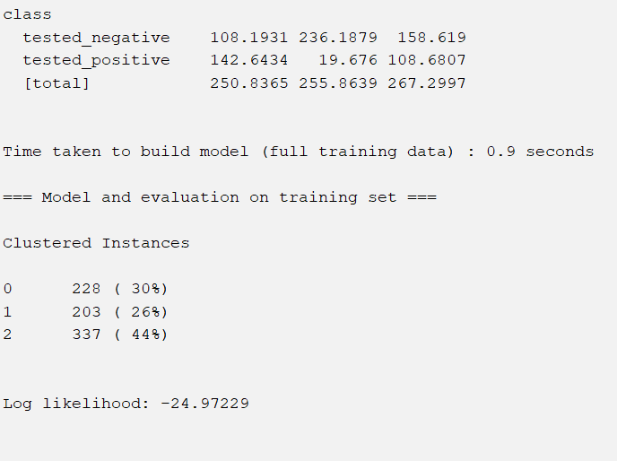
The centroid of each cluster is shown in the result window, along with statistics on the number and percent of instances allocated to each cluster. Each cluster centroid is represented by a mean vector. This cluster can be used to describe a cluster.
when there are very few instances it is very difficult to make a meaningful decision.

Slide 7
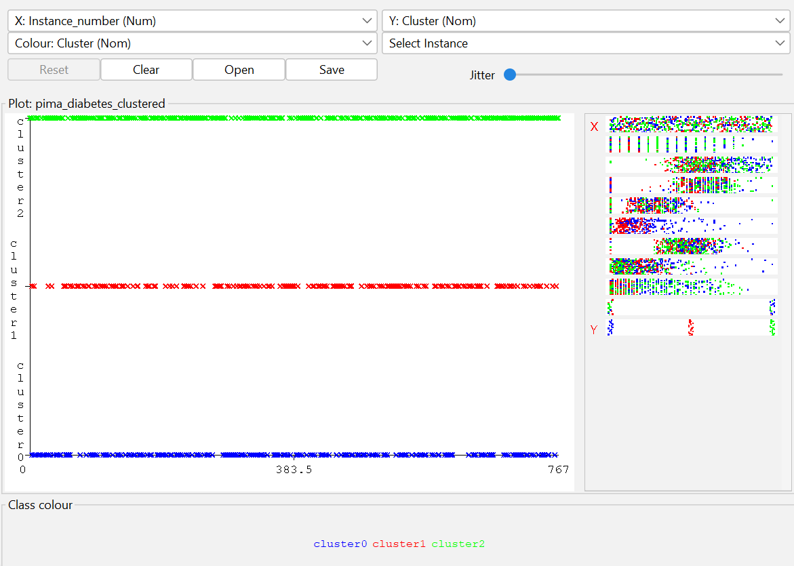
Visualizing Clusters
As in the case of classification, you will notice the distinction between the correctly and incorrectly identified instances. You can play around by changing the X and Y axes to analyze the results. You may use jittering as in the case of classification to find out the concentration of correctly identified instances. The operations in visualization plot are similar to the one you studied in the case of classification

Slide 8
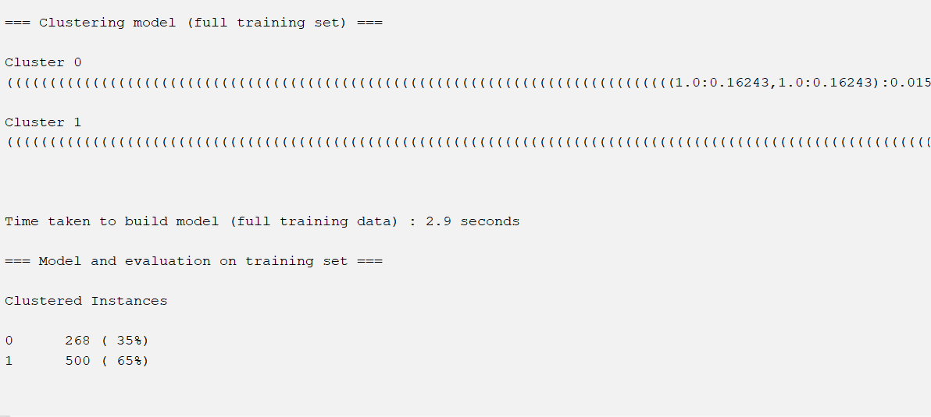
Applying Hierarchical Cluster
Hierarchical clustering, also known as Hierarchical cluster analysis or HCA, is an unsupervised clustering approach that includes forming groups with a top-to-bottom order.

