Slide 1
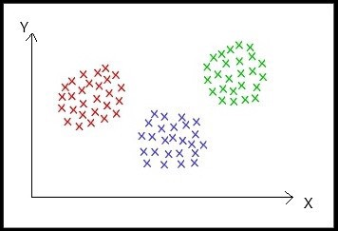
CLUSTERING
Clustering is an unsupervised machine learning technique that divides the population into several clusters such that data points in the same cluster are more similar and data points in different clusters are dissimilar.
Points in the same cluster are closer to each other.
Points in the different clusters are far apart.

Slide 2
`
There are two types of hierarchical clustering methods:
Divisive Clustering
Agglomerative Clustering
DIVISIVE CLUSTERING:
The divisive clustering algorithm is a top-down clustering approach, initially, all the points in the dataset belong to one cluster and split is performed recursively as one moves down the hierarchy.

Slide 3
Steps of Divisive Clustering:
Initially, all points in the dataset belong to one single cluster.
Partition the cluster into two least similar cluster
Proceed recursively to form new clusters until the desired number of clusters is obtained.

Slide 4
1st Image: All the data points belong to one cluster, 2nd Image: 1 cluster is separated from the previous single cluster, 3rd Image: Further 1 cluster is separated from the previous set of clusters.

Slide 5
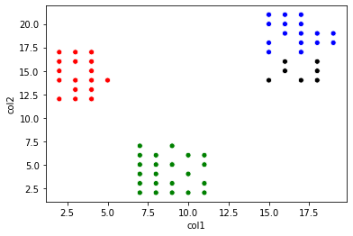
In the above sample dataset, it is observed that there is 3 cluster that is far separated from each other. So we stopped after getting 3 clusters.
Even if start separating further more clusters, below is the obtained result

