Slide 1
Measures of Cluster Validity

Slide 2
Measures
Internal Measures:
SSE
Cohesion and Separation
Silhouette Coefficient
External Measures:
There are several measures—entropy, purity, precision, recall, and the F-measure—that are commonly used to evaluate the performance of a classification model.

Slide 3
SSE
Clusters in more complicated figures aren’t well separated
Internal Index: Used to measure the goodness of a clustering structure without respect to external information
SSE is good for comparing two clustering's or two clusters (average SSE).
Can also be used to estimate the number of clusters

Slide 4
Cohesion and Separation
Cluster Cohesion: Measures how closely related are objects in a cluster, ex: SSE
Cluster Separation: Measure how distinct or well separated a cluster is from other clusters, ex: Squared Error
Cohesion is measured by the within cluster sum of squares (SSE)
Separation is measured by the between cluster sum of squares
Where |Ci | is the size of cluster i

Slide 5
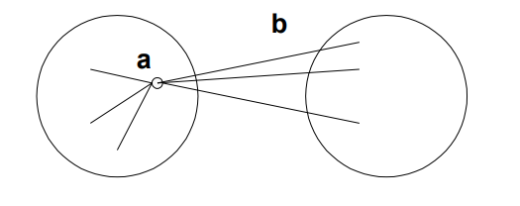
Silhouette Coefficient
Silhouette Coefficient combine ideas of both cohesion and separation, but for individual points, as well as clusters and clustering’s
For an individual point, i
Calculate a = average distance of i to the points in its cluster
Calculate b = min (average distance of i to points in another cluster)
The silhouette coefficient for a point is then given by s = 1 – a/b if a < b, (or s = b/a - 1 if a ≥ b, not the usual case)
Can calculate the Average Silhouette width for a cluster or a clustering

Slide 6
Entropy and Purity

