Slide 1
Agglomerative Clustering
Notes:
Cluster analysis groups data objects based on information found only in the
data that describes the objects and their relationships. The goal is that the
objects within a group be similar (or related) to one another and different from
(or unrelated to) the objects in other groups. The greater the similarity (or
homogeneity) within a group and the greater the difference between groups,
the better or more distinct the clustering.

Slide 2
Agglomerative Clustering
Agglomerative Clustering is a type of hierarchical clustering algorithm.
The agglomerative clustering is the most common type of hierarchical clustering used to group objects in clusters based on their similarity.
It’s also known as AGNES (Agglomerative Nesting).
Notes:
Hierarchical versus Partitional The most commonly discussed distinction among different types of clusterings is whether the set of clusters is nestedor unnested, or in more traditional terminology, hierarchical or partitional. A partitional clustering is simply a division of the set of data objects into non-overlapping subsets (clusters) such that each data object is in exactly one subset. If we permit clusters to have subclusters, then we obtain a hierarchical clustering, which is a set of nested clusters that are organized as a tree. Each node (cluster) in the tree (except for the leaf nodes) is the union of its children (subclusters), and the root of the tree is the cluster containing all the objects. Often, but not always, the leaves of the tree are singleton clusters of individual data objects

Slide 3
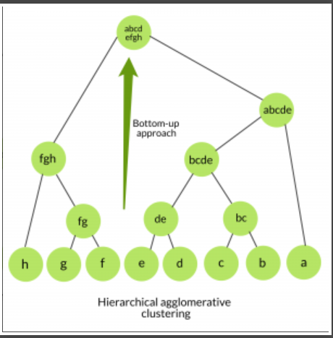
Agglomerative Approach
Start with each data object as individual
cluster.
At each step merge the closest pair of
clusters until only one cluster (or K clusters) left.

Slide 4
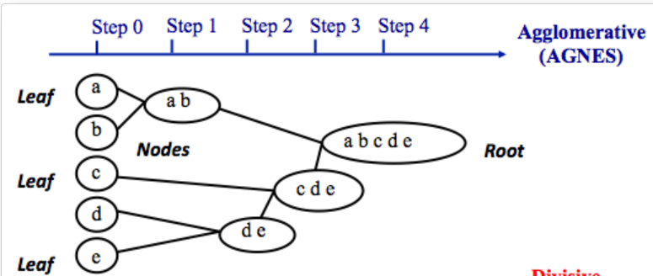
Agglomerative Approach

Slide 5
Agglomerative Approach
Initialization:
Each object is a cluster.
Iteration:
Merge two clusters which are most similar to each other until all objects are merged into a single cluster.

Slide 6
Agglomerative Approach
Drawbacks
They have large storage requirements, and they can be computationally intensive. This is especially true for big data.
These complex algorithms are about four times the size of the K-means algorithm.
Also, merging can’t be reversed, which can create a problem if you have noisy, high-dimensional data.

