Slide 1
Data Discretization
GROUP-8

Slide 2
Clustering Algorithm(Density Based Spatial Clustering of Application with Noise.)
DBSCAN is a density-based clustering algorithm that works on the assumption that clusters are dense regions in space separated by regions of lower density.
It groups ‘densely grouped’ data points into a single cluster. It can identify clusters in large spatial datasets by looking at the local density of the data points. The most exciting feature of DBSCAN clustering is that it is robust to outliers. It also does not require the number of clusters to be told beforehand, unlike K-Means, where we have to specify the number of centroids.

Slide 3
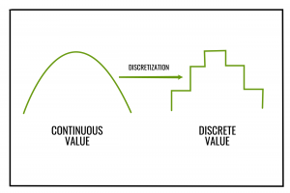
Binning Discretization
In this method the data is first sorted and then
the sorted values are distributed into a number
of buckets or bins. As binning methods consult
the neighborhood of values, they perform local
Smoothing. This binning method can be used
for discretization.

Slide 4
Types of Binning Discretization
Equal width (or distance) binning :
The simplest binning approach is to partition the range of the variable into k equal-width intervals. The interval width is simply the range [A, B] of the variable divided by k,
w = (B-A) / k
Thus, ith interval range will be [A + (i-1)w, A + iw] where i = 1, 2, 3…..k Skewed data cannot be handled well by this method.

Slide 5
Cont.. Types of Binning Discretization
2. Equal depth (or frequency) binning
In equal-frequency binning we divide the range [A, B] of the variable
into intervals that contain (approximately) equal number of points;
equal frequency may not be possible due to repeated values.

Slide 6
Smoothing of data using Binning Discretization
There are three approaches to perform smoothing
1. Bin Means:
In smoothing by bin means, each value in a bin is replaced by the mean value of the bin.
2. Bin Median:
In this method each bin value is replaced by its bin median value.
3. Bin Boundary:
In smoothing by bin boundaries, the minimum and maximum values in a given bin are identified as the bin boundaries. Each bin value is then replaced by the boundary value it is closest to.

