Slide 1
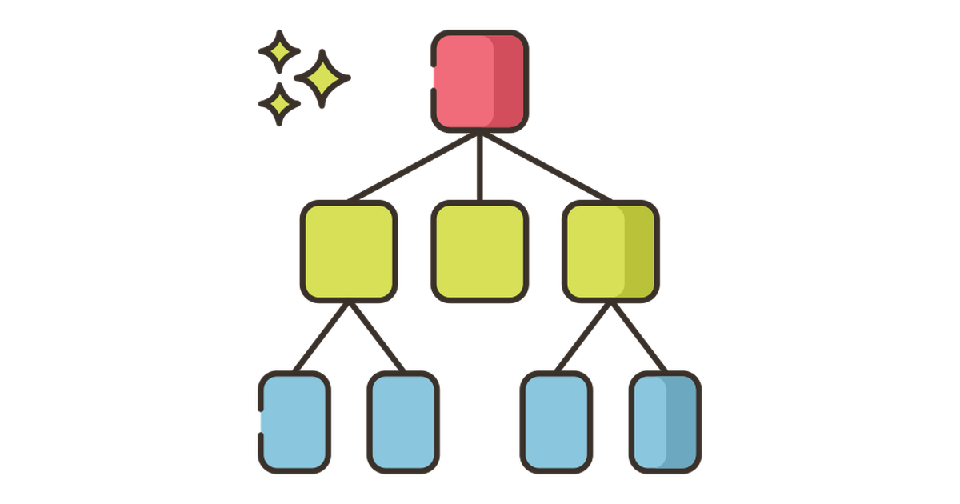
Decision Tree Compared to Other Methods

Slide 2
How is normal Decision Tree different from Random Forest?
A Decision Tree is a supervised learning strategy in machine learning. It may be used with both classification and regression algorithms.
As the name says, it resembles a tree with nodes. The branches are determined by the number of criteria. It separates data into these branches until a threshold unit is reached.
A decision tree has root nodes, child nodes, and leaf nodes. Although it has a lot of strength, random forest is also used for supervised learning. It's well-liked.
The primary difference is that it isn't based on a single choice. It makes a final choice based on most randomized decisions based on many decisions.

Slide 3
What are the main advantages of using a random forest versus a single decision tree?
We'd prefer to eliminate both bias-related and variance-related mistakes in an ideal world. Random forests do a good job of dealing with this problem.
A random forest is just a collection of decision trees with their results merged into a single ultimate outcome. They're so effective because they can decrease overfitting without significantly increasing inaccuracy due to bias. Random forests, on the other hand, are a versatile modeling tool that outperforms a single decision tree. They use a combination of decision trees to prevent overfitting and bias-related inaccuracy, resulting in useful findings.

Slide 4
What is a limitation of decision trees over Random Forest?
When compared to alternative predictors, one of the disadvantages of decision trees is that they are relatively unstable. A little change in the data might result in a major shift in the decision tree's structure, resulting in a result that differs from what customers would anticipate in a normal occurrence.
Furthermore, decision trees are less useful in making predictions when the main goal is to anticipate the outcome of a continuous variable.

Slide 5
Decision tree vs Support- Vector Machine
SVM uses kernel trick to solve non-linear problems whereas decision trees derive hyper-rectangles in input space to solve the problem.
Decision trees are better for categorical data, and it deals colinearity better than SVM.
In conclusion, decision trees assist analysts in evaluating future choices. The tree provides a visual representation of all possible outcomes, incentives, and follow-up choices in a single document. Because of this, decision trees are preferred over alternative techniques.

