Slide 1
Attribute Selection Measures
Entropy
Information Gain
Gini Index
Gain Ratio
Reduction in Variance
Chi-Square

Slide 2
Entropy
Entropy is the measure of Randomness in the given dataset that is being processed.
The toughness to draw any conclusion for given information depends on the value of entropy. The higher the entropy, the harder it is to draw any conclusion.
Flipping a coin and rolling the dice are examples of some random events

Slide 3
Information Gain
Information gain is a statistical property that measures how well a given attribute separates the training examples according to their target classification.
Drawing a decision tree is all about finding an attribute that has highest information gain and lowest entropy.
Information gain is a decrease in entropy. It computes the difference between entropy before split and average entropy after split of the dataset based on given attribute values.

Slide 4
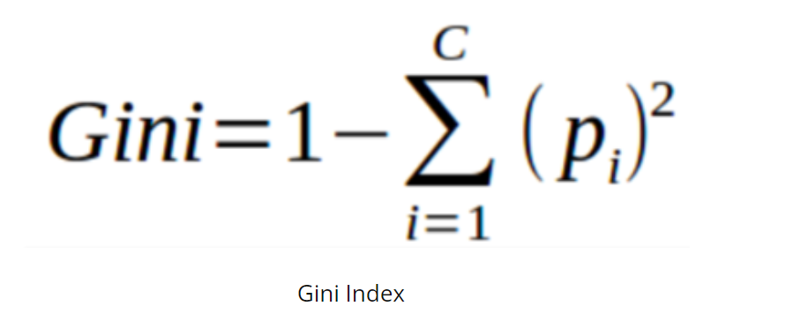
Gini Index
Gini is a cost function used to estimate in splits in the dataset.
Estimates are calculated based on the difference between the squared probabilities of every class from one.
Gini Index suits for larger partitions where as Information gain suits for smaller partitions.

Slide 5
Chi-Square
Chi-Squared Automatic Interaction Detector is one of the oldest tree classification methods.
It is widely used for calculating the statistical significance between the differences of sub-node and parent node.
It is measured with sum of squares of differences between observed and expected frequencies

