Slide 1
History of Decision Trees

Slide 2
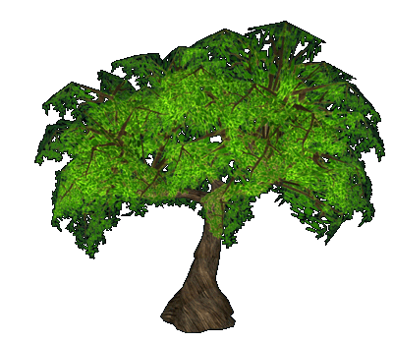
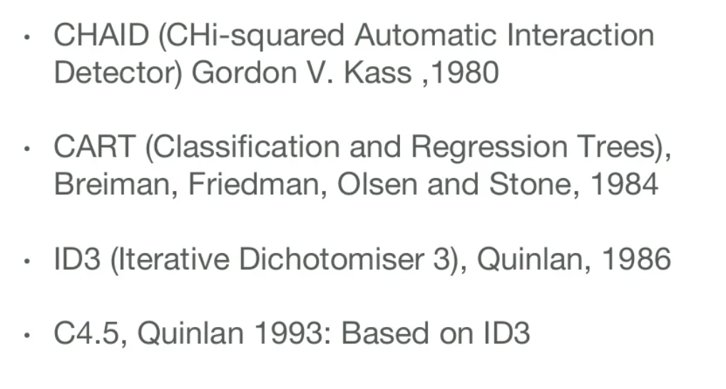
The Origins
In their computational origin they were also referred to as classification trees or regression trees, which are models of biological and cognitive processes

Slide 3
Decision Tree Algorithm CHAID → (Chi-square automatic interaction detection Performs multi-level splits when computing classification trees)
Chi-square automatic interaction detection (CHAID) is a decision tree technique, based on adjusted significance testing (Bonferroni testing). The technique was developed in South Africa and was published in 1980 by Gordon V. Kass, who had completed a PhD thesis on this topic.
CHAID's advantages are that its output is highly visual and easy to interpret. Because it uses multiway splits by default, it needs rather large sample sizes to work effectively, since with small sample sizes the respondent groups can quickly become too small for reliable analysis.

Slide 4
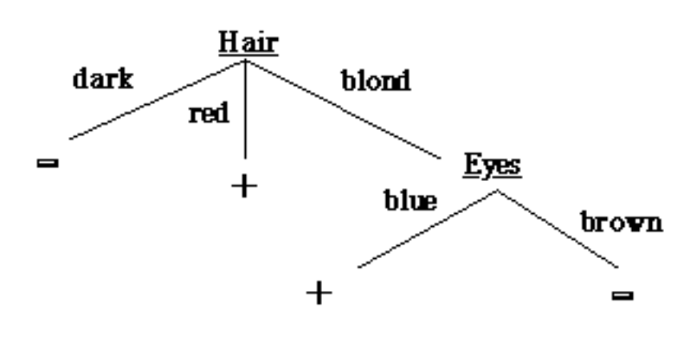
Decision Tree Algorithm ID3
This model for performing decision tree analysis was created by J. Ross Quinlan at the University of Sydney and presented in his book Machine Learning, in 1975 . His first algorithm for decision tree creation was called the Iterative Dichotomiser 3 (ID3)
ID3 uses a top-down greedy approach to build a decision tree. In simple words, the top-down approach means that we start building the tree from the top and the greedy approach means that at each iteration we select the best feature at the present moment to create a node.
Most generally ID3 is only used for classification problems with nominal features only.

Slide 5
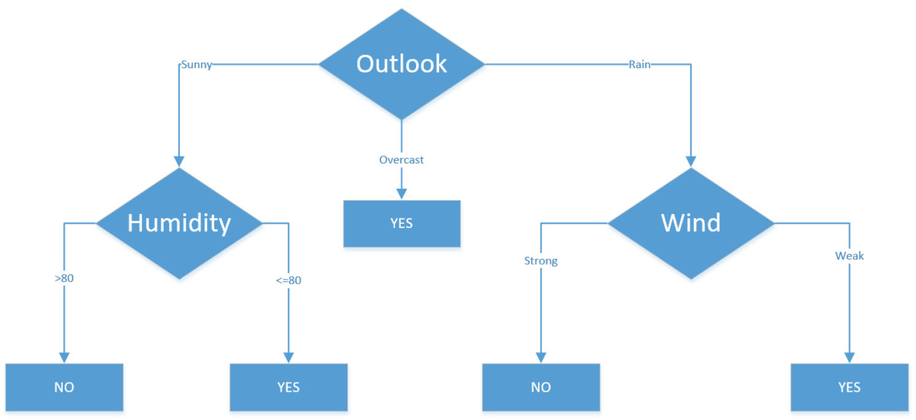
Decision Tree Algorithm C4.5
C4.5 is an extension of Quinlan's earlier ID3 algorithm. The decision trees generated by C4.5 can be used for classification, and for this reason, C4.5 is often referred to as a statistical classifier.
In 2011, authors of the Weka machine learning software described the C4.5 algorithm as "a landmark decision tree program that is probably the machine learning workhorse most widely used in practice to date"

Slide 6
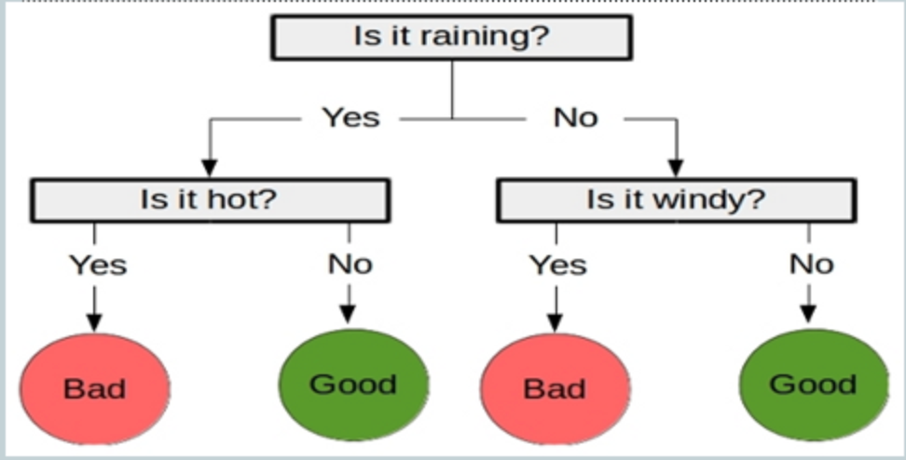
Decision Tree Algorithm CART → (Classification And Regression Tree)
It is one of the oldest tree classification methods. It finds out the statistical significance between the differences between sub-nodes and parent node. We measure it by the sum of squares of standardized differences between observed and expected frequencies of the target variable.
It works with the categorical target variable “Success” or “Failure”. It can perform two or more splits. Higher the value of Chi-Square higher the statistical significance of differences between sub-node and Parent node.

