Slide 1
Attribute Selection For Decision Tree

Slide 2
Need for Decision Trees
Decision making is a critical skill in everyday life
Decision making is a systematic process that involves choosing between all courses of actions to find the best fit.
Decision tree is an excellent tool to evaluate your options that eventually leads to problem solving and revealing potential opportunities

Slide 3
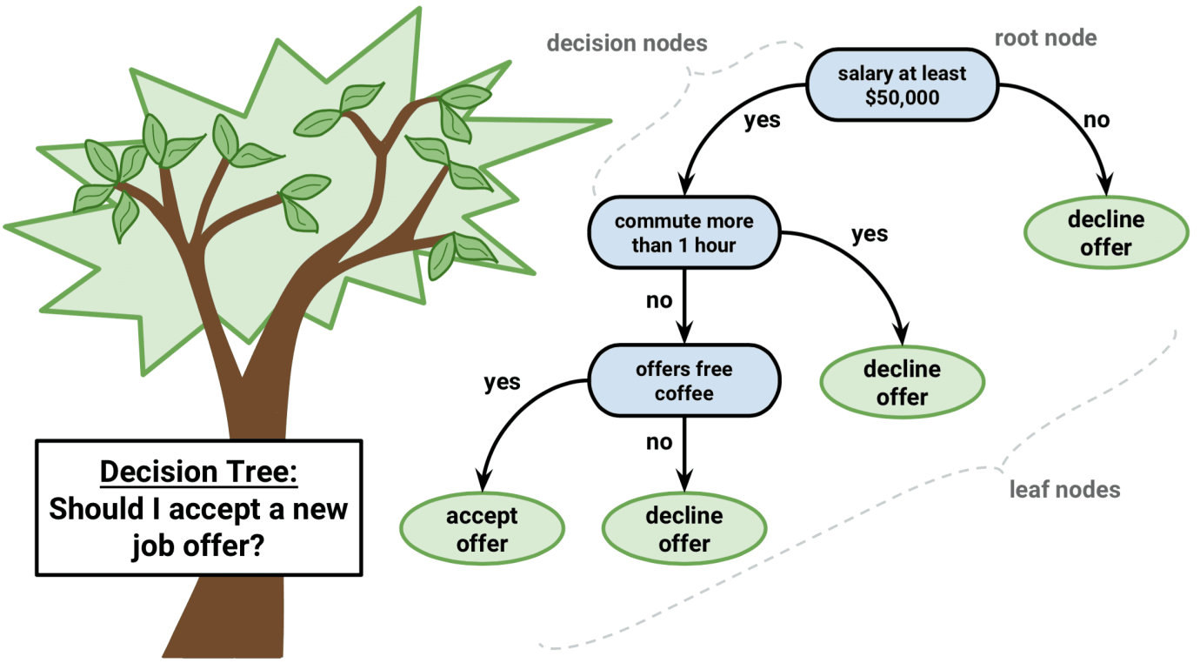
Basic Terminologies
Attribute:
Properties of objects in data set
Represented by Column in a table
Decision Nodes:
Attributes used for decision tree construction
Root Node:
Best attribute of decision tree
Leaf Nodes:
Class label / decision

Slide 4
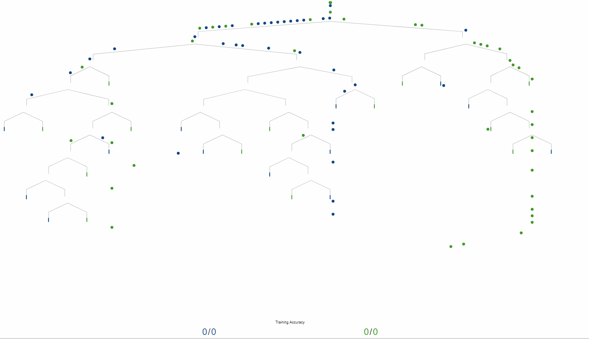
Construction of a Decision Tree
Place the best attribute of the dataset at the root of the tree.
Split the training set into subsets. Subsets should be made in such a way that each subset contains data with the same value for an attribute.
Repeat step 1 and step 2 on each subset until you find leaf nodes in all the branches of the tree.
Once constructed, test on unknown or test data.

Slide 5
Attribute Selection Criteria
In decision tree, we select an attribute to be the decision node if it is the dominant attribute.
This attribute divides the data points in most distinct possible manner
If the attributes are selected in correct order it results in a compact tree which is easier to traverse
Improper selection results in a complex tree which is difficult tot traverse
This process of finding out strongest attribute amongst the set of available attributes therefore becomes very important part of the decision tree construction

Slide 6
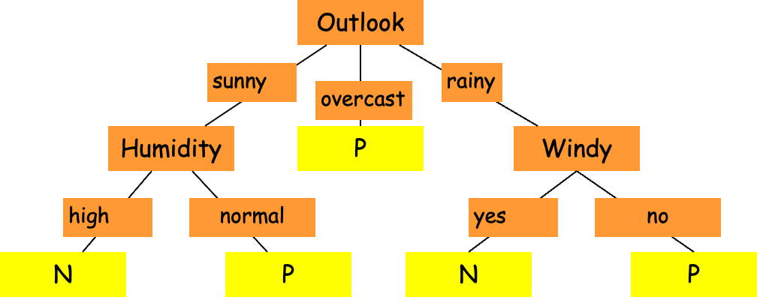
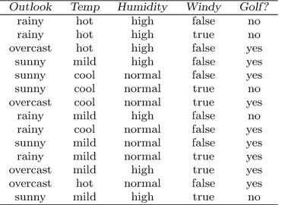
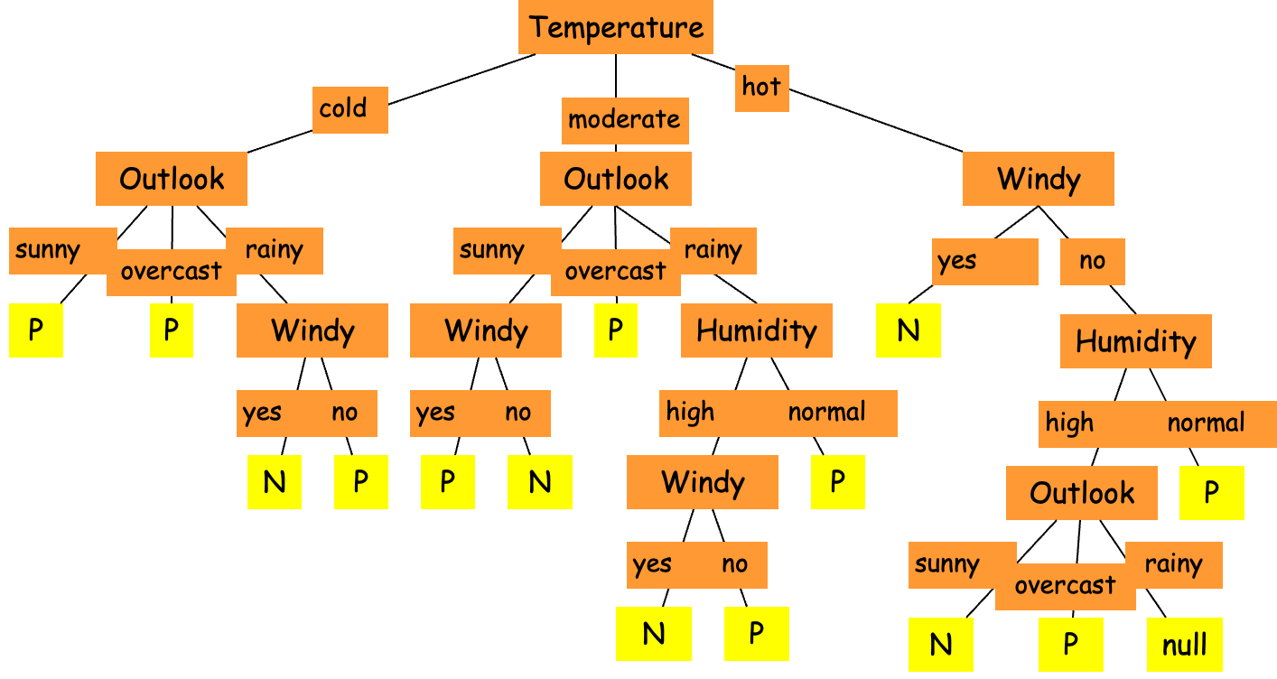
Example
Correct Attribute Choice
Wrong Attribute Choice

