Slide 1
Action Rules

Slide 2
What Are Rules?
Rule is:
unexpected, if it contradicts the user belief about the domain and therefore surprises the user
novel, if to some extent contributes to new knowledge
actionable, if the user can take an action to his/her advantage based on this rule
In the data mining literature the actionability has been quantified in terms of unexpectedness. For example:
- the most of actionable knowledge is unexpected.
- the most of unexpected knowledge is actionable.

Slide 3
Actionable rule mining deals with benefit-driven actions required for decision making
Rules are unexpected if they "surprise" the user, and rules are actionable if the user can do something with them to his/her advantage
For example, a user may be able to change the nondesirable/non-profitable patterns to desirable/profitable patterns

Slide 4
So, if we are able to calculate the actionability of a rule (like the way we are able to calculate support and confidence) then, we have a way of knowing whether our rule is unexpected and interesting
In the data mining literature, data mining is viewed as the process of turning data into information, information into action, and action into value or profit.
However, the task of finding actionable rules is not trivial. As actionability is seen as an elusive concept because it is difficult to know the space of all rules and the actions to be attached to them.

Slide 5
Action Rules Definition
An action rule is a rule extracted from an information system that describes a possible transition of objects from one state to another with respect to a distinguished attribute called a decision attribute
Action rules can be constructed from certain parts of classification rules, but the construction turns out to be expensive
Action rules can be seen as logical terms, describing, knowledge about possible actions associated with objects which are hidden in a decision system

Slide 6
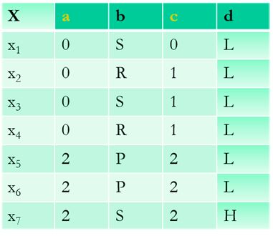
Examples
{a, c} - stable attributes,
{b, d} - flexible attributes,
d - decision attribute.
Rules discovered:
r1 = [(b, P) à (d, L)]
r2 = [(a, 2) Ù (b, S) à (d, H)]
Action rule:
[(a, 2) Ù (b, P® S)](x) Þ[(d, L® H)](x)

Slide 7
Thank You

