Slide 1
Decision RuleS- LERS
Siddharth Jayachandra Babu
801252829

Slide 2
LERS
WHAT IS LERS?
Learning from Examples based on Rough Sets

Slide 3
What is LERS?
The learning system LERS (Learning from Examples based on Rough Sets) induces a set of rules from examples and classifies new examples using the set of rules induced previously by LERS. These rules are more general than information contained in the original input data since more new examples may be correctly classified by rules than may be matched with examples from the original data.

Slide 4
applications
LERS has potential applications to
finances (for example, whether to give a loan),
medical area (for example, decision support for diagnosing), and
military (for example, evaluation of job performance), etc.
The machine learning/ data mining system LERS is universal. It may induce rules from any kind of data.
The machine learning/ data mining system LERS has proven its applicability having been used for years by NASA Johnson Space Center (Automation and Robotics Division), as a tool to develop expert systems of the type most likely to be used in medical decision - making on board the International Space Station.

Slide 5
Handling inconsistencies
LERS handles inconsistencies using rough set theory. The main advantage of rough set theory is that it does not need any preliminary or additional information about data (like probability in probability theory, grade of membership in fuzzy set theory, etc.). In rough set theory approach inconsistencies are not removed from consideration. Instead, lower and upper approximations of the concept are computed. On the basis of these approximations, LERS computes two corresponding sets of rules: certain and possible.

Slide 6
Rough set theory IN KDD
Sravani kalangi
801262728

Slide 7
ROUGH SETS IN KDD
The KDD process consists of six stages:
Data selection
Cleaning of data
Enrichment of data
Coding
Data mining
Reporting
In data selection the data most relevant to the problem at hand is selected, leaving out redundant data. In the cleaning process, the obvious flaws in the data are corrected. In the coding process, data is coded such that it can be used in data mining algorithms. In the data mining process, the actual inference takes place. In the reporting process the results are of course reported, usually in a visually attractive way
Rough set theory constitutes a sound basis for KDD.

Slide 8
WHAT ARE ROUGH SETS?
Rough Set Theory (RST) is a mathematical formalism for representing uncertainty that can be considered an extension of the classical set theory.

Slide 9
WHY ROUGH SETS?
Data contained in the databases of the real world were not collected with learning in mind.
Data is uncertain in nature, in deterministic and contains noise due to errors in measurements, data transfer and human errors performed during the data collection process.
All of the characteristics presented above contribute to the uncertainty of the data.
Rough sets offer useful tools for discovering patterns hidden in data in many aspects like attribute selection, attribute extraction, data reduction, decision rule generation and pattern extraction (templates, association rules)

Slide 10
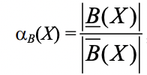
ROUGH SET ANALYSIS IN KDD
There are two different kinds of knowledge representations, namely information systems and decision systems.
A rough set X can be characterized numerically by the following coefficient, called the accuracy of approximation.
In the case of rough sets, the notion of membership is different. The rough membership function quantifies the degree of relative overlap between the set X and the equivalence class to which x belongs. It is defined as follows:

Slide 11
Solving a Problem ON LERS
Radheer Reddy Karri
801237215

Slide 12
LERS
Using LERS to find all certain rules and possible rules by describing G in terms of A, F, C.
(g1)* | {X2, X4}
(g2)* | {X3, X5}
(g3)* | {X1, X6}
(a1)* | {X2, X3, X4, X6}
(a2)* | {X1, X5}
(f1)* | {X1, X4}
(f2)* | {X2, X3, X5, X6}
(c1)* | {X2, X3}
(c2)* | {X1, X4, X5, X6}
 | A | F | G | C
X1 | a2 | f1 | g3 | c2
X2 | a1 | f2 | g1 | c1
X3 | a1 | f2 | g2 | c1
X4 | a1 | f1 | g1 | c2
X5 | a2 | f2 | g2 | c2
X6 | a1 | f2 | g3 | c2
Learning from Examples based on Rough Sets

Slide 13
LERS
LOOP-1:
There are no certain rules because the sets a1, a2, f1, f2, c1, c2 are not subsets of g1 or g2 or g3. Hence, we have only possible rules for all the sets.
Possible Rules
a1 -> g1[Support=2, Confidence=50.0%]
a1 -> g2[Support=1, Confidence=25.0%]
a1 -> g3[Support=1, Confidence=25.0%]
a2 -> g1[Support=0, Confidence=0.0%]
a2 -> g2[Support=1, Confidence=50.0%]
a2 -> g3[Support=1, Confidence=50.0%]
f1 -> g1[Support=1, Confidence=50.0%]
f1 -> g2[Support=0, Confidence=0.0%]
f1 -> g3[Support=1, Confidence=50.0%]
f2 -> g1[Support=1, Confidence=25.0%]
f2 -> g2[Support=2, Confidence=50.0%]
f2 -> g3[Support=1, Confidence=25.0%]
c1 -> g1[Support=1, Confidence=50.0%]
c1 -> g2[Support=1, Confidence=50.0%]
c1 -> g3[Support=0, Confidence=0.0%]
c2 -> g1[Support=1, Confidence=25.0%]
c2 -> g2[Support=1, Confidence=25.0%]
c2 -> g3[Support=2, Confidence=50.0%]

Slide 14
LERS
LOOP-2:
a1, f1 | {X4}
a1, f2 | {X2, X3, X6}
a1, c1 | {X2, X3}
a1, c2 | {X4, X6}
a2, f1 | {X1}
a2, f2 | {X5}
a2, c2 | {X1, X5}
f1, c2 | {X1, X4}
f2, c1 | {X2, X3}
f2, c2 | {X5, X6}
Certain Rules
a1, f1 -> g1[Support=1, Confidence=100.0%]
a2, f1 -> g3[Support=1, Confidence=100.0%]
a2, f2 -> g2[Support=1, Confidence=100.0%]

Slide 15
LERS
LOOP-2: (Continued..)
Possible Rules
a1, c2 -> g1[Support=1, Confidence=50.0%]
a1, c2 -> g2[Support=0, Confidence=0.0%]
a1, c2 -> g3[Support=1, Confidence=50.0%]
f2, c1 -> g1[Support=1, Confidence=50.0%]
f2, c1 -> g2[Support=1, Confidence=50.0%]
f2, c1 -> g3[Support=0, Confidence=0.0%]
f1, c2 -> g1[Support=1, Confidence=50.0%]
f1, c2 -> g2[Support=0, Confidence=0.0%]
f1, c2 -> g3[Support=1, Confidence=50.0%]
f2, c2 -> g1[Support=0, Confidence=0.0%]
f2, c2 -> g2[Support=1, Confidence=50.0%]
f2, c2 -> g3[Support=1, Confidence=50.0%]
a1, f2 -> g1[Support=1, Confidence=33.0%]
a1, f2 -> g2[Support=1, Confidence=33.0%]
a1, f2 -> g3[Support=1, Confidence=33.0%]
a2, c2 -> g1[Support=0, Confidence=0.0%]
a2, c2 -> g2[Support=1, Confidence=50.0%]
a2, c2 -> g3[Support=1, Confidence=50.0%]
a1, c1 -> g1[Support=1, Confidence=50.0%]
a1, c1 -> g2[Support=1, Confidence=50.0%]
a1, c1 -> g3[Support=0, Confidence=0.0%]
a1, f1 | {X4}
a1, f2 | {X2, X3, X6}
a1, c1 | {X2, X3}
a1, c2 | {X4, X6}
a2, f1 | {X1}
a2, f2 | {X5}
a2, c2 | {X1, X5}
f1, c2 | {X1, X4}
f2, c1 | {X2, X3}
f2, c2 | {X5, X6}

Slide 16
LERS
LOOP-3:
Certain Rules
a1, f2, c2 -> g3[Support=1, Confidence=100.0%]
a1, f1, c2 | {x4}; Marked
a1, f2, c1 | {X2, X3}
a1, f2, c2 | {X6}
a2, f1, c2 | {X1}; Marked
a2, f2, c2 | {X5}; Marked
Possible Rules:
a1, f2, c1 -> g1[Support=1, Confidence=50.0%]
a1, f2, c1 -> g2[Support=1, Confidence=50.0%]
a1, f2, c1 -> g3[Support=0, Confidence=0.0%]

Slide 17
Learning from examples based on rough sets-Examples
DINESH Reddy KANKANALA
801274360

Slide 18
LERS
IN ECONOMIC AND FINANCIAL PREDICTION
Business Failure Prediction
Database Marketing
Financial Investment

Slide 19
In Medical sciences
Sensitivity and Specificity analysis
Poor physical formulae or equations for characterizing medical data
Prior setting

Slide 20
In Military
Performance Evaluation
Military Simulation Analysis
Military Simulation Processing

Slide 21
Other examples
Fault diagnosis
Image processing
Email filtering
Intrusion detection
Neural network algorithm Etc.

Slide 22
RSES - Rough Set Exploration System
Satheesh kandula
801272362

Slide 23
What is RSES?
RSES(Rough Set Exploration System) is a software tool that provides the means for analysis of tabular data sets with use of various methods, in particular those based on Rough Set Theory.

Slide 24
The main aim of RSES is to provide a tool for performing experiments on tabular data sets.
In general, the RSES system offers the following capabilities:
• import of data from text files,
• visualization and pre-processing of data including, among others, methods for discretization and missing value completion,
• construction and application of classifiers for both smaller and vast data sets, together with methods for classifier evaluation.

Slide 25
The RSES system is a software tool with an easy-to-use interface,
at the same time featuring a bunch of method that make it possible
to perform compound, non-trivial experiments in data exploration
with use of Rough Set methods.

Slide 26
RSES is a freely available software system toolset for data exploration, classification support and knowledge discovery. The main functionalities of this software system are presented along with a brief explanation of the algorithmic methods used by RSES. Many of the RSES methods have originated from rough set theory.

Slide 27
Object in RSES
Tables
Reduce sets
Rule Sets
Cut sets
Akagra jain
801211198

Slide 28
Tables
Load Save As View | Change Name Remove

Slide 29
Reduce sets
View
Change Name
Remove
Filter
Shorten

Slide 30
Rule Sets
View
Change Name
Remove
Filter
Shoten

Slide 31
Cut set
View
Change Name
Remove
Save as
Load

Slide 32
data analysis methods in RSES
Missing Value Completion
Cuts, Discretization and grouping
Linear Combination
Reducts and Decision rules
Pruthvi Kasula
801254275

Slide 33
MISSING VALUE COMPLETION
RSES offers four approaches to the issue of missing values(MISSING, NULL or ’?’):
Remove objects with missing values
Complete with most common or mean value
Disregard during rule/reduct calculation
Treating the missing data as information
Example of RSES data set :
ATTRIBUTES 5
temperature numeric 1
headache numeric 0
cough symbolic
catarrh symbolic
disease symbolic
OBJECTS 4
38.7 7 no no angina
38.3 MISSING yes yes influenza
MISSING 3 no no cold
36.7 1 no no healthy
Notes:
Example of RSES data set :
TABLE therapy
ATTRIBUTES 5
temperature numeric 1
headache numeric 0
cough symbolic
catarrh symbolic
disease symbolic
OBJECTS 4
38.7 7 no no angina
38.3 MISSING yes yes influenza
MISSING 3 no no cold
36.7 1 no no healthy

Slide 34
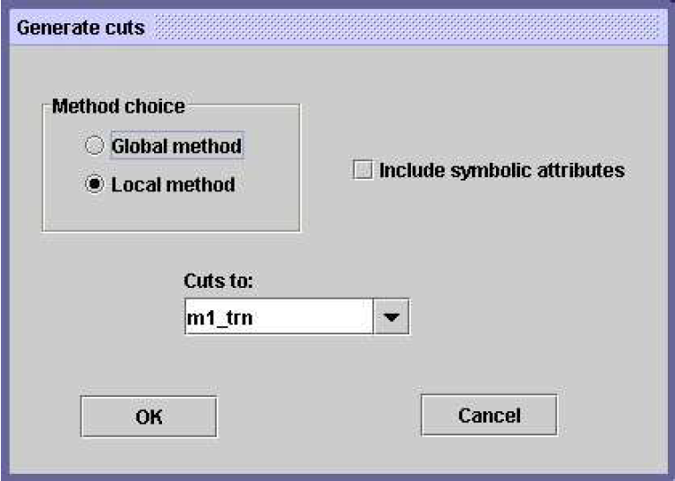
Cuts, discretization and grouping
We generate decompositions/cuts of attributes i.e., discretization of numerical attributes or grouping of nominal attributes using local or global methods.
The default extension for RSES file containing cuts is .cut
Example:
temperature numeric 1
[ 38.5 ]
cough symbolic
[ { MISSING,no } ]
Notes:
Global Method:
CUT_SET demo_global
ATTRIBUTES 4
INCLUDED_SYMBOLIC false
temperature numeric 1
[ 38.5 ]
headache numeric 0
[ 5.0 ]
cough symbolic
[ ]
catarrh symbolic
[ ]
Local Method:
CUT_SET demo_local
ATTRIBUTES 4
INCLUDED_SYMBOLIC true
temperature numeric 1
[ 37.5 ]
headache numeric 0
[ 2.0 5.0 ]
cough symbolic
[ { MISSING,no } ]
catarrh symbolic
[ ]

Slide 35
LINEAR COMBINATIONS
RSES makes it possible to add an attribute to decision table.
This new attribute is created as a weighted sum of selected existing (numerical) attributes.
The default extension for RSES file containing cuts is .dir
Example:​
DIRECTIONS (3)​
temperature*0.707+headache*0.707​
temperature*0.705+headache*0.705+disease*(-0.062)​
temperature*0.696+headache*0.696+disease*0.174

Slide 36
REDUCTS AND DECISION RULES
A reduct is a minimum subset of attributes that retains the same discernibility capacity as the whole set of attributes.
The default extension for RSES file containing reducts is .red
Example:​
REDUCTS (5)
{ temperature, headache } 1.0
{ headache, cough } 1.0
{ headache, catarrh } 1.0
{ cough } 0.25
{ catarrh } 0.25

Slide 37
REDUCTS AND DECISION RULES
Decision rules make it possible to classify objects, i.e. assign the value of decision attribute.
The default extension for RSES file containing rules is .rul
Example:
RULES 16
(temperature=38.7)&(headache=7)=>(disease=angina[1]) 1
(temperature=38.3)&(headache=MISSING)=>
(disease=influenza[1]) 1
(temperature=MISSING)&(headache=3)=>(disease=cold[1]) 1
(temperature=36.7)&(headache=1)=>(disease=healthy[1]) 1
...
(catarrh=no)=>(disease={angina[1],cold[1],healthy[1]}) 3
...
DECISION_VALUES 4
angina
influenza
cold
Healthy

Slide 38
DATA ANALYSIS METHODS IN RSES
Data Decomposition
k-NN Classifiers
LTF Classifier
Cross-validation method
Sakshi

Slide 39
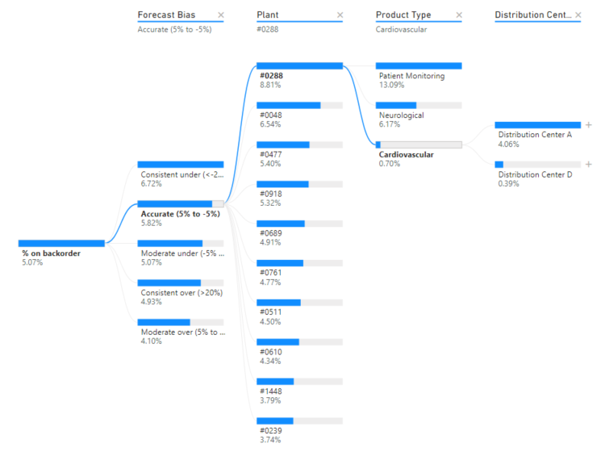
Data Decomposition
Data decomposition tree is a special form of classifier in which the subsets of data in the leaves of decomposition tree are used for calculation of decision rules
Data in the leaf is selected by the algorithm in a way that all objects it contains belong to the same decision class
This set of objects is used to generate rules

Slide 40
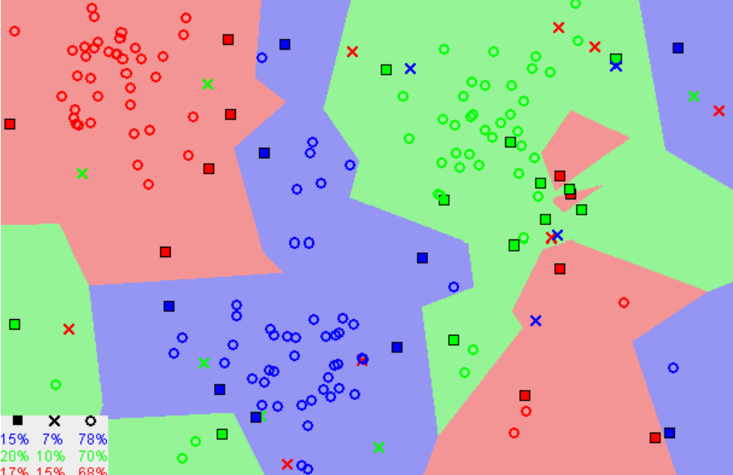
k-NN Classifiers
k-NN (K nearest neighbor) is a classification method that does not require a separate training set
Necessary steps like initialization and parameter setting, are done at the beginning of classification test
So, to classify objects user only has to invoke Classify/Test table button from table’s menu.
User must have a nonempty table object that will be used as training sample.
The algorithm constructs a distance measure based on training sample
Then, for each object in tested sample a decision is made based on how far the training objects that are to the tested one

Slide 41
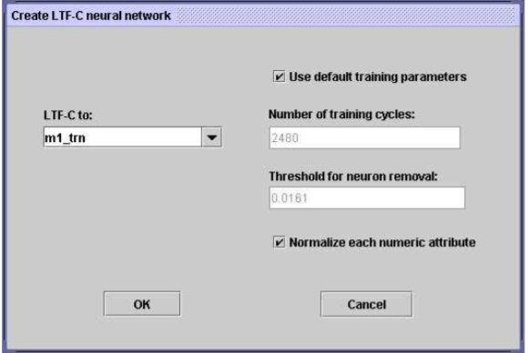
LTF Classifier
LTF-C is based on artificial neural network architecture. It is a training process based on slight alternations of network’s structure and parameters, made after the presentation of each training object:
coordinates for the center of gaussian functions
correcting the width of gaussian functions for each hidden neuron and each component of the input independently
adding new neuron to hidden layer
removing redundant neurons from hidden layer.

Slide 42
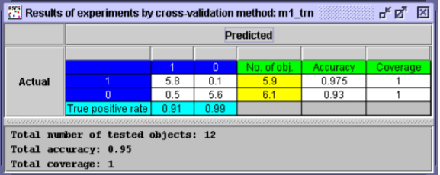
Cross-validation method
The data set is first split into several, equal in size, disjoint parts.
Then, one of the parts is taken as training sample and the remainder (sum of all other parts) becomes the test sample.
The classifier is constructed with the use of training sample and its performance is checked on test sample
These steps are repeated as many times as there are data parts so that each of parts is used as training set once.
The result is the average of scores from the previous step.

Slide 43
LERS
THANK YOU
Learning from Examples based on Rough Sets

