Slide 1
Improvement of FP-Growth algorithm
Approaches
Adjacency table
Parallel FP-growth
Multiple minimum support

Slide 2
Why improvement?
FP-Growth algorithm:
Scans database twice
Create FP-Tree that contains all the itemsets
Require lots of memory
Makes algorithm inefficient

Slide 3
Approach - Improve using adjacency table
Scan the original transaction database once
Form association relationship
Adopt storage method combining the adjacency table with the hash table
Remove itemsets that are less than minimum support
Mining of frequent itemsets

Slide 4
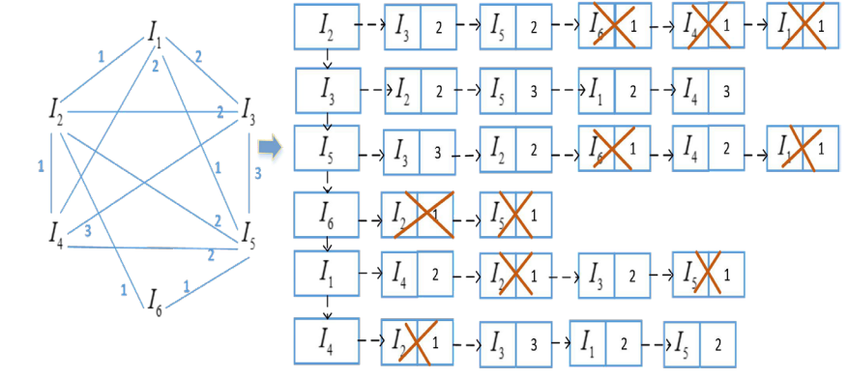
Implementation - Generation of adjacency table
{(I₁,I₃:2), (I₁,I₄:2), (I₂,I₅:2), (I₄,I₃:3), (I₄,I₅:2), (I₅,I₃:3)}
{(I₁,I₃,I₄:2), (I₂,I₃,I₅ :2), (I₄,I₃,I₅ :2)}
TId | Items
T1 | I₂, I₃, I₅
T2 | I₆, I₂
T3 | I₃, I₁, I₄
T4 | I₄, I₂, I₃, I₁, I₅
T5 | I₃, I₅, I₄
T6 | I₅, I₆

Slide 5
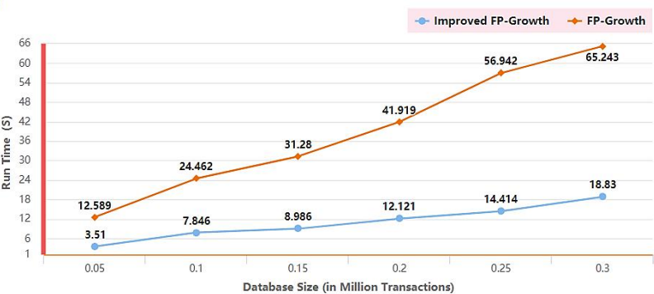
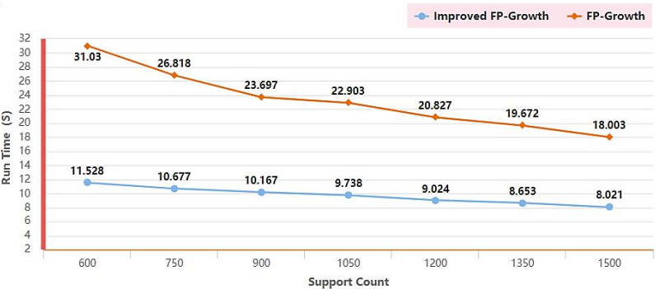
Experimental results

Slide 6
Advantages and future growth
Reduces the I/O operations
Low complexity
Hash table for the fast lookup and avoids recursive mining
Reduce time and memory consumption
Future - Improve in parallelization
Reference: https://doi.org/10.1051/matecconf/201818910012

