Slide 1
Frequent Pattern Growth Strategy

Slide 2
Advantages
Frequent Pattern Tree is a tree-like structure that is made with the initial item sets of the database. The purpose of the FP tree is to mine the most frequent pattern. Each node of the FP tree represents an item of the item set.
The major advantage of FP tree algorithm is that it takes only two passes over the data set.
The FP-Growth algorithm allows the discovery of frequent item set without generating candidate item set.

Slide 3
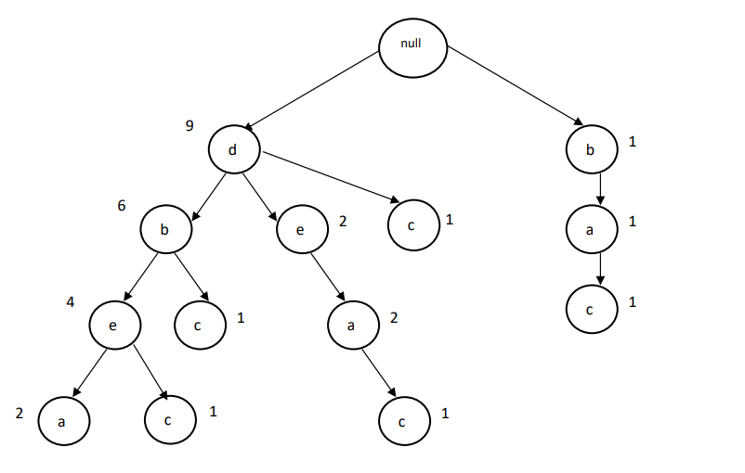
Advantages
FP growth algorithm helps in compression of the data because of overlapping of paths.
The working of the FP-Growth algorithm is much faster as compared to the Apriori algorithm.

Slide 4
Disadvantages
The FP-Growth algorithm may not fit into the memory.
If the data is too long, the complexity of the data structure can reduce the performance.
FP growth algorithm works better with a small data set.

Slide 5
Disadvantages
The FP-Growth algorithm is expensive to construct. It consumes time to build. But once it is done with construction, item sets can be read off easily.
The process of calculating the support can be carried out only after the entire data set is added to the FP-Tree.

Slide 6
References
https://www.arcjournals.org/pdfs/ijrscse/v4-i4/3.pdf
https://www.softwaretestinghelp.com/fp-growth-algorithm-data-mining/#:~:text=Frequent%20Pattern%20Tree%20is%20a,lower%20nodes%20represent%20the%20itemsets

Slide 7
Thank You

