Slide 1
Steps involved in Association Rule Mining

Slide 2
Step 1: Find all frequent itemsets.
An itemset is a set of items that occurs in a shopping basket.
For example, [bread, butter, eggs] is an itemset from a supermarket database.:
support count:
The support count of an item is defined as the frequency of the item in the dataset.

Slide 3
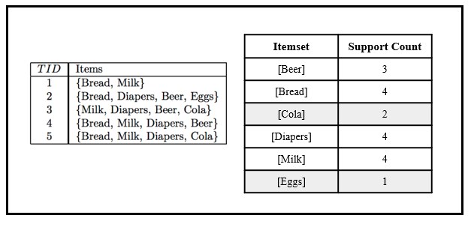
Itemsets and their respective support counts.

Slide 4
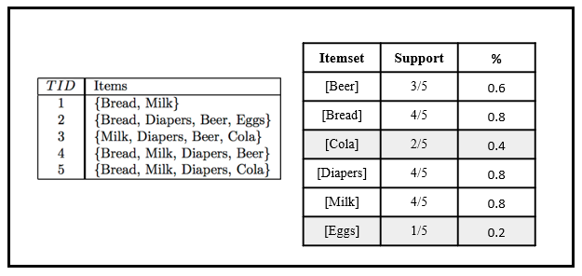
Support of an itemset is the frequency of the itemset with respect to the number of transactions.

Slide 5
Step 2: Generate strong association rules from the frequent itemsets.
Association rules are generated by building associations from frequent itemsets generated in step 1. This uses a measure called confidence to find strong associations. This has been covered in the example section.

