Slide 1
Public Key, Digital Signatures, Management and Security

Slide 2
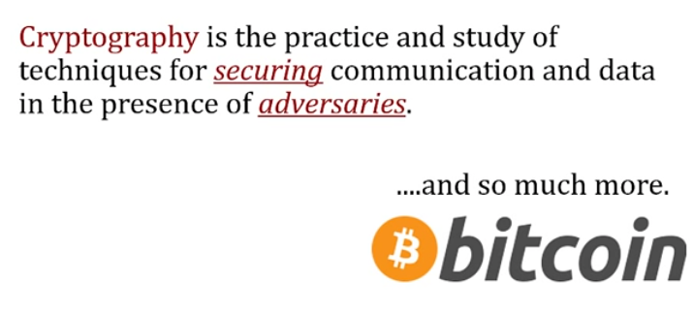
Cryptography

Slide 3
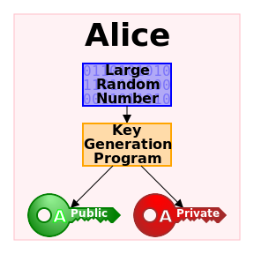
8.3 Public-Key Algorithms

Slide 4
How it works
How it worked before:
Used a key both parties knew to decrypt messages
problem--meeting privately?
Solution?
Asymmetric-key cryptography
Public vs Private key

Slide 5
Public Key Algorithms
1976 -- Diffie-Hellman
Diffie-Hellman is not actually a method of encryption and decryption, but a method of developing and exchanging a shared private key over a public communications channel.
Two parties agree on some common numerical values, and then each party creates a key.
Mathematical transformations of the keys are exchanged. Each party can then calculate a third session key that cannot easily be derived by an attacker who knows both exchanged values.

Slide 6
Public key algorithms
Public key algorithm example: RSA
Requires 2 keys; public and private
Public key is used to encrypt messages
Private key is used for decrypting messages which are encrypted using a public key

Slide 7
RSA
RSA is one of the first public keys and is widely used in secure data transmission.
Authors: Rivest, Shamir, Adleman
Every internet user on earth is using RSA, or some variant of it.
its strength relies on the hardness of prime factorization.
Encryption key is public while the Decryption key is kept private
Method:
1. Choose two large prime numbers (typically 1024 bits)
2. Compute N=P*Q and Z = (P-1)*(Q-1)
3. Choose a number relatively prime to Z, called D
4. Find E, such that E*D=1 mod Z

Slide 8
RSA
Divide plaintext into blocks, so that each plaintext message, called P, falls in the interval 0 <= P < N.
To encrypt a message P, compute C=P^e(mod n) to decrypt C, compute P=C^d (mod n).
So, to perform encryption, you need e and n. To perform decryption, you need d and n.
therefore
the public key consists of the pair (e, n)
the private key consists of the pair (d,n)

Slide 9
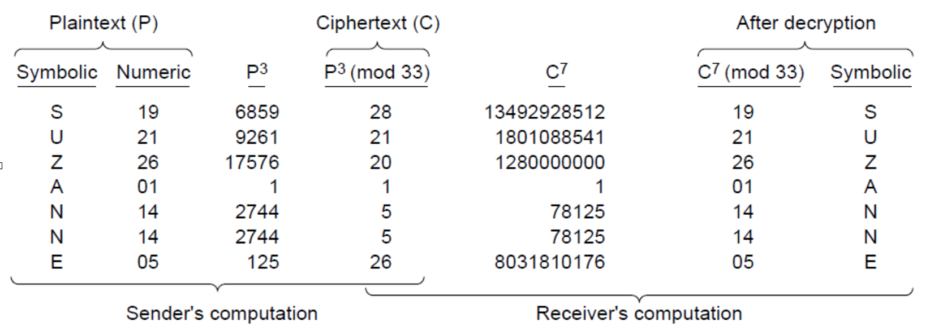
Example of RSA Algorithm

Slide 10
Other Public-Key Algorithms
Knapsack algorithm
first public-key algorithm.
someone owns a large number of object
each object has it’s own unique weight
owner encodes message by secretly selecting a subset of objects and placing in knapsack
total weight of the objects and possible objects with corresponding weights. in the knapsack is made public.
The two major types are those based on the difficulty of factoring large numbers and those based on the difficulty of computing discrete logarithms.
Algorithms using the discrete logarithms principle have been invented by El Gamal and Schnorr.

Slide 11
8.4 Digital Signatures
Digital signature is basically a way to ensure an document is authentic (eg. e-mail, spreadsheet, etc.)
One party can send a message to another party in such a way that the following conditions must hold:
1. The receiver can verify the claimed identity of the sender.
2. The sender cannot later repudiate the contents of the message.
3. The receiver cannot possibly have alter the message himself.

Slide 12
Digital Signatures (Continued)
Aim of a signature: prove to anyone that a message originated at (or is approved by) a particular user
Symmetric key cryptography
Two users, A and B, share a secret key K
Receiver of message (user A) can verify that message came from the other user (B)
User C cannot prove that the message came from B (it may also have came from A)
Public key cryptography can provide signature: only one user has the private key

Slide 13
Public Key Signatures
Signing
User signs a message by encrypting with own private key
S= E(PR_{A}, M)
User attaches signature to a message
Verification
User verifies a message by decrypting signature with signer’s public key
M” = D(PU_{A}, S)
User then verifies received message M with decrypted M”;
if identical, signature is verified

Slide 14
Public Key Signatures
No need to encrypt entire message, encrypt hash of message
Signing
User signs a message by encrypting hash of message with own private key
S= E(PR_{A}, H(M))
User attaches signature to a message
Verification
User verifies a message by decrypting signature with signer’s public key
h= D(PU_{A}, S)
User then compares hash of received message, H(M), with decrypted h;
if identical, signature is verified

Slide 15
Video
https://www.youtube.com/watch?v=3QnD2c4Xovk
https://www.youtube.com/watch?v=sZoPDceh9IU

Slide 16
Message Digests
Message digest
A one-way hash function that takes an arbitrarily long piece of plaintext and from it computes a fixed-length bit string.

Slide 17
Advantages over Signatures
Message digests do not couple authentication and secrecy.
There is no need to encrypt the entire message.
Message digest methods are often faster than signature methods.

Slide 18
Properties
Given P, it is easy to compute MD(P).
Given MD(P), it is effectively impossible to find P.
Given P, no one can find P’ such that MD(P’) = MD(P).
A change to the input of even 1 bit produces a very different output.

Slide 19
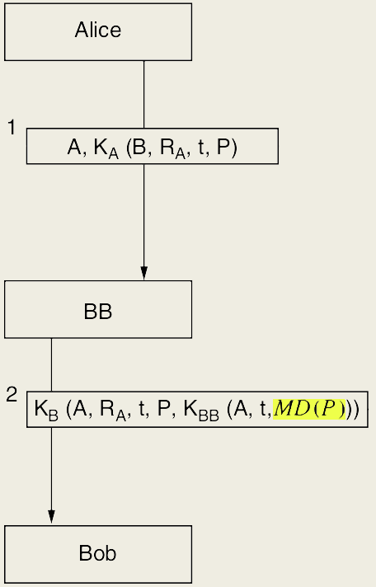
Speeding up Signatures
Message encrypted with Alice’s key
Message encrypted with Bob’s key
Hash

Slide 20
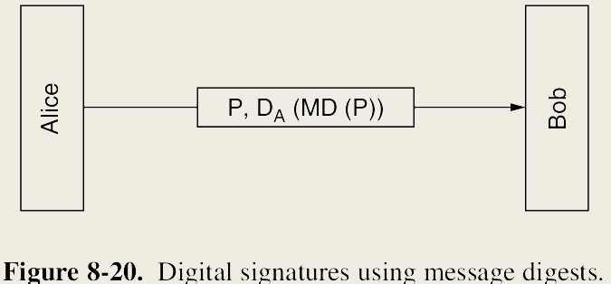
Speeding up Signatures

Slide 21
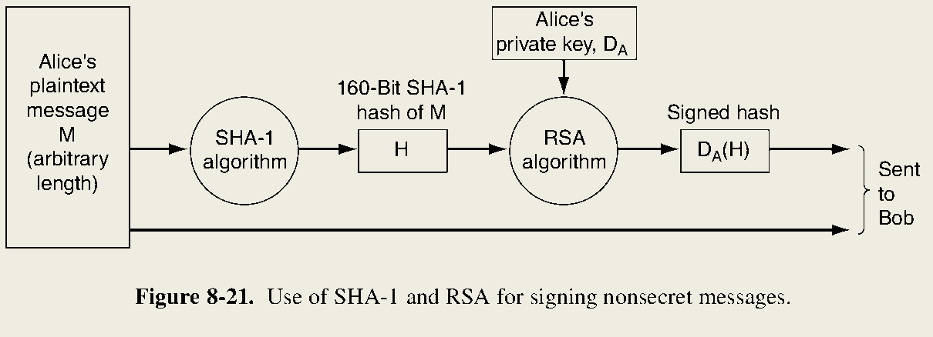
SHA -1 (Secure Hash Algorithm 1)

Slide 22
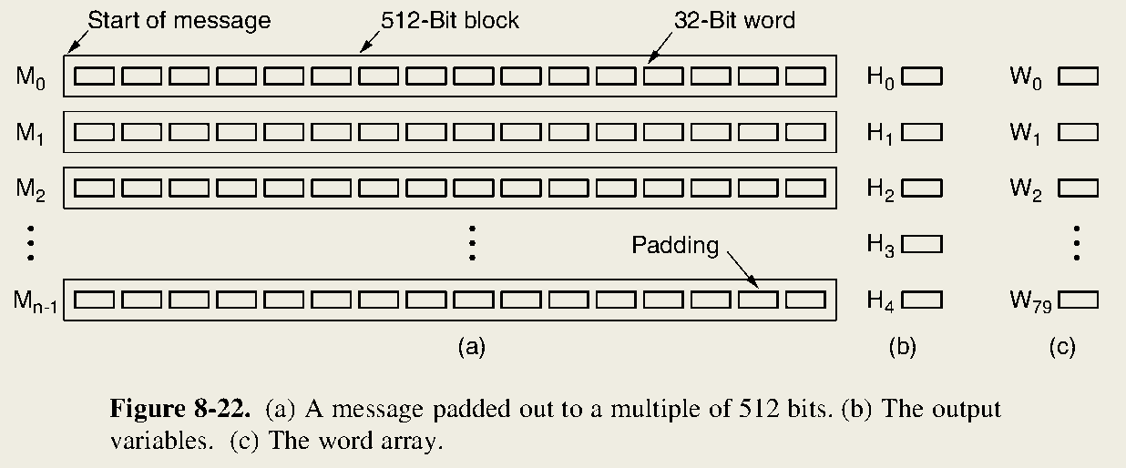
SHA-1 Analysis
H0 - H4 are initialized to constants specified by the standard.
A 512 bit block is processed and the W array is filled out.
W is used to update the 160 bit hash H.
W is reset.

Slide 23
MD5
MD5 is the fifth in a series of message digests designed by Ronald Rivest.
MD5 uses a table constructed from the sine function to output a 128 bit Hash.
Collisions can be found in MD5; therefore it is considered broken.
It is still a popular message digest despite its insecurity.

Slide 24
Birthday Attacks
Birthday Attack
An attack, derived from the birthday problem, that is used to interfere with communication by performing 2^(m/2) operations.

Slide 25
The Birthday Problem
How many people do you need in a room before the probability of having two people with the same birthday exceeds 50%?
Answer: 23
P(m) = 1- P(m’)
P(m) = 1 - 365/365 X 364/365 X … X 343/365 = 50.7%

Slide 26
Birthday Attacks Revisited
if there is some mapping between inputs and outputs with n inputs and k outputs then there are n(n-1)/2 input pairs.
We can determine that a match is likely for n > sqrt(k).
A 64 bit message digest is likely to be broken after generating 2^32 messages.

Slide 27
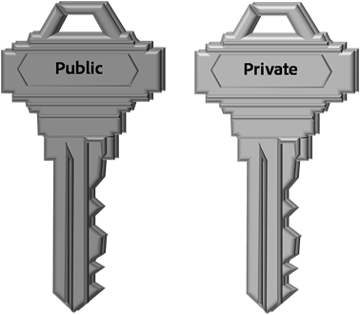
8.5 Management of Public Keys

Slide 28
Problems with Public Keys
Obtaining someone’s public key for the first time can be insecure as messages can be intercepted.
Public keys can only be used to verify identity, not attributes.
Implementing a KDC (key distribution center) would cause a severe bottleneck if it were to go offline.

Slide 29
Certificates
Certificates are designed to bind a public key to the name of a principal (individual, company, etc.).
Certificates are always distributed by a CA and signed with that CA’s private key.
Certificates are not secret or private.
The CA is not required to be online at all times to verify the validity of the certificates.

Slide 30
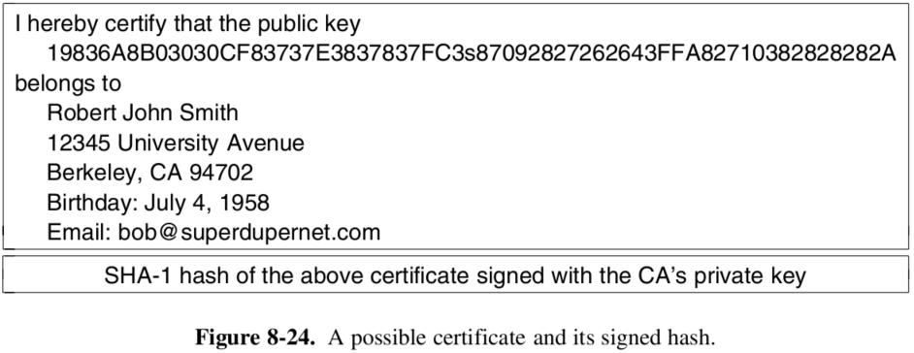
Certificate Example

Slide 31
Uses of Certificates
Certificates can be used to verify the identity of a principal.
Certificates can confirm attributes of a principal.
e.g. - age, citizenship, etc.
Certificates can be distributed in object-oriented distribution systems.
This allows authorized people to perform methods on an object without needing to know the identity of the owner.

Slide 32
X.509
X.509 is a standard for certificates designed and approved by ITU.
In its simplest form X.509 is a way to describe certificates.

Slide 33
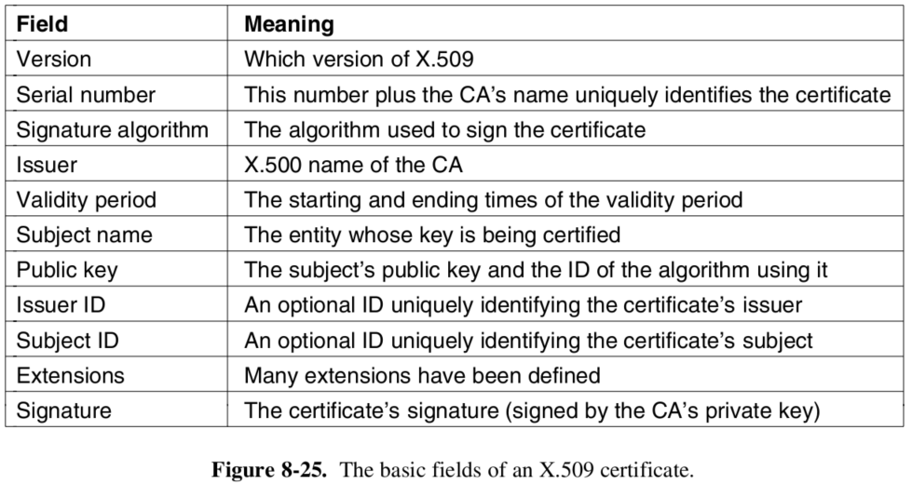
Fields of an X.509 Certificate

Slide 34
X.509 Naming
Problem
The X.500 naming system can be unclear.
bob@moneybank.com
/C=US/O=MoneyBank/OU=Loan/CN=Bob/
Solution
Version 3 of X.509 allows DNS names to be used instead of X.500 names.

Slide 35
Problems with A Single CA
A single CA would likely collapse under the heavy load and become a central point of failure.
Having multiple CAs run by a single organization could introduce key leakage because the organization is only as strong as its weakest CA.
One organization would be solely responsible for the world’s electronic security infrastructure.
There would likely be disagreement on who would control the single CA.

Slide 36
PKI (Public Key Infrastructure)
PKI has multiple components
users
CAs
certificates
directories
The purpose of PKI is to structure its components and define standards for the various documents and protocols.

Slide 37
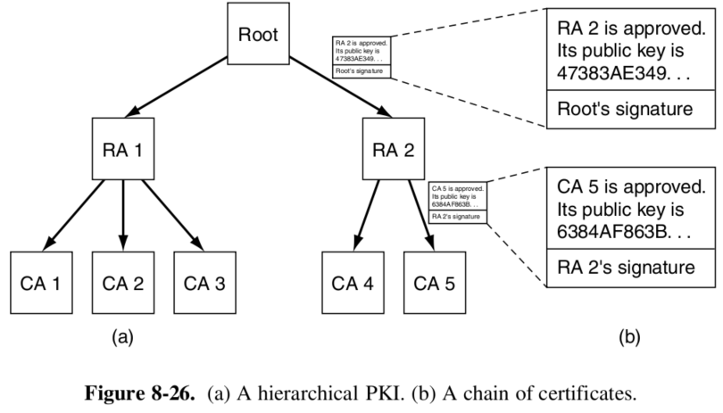
Example of a PKI

Slide 38
Hierarchical Characteristics
Everyone is assumed to know the public key of the root.
modern browsers will typically come preloaded with the public keys for over 100 roots, also known as trust anchors.
A chain of certificates that go back to a root is called a chain of trust or a certification path.

Slide 39
Storing Certificates
Each user can be assigned to store his or her own certificates.
inconvenient
DNS could be used as a certificate directory allowing certificate chains to be given with IP addresses.
Dedicated directory servers could be used to manage certificates.

Slide 40
Revocation
If certificates are abused or private keys have been leaked, Revocation is a common solution.
The CA can periodically release a CRL (Certificate Revocation List).
This list contains the serial numbers of all certificates that have been revoked.

Slide 41
Challenges of CRLs
demanding
reinstatement
storage
length

Slide 42
8.6 Communication Security
Preventing unauthorized interceptors from accessing telecommunications in an intelligible form, while still delivering content to the intended recipients
Where should a security layer be put?
Application Layer?
Transport Layer?
New Layer?

Slide 43
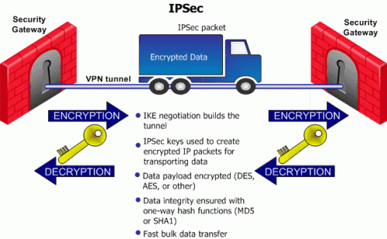
IPSec
Internet Protocol Security, a protocol suite for securing IP communications by authenticating and encrypting each IP packet of a communication session

Slide 44
IPsec
Since encryption is computationally expensive, encryption became required but the use of a null algorithm was permitted.
The complete IPsec design uses multiple algorithms, services and granularities for future planning; even if an algorithm becomes obsolete, the framework can still work
Multiple granularities makes it possible to protect a single TCP connection

Slide 45
IPsec
SA/Security Association: simplex connection between two endpoints and has a security identifier associated with it. Identifiers are used to look up keys when a secure packet arrives
2 Main parts of IPsec:
Two new headers carrying the SA, integrity control data and other info
Internet Security Association and Key Management Protocol (ISAKMP): a framework that deals with establishing keys, the IKE (Internet Key Exchange) is the main protocol

Slide 46
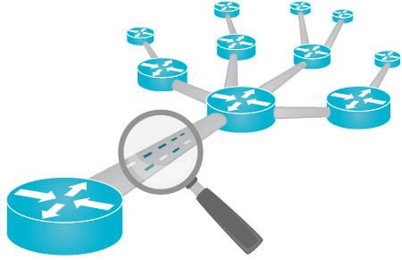
Two Modes
Transport Mode: IPSec header is inserted after IP header and before the TCP header, packet size not affected
Tunnel Mode: The whole IP packet is encapsulated in a new IP Packet with a new header. Can be useful as only the security gateway needs to be aware of IPsec being used. Adds extra IP header, substantial size increase
Tunnel Mode allows a way to foil traffic analysis

Slide 47
Model
Authentication Header (AH): Provides integrity checking and antireplay security, but no data encryption.

Slide 48
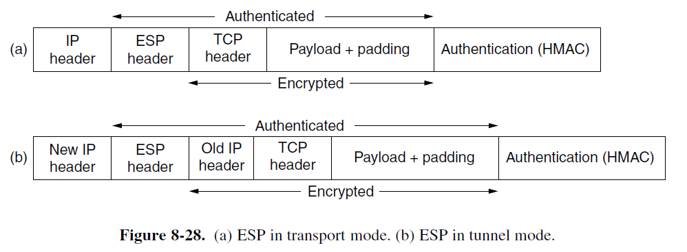
Encapsulating Security Payload

Slide 49
Why keep AH then?
For historical reasons mainly, ESP does everything AH does but better, with the exception of checking part of the IP Header. Also a product that supports AH but not ESP will have trouble getting an export license because it cannot do encryption. Most likely, AH will be phased out in the future.

Slide 50
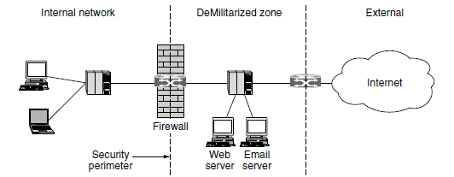
Firewalls
In addition to the danger of information leaking out, there is also a danger of information leaking in.
Viruses, worms, and other digital pests can breach security, destroy valuable data, and waste large amounts of administrators’ time trying to clean up the mess they leave.
Firewalls are just a modern adaptation of that old medieval security standby: digging a deep moat around your castle.

Slide 51
Firewalls
Firewalls act as a packet filter.
It inspects each and every incoming and outgoing packet.
In a TCP/IP setting, the source might consist of an IP address and a port.
Port 25?
Port 80?
Firewalls can block specific ports and anything associated with that port.
Not all ports are easily blocked.

Slide 52
Firewalls
The DMZ (DeMilitarized Zone) is the part of the company network that lies outside of the security perimeter.
Lies outside of the security perimeter.
Stateful firewalls -
Maps and keeps track of connections.
Application-level Gateways -
Processing involves the firewall looking inside packets

Slide 53
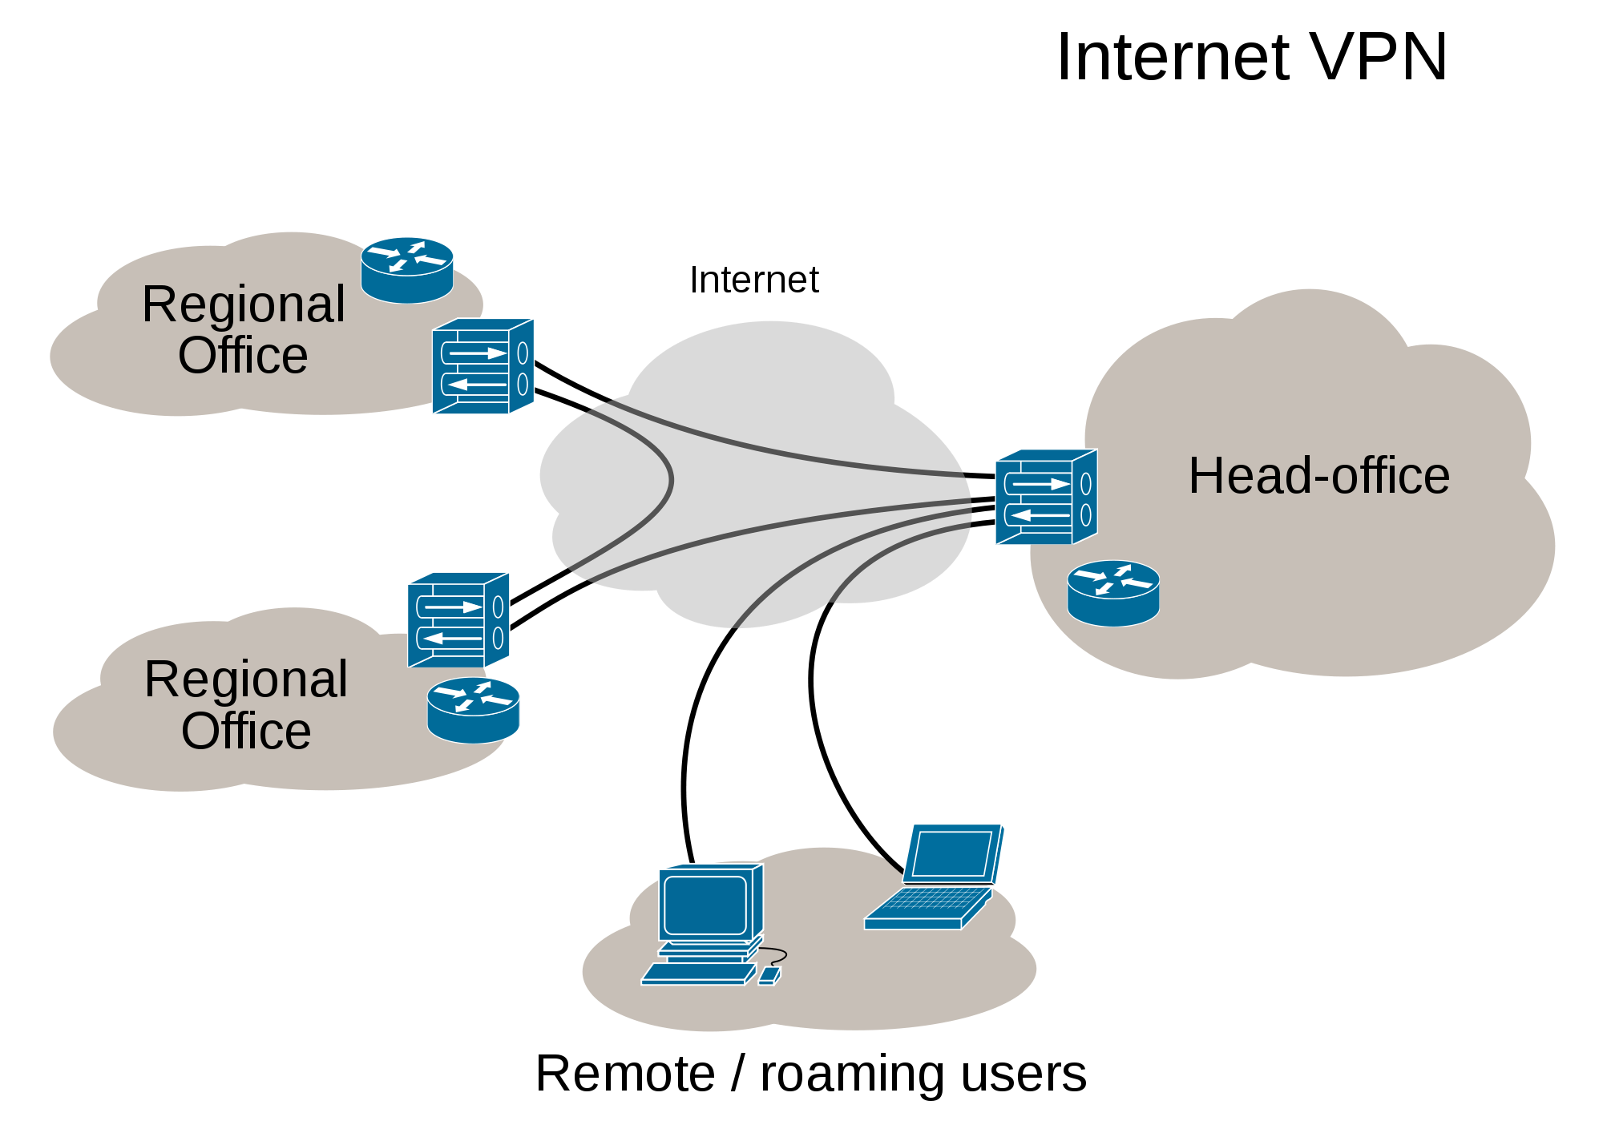
Virtual Private Networks
Extends a private network across a public network, most popularly, the Internet.
Much cheaper than an actual private network

Slide 54
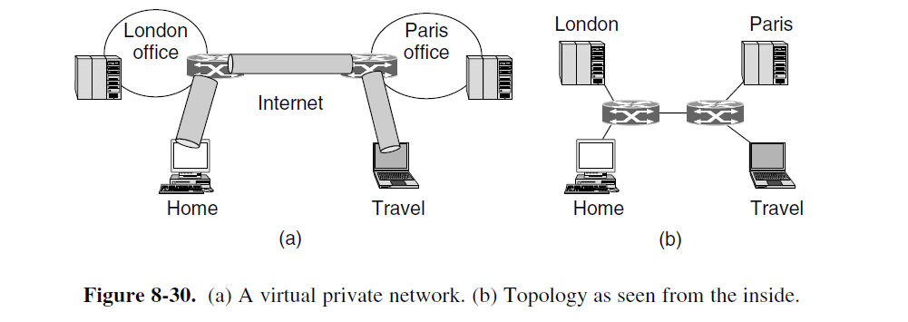
Advantages
Transparent to all user software
Cheaper
Secure connection

Slide 55
Wireless Security
With the rise of wireless networks, security has become even more important.
802.11 Security
WPA2 (WiFi Protected Access 2)
WEP (Wired Equivalent Privacy)
802.11i
WPA2 has two scenarios to be used.
Corporate setting -
802.1X and EAP (Extensible Authentication Protocol)
Home setting -
Less complex; single shared password for router.

Slide 56
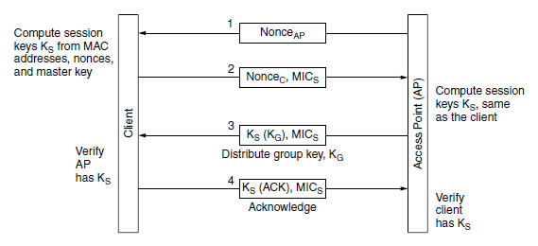
802.11i Key Setup Handshake

Slide 57
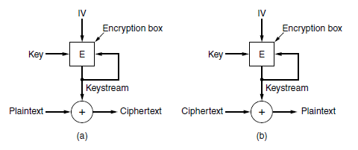
Wireless Security (cont.)
MIC (Message Integrity Check)
Message confidentiality for 802.11i
TKIP (Temporary Key Integrity Protocol)
CCMP (Counter mode with Cipher block chaining Message authentication code Protocol)
Bluetooth Security
Shorter range than 802.11
passkeys - 4 to 6 digits
Encryption ------------------>
Bluetooth connects devices, not users.

Slide 58
Citations
https://www.khanacademy.org/math/precalculus/prob_comb/prob_combinatorics_precalc/v/birthday-probability-problem

