Slide 1
Public-Key, Digital Signatures, Management, Security
By: Sunil, Zack, Yazeed, Rosh, James

Slide 2
Public Key Algorithms
What is it?
Distributing keys has always been a major issue in most cryptosystems
Keys had to be safe from theft, but couldn’t be secured because they had to be distributed
In 1976, two researchers from Stanford University, Diffie and Hellman proposed an entirely new kind of cryptosystem in which the encryption and decryption keys were completely different so that the decryption key could not be obtained from the encryption key
Public-key cryptography requires each user to have two keys: a public key, used by the entire world for encrypting messages to be sent to the user, and a private key, which the user needs for decrypting messages
Example:
Alice uses Bob’s public key to encrypt the plaintext message using EB(P) = C
Alice sends this to Bob
Bob uses his private key to decrypt the ciphertext message using DB(C) = DB(EB(P)) = P

Slide 3
Public Key Algorithms (cont’d)
RSA
Algorithm discovered by Rivest, Shamir, and Adleman at M.I.T.
Survived all attempts to break it for more than 30 years and is considered very strong
Major disadvantage is that it requires keys of at least 1024 bits for good security which makes it slow
Very slow for encrypting large amounts of data, but is widely used for key distribution
Select two large primes, p and q and compute n = p x q and z = (p - 1)(q - 1)
Choose d such that it is relatively prime to z and find e such that e x d = 1 mod z
To encrypt a plaintext message: C = p^e mod n
To decrypt a ciphertext message: P = c^d mod n
Public key: (e,n) and Private key: (d,n)

Slide 4
Public Key Algorithms (cont’d)
Other Public-Key Algorithms
The first public-key algorithm was the knapsack algorithm
Basically someone owns a large number of objects, each with a different weight. The owner encodes the message by secretly selecting a subset of the objects and placing them in the knapsack
The knapsack algorithm is not considered to be secure and is not used in practice anymore
Other public-key algorithms are based on the difficulty of computing discrete algorithms invented by El Gamal and Schnorr

Slide 5
Public Key Algorithms Question:
What does Public-Key Cryptography require from each user?

Slide 6
Digital Signatures
It basically is a unique code that is hard to replicate
This is a secure way to verify the identity of the sender of a document
A digital signature also prevents both the sending and receiving parties from altering a document after it is sent
The goal of a digital signature is to ensure that a document was sent by (or approved by) the person who sent it

Slide 7
Digital Signatures (cont.)
There are two different types of digital signatures; public key, and symmetric key
A public key digital signature is a specific code that belongs to only one person, and anyone that person sends information to can verify the sender
A symmetric key is a little different, when a symmetric key is used there is a single key shared by two people. Each of these individuals can verify that a document came from the other, however, any third party will not be able to identify a sender using this key.
Message digest is known as a faster way to encrypt a document as both public and symmetric keys take a lot of time
Message digest uses a mathematical formula designed to be hard to track back to a source

Slide 8
Digital signatures question
Name one of the types of digital signatures

Slide 9
Management
Key management consist of three steps:
Exchange
Users must set up the details of the cryptography
Symmetric keys must be exchanged over a secure communication channel
Storage
Keys must be stored securely to maintain communications security
Storage access code is given to users that are trusted
Use
Major issue is length of time a key is to be used in which it needs to be changed frequently
As the stored key became readable thus it will increase the chances of it being cryptanalyzed

Slide 10
Types of Certificates
TLS/SSL server certificate
This a Client server connection which will the path validation algorithm.
TLS/SSL client certificate
Are used to authenticate the client connecting to a TLS service, for instance to provide access control
End-entity or leaf certificate
Any certificate that cannot be used to sign other certificates. For instance, TLS/SSL server and client certificates, email certificates, code signing certificates, and qualified certificates are all end-entity certificates.

Slide 11
Public key infrastructure
Public key infrastructure (PKI) lets trusted electronic identities for people, services and things, which make it possible to implement strong authentication, data encryption and digital signatures
They are Used to grant secure access to physical and digital resources; secure communication between people, services and things; and enable digital signing of documents and transactions

Slide 12
Management Question
What are the three steps of key management?

Slide 13
Security- IP Security
IP security: follows a framework that allows a pair of communicating entities to use a set of algorithm for secure communication.
Protocols used by IP security
Authentication Headers
Encapsulating Security
Security Associations
IPsec can be Implemented in two mode
Transport mode-only the payload of the IP packet is encrypted and/r authenticated.
Tunnel mode-The entire IP packet is encrypted and/or authenticated. It is then encapsulated into a new IP packet with a new IP header.

Slide 14
Security - VPN / Firewall
Other types of security are:
Firewall: Which is a network security system that monitors and controls over all your incoming and outgoing network traffic based on advanced and a defined set of security rules.
VPN (Virtual Private Network) is a service that lets you access the web safely and privately by routing your connection through a server and hiding your online actions.

Slide 15
Security - Wireless Security
Wireless security: is the process of designing, implementing, and ensuring security on a wireless computer network
Two of the most common type of wireless security is:
802.11 Security
WEP (Wired Equivalent Privacy): The the first form of authentication used with Wi-Fi. It was easy to crack, and other systems are now more widely used
WPA1 /WPA2 (WiFi Protected Access 1 / 2): uses an encryption device that encrypts the network with a 256-bit key; the longer key length improves security over WEP.

Slide 16
Security Question
What does VPN stand for?

Slide 17
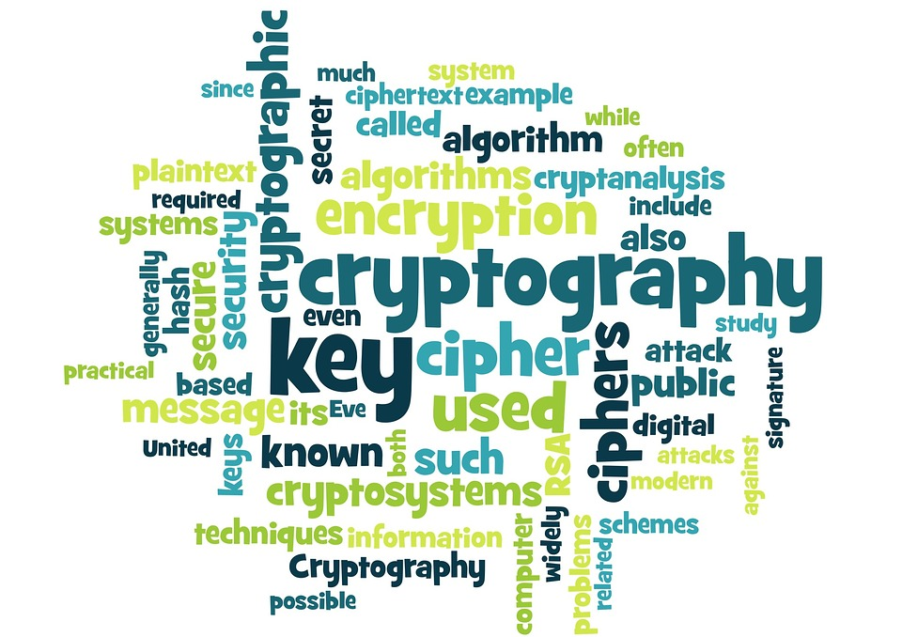
Video
https://www.youtube.com/watch?v=FlIG3TvQCBQ

Slide 18
Questions?

