Slide 1
Public-Key, Digital Signatures, Management, Security

Slide 2
Public-Key Algorithms
Originally encryption and decryption keys were the same
Diffie and Hellman created a new cryptosystem
D(E(P)) = P
It is exceedingly difficult to deduce D from E
E cannot be broken by a chosen plaintext
Encryption algorithms are made public and decryption algorithms are private
Send messages using recipients encryption algorithm
Decrypt message using private key

Slide 3
RSA
Named after inventors (Rivest, Shamir, Adleman)
Not broken in over 30 years
Requires that the key be at least 1024 bits
Initial parameters
Choose two large primes, p and q (1024 bits)
Compute n = p x q and z = (p-1) x (q –1)
Choose a number relatively prime to z and call it d
Find e such that e x d = 1 mod z

Slide 4
RSA Continued
Divide the plaintext into blocks, P, such that 0 <= P < n
Plaintext will be grouped in blocks of k bits, where k is the largest integer for which 2^k < n is true
To encrypt compute C = P^e mod n (based on pair (e, n))
To decrypt compute P = C^d mod n (based on pair (d, n))
Security based in the difficulty of factoring large numbers
Factoring a 500-digit number would take 10^25 years

Slide 6
Other Public-Key Algorithms
Knapsack Algorithm
There is a "knapsack" of objects each with a different weight
Total weight and list of all possible objects and their weights are known
The list of objects in the knapsack are not known
Has been broken
Misc. Algorithms
Public-key schemes based on discrete logarithms
Others based on elliptic curves

Slide 7
Public Key Cryptography

Slide 8
Management of Public Keys
After understanding how public key cryptography works, there is still some important questions that need answering...
How can we make sure public keys can be exchanged securely?

Slide 9
Certificates
Certification Authority - Is an organization that certifies public keys.
The CA issues a certificate and signs its SHA-1 hash with the CA’s own private key.
Then the person is given a certificate which contains their public key.
These certificates bind a particular person to a specific public key.
This way you can know for sure that you have the public key connected to the person you are trying to communicate with.
You can double check that the certificate belongs to who you intend to communicate with
You can run the SHA-1 algorithm on the certificate and apply it to the CA’s public key and compare results.
The intruder would need access to the CA’s private key in order to intercept the
information.
The fundamental job of a certificate is to bind a public key to the name of a
principal (individual, company, etc.)
Notes:
Now let us run through the scenario of Fig. 8-23 again. When Trudy inter-cepts Alice’s request for Bob’s home page, what can she do? She can put her own certificate and signature block on the fake page, but when Alice reads the contents of the certificate she will immediately see thatshe is not talkingto Bob because Bob’s name is not in it. Trudy can modify Bob’s home page on the fly, replacing Bob’s public key with her own. However, when Alice runs the SHA-1 algorithm on the certificate, she will get a hash that does not agree with the one she gets when she applies the CA’s well-known publickey to the signature block. Since Trudy does not have the CA’s private key, she has no way of generating a signa-ture block that contains the hash of the modified Web page with her public key on it. In this way, Alice can be sure she has Bob’s public key and not Trudy’s or someone else’s. And as we promised, this scheme does not require the CA to be online for verification, thus eliminating a potential bottleneck.

Slide 10
Certificates Continued
Certificates can also be used to bind a public key to an attribute.
For example certificate say: Public Key belongs to someone over the age of 18 or Public Key belongs to an object that can run these specific methods
In both of these cases these certificates can be bound to a public key. As long as those who hold these public keys can prove that they own the corresponding private key they can perform the tasks they were intending to perform.
Access a site that requires you to be over the age of 18
Run a certain set of methods in an object-oriented distributed system

Slide 11
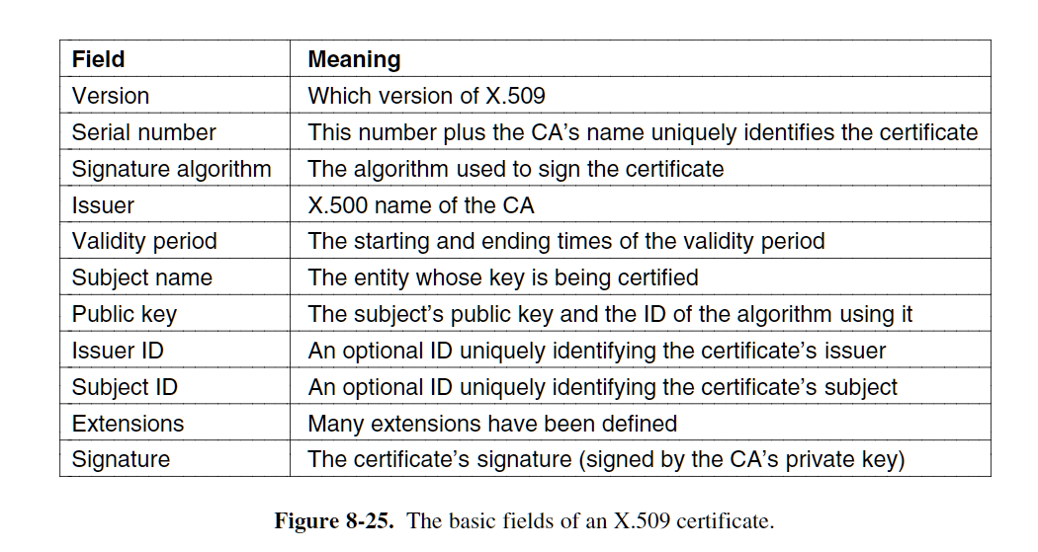
X.509
A standard for certificates. A way to manage different formats for certs.
X.509 is a way to describe certificates. The descriptions given should provide a general idea of what the fields do.
Certificates are encoded using OSI ASN.1(Abstract Syntax Notation 1)

Slide 12
Public Key Infrastructures
Issues with having a single CA (Certification Authority)
Can collapse under heavy load and be the central point of failure
What about multiple CAs, all run by the same organization and all using the same private key to sign certificates.
Solves load and failure issue, but also causes key leakage
What if the private key is hacked then all hope for security would be lost.
This is why we need a better way for certifying public keys
This is called Public Key Infrastructure (PKI)

Slide 13
Public Key Infrastructures(PKI)
The PKI contains 4 main components: Users, Certificate Authority (CA), certificates, and directories.
The PKI provides a way for structuring these components and defines standards. An example of this is a hierarchy of CAs.
The top-level CA (Root) certifies the second-level CAs (Regional Authorities RAs)
The second level RAs then certify the actual CAs (Certificate Authorities)
These CA’s issue X.509 certificates to organizations and individuals/attributes
This creates a chain of certificates called a certification path.
In the real world there are many roots all with their own RAs and CAs
All of these roots are called sometimes called trust anchors

Slide 14
PKI Continued
Directories (Where do we store certificates and their chains?)
Instead of using DNS, most prefer there to be dedicated directory servers that only deal with X.509 certificates.
These would provide lookup services using X.500 names (without DNS)
Revocation (What happens when certificates are revoked?)
Each CA should periodically issue a Certificate Revocation List (CRL)
Keeps Track of all serial numbers of the revoked certificates.
Certificates already have expire times so the CRTs only need to keep track of certs that aren’t expired.
CRLs should be stored in the same place that certificates are stored.
This way the directories can process them both and remove revoked/expired certificates.
CRLs and certs go hand in hand because if a user is about to use a cert they must now acquire the CRL to see if that cert has been revoked.
Also, some revoked certificates can be in reinstated, so it is important to have both the periodical CRLs and certificates easily accessible.

Slide 15
What is IP security( IP sec)
IP security's general framework that allows a pair of communicating entities to use a set of algorithm for secure communication. Using Encrypt and/or authenticate all traffic at IP level.
Ie. Application, E-mail, file transfer, WEB access can be secured
IP Sec uses the following protocols to perform various of functions
Authentication Headers(AH)
Encapsulating security payloads(ESP)
Security associations(SA)

Slide 16
Mode of operation
IPsec can be Implemented in two mode
Transport mode
-only the payload of the IP packet is encrypted and/r authenticated.
Tunnel mode
-The entire IP packet is encrypted and/or authenticated. It is then encapsulated into a new IP packet with a new IP header.

Slide 17
Security Association
It is a one way relationship between a sender and a receiver that provide security services to a traffic.
Security associations are established using ISAKMP( Internet Security Association and Key Management Protocol )
Identify by three parameter
- Security parameter Index
- Destination IP address
- Security Protocol Identifier( indicate is it AH or ESP? )

Slide 18
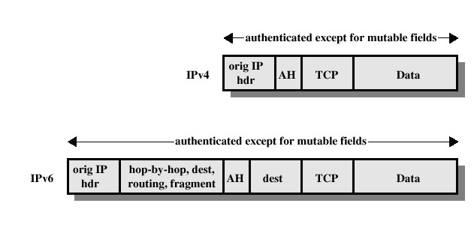
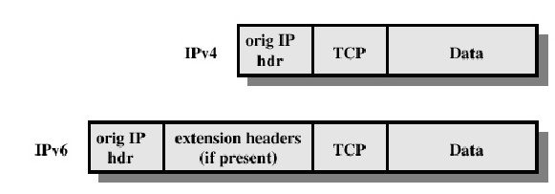
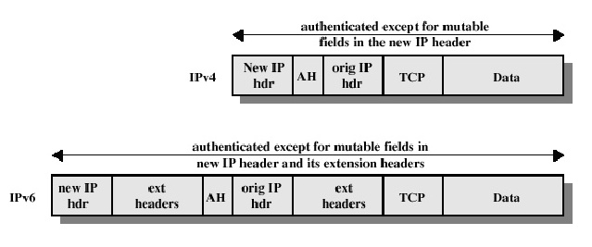
Authentication header(AH)
AH
-Access control
-Integrity
-Data origin authentication
-Rejection of replayed packets
-Confidentiality (encryption)
Transport mode
Tunnel mode

Slide 19
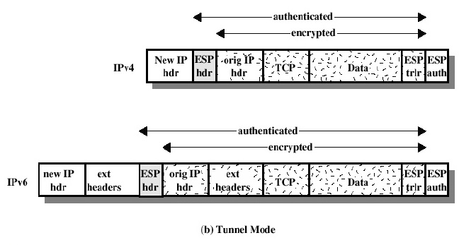
Encapsulating security payload
Provides
-origin authenticity
-integrity
-Confidentiality protection of packets
-Everything as AH does, ESP come after payload, also encryption and decryption.

Slide 20
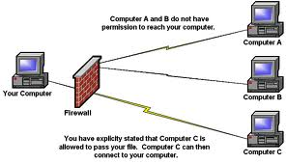
Firewalls
Firewall is an internal software that designed to permit or deny network transmission based on a set of rules and it's usually used to protect networks from unauthorized access.

Slide 21
Type of firewall technique
Packet filter
-Inspects each every incoming and outgoing packet in the network based on user-defined rules.
-ie. Allowing or disallowing packets on the basis of the source IP address, destination port or protocol.
Application-level gateway
- works on all seven layers, an application firewall can filter higher layer protocols such as FTP, DNS, HTTP, TCP, UDP..ect
Stateful firewall
-stateful packet inspection as it maintains records of all connection passing through the firewall and is able to determine whether a packet is start of a new connection, existing connection or an invalid packet

Slide 22
Virtual Private Networks
Before VPNs, companies leased physical lines from telecom companies to network multiple work sites, these networks were called private networks
Very secure, must physically wiretap to breach security
Unfortunately very expensive
Advent of public networks and the Internet led to demand of moving traffic to public networks
Demand answered with VPNs
VPNs are "housed" virtually in public networks but have the desired properties of physical private networks

Slide 23
VPN continued
Common approach to VPNs is to equip each destination with a firewall and construct tunnels through the Internet to other firewalls
Very easy to set up new tunnels, in case of employee working from home or construction of new site
Much more flexible overall than physical networks, but network topology is identical
Many firewalls come standard with VPN capabilities
Also possible to have ISP directly set up VPN
ISP uses MPLS to set up paths across the ISP network
Keeps VPN traffic separate from public Internet traffic and allows ISP to guarantee certain amount of bandwidth or other quality of service

Slide 24
VPN Continued
Each pair of firewalls must negotiate SA to exchange traffic
IPsec tunneling can be use to aggregate all traffic between any two firewalls onto a single authenticated, encrypted SA
Provides integrity control, secrecy, and good protection from traffic analysis
Once SA is established, packets can travel through public networks unhindered, as routers see them as ordinary packets – the IPsec header does not affect forwarding process
General idea is office – firewall – tunnel – firewall – office
Key advantage of VPNs is that they do not hinder user software – most likely the only person to know that the network is virtual is the system admin or ISP

Slide 25
VPN CONTINUED
Physical network on the left vs. VPN on the right – identical topology, different means

Slide 26
Wireless Security
Logically secure networks are easy to design, difficult to put into place, especially if wireless networks come into play
Company using VPNs to connect sites have secure inter-site traffic, but may not have secure on-site traffic
Unsecured wireless network can be accessed by anyone, can then be used to track all traffic
Often an issue of ease of use – many devices work out of the box as soon as power is supplied, without any default security
802.11 standard (also known as WiFi Protected Access 2) prescribes data-link level security to prevent wireless nodes from reading or interfering with traffic between other nodes
WPA2 has replaced WEP, which is very easy and simple to compromise due to poor encryption practices

Slide 27
Wireless security – 802.11
WPA2 is used commonly in both corporate and residential settings
As such, it can be used both with and without an authentication server
Corporate settings will have an authentication server, containing a database of valid login information, set up to clear clients for network access
Standard protocols are 802.1X and Extensible Authentication protocol
802.1X observes client to server communication, while EAP acts more like a middleman
Each client has totally unique encryption key to keep other clients from viewing their traffic
Home settings will have a single password to authenticate clients wishing to access the network, making connection simpler but less secure
Each client still has a different encryption key, but they are often derivatives of each other, making them inherently less secure

Slide 28
802.11 continued
Encryption keys are provided during the authentication handshake
Once the client connects to the network and authenticates by password or server authentication, the password is used to derive a master key
The master key is not used for encryption; instead, a session key is then computed to hide the master key from observation and keep keys unique across sessions
To compute the session key, the access point sends a random nonce (number used once). The client picks its own nonce as well. Then, both nonces, the MAC addresses of both the client and the AP, and the master key are used to compute a session key.
The AP does not receive this information, so the client sends its unique nonce to allow the AP to compute the same key.
Nonces are fine to send unsecured, since the session key cannot be derived without both MAC addresses and the master key.
In the last message from AP to client, the AP sends a group key to allow the AP to broadcast traffic just once to all connected clients

Slide 29
802.11 continued
Main protocol to manage traffic confidentiality is CCMP, or Counter mode with Cipher block chaining Message authentication code Protocol.
CCMP uses AES encryption with 128-bit keys, obtained from session keys
Messages are encrypted in counter mode, mixing a random counter into the encryption
Fields are encrypted with cipher block chaining and last 128-bit block is kept as the Message Integrity Check.
Both the client and AP can decrypt these messages with their keys.

Slide 30
Bluetooth Security
Much shorter range than 802.11, so much harder to inconspicuously infiltrate, but still insecure
For instance, an unsecured Bluetooth keyboard could broadcast keypresses to any listening device, effectively keylogging itself, or documents can be intercepted on the way to a Bluetooth printer
Luckily, Bluetooth 2.1 and later has four security modes, ranging from unsecured to full data encryption
Older Bluetooth devices often had hardware-coded passkeys, often hardcoded to predictable values of four digits or less, allowing only for 10^4 permutations
Simple 2.1 pairings allow for random 6 digit keys, which are still far from secure

Slide 31
Bluetooth Continued
To establish a channel, the slave and master each check to see if the other knows the passkey; if so, they will negotiate over channel security (encrypted, integrity controlled, or both)
They will then select a 128-bit session key, some of which may be public for legal reasons
Encryption uses E0, integrity uses SAFER+, both of which are traditional block ciphers
Bluetooth was finalized before AES was established
E0 may have fatal weaknesses, but as of now remains unbroken
Most glaring security issue is Bluetooth only authenticates devices, hence a stolen device may allow for breaching of security
However, many important applications have some sort of authentication of their own, such as a PIN code

Slide 32
Digital Signatures
Digital Signatures are usually used to authenticate many legal, financial, and other documents.
A party must send a document to another party while meeting certain criteria:
Receiver can verify claimed identity of sender
Sender cannot later repudiate contents of message.
Receiver cannot have altered the message himself.

Slide 33
Digital Signatures (continued)
The main goal of a signature is to prove that a message/document is originated by the correct user.
Symmetric Key:
Users with allowed access would share a secret key(best if face to face).
The receiver/receivers would verify the message with the shared secret key.
Public key:
Users share a public key but not a private key.

Slide 34
Digital Signatures (continued)
Public Key Signatures:
Signing:
User signs a message by encrypting the message with his/her own private key
User attaches a signature to the message/document.
Verification:
User verifies a message by decrypting the signature with the signer's public key
User can then verify the message received if the message received is identical to the message decrypted.

