Slide 1
Group 9 Chapter 8.3 – 8.6

Slide 2
Public Key Algorithms
Symmetric Key Algorithms face an inherent problem
Keys must be distributed to all parties but kept secret from potential attackers
Introduced by Diffie and Hellman in 1976
Uses two keys, one public and one private
Example – Alice sends Bob a message
Alice uses Bob’s public key to encrypt the plaintext message
E_{B}(P) = C
Alice sends this to Bob
Bob uses his private key to decrypt the ciphertext message
D_{B}(C) = D_{B}(E_{B}(P)) = P
Notes:
When Bob wants to send Alice a message he does the same thing. Encrypting it with Alice’s public key and Alice decrypts it with her private key. This also requires that users possess fewer keys because they only need to keep track of their pair but need 1 key for each person in symmetric encryption.

Slide 3
RSA (Rivest, Shamir, Adleman)
Select 2 large primes, p and q
Compute n = p x q and z = (p – 1) (q – 1)
Choose d such that it is relatively prime to z
Find e such that e x d = 1 mod z
To encrypt a plaintext message:
C = P^{e} mod n
To decrypt a ciphertext message:
P = C^{d} mod n
Public key – (e,n); Private key – (d,n)
Notes:
Created in 1978. primes p and q are typically 1024 bits. The security depends on the fact that it is infeasible to determine d from only e and n when p and q are extremely large. p = 11; q = 5; n = 55; z = 40; d = 13; e = 37; P = 7; C = Pe mod n = 17; P = Cd mod n = 7

Slide 4
Other Algorithms
Knapsack (Merkle)
First one developed (1978)
No longer used because it is not considered secure
Others based on logarithms
Few others (elliptical curves)
Algorithms based on factoring large numbers and logarithms remain the two major types
This is due to the mathematical difficulty of solving these problems
Notes:
Knapsack – Merkle offered $100 to anyone who could crack the code (Shamir RSA collected the reward). Merkle improved the algorithm and offered $1000 to crack it (Rivest RSA collected the reward)

Slide 5
Digital Signatures
Used for authenticate many legal, financial, and other documents and is determined by the presence or absence of an authorized handwritten signature.
Its Difficult: One party can send a signed message to another party but must meet the conditions
The Receiver can verify the claimed identity of the sender.
The sender cannot later repudiate the contents of the message.
The receiver cannot possibly have concocted the message himself.
Nonrepudiation – the property that no party to a contract can later den having signed it.

Slide 6
Symmetric Key - Signatures
Digital Signature with Big Brother(BB)
Have a central authority that knows everything and whom everyone trusts.
Timestamps
(Everybody has to trust big brother, gov, banks, etc)

Slide 7
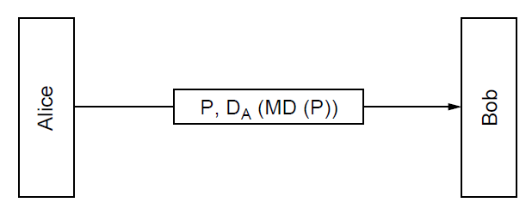
Public Key Signatures
Message Digests
Given p, it is easy to compute MD(P)
Given MD(P), it is effecitively impossible to find P.
Given P, no one can find P’ such that MD(P’) = MD(P)
A Change to the input of even 1 bit produces a very different output.

Slide 8
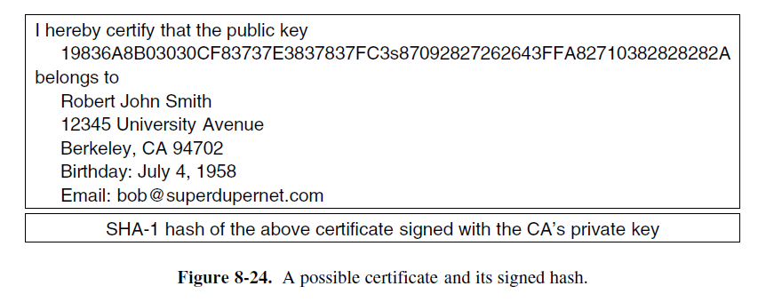
Management of Public Keys
Certificate authority (CA)- an organization that certifies public keys are authentic
Binds a certain public key to an individual or company

Slide 9
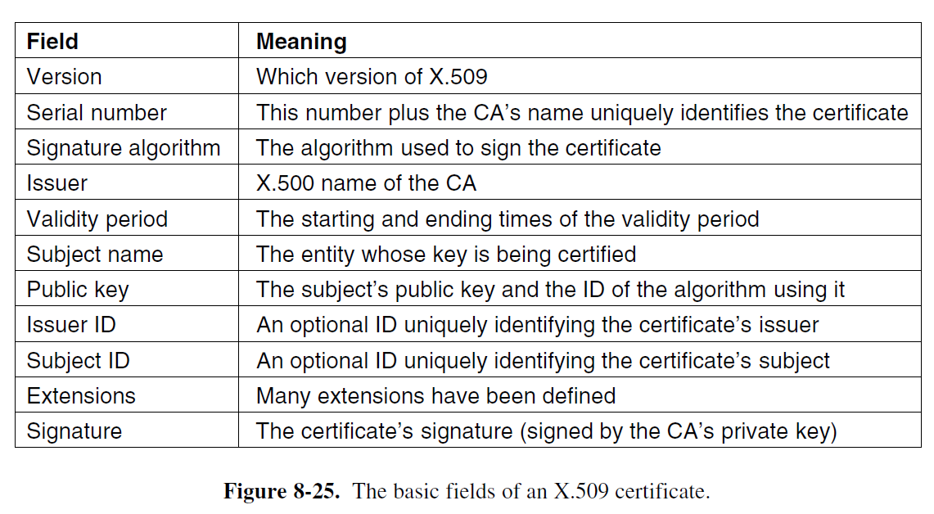
X.509
Created to simplify the different types of certificates
A way to describe public certificates

Slide 10
Public Key Infrastructure
PKI is a hierarchy of CAs
Directories – where to store Certificates?
DNS
Dedicated directory servers
Certified Revocation List – issued by the CA
Abuse
Company/ Individual’s private key has been exposed
CA’s private key has been exposed

Slide 11
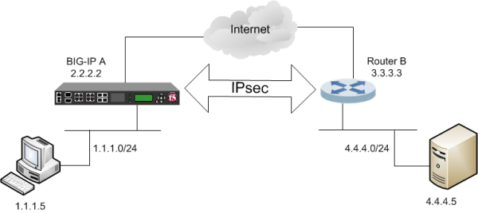
Communication Security
IPsec (IP security)
Works with multiple services, algorithms, and granularities
Is located in the IP Layer, but is a connection orientated service!
SA (Security Association)
A simplex connection between two endpoints, two SA’s are required to establish this connection.
ISAKMP (Internet Security Association and Key Management Protocol)
This establishes keys, and uses the IKE (Internet Key Exchange)
IPsec can function in one of two modes
Transport Mode – The IPsec header is inserted just after the IP Header
Tunnel Mode – he entire IP packet is encapsulated in the new IP packet with a brand new IP Header. (Adds foiling, but substantially increases packet size).

Slide 12
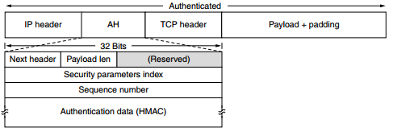
Authentication
AH (Authentication Header)
Provides integrity checking, antireplay security, but no data encryption.
It is comprised of four key components
Next Header – The code for the TPC is stored here
Security Parameters Index – Inserted by the sender to indicate a particular record in the receivers database
Sequence Number – Numbers the packets send on an SA, giving every packet a unique number. A unique number is generated even in transmissions.
Authentication Data – A variable length field, containing the payload’s digital signature
ESP (Encapsulating Security Payload)
Consists of two 32-bit words, which are the Security Parameters Index and the Sequence Number Fields. ESP also provides integrity checks, but after the payload.
The ESP can perform the same job as AH, except in a more efficient matter.

Slide 13
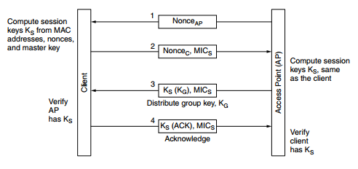
Wireless Security
802.11 Security
Data Link-level security protocol, for preventing a wireless node fro reading or intervening with messages sent between other wireless nodes.
This is also called the WPA2 (WiFi Protected Access 2), which replaced the WEP. The WEP has major security flaws, including easily cracked password security.
802.1X & EAP (Extensible Authentication Protocol)
The 802.1X is the main access point that carries the dialogue with the authentication sever, the EAP tells how the client and authentication sever interact.
MIC (Message Integrity Check)
Protects messages from the client, based on the session key.
TKIP (Temporary Key Integrity Protocol)
Provides message confidentiality, integrity, and authentication to WPA protocols.

Slide 14
Video
https://youtu.be/Kf9KjCKmDcU

Slide 15
Questions?

